Slide 1
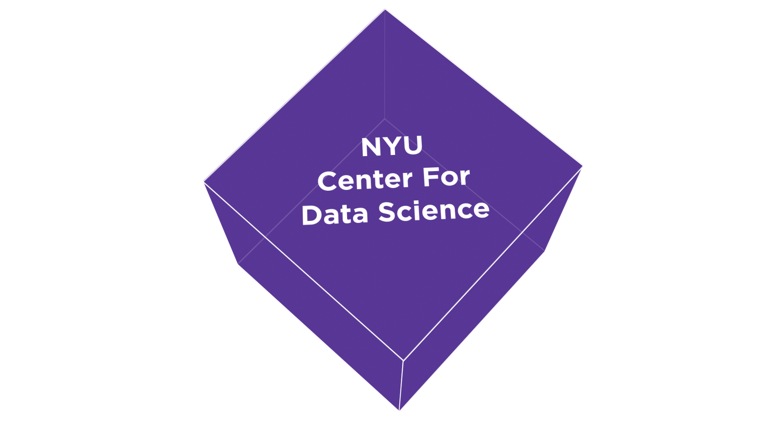

Software and engineering efforts at
NYU Center for Data Science
Andreas Mueller

Slide 2

About me
Research Engineer @ NYU since 2014
Spent most on my time on scikit-learn

Slide 3
About the NYU Center for Data Science

Slide 4
Statistics
Inference
Big Data Technologies
Python
Machine Learning
Data management
Probabilistic Modeling
Urban Science
Business
Economics
Biology
Politics
Sociology
Neuroscience
Psychology

Slide 5
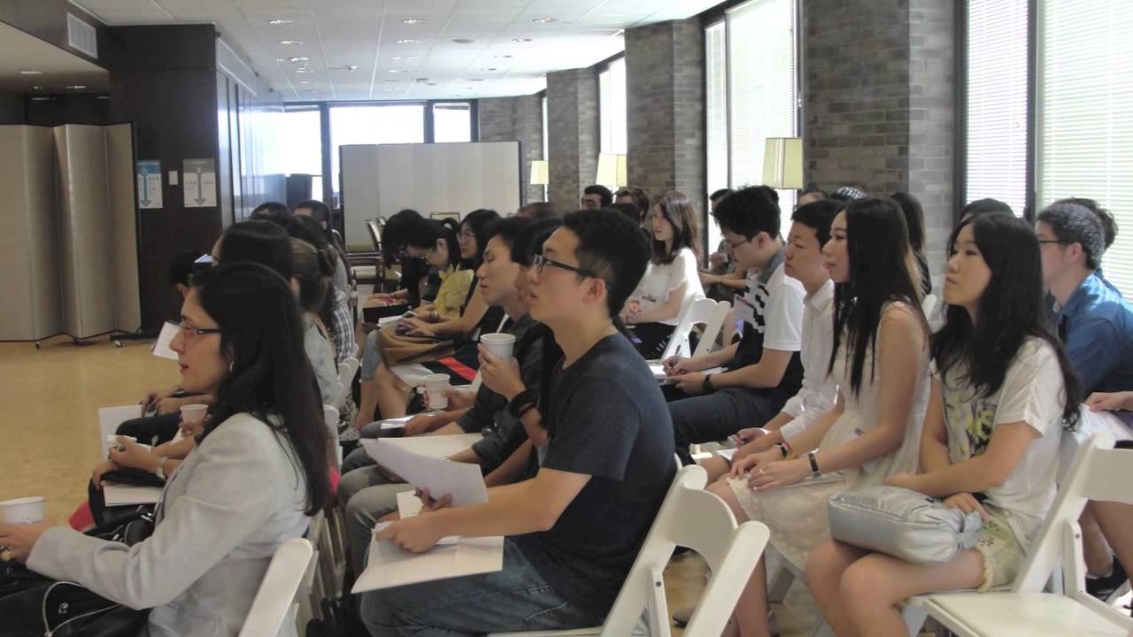


Master of Data Science
Moore-Sloan
Data Science Environment

Slide 6


Master of Data Science
Class of 2015
Class of 2016
Class of 2017
66 Students

Slide 7
Statistics
Inference
Big Data Technologies
Python
Machine Learning
Data management
Probabilistic Modeling
Urban Science
Business
Economics
Biology
Politics
Sociology
Neuroscience
Psychology

Slide 8
Master of Data Science
Two year program
Third cohort – 60 students
Designed to fulfill need for Data Scientists in Industry and “Domain Sciences”
Courses: Programming, Data wrangling, Statistics, machine learning, inference, big data technologies, …
Courses shared with Statistics, Business, Math, CS, Urban Science, Economics, Psychology...
Python is primary language in teaching
Capstone projects facilitate software building

Slide 9
Moore-Sloan Data Science Environment
5 year effort?
Three universities
Goals... tools, open science, reproducibility etc

Slide 10
MSDSE @ NYU
Fellows
Working Groups
Research Engineers
Ethnographer : Laura Noren
Weekly Events
Associated Faculty

Slide 11
Reproducibility and Open Science Working Group
Juliana Freire and Kyle Cranmer
Reprozip
VisTrails

Slide 12
ReproZip

Slide 13
VisTrails

Slide 14
Software Working Group
Goals:
Outreach to “Domain Sciences” to help with data sciences
Education about software development
Build and Support infrastructure for science
Build community around software development at NYU

Slide 15
Software Working Group
Chair: Claudio Silva
Resources:
  None (for the first year)
  Me (for the second year)
  Stefan Karpinski (started this summer)
  Heiko Mueller (starting now)
  Two more to come
Six master students started this summer.

Slide 16
Successes so far
Many scikit-learn tutorials, at NYU and elsewhere
Student research projects completed
Several contributions to scikit-learn by students

Slide 17
Voter Ethnicity Prediction (Tian Wang)

Slide 18
KNN Imputation (Tian Wang)

Slide 19
Neural Network (Jiyuan Qian)

Slide 20
Robust PCA (Jiyuan Quian)

Slide 21
Huber Regression (Manoj Kumar)

Slide 22
Ying-Yan Kmeans (Manoj Kumar)

Slide 23
Other scikit-learn contributions
(Vighnesh Birodkar)
Fixes to input validation in scikit-learn
Fixes to K-Means clustering
Fixes to preprocessing

Slide 24
Patsy-sklearn

Slide 25
Dask-learn

Slide 26
Add Backlinks to Docs

Slide 27
Connection to Library Sciences

Slide 28
Thank you for your attention.

