Slide 1


Writing a book with
Jupyter Notebooks
Andreas Müller
Columbia University, scikit-learn

Slide 2

Book signing and giveaway today 3:20!

Slide 3
Not about bookbook
https://github.com/takluyver/bookbook
By Thomas Kluyver

Slide 4
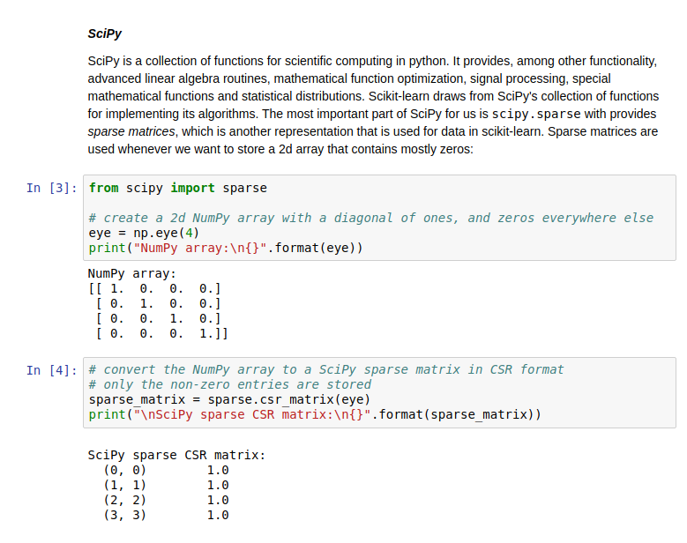
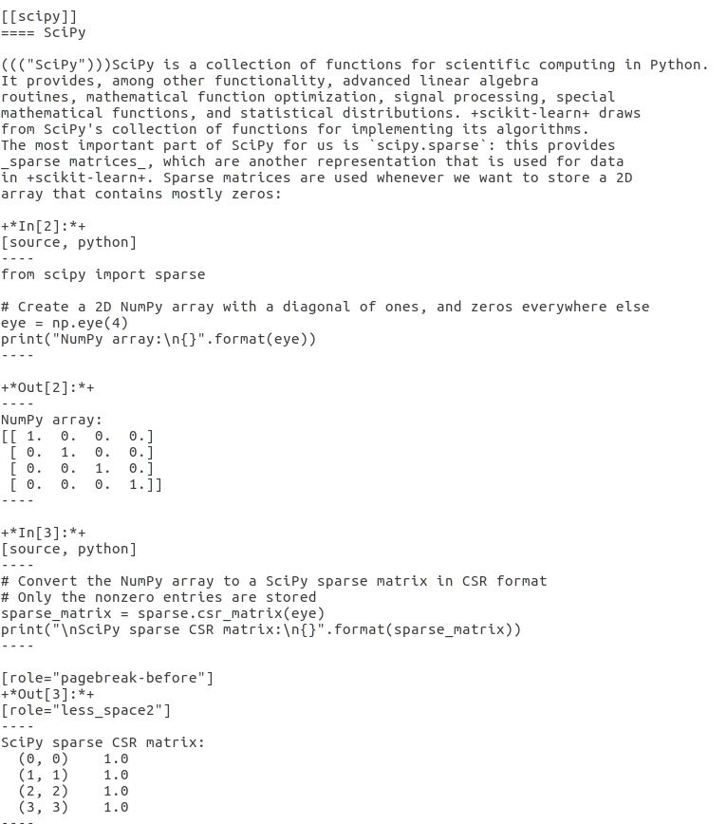
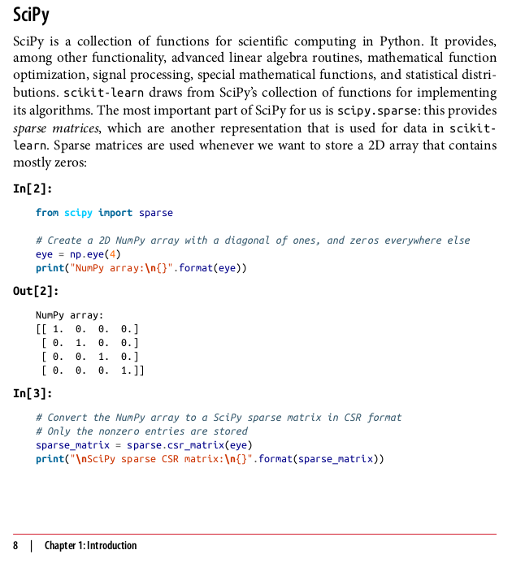
asciidoc
nbconvert
notebook
Pdf / epub
atlas

Slide 5
nbconvert

Slide 6
nbconvert
Notebook
Plain python
Pandoc / markdown
HTML
Latex
RST

Slide 7
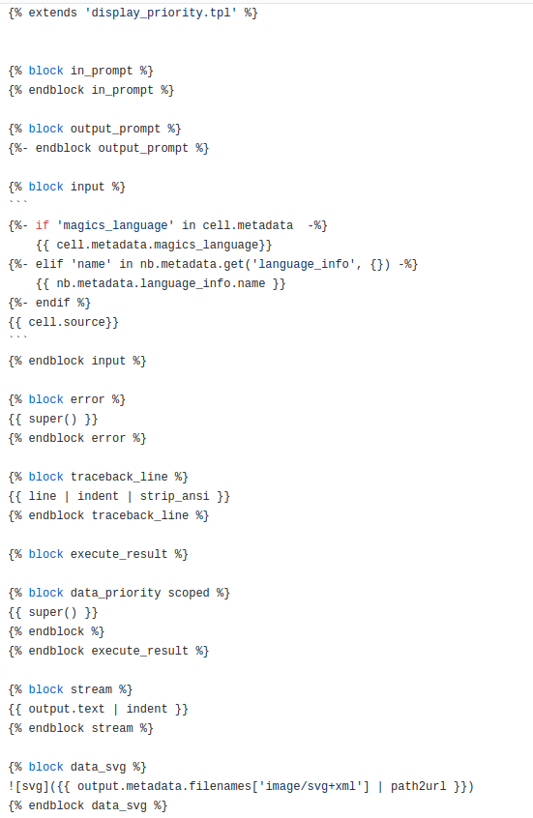
via Jinja

Slide 8
Exporter
Preprocessors
Template
execute
Filters
notebook
Clear output
notebook
Layout
notebook
Output document
Styling
Convert images
(left out postprocessors and writers that are less important for customization)
http://nbconvert.readthedocs.io/en/stable/architecture.html Thanks Min!

Slide 9
Adding an output format: asciidoc

Slide 10
Add asciidoc exporter
Add asciidoc template
Add filters for converting to asciidoc
(via pandoc)

Slide 11
Add asciidoc exporter
Add asciidoc template
Add filters for converting to asciidoc
(via pandoc)
Easy!

Slide 12
Notebook
Pandoc = Markdown
asciidoc

Slide 13
Limitations of Pandoc / Markdown

Slide 14
No Colspan / Rowspan in Tables

Slide 15
No internal references
(to sections, figures, equations)

Slide 16
No references across documents.

Slide 17
No figure captions.
(Also hard to express in notebook)

Slide 18
Html to rescue?
Pandoc passes through html
when converting to html.
Pandoc strips html in any other case!

Slide 19
Overcoming Limitations

Slide 20

Add internal references via filters:
![anythinghere](#internal_reference) becomes internal reference.
Reference points currently done manually (by editors).

Slide 21
Figure captions / colspan:
?!?!
(ideas welcome for my next book ;)

Slide 22
Lessons

Slide 23
Writing exporters is easy!
Writing great is exporters is hard.

Slide 24
Pandoc is not expressive enough!

Slide 25
Preprocessors + Jinja templates + filters
allow you to do anything you want!

Slide 26
Keep notebooks short – split up chapters!

Slide 27
Unsolved problem
Upstreaming asciidoc edits into Notebooks.
Probably possible.

Slide 28




amueller.github.io
@amuellerml
@amueller
t3kcit@gmail.com
https://github.com/amueller/talks_odt/
Notes:
Buy my book. It’s about machine learning. It’s written for programmers, and should be a pretty easy read for anyone that knows a bit of numpy. I avoided adding to much math. If you want math, there are many awesome books to check out. This one is more about coding and how to get started with ml in python…. Which, you know, is why that’s the title…
I hope my rant was a bit informative, or at least entertaining. And A big shout out to the organizers for putting together such a great conference, and thanks again for having me!

