Slide 1



A whirlwind tour of scikit-learn
Andreas Mueller
http://bit.ly/skCUNY
http://bit.ly/skCUNY

Slide 2





Slide 3
What is scikit-learn?

Slide 4




Slide 5
Classification
Regression
Clustering
Semi-Supervised Learning
Feature Selection
Feature Extraction
Manifold Learning
Dimensionality Reduction
Kernel Approximation
Hyperparameter Optimization
Evaluation Metrics
Out-of-core learning
…...

Slide 6






9500+ research papers

Slide 7
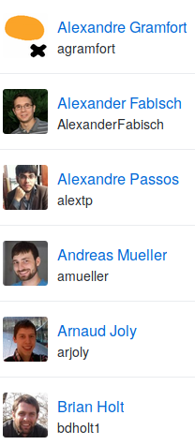
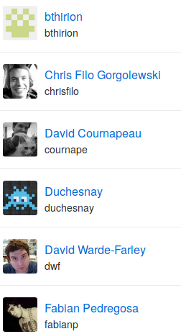
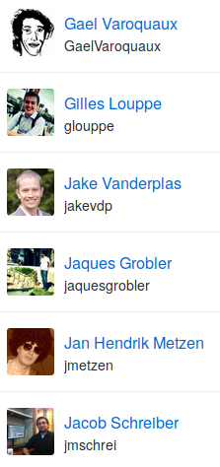
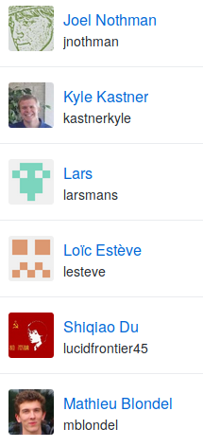
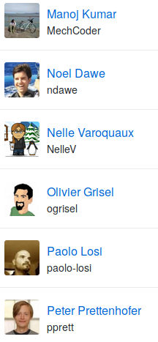
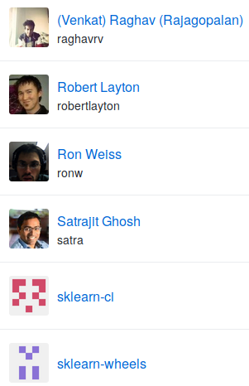
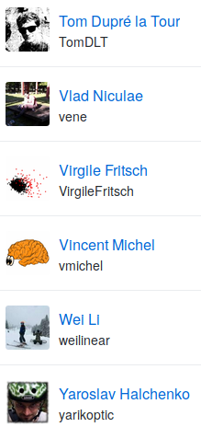

Slide 8
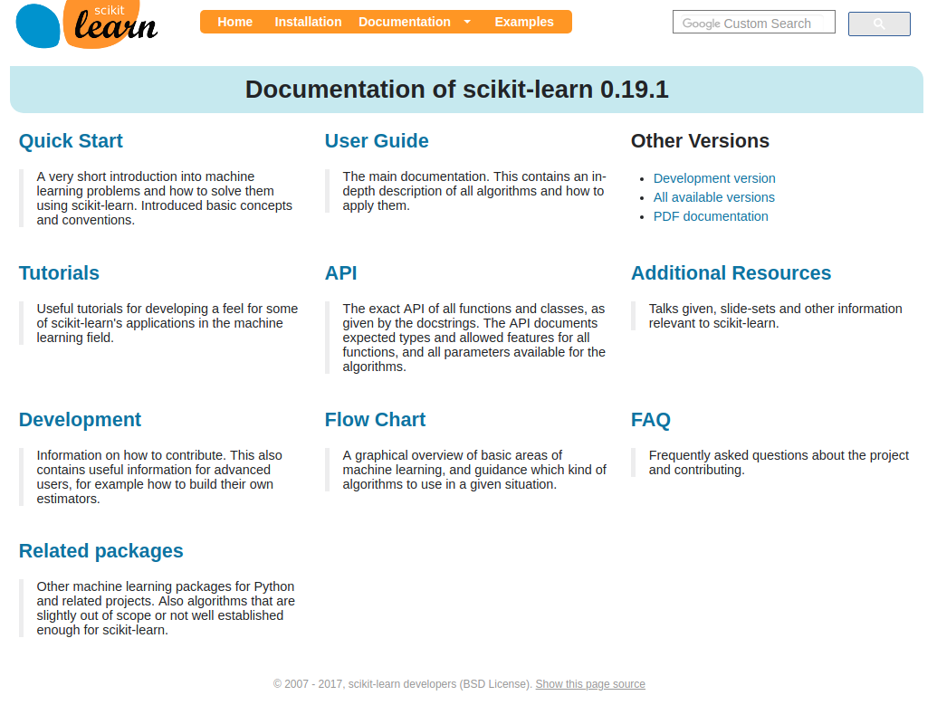
http://scikit-learn.org/

Slide 9
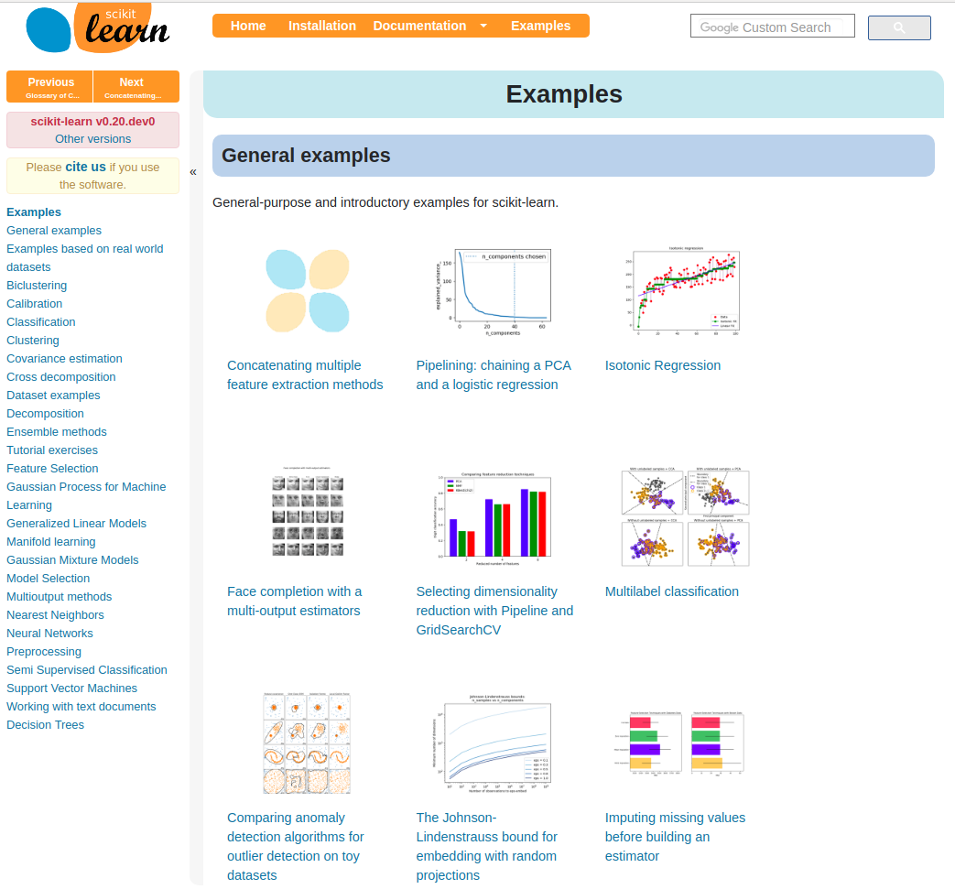

Slide 10
Basic API

Slide 11

Representing Data
one sample
1.1 | 2.2 | 3.4 | 5.6 | 1.0
6.7 | 0.5 | 0.4 | 2.6 | 1.6
2.4 | 9.3 | 7.3 | 6.4 | 2.8
1.5 | 0.0 | 4.3 | 8.3 | 3.4
0.5 | 3.5 | 8.1 | 3.6 | 4.6
5.1 | 9.7 | 3.5 | 7.9 | 5.1
3.7 | 7.8 | 2.6 | 3.2 | 6.3
1.6
2.7
4.4
0.5
0.2
5.6
6.7
X =
y =
one feature
outputs / labels

Slide 12
Supervised Machine Learning
Training Data
Model
Training
Training Labels
Test Data
Prediction
Generalization
Test Labels
Evaluation

Slide 13
clf = RandomForestClassifier()
clf.fit(X_train, y_train)
Training Data
Model
Training Labels
y_pred = clf.predict(X_test)
Test Data
Prediction
Test Labels
Evaluation
clf.score(X_test, y_test)

Slide 14
Unsupervised Machine Learning
Training Data
Model
Test Data
New View

Slide 15
Unsupervised Transformations
pca = PCA()
pca.fit(X_train)
X_new = pca.transform(X_test)
Training Data
Model
Test Data
Transformation

Slide 16
Basic API
estimator.fit(X, [y])
estimator.predict | estimator.transform
Classification | Preprocessing
Regression | Dimensionality reduction
Clustering | Feature selection
 | Feature extraction

Slide 17
Model Evaluation and Model Selection

Slide 18
All Data
Training data
Test data
Fold 1
Fold 2
Fold 3
Fold 4
Fold 5
Split 1
Fold 1
Fold 2
Fold 3
Fold 4
Fold 5
Split 2
Fold 1
Fold 2
Fold 3
Fold 4
Fold 5
Split 3
Fold 1
Fold 2
Fold 3
Fold 4
Fold 5
Split 4
Fold 1
Fold 2
Fold 3
Fold 4
Fold 5
Split 5
Fold 1
Fold 2
Fold 3
Fold 4
Fold 5

Slide 19
Cross-Validation
from sklearn.model_selection import cross_val_score
scores = cross_val_score(SVC(), X, y, cv=5)
print(scores)
>> [ 0.92 1. 1. 1. 1. ]

Slide 20
All Data
Training data
Test data
Fold 1
Fold 2
Fold 3
Fold 4
Fold 5
Split 1
Fold 1
Fold 2
Fold 3
Fold 4
Fold 5
Split 2
Fold 1
Fold 2
Fold 3
Fold 4
Fold 5
Finding Parameters
Split 3
Fold 1
Fold 2
Fold 3
Fold 4
Fold 5
Split 4
Fold 1
Fold 2
Fold 3
Fold 4
Fold 5
Split 5
Fold 1
Fold 2
Fold 3
Fold 4
Fold 5
Final evaluation
Test data

Slide 21
Cross -Validated Grid Search
from sklearn.model_selection import GridSearchCV
from sklearn.model_selection import train_test_split
X_train, X_test, y_train, y_test = train_test_split(X, y)
param_grid = {'C': 10. ** np.arange(-3, 3),
'gamma': 10. ** np.arange(-3, 3)}
grid = GridSearchCV(SVC(), param_grid=param_grid)
grid.fit(X_train, y_train)
grid.predict(X_test)
grid.score(X_test, y_test)

Slide 22
Training Labels
Training Data
Model

Slide 23
Training Labels
Training Data
Feature
Extraction
Scaling
Feature
Selection
Model
Cross Validation

Slide 24
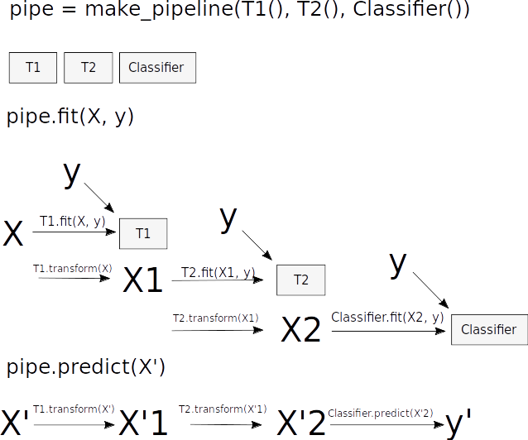
Pipelines

Slide 25
Pipelines
from sklearn.pipeline import make_pipeline
pipe = make_pipeline(StandardScaler(), SVC())
pipe.fit(X_train, y_train)
pipe.predict(X_test)
param_grid = {'svc__C': 10. ** np.arange(-3, 3),
'svc__gamma': 10. ** np.arange(-3, 3)}
scaler_pipe = make_pipeline(StandardScaler(), SVC())
grid = GridSearchCV(scaler_pipe, param_grid=param_grid, cv=5)
grid.fit(X_train, y_train)

Slide 26
Combining Pipelines and
Grid Search
Proper cross-validation
param_grid = {'svc__C': 10. ** np.arange(-3, 3),
'svc__gamma': 10. ** np.arange(-3, 3)}
scaler_pipe = make_pipeline(StandardScaler(), SVC())
grid = GridSearchCV(scaler_pipe, param_grid=param_grid, cv=5)
grid.fit(X_train, y_train)

Slide 27
Combining Pipelines and
Grid Search II
Searching over parameters of the preprocessing step
param_grid = {'selectkbest__k': [1, 2, 3, 4],
'svc__C': 10. ** np.arange(-3, 3),
'svc__gamma': 10. ** np.arange(-3, 3)}
scaler_pipe = make_pipeline(SelectKBest(), SVC())
grid = GridSearchCV(scaler_pipe, param_grid=param_grid, cv=5)
grid.fit(X_train, y_train)

Slide 28





amueller.github.io
@amuellerml
@amueller
t3kcit@gmail.com
Notes:
Alright, as I said, buy my book.
You can also find a lot of free videos and notebooks about machine learning and scikit-learn on my website. All the code from the book is BSD-licensed and on github.
I’ll hang around for the rest of the day if you want to chat about machine learning.
Or if you want to take a selfie, that seems to be even more popular than machine learning these days.
Alright, thank you for your attention.

