Slide 1





Open Source
for (Data) Science
Andreas Müller
Associate Research Scientist
Columbia University
Scikit-learn Technical Committee
Notes:
Hi, I’m Andreas Mueller. I’m grateful for the opportunity to talk to you today about my work here at the DSI, and about Open Source for Science and Data Science.
I’m an Associate Research Scientist, and I mostly work on open source software for machine learning, in particular the scikit-learn library.
My talk will have two parts: first, I want to talk a bit about the importance of software for science, and the scientific python ecosystem.
Then I’ll talk more about the project I’m working on, scikit-learn, and my group here at Columbia.

Slide 2


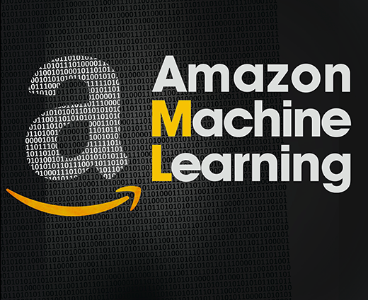


Notes:
Very briefly some background on myself. I did my PhD in Machine learning at the University of Bonn in Germany. Then I worked for the Amazon Machine Learning Research lab in Germany in Berlin. During my PhD I had started contributing to open source, and I couldn’t really do that well while at Amazon.
I was then lucky to get a position at NYU as a Research Engineer as part of the moore-sloan data science environment, where I continued my open source work and also co-authored this book about machine learning with python.
After two years at NYU I moved to the DSI, first as lecturer and now as Associate Research Scientist.

Slide 3
Why Software Matters
“An article about computational science in a scientific publication is not the scholarship itself, it is merely advertising of the scholarship.
The actual scholarship is the complete software development environment and the complete set of instructions which generated the figures.”
- Buckheit and Donoho (1995)
Notes:
I care a lot about software, because I think software is an important tool for science.
Here is a well-known quote on reproducible research that I really believe in. It says (…)
The actual scholarship is the software, and the data. And so how this software is written is very important to how good the science is. In particular, bad software leads to bad science, while good, and easy to use tools enables good science and reproducible science.
We need open software, that’s available for everybody, and that can be reviewed and inspected. This is why I and others have pushed for the adoption of open source principles in scientific software – quite successfully.
My personal role in this is that I see myself very much as a tool-builder that provides tools for others to do science. I don’t do a lot of research myself, but the software I build is used by many researchers across disciplines.

Slide 4
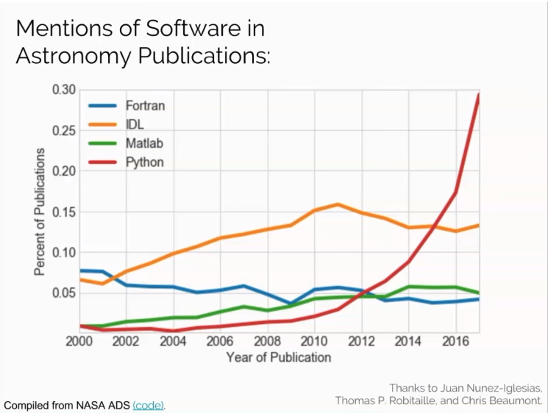
Notes:
The software I’m working on is part of what’s known as PyData or the scientific python ecosystem. This ecosystem has found tremendous adoption in science. Here is an example from Astronomy, where there has been spectacular adoption.
People move away from low level languages and proprietory solutions to Python.
You could plot similar graphs for other disciplines, like biology or earth science or neuroscience and would see similar trends.
The other big player in this field is the R programming language, which is a domain specific language for statistical analysis. Some fields that have a closer connection to statistics prefer using R over python. R is also open source and has many great tools for statistical analysis and visualization available.
This is not an either-or. Both are important tools for scientists, though the adoption of Python is much greater, both in industry and academia.

Slide 5

Impact
“The scientific Python ecosystem is critical
infrastructure for the research done at LIGO.”
David Shoemaker, LIGO Scientific Collaboration
These [SciPy/PyData] are fundamental to training biologists to have the computational skills they need to be effective in today's research realm.
Bonnie Hurwitz, Hurwitz lab, iPlant
Notes:
Let me provide some data points on the use of the scientific python ecosystem. It’s critical for LIGO, and the discovery of gravitational waves was made using these tools, and the data analysis was made openly availabe.
It’s indespensable in biology and training biologists.
You might have seen this picture of a black hole recently, it, of course, has also been made using the scientific python ecosystem.
It’s fair to say that a large fraction of computational science that’s done in any discipline, anywhere in the world, builds on the scientific python ecosystem.

Slide 6
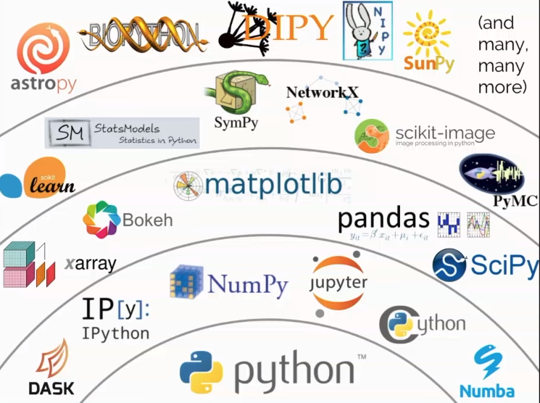
The Scientific Python Ecosystem
Notes:
Let me explain a bit more what I mean by the scientifc python ecosystem. Sometimes I and others just say “Python”. Python is the programming language that is used to build all these tools. But the real strength of the ecosystem are all the tools that are created using Python.
So at the bottom we have the language Python. Above that we have tools for efficient numeric computation, in particular numpy and cython, and tools for interacting with the computation in an intuitive way, jupyter and ipython. These build on the language, of course.
The layer above builds on these in turn, and consists of librarys for working with n-dimensional data, doing data visualization, doing optimization and doing ETL.
Everybody that uses Python in science or industry uses these tools.

Slide 7
The Scientific Python Ecosystem
Notes:
Building on these are more specialized libraries, like scikit-learn for machine learning, which is what I’m primarily working on. There’s other tools for statistics, image analysis, working with graphs, probablistic modeling and many more.
Finally on top of the stack, we have domain specific packages like astropy, biopython, and many more.
So when someone says Python in the context of science or data science, what is meant is the collection of all of these projects working together. Most of the bottom three levels are used universally in computational science and data science in industry, and scikit-learn is also widely used.
So far, that all sounds great, right? And actually both the python community and adoption in the scientific community have made strides and I’m very happy about this. But not all is good.

Slide 8
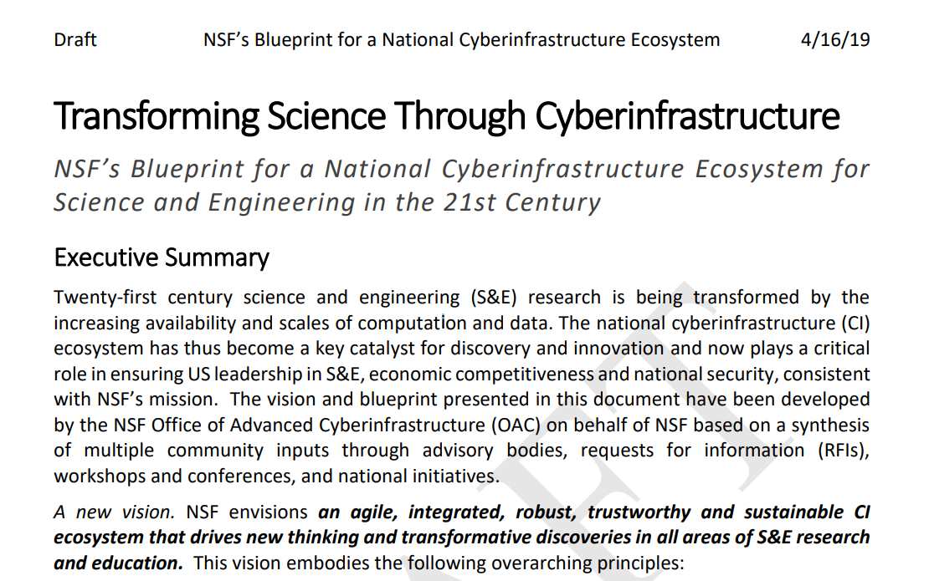
Notes:
Let’s look at this roadmap document from the NSF. This is the current draft from April about how to transform science through cyberinfrastructure – which mostly means software.

Slide 9
No mention of
- Python
- SciPy
- R
- Open Source
Notes:
Shockingly, this document doesn’t mention Python or the scientific python ecosystem. It also doesn’t mention R. In fact, it doesn’t mention even the concept of open source.
I just laid out to you that the scientific python stack is the computational basis of most of the science that’s funded by the NSF. Yet their vision completely ignores it.
This is a symptom of the academic community undervaluing software tools, and not providing enough support.
Unfortunately, industry is not much better here and most of the projects I mentioned above, are build primarily on volunteer labor and barely have any financial support.
Maybe I have time to come back to that later, but let’s leave it at this and talk about scikit-learn now.

Slide 10
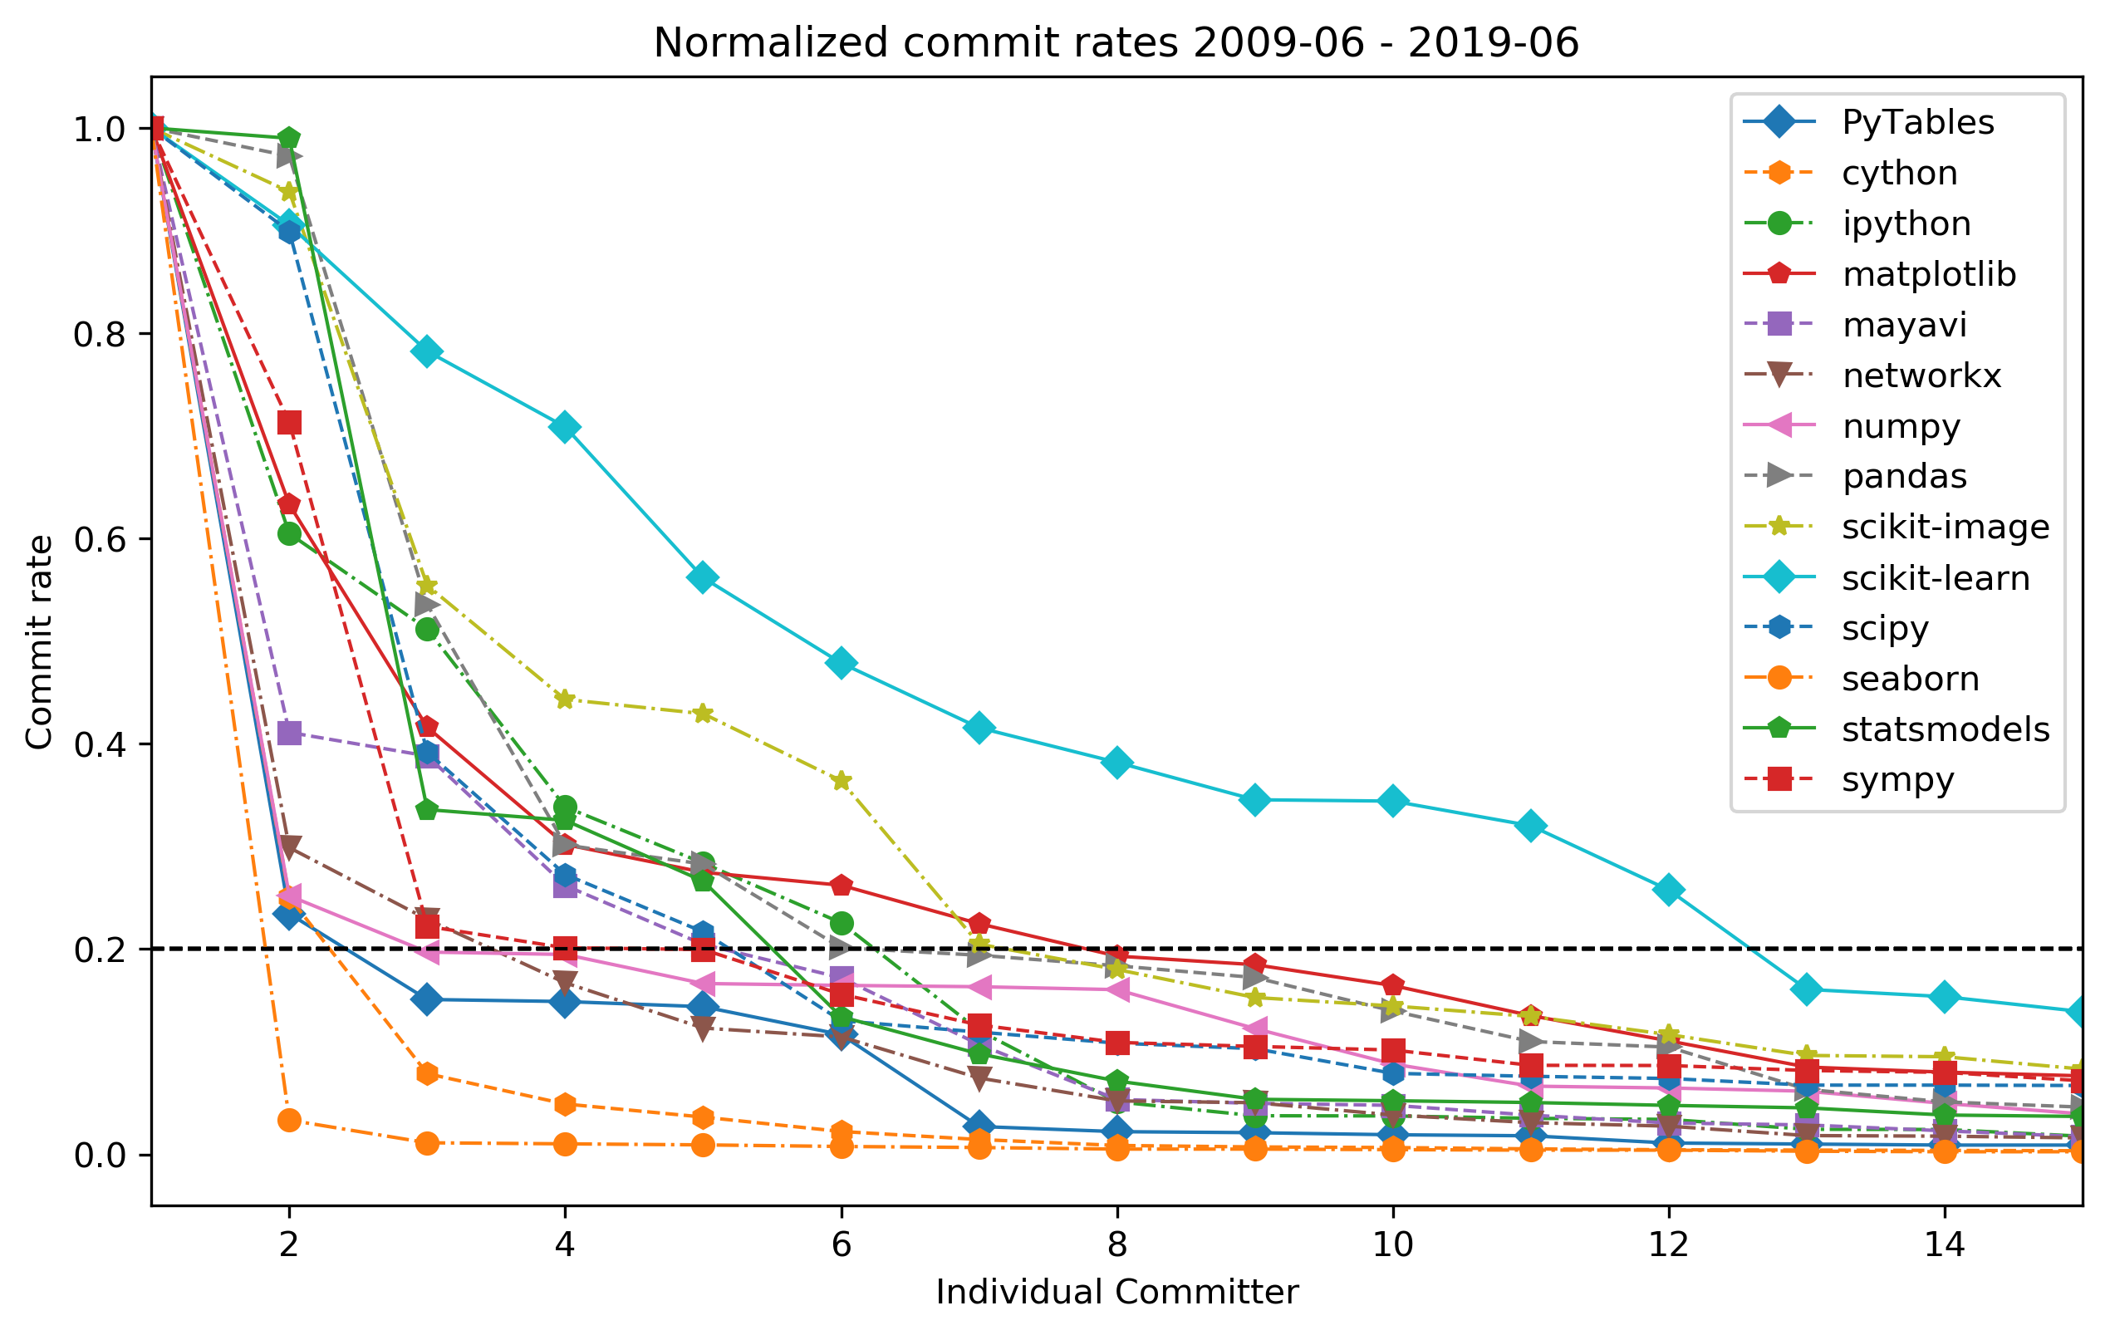
Support and Bus Factor
Notes:
That lack of support has some dire consequences.
Here is a plot of contributions to the major packages of the scipy ecosystem, normalized across contributors. On the right is the most prolific contributor, then the second most prolific and so on. This is aggregated over the last 10 years.
What you can see here is that for many projects, the majority of the work might have been done by only one or two developers. These are mostly people working in their free time out of idealism. If any of these top contributors would leave the project, this would significantly harm the ecosystem. Yet this work is not usually even part of their job, they fit it in on the side.
There is the somewhat macabre notion of bus factor, which says “how many people have to be run over by a bus for this project to die”. In reality, recently it’s more the “google bus” that hires devs away from academia to industry jobs where they have less free time to work on open source.
This issue that’s pervasive in the ecosystem leads to what I call the scholz factor.

Slide 11
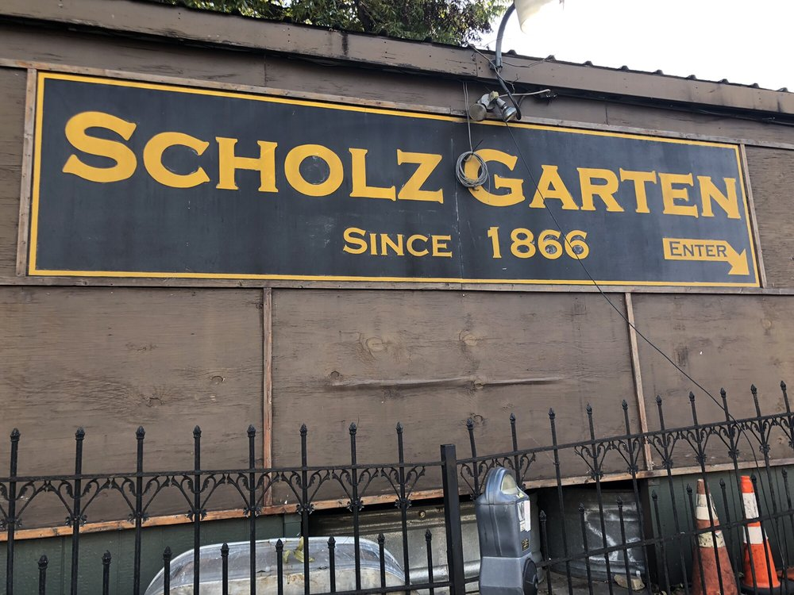
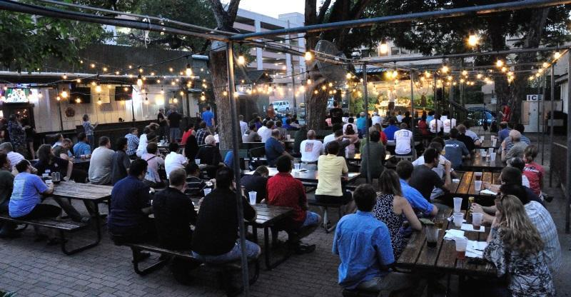
Scholz Factor
Notes:
There is this conference every year in Austin where many of the developers from the scipy ecosystem gather. And there’s a social event at this nice place here, Scholz Beer Garden.
We are right now in a situation, where if someone dropped a bomb on this beer garden on the right day in July, basically the whole computational infrastructure for science, globally, would collapse.
I know it sounds like I’m exaggerating. The sad part is, I am not. There are maybe 50 people in the world that in their free time develop and maintain the whole infrastructure that computational science relies on, and most of them don’t get anything for it.
I will come back to this later, but now let me switch gears and talk about scikit-learn, the project I’m working on.

Slide 12
Machine Learning with Python and Scikit-learn
Notes:
Scikit-learn, as I said, is part of the scientific python ecosystem. It’s the main tool to do machine learning within this ecosystem, and arguably the most popular tool to do machine learning overall.
Scikit-learn is a tool mainly for supervised learning, but also unsupervised learning, preprocessing, model selection, model evaluation and other tools around machine learning.

Slide 13
Our Mission:
Commoditize and Democratize Machine Learning
Notes:
The mission of scikit-learn is to commoditize and democratize machine learning.
We want to enable everybody to use machine learning and data science. We want to make it easy, and we want to make it easy to do it right.
We are not at the cutting edge of machine learning research, we are building tools that actually work, and work robustly, and are well documented and easy to use.
And I would say we’ve been quite successful.

Slide 14
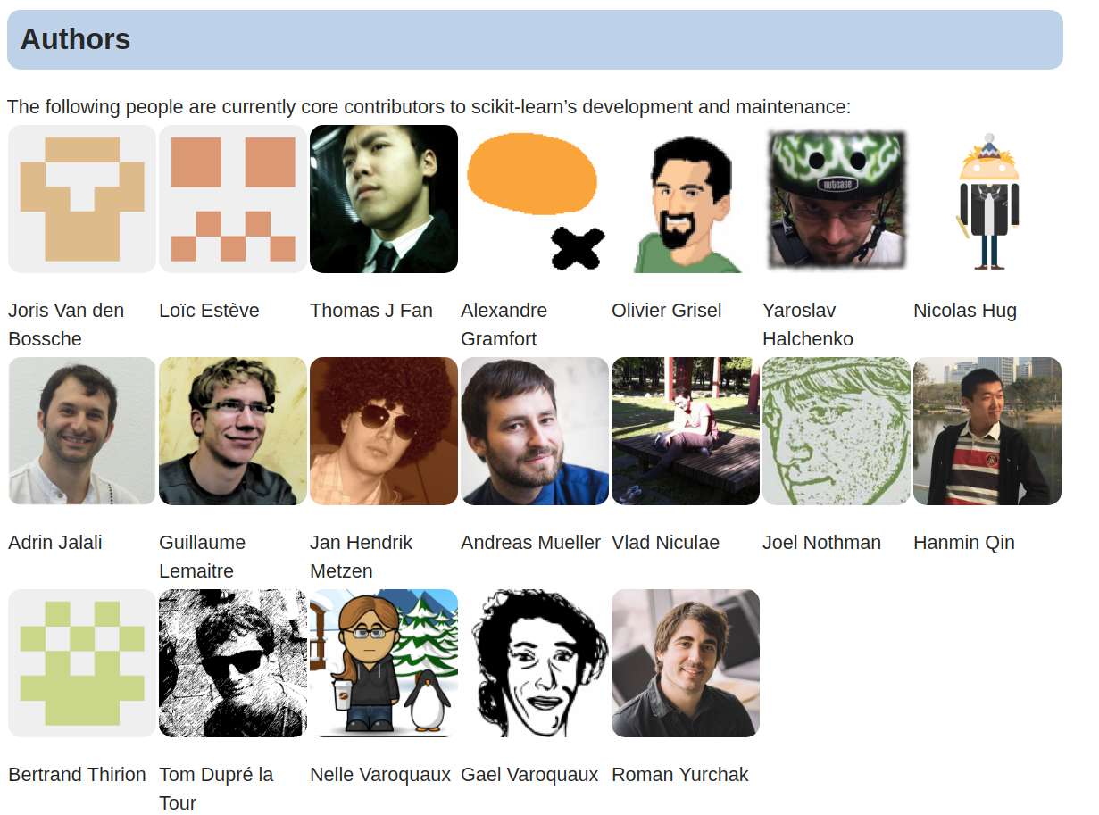

History?
Emeritus
Core Developers
Alexander Fabisch
Alexandre Passos
Angel Soler Gollonet
Arnaud Joly
Chris Gorgolewski
David Cournapeau
David Warde-Farley
Eduard Duchesnay
Fabian Pedragosa
Gilles Louppe
Jacob Schreiber
Jake Vanderplas
Jaques Grobler
Jarrod Millman
Kyle Kastner
Lars Buitinck
Manoj Kumar
Mathieu Blondel
Matthieu Brucher
Noel Dawe
Paolo Losi
Peter Prettenhofer
Raghav Rajagopalan
Robert Layton
Ron Weiss
Satrajit Ghosh
Shiqiao Du
Thouis (Ray) Jones
Vincent Dubourg
Vincent Michel
Virgile Fritsch
Wei Li
Notes:
The project was started around 2010 by a team working on Neuroscience at INRIA in Paris, and that team is still very involved. For example Alex Gramfort, Olivier Grisel, Bertrand Thiron and Gael Varoquaux are among the original authors.
There is currently 19 core developers, with a long list of past contributors. In total the project has had contributions from over 1,300 developers, including researchers at at least 34 US universities.
I have been contributing to the project for about 8 years.
Both I and INRIA have people working on the project on the clock, but a lot of the contributions are done by people in their free time.

Slide 15
History?
Emeritus
Core Developers
Alexander Fabisch
Alexandre Passos
Angel Soler Gollonet
Arnaud Joly
Chris Gorgolewski
David Cournapeau
David Warde-Farley
Eduard Duchesnay
Fabian Pedragosa
Gilles Louppe
Jacob Schreiber
Jake Vanderplas
Jaques Grobler
Jarrod Millman
Kyle Kastner
Lars Buitinck
Manoj Kumar
Mathieu Blondel
Matthieu Brucher
Noel Dawe
Paolo Losi
Peter Prettenhofer
Raghav Rajagopalan
Robert Layton
Ron Weiss
Satrajit Ghosh
Shiqiao Du
Thouis (Ray) Jones
Vincent Dubourg
Vincent Michel
Virgile Fritsch
Wei Li
Notes:
Here I is my current team, Thomas Fan, Nicolas Hug and myself.
We have nearly 3 FTEs on the project, about the same amount as the team in Paris. This makes us some of the biggest contributors to the project and my team has been making many important improvements.
Nicolas has started last summer and Thomas has started this spring. I’m quite excited for what we’ll achieve in the next year, and hope we can continue beyond that.
We are one of the biggest teams biggest teams working on open source for data science in academia the US, and certainly the only group working on such a popular tool.

Slide 16

About 100 citations / day
About 4 citations since this meeting started!
Notes:
Here are a couple of measures of our success. The paper describing scikit-learn has over 17,000 citations, and it’s growing at an amazing rate of about 100 citations a day.
That means since this meeting started, about 4 scientific papers have been published using our software.
Actually, these numbers are likely to underestimate the usage, as software is rarely cited. Personally I think multiplying these numbers by 10 seems more realistic.

Slide 17

About 100 citations / day
About 4 citations since this meeting started!
Notes:
Github tells us that there are nearly 60,000 projects on github that rely on scikit-learn.
I would say that a large fraction of machine learning projects that are not doing deep learning are driven by scikit-learn. That’s true both for academia and industry.
As some examples, the Spotify artist radios used to run onscikit-learn. Mayor credit card companies use it for fraud detection. Microsoft told me about half of their data scientists use scikit-learn, which is the same amount as use their internal tool.

Slide 18
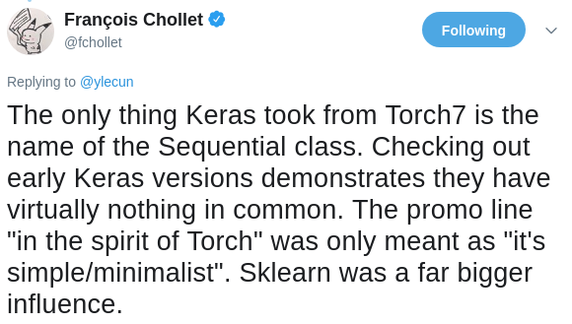
About 100 citations / day
About 4 citations since this meeting started!
Notes:
While scikit-learn doesn’t do deep learning, and is pretty conservative in it’s scope, it has inspired other packages that mimic and extend it.
The user interface we created was the blueprint for deep learning packages like keras, which is now developed by google.

Slide 19
Current Work
Notes:
I think that’s enough bragging, so I want to talk a little bit more about what my team is currently working on.
A lot of the work we do is quite technical and I don’t want to go into the details too much. Much of it is maintenance and bug fixes and usability improvements, which are crucial, but don’t make for a great presentation. Instead I want to talk about some more visible highlights.

Slide 20
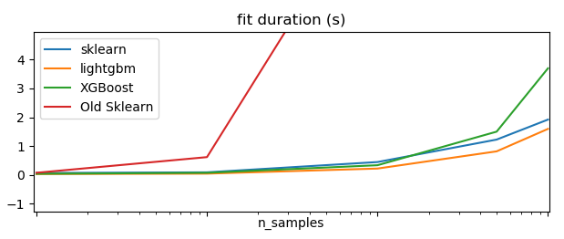
Extreme Gradient Boosting
Notes:
One of the recent additions by my team is an implementation of extreme gradient boosting by Nicolas Hug. This is much, much faster than what was in scikit-learn before and it will have a huge impact on the ML community.
You can see here that it’s comparable to two existing tools, xgboost and lightgbm. LightGBM was released by microsoft and it’s quite great, but by including our own implementation into scikit-learn, we make it available to a much wider audience.

Slide 21
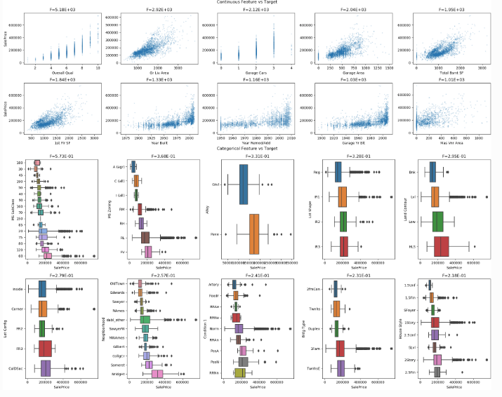
Visualization
Notes:
One of the other areas that we’re working on is visualization. We’re adding new visualization tools to scikit-learn, to make common visualizations more easy to produce. We’re also building new tools that automatically create relevant and informative visualizations for machine learning tasks.
I think the human in the loop in data science is very important and I want to make it as easy as possible for the user to look at the data in different ways.
Tufte said there’s no reason not to look at the data.

Slide 22
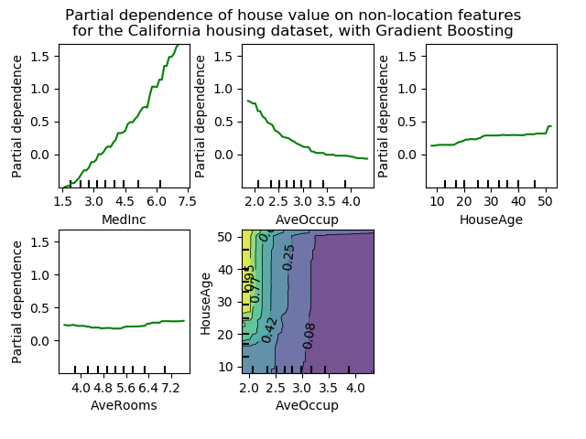
Model understanding and inspection
Notes:
Related to visualization is model understanding and inspection.
We’re building tools that allow users to validate and debug their models, and understand their data better.
This allows our users to better judge when and why their model might work or fail, or how to improve data quality and data collection.

Slide 23
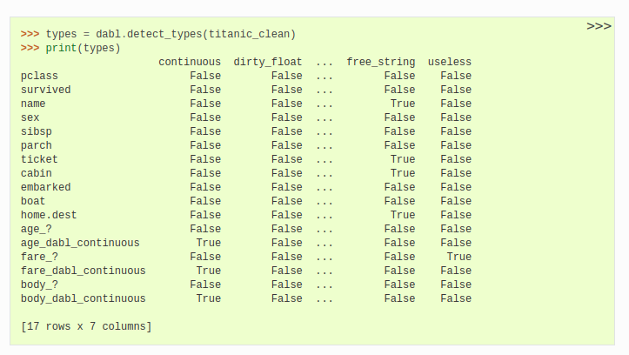
AutoML & dabl
sc = SimpleClassifier()
sc.fit(data, target_col=”survived”)
ac = AnyClassifier()
ac.fit(data, target_col="survived")
Notes:
Finally, we’re working on tools build on top of scikit-learn for more automated machine learning.
What we’re trying to automate is parameter tuning and selecting the right algorithms. These are things that are actually fairly easy to automate to some degree.
The hard part in machine learning is collecting and preparing the data and understanding the interaction between data and model. So we’re automating one part, but the goal is to enable the user to iterate more quickly on other aspects. I want the human in the loop, but I don’t want the user to waste their time tuning parameter. I want them to interpret the results.
So dabl tries to create an interactive loop in which the user can spend their time where it matters, looking at the data and looking at the model, not tuning it.

Slide 24
Where to go from here
Notes:
So I think there is a lot of very exciting and impactful work that we can do here, and reduce the barrier to entry for machine learning even more, both for academia and industry. Providing tools that encourage best practices, like data visualization and model inspection will also improve how people use machine learning in practice.
Investing in this infrastructure is hugely productive, both for the scientific community and data science in industry, and the contributions my team has made so far have already been tremendously useful.
I hope that we can slowly convince both academia and industry how effective investing in better tools can be, and how much value is created.

Slide 25




amueller.github.io
@amuellerml
@amueller
andreas.mueller
@columbia.com
Notes:
Thank you for your attention and I’m happy to take any questions!

