Slide 1

Advanced Scikit-Learn
Andreas Mueller (NYU Center for Data Science, scikit-learn)

Slide 2



Me

Slide 3
Classification
Regression
Clustering
Semi-Supervised Learning
Feature Selection
Feature Extraction
Manifold Learning
Dimensionality Reduction
Kernel Approximation
Hyperparameter Optimization
Evaluation Metrics
Out-of-core learning
…...

Slide 4







Slide 5
Overview
Reminder: Basic sklearn concepts
Model building and evaluation:
  Pipelines and Feature Unions
  Randomized Parameter Search
  Scoring Interface
  Bias Variance Tradeoff
  Generalized Cross-Validation
Out of Core learning
  Feature Hashing
  Kernel Approximation
New stuff in 0.16.0
  Overview
  Calibration

Slide 6
Supervised Machine Learning
Training Data
Model
Training
Training Labels
Test Data
Prediction
Generalization
Test Labels
Evaluation

Slide 7
clf = RandomForestClassifier()
clf.fit(X_train, y_train)
y_pred = clf.predict(X_test)
Training Data
Model
Training Labels
Test Data
Prediction
Test Labels
Evaluation
clf.score(X_test, y_test)

Slide 8
Unsupervised Machine Learning
Training Data
Model
Test Data
New View

Slide 9
Unsupervised Transformations
pca = PCA()
pca.fit(X_train)
X_new = pca.transform(X_test)
Training Data
Model
Test Data
Transformation

Slide 10
Basic API
estimator.fit(X, [y])
estimator.predict | estimator.transform
Classification | Preprocessing
Regression | Dimensionality reduction
Clustering | Feature selection
 | Feature extraction

Slide 11
Cross-Validation
from sklearn.cross_validation import cross_val_score
scores = cross_val_score(SVC(), X, y, cv=5)
print(scores)
>> [ 0.92 1. 1. 1. 1. ]

Slide 12
Cross-Validation
from sklearn.cross_validation import cross_val_score
scores = cross_val_score(SVC(), X, y, cv=5)
print(scores)
>> [ 0.92 1. 1. 1. 1. ]
cv_ss = ShuffleSplit(len(X_train), test_size=.3,
n_iter=10)
scores_shuffle_split = cross_val_score(SVC(), X, y,
cv=cv_ss)

Slide 13
Cross-Validation
from sklearn.cross_validation import cross_val_score
scores = cross_val_score(SVC(), X, y, cv=5)
print(scores)
>> [ 0.92 1. 1. 1. 1. ]
cv_ss = ShuffleSplit(len(X_train))
scores_shuffle_split = cross_val_score(SVC(), X, y, cv=cv_ss)
cv_labels = LeaveOneLabelOut(labels)
scores_pout = cross_val_score(SVC(), X, y, cv=cv_labels)

Slide 14

Cross -Validated Grid Search

Slide 15
Cross -Validated Grid Search
from sklearn.grid_search import GridSearchCV
from sklearn.cross_validation import train_test_split
X_train, X_test, y_train, y_test = train_test_split(X, y)
param_grid = {'C': 10. ** np.arange(-3, 3),
'gamma': 10. ** np.arange(-3, 3)}
grid = GridSearchCV(SVC(), param_grid=param_grid)
grid.fit(X_train, y_train)
grid.predict(X_test)
grid.score(X_test, y_test)

Slide 16
Training Labels
Training Data
Model

Slide 17
Training Labels
Training Data
Feature
Extraction
Scaling
Feature
Selection
Model
Cross Validation

Slide 18
Pipelines
from sklearn.pipeline import make_pipeline
pipe = make_pipeline(StandardScaler(), SVC())
pipe.fit(X_train, y_train)
pipe.predict(X_test)

Slide 19
Combining Pipelines and
Grid Search
Proper cross-validation
param_grid = {'svc__C': 10. ** np.arange(-3, 3),
'svc__gamma': 10. ** np.arange(-3, 3)}
scaler_pipe = make_pipeline(StandardScaler(), SVC())
grid = GridSearchCV(scaler_pipe, param_grid=param_grid, cv=5)
grid.fit(X_train, y_train)

Slide 20
Do cross-validation over all steps.
Keep a separate test set till the very end.

Slide 21
Combining Pipelines and
Grid Search II
Searching over parameters of the preprocessing step
param_grid = {'selectkbest__k': [1, 2, 3, 4],
'svc__C': 10. ** np.arange(-3, 3),
'svc__gamma': 10. ** np.arange(-3, 3)}
scaler_pipe = make_pipeline(SelectKBest(), SVC())
grid = GridSearchCV(scaler_pipe, param_grid=param_grid, cv=5)
grid.fit(X_train, y_train)

Slide 22
Feature Union
Training Labels
Training Data
Feature
Extraction I
Feature
Extraction II
Model

Slide 23
Feature Union
char_and_word = make_union(TfidfVectorizer(analyzer="char"), TfidfVectorizer(analyzer="word"))
text_pipe = make_pipeline(char_and_word, LinearSVC(dual=False))
param_grid = {'linearsvc__C': 10. ** np.arange(-3, 3)}
grid = GridSearchCV(text_pipe, param_grid=param_grid, cv=5)
param_grid2 = {'featureunion__tfidfvectorizer-1__ngram_range':
[(1, 3), (1, 5), (2, 5)],
'featureunion__tfidfvectorizer-2__ngram_range':
[(1, 1), (1, 2), (2, 2)],
'linearsvc__C': 10. ** np.arange(-3, 3)}

Slide 24
Randomized Parameter Search

Slide 25

Randomized Parameter Search
Step-size free for continuous parameters
Decouples runtime from search-space size
Robust against irrelevant parameters
Source: Bergstra and Bengio

Slide 26
Randomized Parameter Search
params = {'featureunion__tfidfvectorizer-1__ngram_range':
[(1, 3), (1, 5), (2, 5)],
'featureunion__tfidfvectorizer-2__ngram_range':
[(1, 1), (1, 2), (2, 2)],
'linearsvc__C': 10. ** np.arange(-3, 3)}

Slide 27
Randomized Parameter Search
params = {'featureunion__tfidfvectorizer-1__ngram_range':
[(1, 3), (1, 5), (2, 5)],
'featureunion__tfidfvectorizer-2__ngram_range':
[(1, 1), (1, 2), (2, 2)],
'linearsvc__C': expon()}

Slide 28

Randomized Parameter Search
params = {'featureunion__tfidfvectorizer-1__ngram_range':
[(1, 3), (1, 5), (2, 5)],
'featureunion__tfidfvectorizer-2__ngram_range':
[(1, 1), (1, 2), (2, 2)],
'linearsvc__C': expon()}
rs = RandomizedSearchCV(text_pipe,
param_distributions=param_distributins, n_iter=50)

Slide 29
Randomized Parameter Search
Always use distributions for continuous variables.
Don't use for low dimensional spaces.
Future: Bayesian optimization based search.

Slide 30
Genearlized Cross-Validation

Slide 31
rfe = RFE(LogisticRegression())
param_grid = {'n_features_to_select':
range(1, n_features)}
gridsearch = GridSearchCV(rfe, param_grid)
grid.fit(X, y)
rfecv = RFECV(LogisticRegression())
rfecv.fit(X, y)

Slide 32
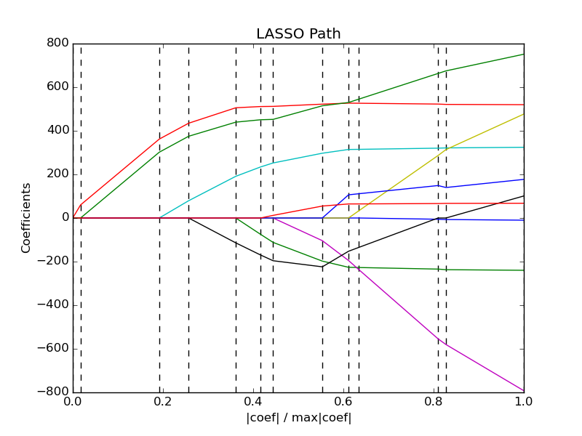

Slide 33
Linear Models | Feature Selection | Tree-Based models [possible]
LogisticRegressionCV [new] | RFECV | [DecisionTreeCV]
RidgeCV |  | [RandomForestClassifierCV]
RidgeClassifierCV |  | [GradientBoostingClassifierCV]
LarsCV
ElasticNetCV ...

Slide 34
Scoring Functions

Slide 35
GridSeachCV
cross_val_score
validation_curve
Default:
Accuracy (classification)
R2 (regression)
For GridSeachCV
cross_val_score
validation_curve
Typical: accuracy

Slide 36
Scoring
Motivation: Imbalanced data 1:9
cross_val_score(SVC(), X_train, y_train)
>>> array([ 0.9, 0.9, 0.9])

Slide 37
Scoring
Motivation: Imbalanced data 1:9
cross_val_score(SVC(), X_train, y_train)
>>> array([ 0.9, 0.9, 0.9])
cross_val_score(DummyClassifier("most_frequent"), X_train, y_train)
>>> array([ 0.9, 0.9, 0.9])

Slide 38
Scoring
Motivation: Imbalanced data 1:9
cross_val_score(SVC(), X_train, y_train)
>>> array([ 0.9, 0.9, 0.9])
cross_val_score(SVC(), X_train, y_train, scoring="roc_auc")
array([ 0.99961591, 0.99983498, 0.99966247])

Slide 39

Scoring
Motivation: Imbalanced data 1:9
cross_val_score(SVC(), X_train, y_train)
>>> array([ 0.9, 0.9, 0.9])
cross_val_score(SVC(), X_train, y_train, scoring="roc_auc")
array([ 0.99961591, 0.99983498, 0.99966247])

Slide 40
Available metrics
print(SCORERS.keys())
>> ['adjusted_rand_score',
'f1',
'mean_absolute_error',
'r2',
'recall',
'median_absolute_error',
'precision',
'log_loss',
'mean_squared_error',
'roc_auc',
'average_precision',
'accuracy']

Slide 41
Defining your own scoring
def my_super_scoring(est, X, y):
return accuracy_scorer(est, X, y) - np.sum(est.coef_ != 0)

Slide 42
Defining your own scoring
def my_super_scoring(est, X, y):
return accuracy_scorer(est, X, y) - np.sum(est.coef_ != 0)
def scoring_function(y_true, y_pred):
return (np.abs(y_true – y_pred) < 2).mean()
tolerant_scoring = make_scorer(scoring_function)

Slide 43
Out of Core Learning

Slide 44

Or: save ourself the effort

Slide 45
Think twice!
Old laptop: 4GB Ram
1073741824 float32
Or 1mio data points with 1000 features
EC2 : 256 GB Ram
68719476736 float32
Or 68mio data points with 1000 features

Slide 46
Supported Algorithms
All SGDClassifier derivatives
Naive Bayes
MinibatchKMeans
IncrementalPCA
MiniBatchDictionaryLearning

Slide 47
Out of Core Learning
sgd = SGDClassifier()
for i in range(9):
X_batch, y_batch = cPickle.load(open("batch_%02d" % i))
sgd.partial_fit(X_batch, y_batch, classes=range(10))
Possibly go over the data multiple times.

Slide 48
Stateless Transformers
Normalizer
HashingVectorizer
RBFSampler (and other kernel approx)

Slide 49
Text data and the hashing trick

Slide 50
Bag Of Word Representations
CountVectorizer / TfidfVectorizer
“You better call Kenny Loggins”

Slide 51
Bag Of Word Representations
CountVectorizer / TfidfVectorizer
“You better call Kenny Loggins”
tokenizer
['you', 'better', 'call', 'kenny', 'loggins']

Slide 52
Bag Of Word Representations
CountVectorizer / TfidfVectorizer
“You better call Kenny Loggins”
tokenizer
['you', 'better', 'call', 'kenny', 'loggins']
Sparse matrix encoding
aardvak
better
call
you
zyxst
[0, …, 0, 1, 0, … , 0, 1 , 0, …, 0, 1, 0, …., 0 ]

Slide 53
Hacking Trick
HashingVectorizer
“You better call Kenny Loggins”
tokenizer
['you', 'better', 'call', 'kenny', 'loggins']
hashing
[hash('you'), hash('better'), hash('call'), hash('kenny'), hash('loggins')]
= [832412, 223788, 366226, 81185, 835749]
Sparse matrix encoding
[0, …, 0, 1, 0, … , 0, 1 , 0, …, 0, 1, 0, ... 0 ]

Slide 54
Out of Core Text Classification
sgd = SGDClassifier()
hashing_vectorizer = HashingVectorizer()
for i in range(9):
text_batch, y_batch = cPickle.load(open("text_%02d" % I))
X_batch = hashing_vectorizer.transform(text_batch)
sgd.partial_fit(X_batch, y_batch, classes=range(10))

Slide 55
Kernel Approximations

Slide 56

Reminder: Kernel Trick
x

Slide 57

Reminder: Kernel Trick

Slide 58
Reminder: Kernel Trick
Classifier linear → need only

Slide 59
Reminder: Kernel Trick
Classifier linear → need only
Linear:
Polynomial:
RBF:
Sigmoid:

Slide 60
Complexity
Solving kernelized SVM:
~O(n_samples ** 3)
Solving linear (primal) SVM:
~O(n_samples * n_features)
n_samples large? Go primal!

Slide 61
Undoing the Kernel Trick
Kernel approximation:
k =
= RBFSampler

Slide 62
Usage
sgd = SGDClassifier()
kernel_approximation = RBFSampler(gamma=.001, n_components=400)
for i in range(9):
X_batch, y_batch = cPickle.load(open("batch_%02d" % i))
if i == 0:
kernel_approximation.fit(X_batch)
X_transformed = kernel_approximation.transform(X_batch)
sgd.partial_fit(X_transformed, y_batch, classes=range(10))

Slide 63
Highlights from 0.16.0
Multinomial Logistic Regression, LogisticRegressionCV.
IncrementalPCA.
Probability callibration of classifiers.
Birch clustering.
LSHForest.
More robust integration with pandas.

Slide 64
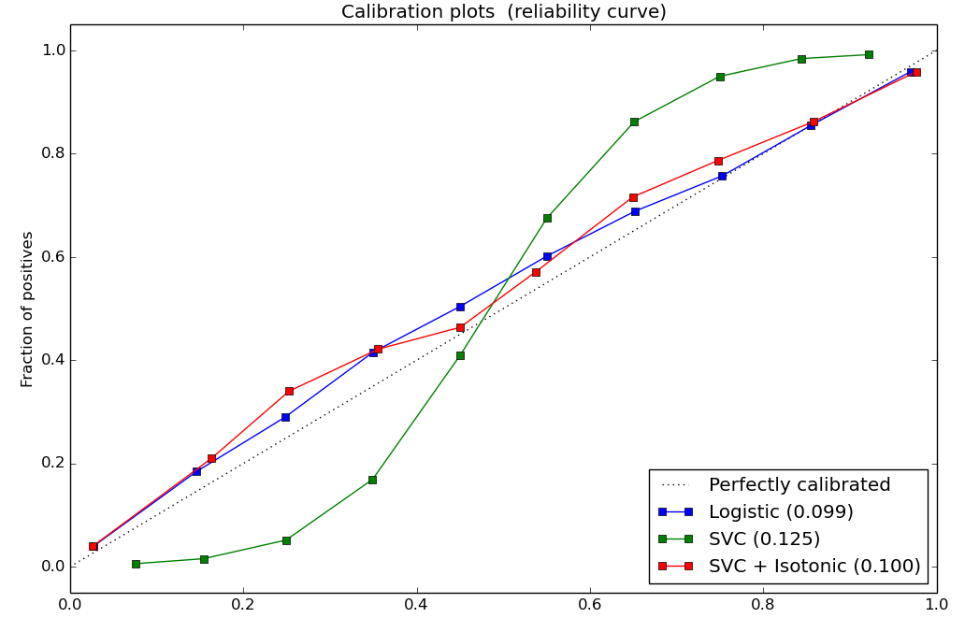
Probability Calibration
SVC().decision_function()
→ CalibratedClassifierCV(SVC()).predict_proba()
RandomForestClassifier().predict_proba()
→ CalibratedClassifierCV(RandomForestClassifier()).predict_proba()

Slide 65


Slide 66
CDS is hiring Research Engineers

Slide 67



Thank you for your attention.
@t3kcit
@amueller
t3kcit@gmail.comx

Slide 68
Bias Variance Tradeoff
(why we do cross validation and grid searches)

Slide 69
Overfitting and Underfitting
Training
Sweet spot
Accuracy
Generalization
Underfitting
Overfitting
Model complexity

Slide 70

Linear SVM

Slide 71


(RBF) Kernel SVM

Slide 72











Decision Trees

Slide 73




Random Forests

Slide 74
Know where you are on the bias-variance tradeoff

Slide 75

Validation Curves
train_scores, test_scores = validation_curve(SVC(), X, y, param_name="gamma", param_range=param_range)

Slide 76

Learning Curves
train_sizes, train_scores, test_scores = learning_curve(
estimator, X, y,train_sizes=train_sizes)

