Slide 1


Machine Learning,
Computer Vision
& Open Source
Andreas Müller
Columbia University, scikit-learn

Slide 2
What is machine learning?
Notes:
So let’s dive right in and talk about what machine learning is. Machine learning is about extracting knowledge from data. It is closely related to statistics and optimization.
What distinguishes machine learning is that it is very focused on prediction.
We want to learn from a large dataset how to make decisions based on future observations.
You could say that the input to a machine learning program is the dataset, and the output is a program that can make decisions on future observations.

Slide 3
Types of machine learning:
- supervised
- unsupervised
- reinforcement
Notes:
There are three main branches of machine learning, called supervised learning, unsupervised learning and reinforcement learning.
I will talk mostly about supervised learning, but I want to briefly give an overview of the other two types.

Slide 4
Supervised Learning
i.i.d.
Notes:
In supervised learning, the dataset we learn form is input-output pairs (x_i, y_i), where x_i is some n_dimensional input, or feature vector, and y_i is the desired output we want to learn.
We assume these samples are drawn from some unknown joint distribution p(x, y).
You can think of this as there being some (not necessarily deterministic) process that goes from x_i to y_i, but that we don’t know.
The goal is to learn a function f so that for new inputs x , and unobserved y, f(x) is approximately y.
This Is very closely related to function approximation.
The name supervised comes from the fact that during learning, a supervisor gives you the correct answers y_i.

Slide 5
Examples of Supervised Learning
Notes:
Here are some examples of supervised learning.
Given an array of test results from a patient, does this patient have diabetes? The x_i would be the different test results, and y_i would be diabetes or no diabetes.
Given a piece of a satellite image, what is the terrain in this image? Here x_i would be the pixels of the image, and y_i would be the terrain types.
In your setting, it’s probably good to think of each x_i as an experiment, and each entry of x_i as one sensor measurement.
This is often used to automate manual labor. For example, you might annotate part of a dataset manually, then learn a machine learning model from this annotations, and use the model to annotate the rest of your data.

Slide 6
Classification and Regression
Classification:
y discrete
Regression:
y continuous
Notes:
As I said, I want to focus on supervised learning, though.
There are two basic kind of supervised learning, called classification and regression.
The difference is quite simple, if y is continuous, then it’s regression, and if y is discrete, it’s classification.
To this audience that’s probably pretty clear, but let me give you two examples.
If I want to learn how much energy a reaction releases, that’s regression. If I want to learn whether it releases energy above a certain threshold, it is classification, because the output is just a yes-no decision.
This distinction into classification and regression might seem a bit trivial, but measuring “how good” a prediction is is quite different for discrete and continuous y.

Slide 7
Generalization
Not only
Also for new data:
Notes:
Ok, so I want to talk in more depth about supervised learning, and I want to get a little more formal.
Let’s say we have a regression task. We have features, that is data vectors x_i and targets y_i drawn from a joint distribution.
We now want to learn a function f, such that f(x) is approximately y, not on this training data, but on new data drawn from this distribution. This is called generalization, and this is a core distinction to function approximation. In principle we don’t care about how well we do on x_i, we only care how well we do on new samples from the distribution.

Slide 8
(regularized) Empirical Risk Minimization
Notes:
This leads us to one of the core principles of machine learning, which I will only sketch here, but which is the essence of all the machine learning theory.
If we can find a model that fits the training data well, and that is “simple” then we are guaranteed that it will work well on new data.
The machine learning problem can then be formalized as minimizing the error on the training set, say the squared error, while constraining the model to be simple.
This is called “regularized empirical risk minimization” and that’s basically what all machine learning algorithms do, with different choices of the domain of f, and different choices of the regularizer R.

Slide 9
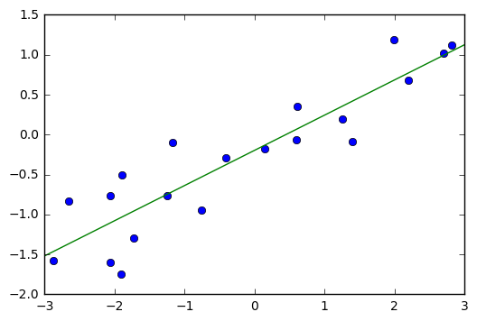
Linear Regression as ERM
Notes:
I want to tie this principle to something your are probably familiar with, linear regression.
That’s even simpler than polynomial fitting, but one of the really simple and successful methods in statistics and machine learning.
Linear regression, or ordinary least squares means finding a vector w such that w * x – y is minimized.
This is basically only the first part of the principle I just showed you, the data fitting part.
And if you look at this in 2d, it looks like a great idea.
This is mostly because linear models in 2d are inherently simple.
However, if you go to higher dimensional spaces, linear models can become quite complex.

Slide 10
Regularized Linear Regression: Ridge
Notes:
If you have more features (so sensor measurements) than observations, you can find a linear model that fits any possible outcome y perfectly! You might call this an underspecified linear system.
But I don’t want to give up, I still want to learn. And I can. I just need to add in the second part, the regularization, that tells me to keep the model simple.
For linear regression, the easiest way to do that is by adding the l2 norm of w to the objective, and we get what’s called ridge regression. This basically says “I want to fit the data, but don’t make w too long” - or in other words, don’t make any particular entry of w too large.
This will make the optimization problem well-specified, and lead to a more “simple” model that generalizes better.
You might notice that the formula also has an alpha in it, which balances between data fitting and regularization, and you probably want to ask: what’s alpha? Well, it’s a real number, and I’ll tell you how to set it later.

Slide 11
training set
1.1 | 2.2 | 3.4 | 5.6 | 1.0
6.7 | 0.5 | 0.4 | 2.6 | 1.6
2.4 | 9.3 | 7.3 | 6.4 | 2.8
1.5 | 0.0 | 4.3 | 8.3 | 3.4
0.5 | 3.5 | 8.1 | 3.6 | 4.6
5.1 | 9.7 | 3.5 | 7.9 | 5.1
3.7 | 7.8 | 2.6 | 3.2 | 6.3
1.6
2.7
4.4
0.5
0.2
5.6
6.7
X =
y =
test set
Notes:
So in the previous example, I asked you whether you think a model will generalize well to new data from eyeballing it. That’s clearly not a good way to test a model, and usually impossible in higher dimensions.
The standard method to evaluate the generalization capabilities is with a hold-out set, also known as test-set or validation set.
The way this works it that we split our initial dataset into one part that is used for actually building the model, which we call the training set, and another part, the test set, which will be our “pretend future data”. The essential point here is that we have the true outputs, or ground truth, for this data, so we can measure how well our model did on this “new” data.

Slide 12
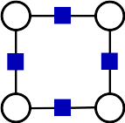
PyStruct
Structured Prediction in Python

Slide 13
Structured Prediction

Slide 14
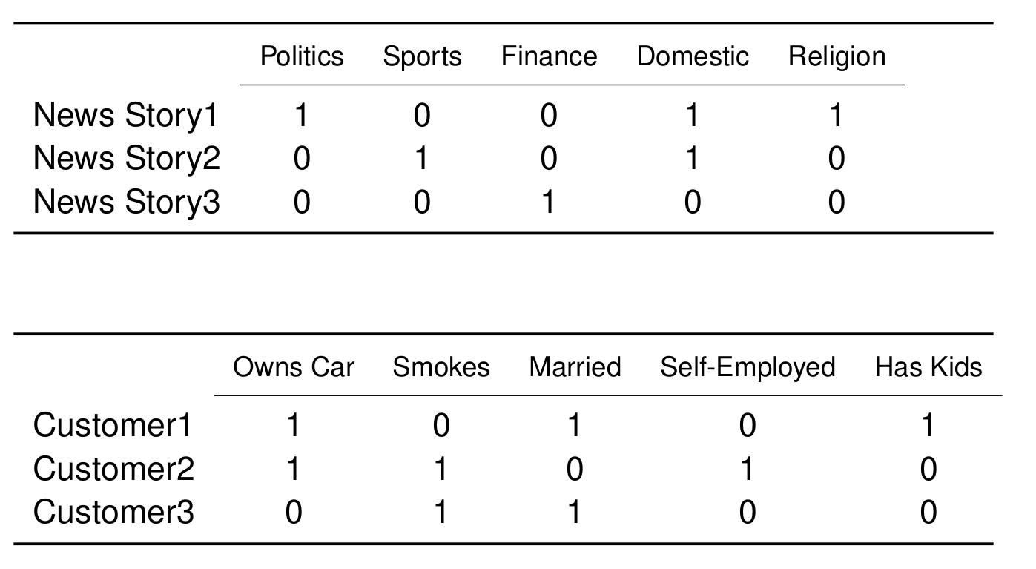
Applications: Multi-Label Classification

Slide 15
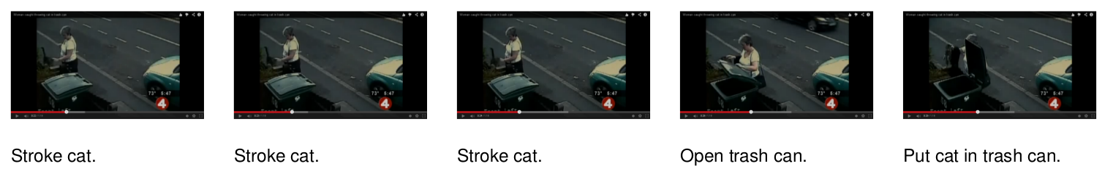
Applications: Sequence Tagging

Slide 16
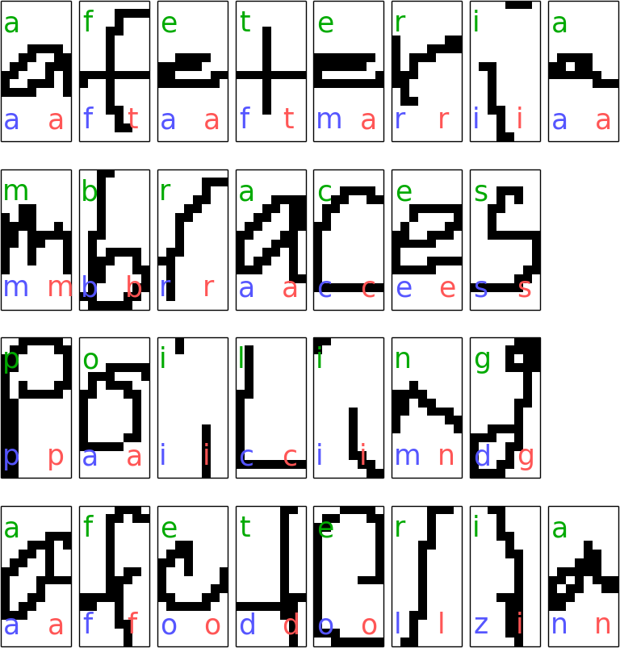
Sequence Tagging example
c
e
s
c
model = ChainCRF()
ssvm = OneSlackSSVM(model=model, C=.1)
ssvm.fit(X_train, y_train)

Slide 17
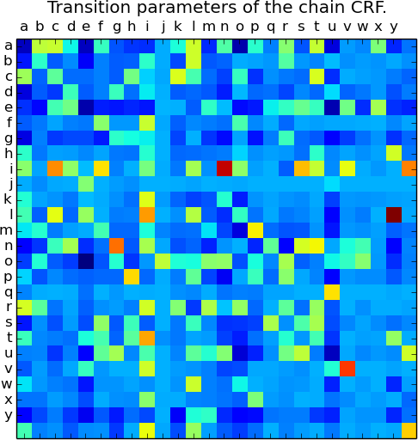
Sequence Tagging example
c
e
s
c
model = ChainCRF()
ssvm = OneSlackSSVM(model=model, C=.1)
ssvm.fit(X_train, y_train)

Slide 18
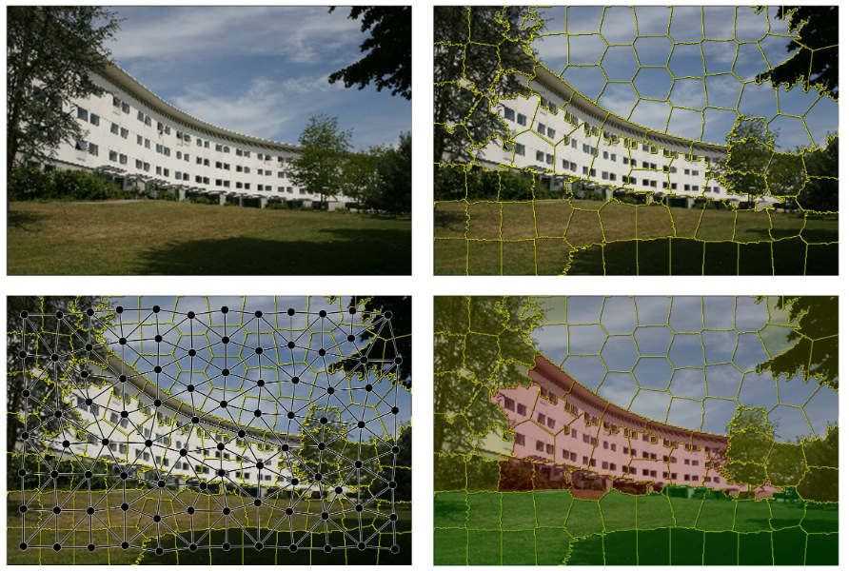

Slide 19
The Open Source Idea

Slide 21
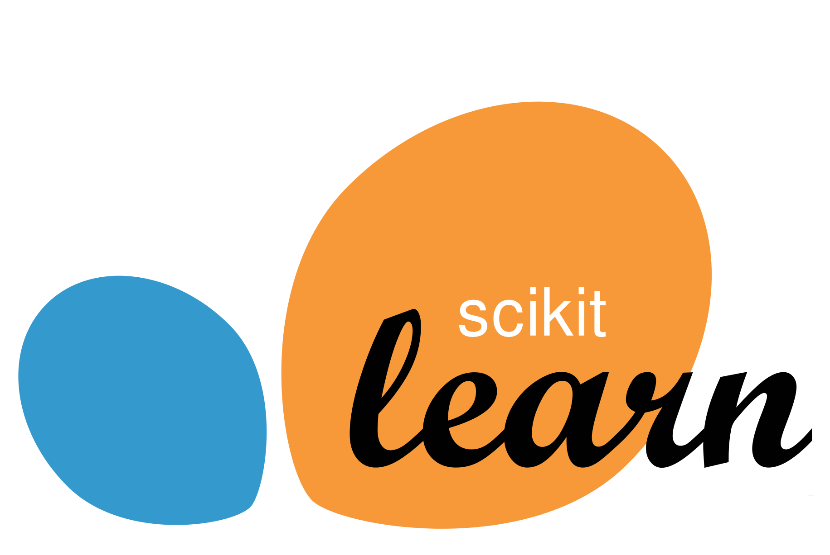
Notes:
So if you want to do machine learning in python, your go-to library is scikit-learn. And I’m only saying that because I’m one of the maintainer ;)
The rest of my talk I want to spend on how to apply scikit-learn to do machine learning, and discuss some methods and best practices.
Scikit-learn is built upon numpy and scipy, and the main data structures it works with are numpy arrays, and I hope you’re all familiar with them.

Slide 22
Classification
Regression
Clustering
Semi-Supervised Learning
Feature Selection
Feature Extraction
Manifold Learning
Dimensionality Reduction
Kernel Approximation
Hyperparameter Optimization
Evaluation Metrics
Out-of-core learning
…...

Slide 23
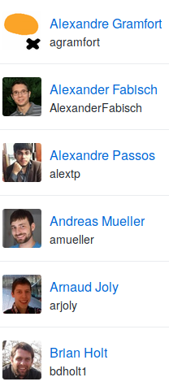
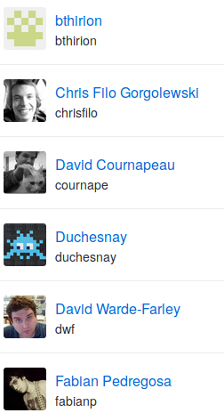
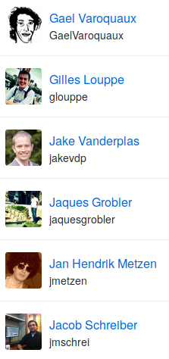
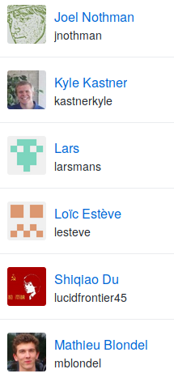
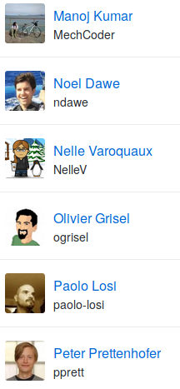
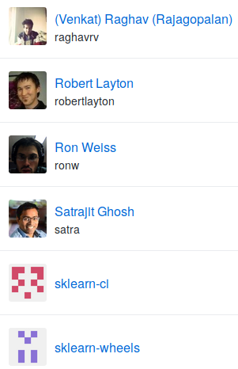
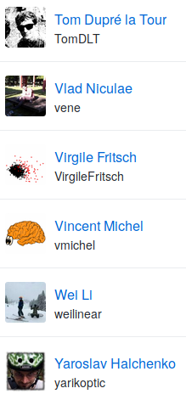

Slide 24
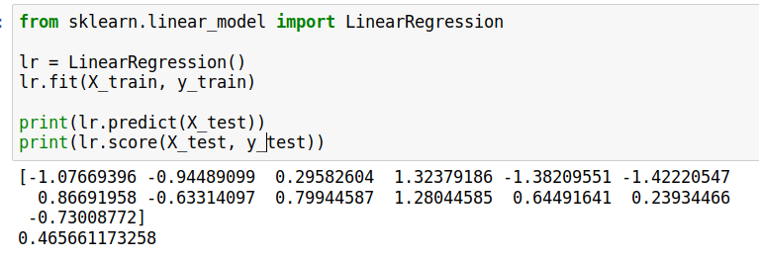
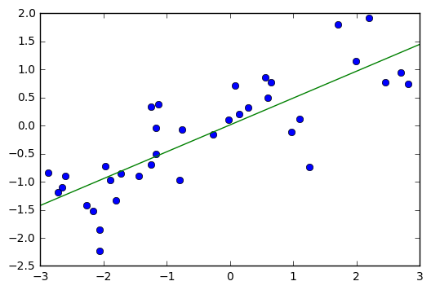
Notes:
We import linear regression and instantiate the class
Then we can fit the model on the training data and the training targets with the fit method.
This estimates slope and offset of the linear regression, which are stored in the lr object.
We can access them as lr.coef_ and lr.intercept_.
We can then make prediction using this linear regression model using the ``predict`` function.
Here are the predictions for the training set.
We can also make predictions for the unseen data, the test set.
To evaluate how well we do on either the training set
or the test set, we can use the score method, which for regression computes the R^2.
So here you can see the three central methods of scikit-learn: fit, predict and score.

Slide 25

Mission:
Commoditize and Democratize Machine Learning
Notes:
Let’s start with a mission statement. To me, and I think to many others in the project, the mission of scikit-learn is to create effective and easy to use machine learning solutions, and make them accessible to everybody. In other words, we want to commoditize and democratize machine learning. This is a goal we share with the people at google, like Josh, working on Tensorflow. We have a slightly different angle, as we are an open source project, not a company. And we have been doing this for about 6 years now. Take that tensor flow.

Slide 26

Simple things should be simple,
complex things should be possible.
Alan Kay
Notes:
There is this nice quote here by alan kay, which says “simple things should be simple, complex things should be possible”. Whenever I think about a new feature or a new api, I keep that in mind. When in doubt, in scikit-learn we err on the side of keeping simple things simple, sometimes sacrificing some of the power of more complex designs. But I’ll talk about that more later.

Slide 27

Scoping
Well established
Widely
useful
sklearn
Matrix in,
matrix out
Notes:
One of the most important tools we used is very rigorous scoping. We only include methods that are well established and widely useful. We don’t have methods that are only good in biology, or that are only good for financial data. We aim to have a very broad spectrum. We also limit ourselves to well-established methods. One of the reasons we don’t want to implement the bleeding edge is that the field of Machine learning is very fast moving, and what looked promising half a year ago might no longer be any good. Basically everything in scikit-learn stood the test of time. A last very important restriction to scope is that we only have algorithms that work on a fixed matrix of data, and produce some matrix or array-formed results. This basically excludes active learning, reinforcement learning and collaborative filtering. It also excludes working on sequences or structured data.

Slide 28

Simplicity
est = Est()
est.fit(X_train, y_train)
est.score(X_test, y_test)
Notes:
To make scikit-learn usable, we really focus on simplicity. You can build really powerful machine learning experiments and pipelines with scikit-learn with just a couple of lines of code. And doing a standard supervised machine learning task boils down to just these three lines: instantiate a model, fit the model on the training data, evaluate it on the test data. We really want to keep simple things simple.

Slide 29

grid = GridSearchCV(svm,param_grid)
grid.fit(X_train, y_train)
grid.score(X_test, y_test)
Consistency
Notes:
And not only is the scikit-learn api designed to be simple, it’s also designed to be consistent, and only have a few basic building blocks. The grid-search for example acts as a model (which we call an estimator), and has exactly the same interface as any other model. So adjusting the parameters of a model looks like just another model fitting.

Slide 30

Flat Class Hierarchy, Few Types
Numpy arrays / sparse matrices
Estimators
[Cross-validation objects]
[Scorers]
Notes:
This simplicity is not only in the methods, interface, it is also in the types. There are very few types of objects in scikit-learn. Data is always numpy arrays, and basically every building block in scikit-learn is an “Estimator”. And that’s it. That’s more or less the only two types of objects you have to deal with in scikit-learn.
There is no dataset object, for example. There are some limitations in restricting ourself in this way, but having few types and a flat class hierarchy not only makes the project easier to use, it also makes it easier for new contributors to join the project, and simplifies maintaining the project.
For advanced users there are also cross-validation objects and scoring objects, which allow for more fine-grained control in model selection.

Slide 31

Maintainability
Notes:
The small number of types brings us to the next point, which is particularly important for an open source project: maintainability. The project was built with maintainability in mind from the start. I’d say maintainability is more important in open source, because at some point, you might want to find another idiot to waste their weekends on maintaining this code voluntarily. You can’t hire a new engineer and say “here deal with this mess of legacy code”. You wouldn’t have any contributors. Maintainability helps us create a thriving ecosystem of contributors, even though the barrier of entry inevitably keeps rising over time.
I should mention here a stellar paper by a team at google, called the high interest credit card of technical depth, which talks about how important it is to be aware of the complexity, robustness and maintainability of the machine learning systems you built.

Slide 32

Programs should be written for people to read,
and only incidentally for machines to execute.
Notes:
Maintainable code is easy to read and understand for someone new to the code base. You should keep in mind this classic quote from the classic wizzard book.

Slide 33

avoid code;
avoid code rot!
Notes:
One of the easiest way to keep a project maintainable is to avoid code. I really don’t like code, and I like to delete as much of it as I can. Some people really love writing long and complex code. But some day some poor soul has to read that and understand it. Every time you add a new feature, you add more complexity, and more moving parts to a project. Stop writing so much code, and start deleting more code. For every feature you add, ask yourself: is this worth the added burden for my future self, maintaining this code to the end of time?

Slide 34

Challenges
Notes:
So now that I talked about things that worked well for us, here are some things that we haven’t really figured out, or that keep coming up.

Slide 35

Feature Creep
Notes:
I’m not sure if you know this comic, it’s from bokersworld. If you don’t know bonkersworld, definitely check it out. So, you know, whenever you start a new project, you think to yourself: This time I’ll do it right. And then at some point you end up with some frankenstein monster. The comic says “much later”, but in my experience, it usually doesn’t take that long. Even though we have pretty strict scoping, feature creep is a problem, and we constantly fight with the tradeoff of adding features and keeping complexity of the project reasonable.

Slide 36
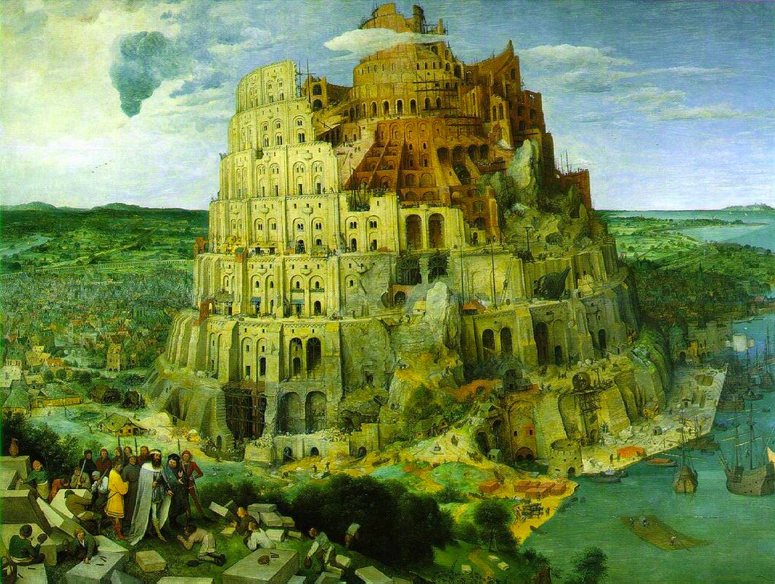


Two Language Problem
Notes:
Another problem that is somewhat ongoing is the two language problem. Python is a nice high level language and very easy to use. It’s general purpose and great for data science. But it’s slooow. Which means we have to use Cython, which basically boils down to C, to implement most algorithms. That is frustrating because it means we need to work with both python tooling and C tooling, for debugging and profiling. It also means that the barrier to contribute to the actual algorithms is quite high for people that only program in python, because all of a sudden they have to think about memory management and types.

Slide 37



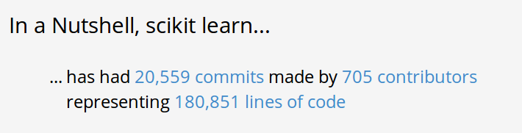
Project Size
Notes:
Another struggle for us, that I guess is also particular to open source, is our fight with the project size. We have a lot of people contributing and reporting bugs, which is great. But we have very few people that have a good overview of the project, and most of these are busy writing grants all day to fund the people actually implementing stuff. That means we have hundreds of contributors, around 10 or 20 people that review code, and at the top maybe 5 very busy people that try to keep a lid on things. And the problem is that you can’t really just add people to the top. For one, we have no money – corporate contributions to scikit-learn are exactly zero, as far as I know. And also, hiring someone to manage the project is not really how open source works. We could try, but if the person doesn’t have the support of the community, this could fail badly.

Slide 38





amueller.github.io
@amuellerml
@amueller
andreas.mueller
@columbia.edu
https://github.com/amueller/talks_odt/
Notes:
Buy my book. It’s about machine learning. It’s written for programmers, and should be a pretty easy read for anyone that knows a bit of numpy. I avoided adding to much math. If you want math, there are many awesome books to check out. This one is more about coding and how to get started with ml in python…. Which, you know, is why that’s the title…
I hope my rant was a bit informative, or at least entertaining. And A big shout out to the organizers for putting together such a great conference, and thanks again for having me!

