Slide 1




Down to the metal with
scikit-learn
Andreas Müller
Columbia University, scikit-learn
Notes:
Hi and thank you for coming to my talk today.
I’m andreas mueller, I work at the NYU center for data science, and I’ll talk a bit about the scikit-learn project I’ve been working on in the last couple of years, and my recent work at NYU.
Let me start by giving you first a bit of background on my self, and then on scikit-learn.

Slide 2






Slide 3
What is scikit-learn?

Slide 4

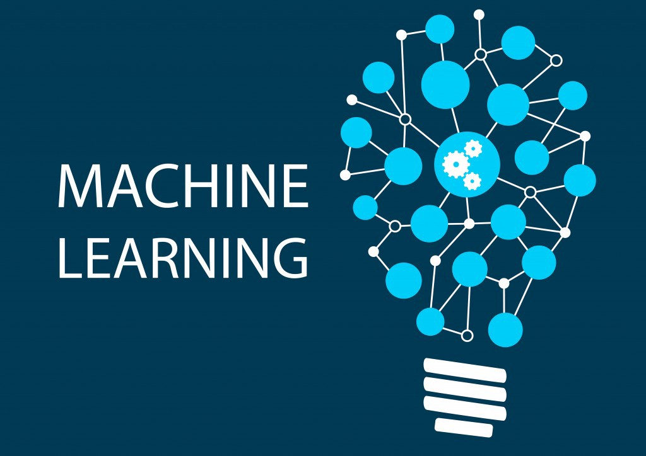


Slide 5

Classification
Regression
Clustering
Semi-Supervised Learning
Feature Selection
Feature Extraction
Manifold Learning
Dimensionality Reduction
Kernel Approximation
Hyperparameter Optimization
Evaluation Metrics
Out-of-core learning
…...
Notes:
Scikit-learn is a machine learning library for python that implements many different algorithms, as well as tools to tune and evaluate machine learning models.
You’ll find all the standard text-book algorithms like linear models, random forest, SVMs, neural networks, PCA, NMF, ICA, t-SNE, K-Means, and so on. In addition, scikit-learn also contains tools to build machine learning pipelines and tools for cross-validation and parameter searches.
Scikit-learn is a library, and there’s no official graphical interface or command line interface, so to use it, you need to write python code. Though not very much as I’ll show you in a bit.

Slide 6
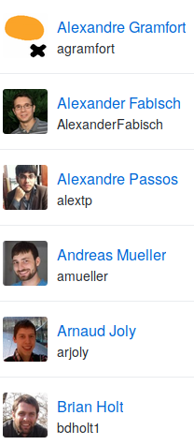
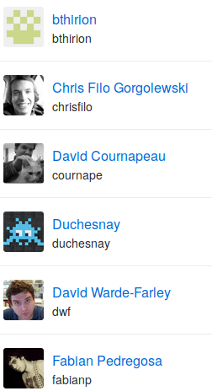
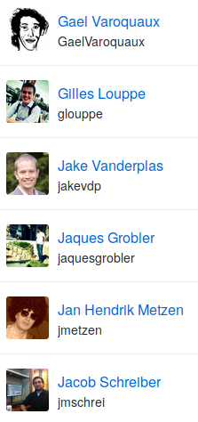
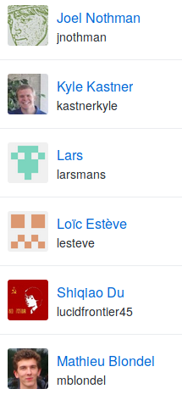
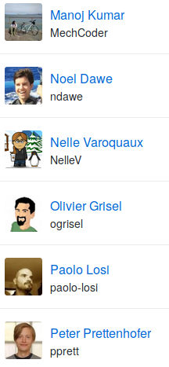
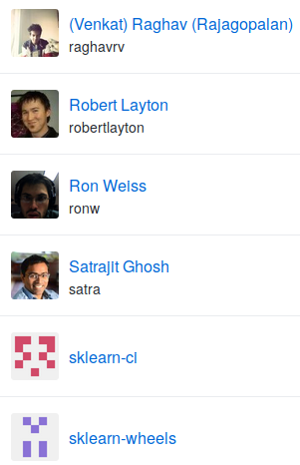
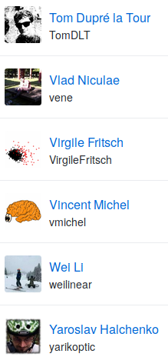

Slide 7
Mission
Commoditize and Democratize Machine Learning
Notes:
So why this project? To me, and I think to many others in the project, the mission of scikit-learn is to create effective and easy to use machine learning solutions, and make them accessible to everybody. In other words, we want to commoditize and democratize machine learning.
That is quite different from just putting a collection of algorithms out there, and I think it’s one of the reasons why the project has been so successful.

Slide 8
Basic API

Slide 9

Representing Data
one sample
1.1 | 2.2 | 3.4 | 5.6 | 1.0
6.7 | 0.5 | 0.4 | 2.6 | 1.6
2.4 | 9.3 | 7.3 | 6.4 | 2.8
1.5 | 0.0 | 4.3 | 8.3 | 3.4
0.5 | 3.5 | 8.1 | 3.6 | 4.6
5.1 | 9.7 | 3.5 | 7.9 | 5.1
3.7 | 7.8 | 2.6 | 3.2 | 6.3
1.6
2.7
4.4
0.5
0.2
5.6
6.7
X =
y =
one feature
outputs / labels

Slide 10
Supervised Machine Learning
Training Data
Model
Training
Training Labels
Test Data
Prediction
Generalization
Test Labels
Evaluation

Slide 11
clf = RandomForestClassifier()
clf.fit(X_train, y_train)
Training Data
Model
Training Labels
y_pred = clf.predict(X_test)
Test Data
Prediction
Test Labels
Evaluation
clf.score(X_test, y_test)

Slide 12
Unsupervised Machine Learning
Training Data
Model
Test Data
New View

Slide 13
Unsupervised Transformations
pca = PCA()
pca.fit(X_train)
X_new = pca.transform(X_test)
Training Data
Model
Test Data
Transformation

Slide 14
Core API Summary
estimator.fit(X, [y])
estimator.predict | estimator.transform
Classification | Preprocessing
Regression | Dimensionality reduction
Clustering | Feature selection
 | Feature extraction

Slide 15
Cross -Validated Grid Search
from sklearn.model_selection import GridSearchCV
from sklearn.model_selection import train_test_split
X_train, X_test, y_train, y_test = train_test_split(X, y)
param_grid = {'C': 10. ** np.arange(-3, 3),
'gamma': 10. ** np.arange(-3, 3)}
grid = GridSearchCV(SVC(), param_grid=param_grid)
grid.fit(X_train, y_train)
grid.predict(X_test)
grid.score(X_test, y_test)

Slide 16
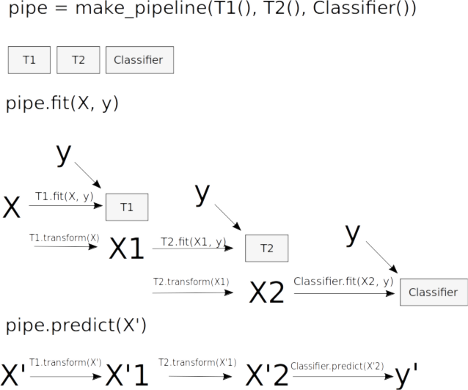
Pipelines

Slide 17
Pipelines
from sklearn.pipeline import make_pipeline
pipe = make_pipeline(StandardScaler(), SVC())
pipe.fit(X_train, y_train)
pipe.predict(X_test)

Slide 18
Guiding Ideas

Slide 19
Goals:
Maintainability
Ease of use
Notes:
Which brings us to the next point, which is particularly important for an open source project: maintainability. Scikit-learn was built with maintainability in mind from the start, to make this a sustainable project. If me, or the people in Paris, would stop working on the project, it would still live on. Creating software that can be taken over by someone else is quite challenging, and you should ask yourself how much of your research software holds up to that bar.
Maintainability helps us create a thriving ecosystem of contributors, even though the barrier of entry inevitably keeps rising over time.

Slide 20

Simple things should be simple,
complex things should be possible.
Alan Kay
Notes:
There is this nice quote here by alan kay, which says “simple things should be simple, complex things should be possible”. Whenever I think about a new feature or a new api, I keep that in mind. When in doubt, in scikit-learn we err on the side of keeping simple things simple, sometimes sacrificing some of the power of more complex designs. But I’ll talk about that more later.

Slide 21

Programs should be written for people to read,
and only incidentally for machines to execute.
Harold Abelson
Notes:
Maintainable code is easy to read and understand for someone new to the code base. You should keep in mind this classic quote from the classic wizzard book.

Slide 22
Simplicity
lr = LogisticRegression()
lr.fit(X_train, y_train)
lr.score(X_test, y_test)
Notes:
To make scikit-learn usable, we really focus on simplicity. You can build really powerful machine learning experiments and pipelines with scikit-learn with just a couple of lines of code. And doing a standard supervised machine learning task boils down to just these three lines: instantiate a model, fit the model on the training data, evaluate it on the test data. We want to keep simple things simple.
Here, I used the logistic regression classifier, but I could replace that first line with any other algorithm and the code would be exactly the same.

Slide 23
Consistency
grid = GridSearchCV(svm,param_grid)
grid.fit(X_train, y_train)
grid.score(X_test, y_test)
Notes:
And not only is the scikit-learn api designed to be simple, it’s also designed to be consistent, and only have a few basic building blocks. The grid-search for example acts as a model (which we call estimator), and has exactly the same interface as any other model.

Slide 24
Composition
feature_selection = RFECV(NaiveBayes())
pipe = make_pipeline(feature_selection,
RandomForestClassifier())
grid = GridSearchCV(pipe, param_grid)

Slide 25
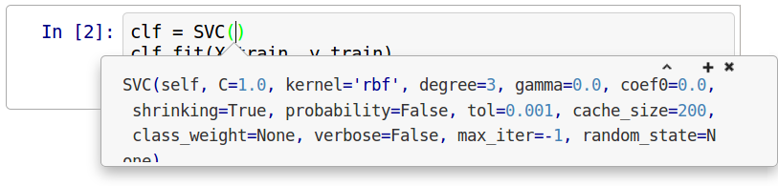
Default Parameters

Slide 26
Flat Class Hierarchy, Few Types
Numpy arrays / sparse matrices
Estimators
Cross-validation objects
Scorers
Notes:
But the simplicity goes further. There are very few types of objects in scikit-learn. Data is always numpy arrays, and basically every building block in scikit-learn is an “Estimator”. And that’s it. That’s more or less the only two types of objects you have to deal with in scikit-learn. There is no dataset object, for example. There also two kinds of object for model evaluation, but these are only interesting to expert users.
Having few types and a flat class hierarchy not only makes the project easier to use, it also makes it easier for new contributors to join the project, and simplifies maintaining the project.

Slide 27
Scoping
Well established
Widely
useful
sklearn
Matrix in,
matrix out
Notes:
One of the most important tools to help with maintainability is scoping. We only include methods that are well established and widely useful. We don’t have methods that are only good in biology, or that are only good for financial data. We aim to have a very broad spectrum. We also limit ourselves to well-established methods. One of the reasons we don’t want to implement the cutting edge is that the field of Machine learning is very fast moving, and what looked promising half a year ago might no longer be any good. Basically everything in scikit-learn stood the test of time. Another very important restriction to scope is that we only have algorithms that work on a fixed matrix of data, and produce some matrix or array of results. This basically excludes active learning, reinforcement learning and collaborative filtering. It also excludes working on structured data, and allows us to have such a simple interface.

Slide 28
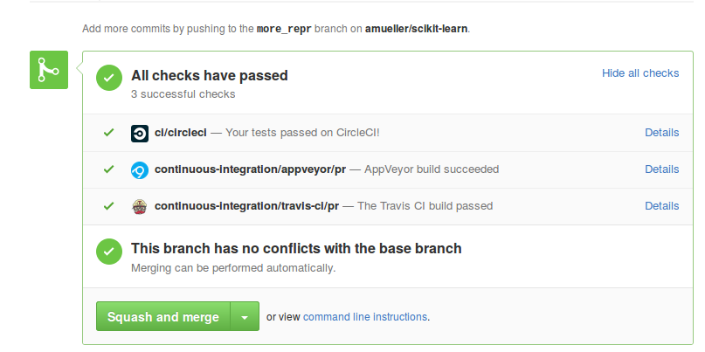
Testing & Continuous Integration
Notes:
Another tool that helps with maintainability and usability is extensive testing. We have tests for everything. Every option is tested, every edge case.
We also have automatic tests to check that everything has the same interface and all parts play nicely together.
What I mean by testing here might be slightly unfamiliar for the people without an software engineering background. Often when I asked researchers if they test their code they answer with “yes, I tried it”. That’s not what testing is about.
I’m talking about continuous integration and unit tests.
Whenever anyone suggests a change to the package, an automated service starts and runs all our tests against the changed version, and makes sure they all pass. That ensures that all additions are sane.

Slide 29



Three way documentation
Notes:
Another thing that’s very important, both for maintainability and usability is extensive documentation. We document each feature in three ways: we have a user guide that explains algorithms in a text-book style and provides references. We also have an API documentation that explains all the parameters, and finally we have examples that illustrate particular properties of the algorithms and compare their strength and weaknesses.

Slide 30
Behind the scenes

Slide 31
API implementation & contracts

Slide 32
Method Chaining
Fit must return self:
X_scaled = StandardScaler().fit(X).transform(X)
pred = SVC().fit(X_train, y_train).score(
X_test, y_test)

Slide 33
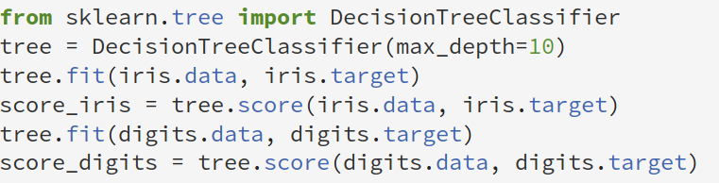
fit resets

Slide 34
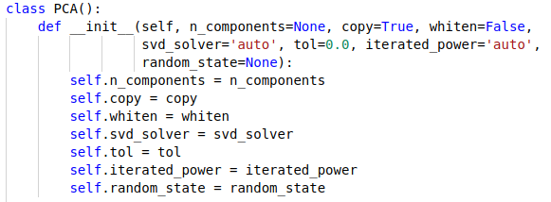
__init__ does nothing

Slide 35
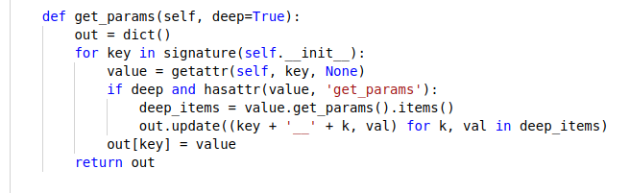
get_params & set_params
Used in GridSearchCV etc.
Not __init__ !!!
All parameter validation etc in fit!

Slide 36
(only) fit mutates self
__init__ only remembers construction parameters
Transform / score etc don’t change object
Fit returns self but mutates object!

Slide 37
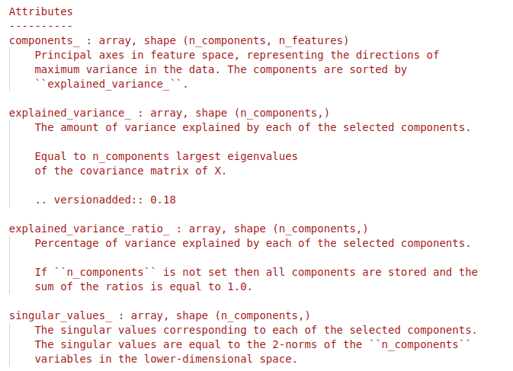
Estimated attributes
Leaves two kinds of attributes:
arguments to __init__; things estimated during fit

Slide 38
Transform only X

Slide 39
fit_transform / fit_predict
In general: computational shortcut:
pca = PCA()
pca.fit(X)
X_pca = pca.transform(X)
X_pca2 = pca.fit_transform(X)
Clustering / Manifold learning: Not inductive.
tsne = TSNE()
X_tsne = tsne.fit_transform(X)
dbscan = DBSCAN()
cluster_labels = dbscan.fit_predict(X)

Slide 40
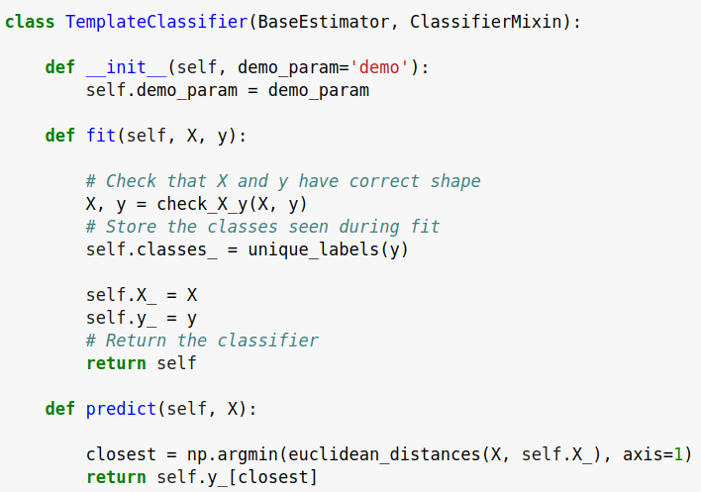
check_estimator
AssertionError: Error message does not include the expected string: 'fit'.
Observed error message: "'TemplateClassifier' object has no attribute 'X_'"

Slide 41
Other API Building Blocks

Slide 42
Scorers
grid = GridSearchCV(SVC(), params, scoring=’roc_auc’)
def my_acc_scorer(est, X, y):
y_pred = est.predict(X)
return (y == y_pred).mean()
grid = GridSearchCV(SVC(), params,
scoring=my_acc_scorer)

Slide 43
Cross-validation iterators
grid = GridSearchCV(SVC(), param_grid, cv=5)
cv = KFold(n_split=5, shuffle=True, random_state=3)
grid = GridSearchCV(SVC(), param_grid, cv=cv)
cv = RepeatedKFold(n_split=5, n_repeats=10)
grid = GridSearchCV(SVC(), param_grid, cv=cv)

Slide 44
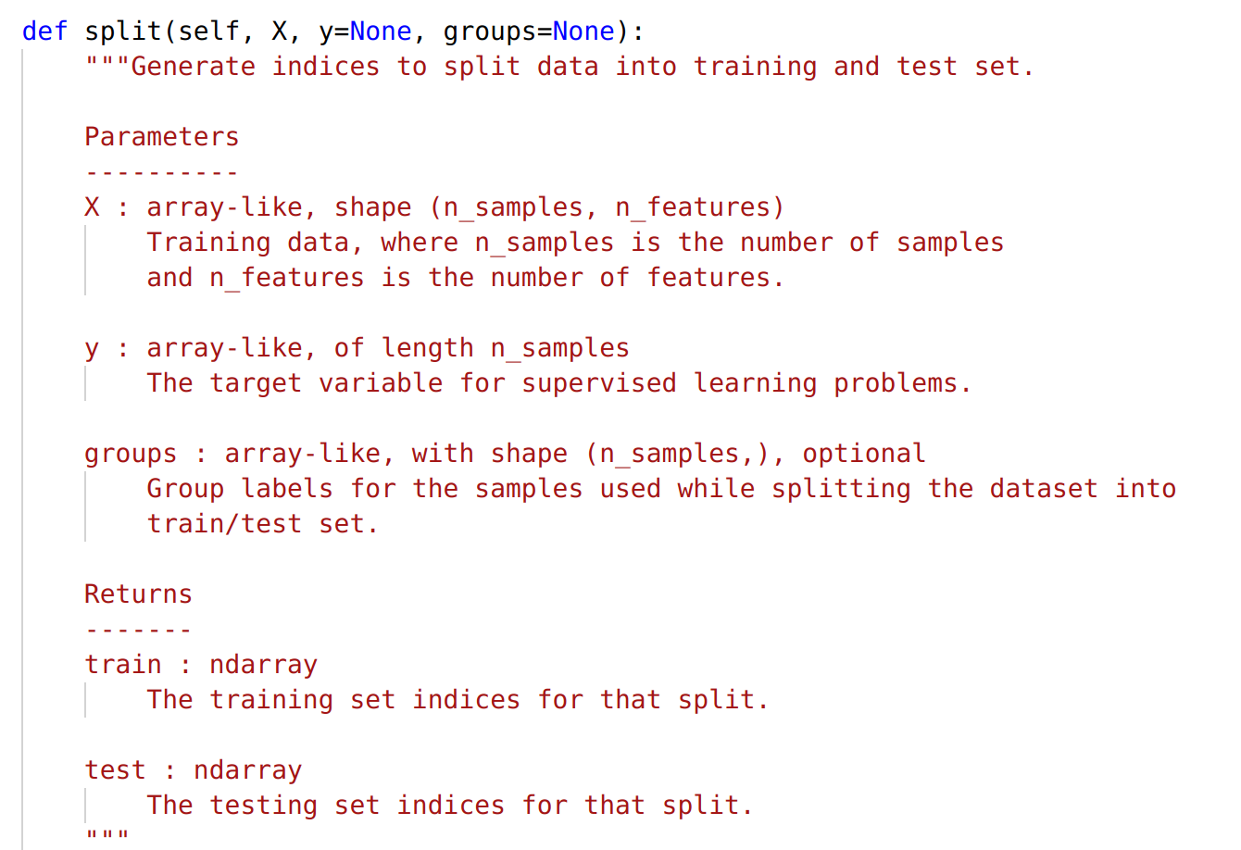
CV Iterators API
kfold = KFold(n_splits=5)
for train, test in kfold.split(X, y):
X_train = X[train]
X_test = X[test]

Slide 45
Misc functions
Scoring functions
func(y_true, y_pred/y_scores, …)
Pairwise Distances/kernels
euclidean_distances
rbf_kernel
Evaluation:
cross_validate
learning_curve
roc_curve
Helpers:
train_test_split

Slide 46
Development Practices

Slide 47
Standards for OSS
Everything discussed in the open.
Every convention and process documented.

Slide 48
Development guide
http://scikit-learn.org/dev/developers/contributing.html
Contains:
API details
Bug report guidelines
PR guidelines
Reviewing guidelines
How to find issues
Details of CI
Even more at http://scikit-learn.org/dev/developers/

Slide 49
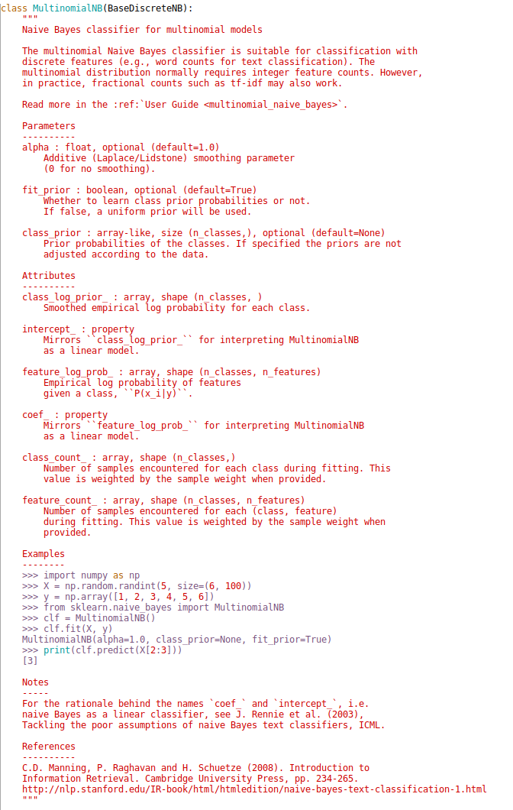
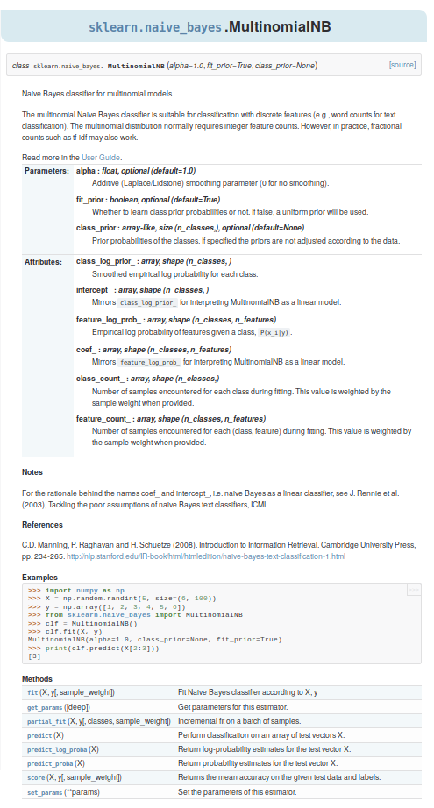
Sphinx / numpydoc

Slide 50
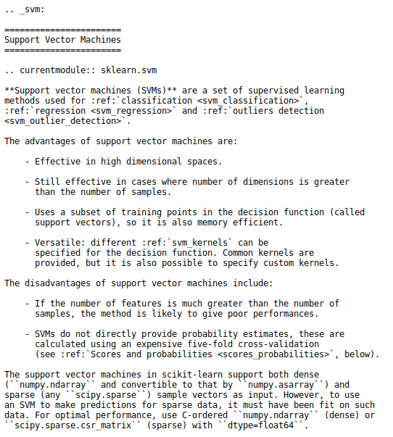
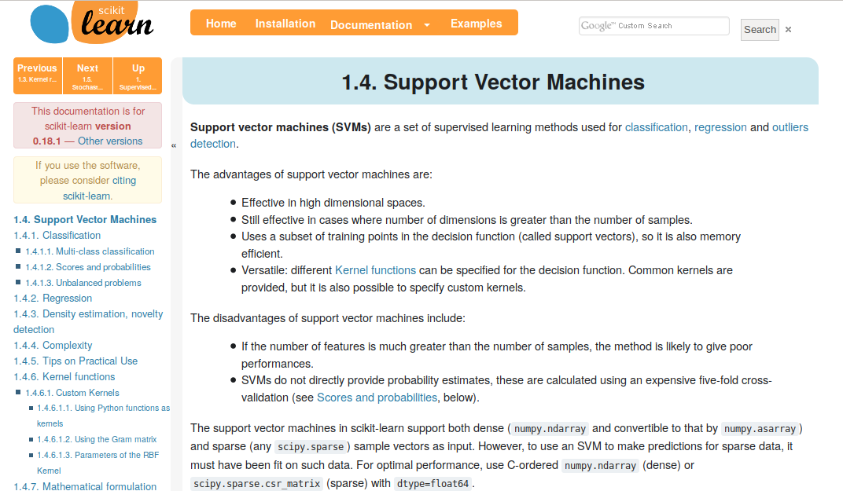
Sphinx / numpydoc

Slide 51
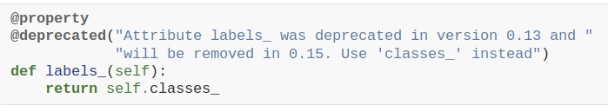
Deprecations / backward compatibility
Don’t change any behavior (except bug fixes)

Slide 52
Practical Notes on Contributing

Slide 53
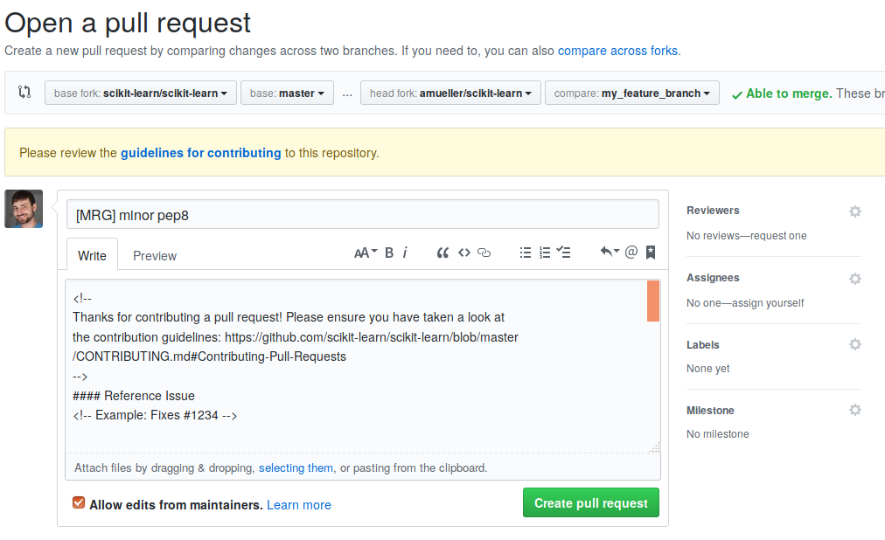
Describing PR
[WIP] = work in progress
[MRG] = ready to merge

Slide 54
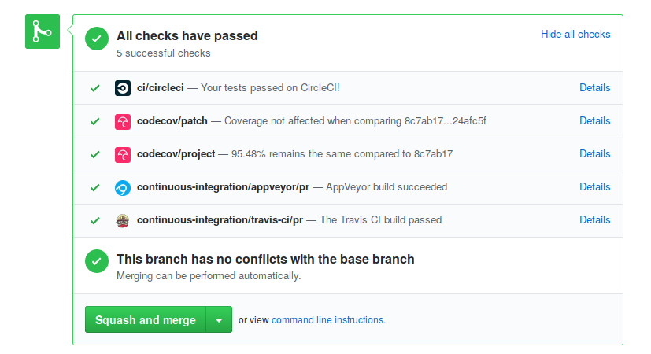
Regression tests
Are mandatory! For everything (except documentation changes)!
Make sure continuous integration passes:

Slide 55
What’s next?
Wait for reviews (be patient).
Address review comments in the same branch.
Pushing to your fork will update the PR
Reviewers will “approve” PR or change title to [MRG + 1]
You need two approvals for a merge.

Slide 56
Finding Issues
Check “need contributor”, “easy” and “sprint” issues.
Something unclear in the docs? Fix it!
Can’t fix something that’s unclear? Open an issue!
Problem that you keep running into: Open an issue!
Find stalled PRs (the author didn’t address reviews for ~>1 month) and continue them!

Slide 57
Reviewing
You can review PRs and issues!
Some bugs are not confirmed. See if you can confirm them and under what conditions?
You can review documentation PRs for language and whether they are clear to you.
You can review code changes on whether they address the issue (might be a bit tricky).
Don’t be afraid to ask clarifying questions!

Slide 58
Final words
Pick something TRIVIALLY SIMPLE as the first contribution.
You can do the cool stuff afterwards!
There might be interesting issues that are not appropriately tagged.
Consider finishing up stalled PRs

Slide 59
Notes:
Because I have been talking about what I’ve been up to within the last year or so, I also wanted to mention this book that I wrote with Sarah Guido that just came out. It’s a guide to practical machine learning in python. It doesn’t contain any math, but a lot of code examples with scikit-learn.

Slide 60




Thank you.
@amuellerml
@amueller
amueller@nyu.edu
http://amueller.io
Notes:
That’s it from my side, than you for your attention.

