Slide 1

Commodity Machine Learning
Past, present and future
Andreas Mueller
Notes:
Hey everybody, welcome to my talk on commodity machine learning, past present and future.
And thank you to the organizers for inviting me to this great conference.
(intro?)
I’m probably most well-known here as a core-developer of scikit-learn, and co-release manager with Olivier Grisel. I’m working at NYU as a research engineer … ?

Slide 2
What is machine learning?
Notes:
Let’s start with “what is machine learning?” Many of you are probably familiar, given the recent hype. But this is PyCon and not PyData, so I want to give a little bit of background and my personal perspective.

Slide 3
Automatic Decision Making
Face detection etc
Notes:
The goal of machine learning is to automate decision making processes. Instead of having a human make a decision, we want a program to make a decision, for example, “is this email spam” or “does this person have cancer”, or, one of my favorites “is there a face in this image”.
For some simple decisions, we, the programmers can come up with some rules that allow the program to make decisions. We could say “if the email comes from a known bad host, or contains “You have won” or three dollar signs, it’s spam”. That would get rid of at least some amount of bad emails.
Coming up with good rules is hard, though, and sometimes impossible. How would you write a rule to decide whether an image contains a face? That’s really hard to decide based on the values of the pixels.

Slide 4
Notes:
This is where machine learning comes in. Instead of programming the rules ourselves, we let an algorithm decide how to make a decision. So we let the algorithm come up with it’s own rules.
The only thing we need to make this work is data, more specifically, we need to show the algorithm examples of possible inputs and the decisions that should be made for this input.
For the spam example, we need to collect a whole lot of emails, and have a human label them as spam or not spam. Then we can provide these emails to the algorithm, together with the information if they were spam or not. The algorithm can then learn a decision rule.
Getting the data, together with the desired output, is often tricky, but it’s much easier than coming up with a rule yourself.

Slide 5
Notes:
Another way to think of machine learning is as a program creating new programs:
Usually, a program gets as input some data, and produces some data as output.
A machine learning program gets as input data, and as output it produces a new program – the program that knows how to make decisions.
However, keep in mind, machine-learning is not a cure-all. And it’s somewhat complex, so if you can actually come up with a good rule yourself, just use that, and move on.

Slide 6
Machine learning is EVERYWHERE
Notes:
Now you might think (well, at least if you’ve been asleep for the last couple years) “wow that sounds interesting but is it actually useful?”.
And yes, it is. These days, machine learning is every where. I’m pretty sure half of the tabs you have open in your browser right now show you the results of some machine learning algorithm. Let me give you some examples.

Slide 7
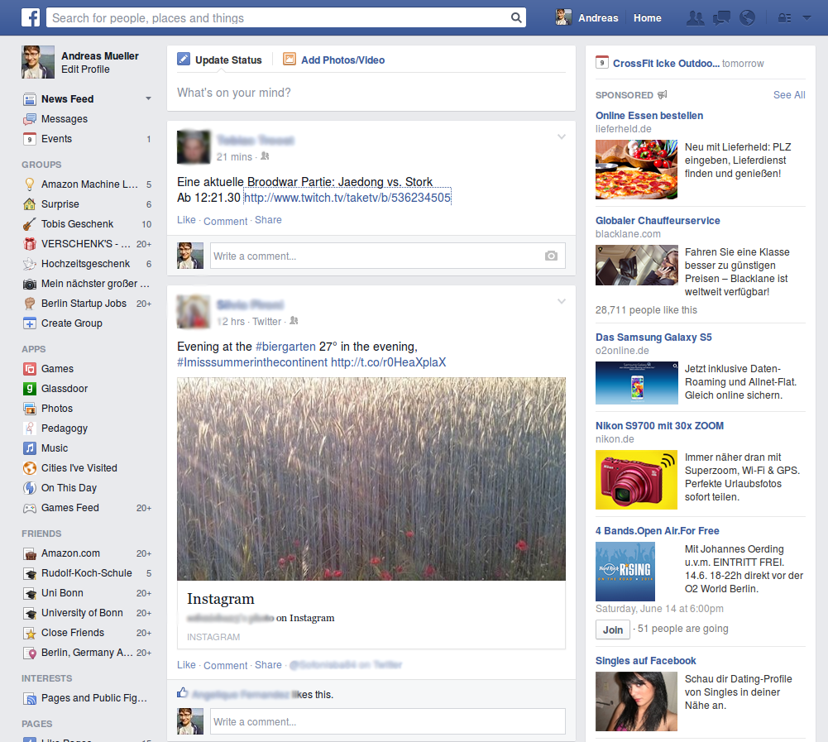
Notes:
So this social network here might look familiar to you. There are probably many more algorithms at work here than I can see, but some are fairly obvious. They are showing me advertisements, and they use machine learning to know what ads to show. And how much money they are worth.
They also use machine learning to know what to show me in my timeline, and in which order. If you upload pictures, they’ll identify all the faces, and they might also label the faces with the names of your friends.

Slide 8
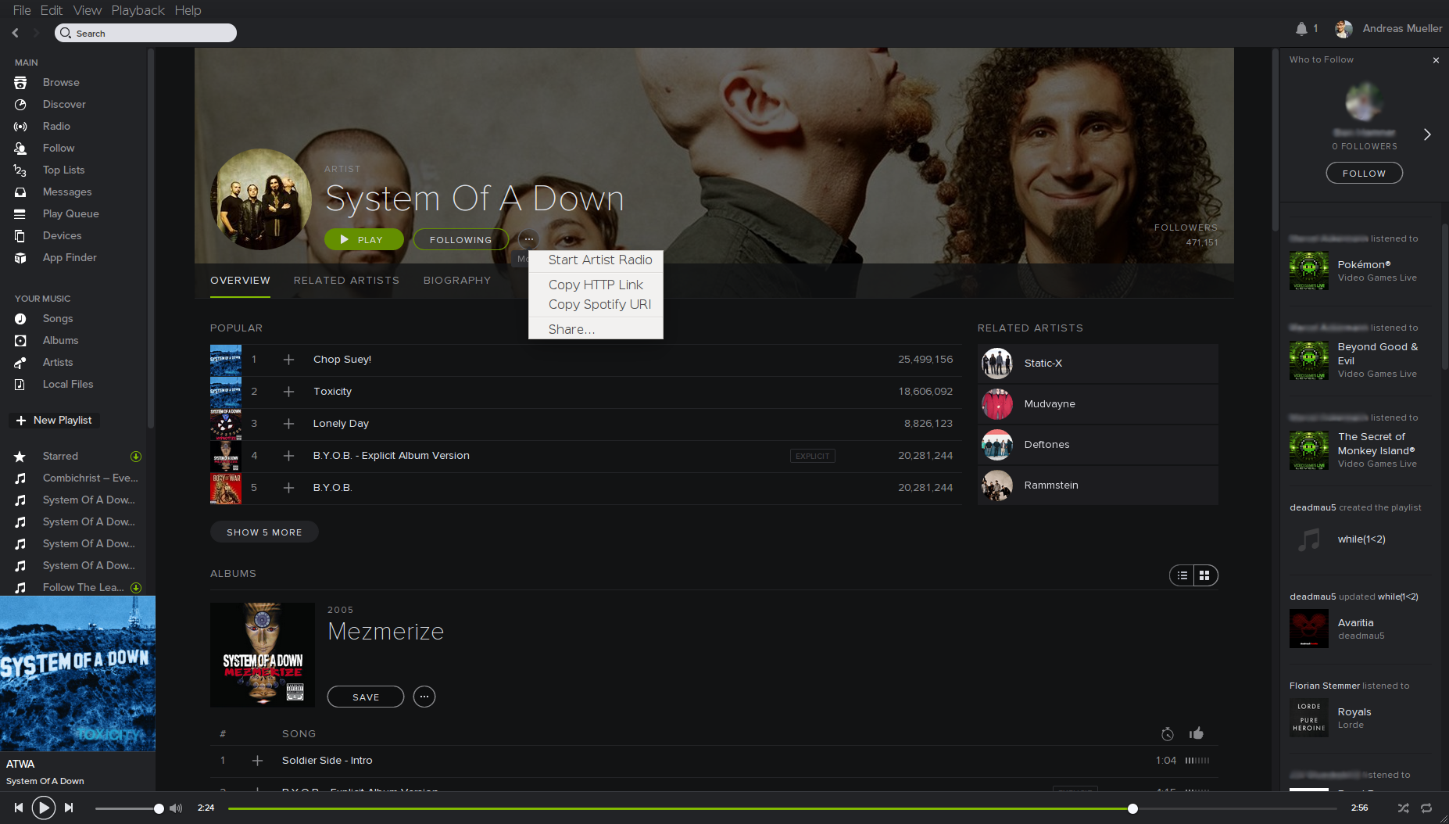
Notes:
Another machine learning application I’m constantly using is spotify.
Here, you can see an artists page, and there are links to “similar artists” - generated by machine learning. And an “artist radio” - also generated by machine learning. They have recently started a pretty big marketing campaign featuring their “discover weekly” which are tracks they recommend for you once a week, which is driven by, you guessed it, machine learning.

Slide 9
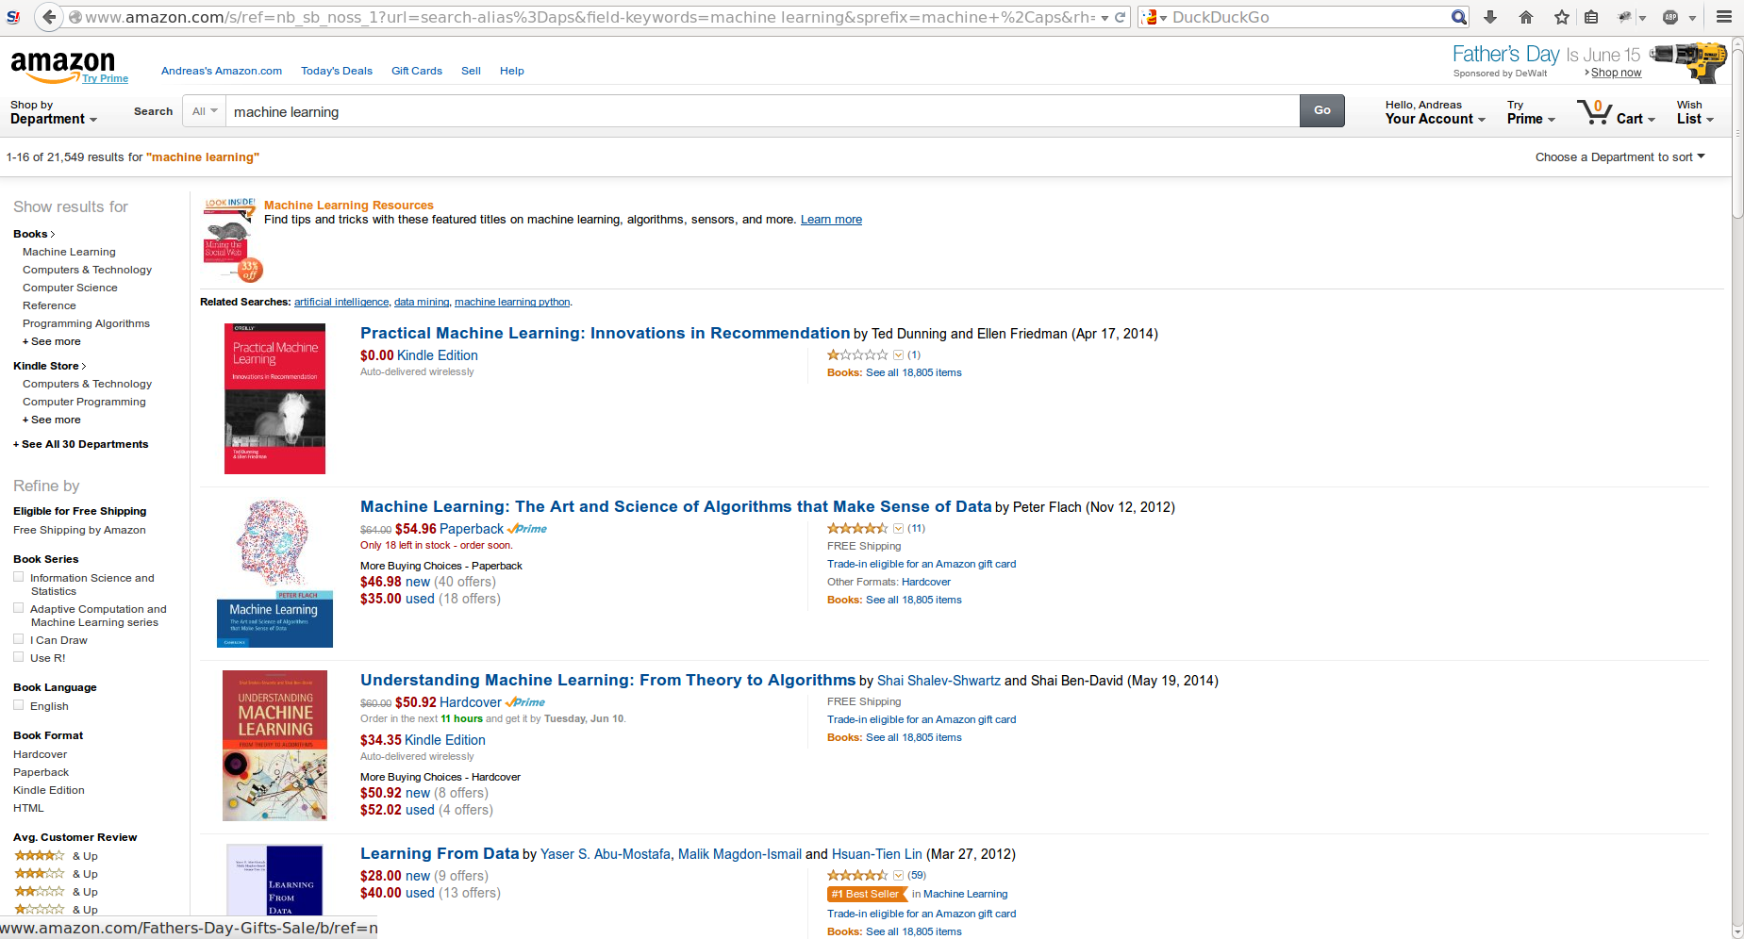
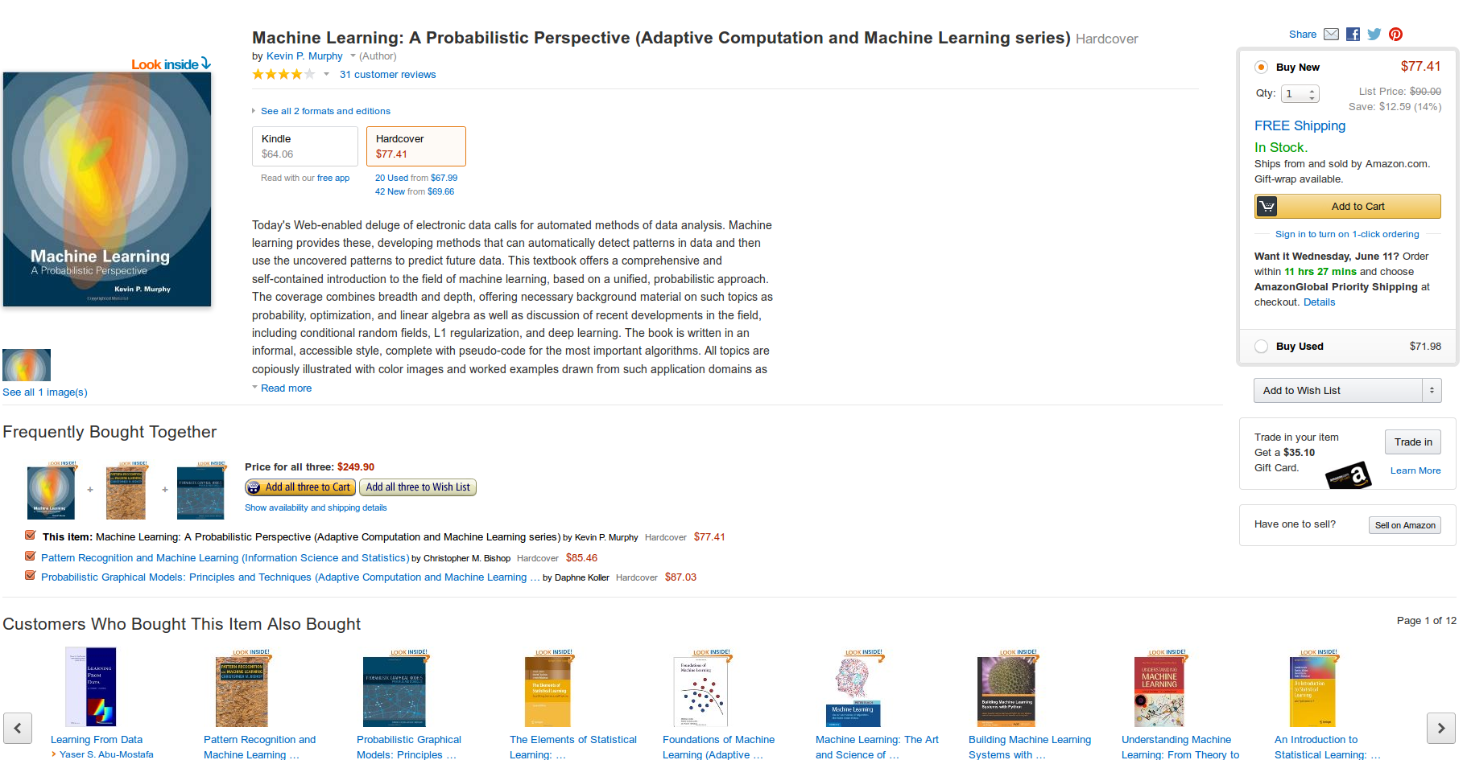
Notes:
Here’s another website you might have open. I actually know a bit more about this one because I worked for them. But many of the machine learning applications are fairly obvious. This is a product page for a pretty good book. Hm, maybe I should have replaced this with my book? Well… this is still a pretty good book.
At the bottom, you can see recommendations of what to buy together. And other items people bought that bought this item. Both are driven by machine learning. Less obvious is machine learning that picks a seller to show in the buy box to the right. There are many people selling this book, but one was selected just for you.

Slide 10
Science
Engineering
Medicine
...
Notes:
These are the places where you interact with machine learning probably everyday on the web. But Machine learning is not only important on the internet. It’s increasingly used in sciences of all kinds, from astronomy for finding distant planets, to finding the higgs boson or predicting elections.
It’s also used in many engineering disciplines, in particular in chip and circuit design to estimate efficiency and power consumption without actually building a chip. There’s of course also self-driving cars, and maybe soon drones delivering packages.
In medicine, machine learning is used to diagnose disease based on test results and imaging, but also to estimate the effect of new drugs.
And these are just some of the many important applications of ML

Slide 11
Commodity machine learning
Notes:
So now that we talked about what machine learning is, and where it’s used, I want to talk about what I mean by commodity machine learning. To me, machine learning is an important tool in data processing, and should be accessible to anyone. It shouldn’t be restricted to large companies with giant R&D departments, or research labs, it should be accessible to all of you. But there are some hurdles to become a commodity for relative sophisticated technology like machine learning. What I want to talk about here is the path that of machine learning tools and software took, and where it is going, from a user perspective.
You will see how over time, the barrier to entry became smaller and smaller, and hopefully it will become smaller still in the future.

Slide 12
Past
Notes:
So let’s start with the dark ages of machine learning software, say the early 2000’s

Slide 13
C++, custom code, read paper, implement
Notes:
I got into machine learning in 2009, at the start of my PhD. Luckily, by this point, already a lot of machine learning tools were available.
But if you go back just a little bit further, the amount of code that people are willing to share was small, and the amount of documentation was basically zero. So if you wanted to apply an algorithm, you usually had to do it from scratch. You took the paper, you implemented the algorithm, often in C or C++, or matlab if the algorithm was fast enough or you didn’t have a lot of data.
You maybe see if you can reproduce the results in the paper to ensure you didn’t make any horrible mistakes, and then you run the code on your own problem.

Slide 14
C++, custom code, read paper, implement
Notes:
There are some obvious problems with this approach: First, it’s very time-consuming and tricky to implement complex algorithms from scratch in a language like C or C++. One thing I often stumbled over is that there is no widely accepted common language for arrays, so often your have to rewrite many standard operations from scratch.
Then, the papers often leave out important details, or the tricks that are needed to make it work. The implementation is often different from the mathematical guarantees, and that’s not always mentioned in the paper.

Slide 15
Tool-boxes: shogun, R, weka, python
Notes:
Luckily, as some methods got more wide-spread use, open implementations became available, with libsvm one of the pioneers. Then more fully-fledged tool-boxes like Shogun and weka appeared, and the eco-systems in R and Python started growing.

Slide 16
command line and commercial software
Notes:
Still, in the early days, many efficient implementations were only available in C, which is quite annoying, because no-one wants to run experiments in C. Experiments are often very interactive and, you know, experimental, in nature, which doesn’t match well with the slow write-compile-debug loop of C and C++. Command line interfaces are slightly better, but encourage the manual stitching together of tools, often with a workflow that’s not written down anywhere. That makes it nearly impossible to rerun any experiments.
As many tools were only available commercially, or provided as a free binary, there was little choice.
Luckily, more integrated environments were growing in R and Python.

Slide 17
Documentation? Testing?
Notes:
Another big pain point with early machine learning software, and I guess still with a lot of scientific software out there, are installation, testing and documentation.
Scientists often just upload some C or matlab code to their website. If you’re lucky, maybe python. But that’s it. No build instructions or declaration of dependencies, no documentations. And tests? Most scientists don’t even know that that’s something you should do. Things are starting to get better, but these are still problems in academia today.
As someone who wants to apply the method, it can be really frustrating to try to compile something for hours, finally succeeding, and then not knowing how to actually use the tool, because there are no examples and no documentation whatsoever.

Slide 18
Scikit-learn: User centric machine learning
Notes:
So now let’s talk about scikit-learn.
To me, this is where the commodization really started.
While there were other great libraries for machine learning in python before scikit-learn, I think the approach that scikit-learn took was pretty unique. I can not take any credit for it, most of the design goes back to Gael Varoquaux and Alex Gramfort.

Slide 19
.fit(X, y)
.predict(X)
.transform(X)
Notes:
I think there are three four ingredients to the success of scikit-learn, which help in makes scikit-learn as accessible a tool as possible. First, it is easy to install. Second, it has a very simple interface, consisting mostly of three methods: fit, for building models, predict for making predictions, and transform to change the representation of your data. You can’t really make machine learning any more simple than that. The third, documentation. There is really a lot of documentation, to the point where you might not even need to know about the method to be able to apply it.
And finally, it is integrated into a whole ecosystem of tools, with established dataformats, input, output and visualization.

Slide 20
present
Notes:
Which brings us to the present.

Slide 21
Highly developed eco systems in Python, R, Julia
Notes:
There is now a thriving eco-system of machine learning and data science tools in Python, but not only in Python! There are also R and Julia, two growing languages for data science and scientific computing with their own open ecosystems.
And within these eco-systems there are even more choices for the users available. I’ll focus mostly on the python ecosystem in what follows, but I’m glad that we are not the only ones trying to solve data analysis and machine learning questions, and all of these tools are openly available.

Slide 22
Open! Documented! Tested!
Notes:
One of the things that are great about the python ecosystem in particular is that the community puts a strong emphasis on documentation, testing and good software development practices.
Also, people tend to use version control, usually github. And continuous integration!
That is so much better than downloading a tarball from a website that maybe compiles with one specific operating systems with one specific version of the compiler! (And I’m not joking, this happened to me more than once).

Slide 23
Emphasis on usability!
Ease of installation, documentation, interface.
Integration with other tools
Notes:
And more than just good software development practices, the machine learning community learned how valuable it is to focus on usability. So the values that scikit-learn holds high are becoming more wide-spread.
The documentation should be accessible and well-organized. And interface is important. Remember the scikit-learn interface: three methods get you nearly all the way there. Your functionality doesn’t matter if your users can’t figure out how to do the thing they really want to do.
And last but not least, you need to play nice with the ecosystem. No project can do all the things, and if you can interact with the existing libraries and data formats, the barrier to entry is lowered immensly.

Slide 24
Ready-made solutions vs elaborate frameworks:
Scikit-learn // tensor-flow, keras, stan..
Notes:
There’s actually a lot more machine learning in Python today outside of scikit-learn that I want to mention. There is a lot of tools for deep learning, in particular tensor-flow and theano for the low-level primitives, and then keras and lasagne for higher-level interfaces.
There are also tools for building probabilistic models, like pymc, stan and pommegranade.
All of these are important tools, but they lie a bit beyond what a non-expert can easily use: these are very powerful tools, but they require a lot of knowledge from the user.
So definitely a lot of machine learning there, not so much commodity, though.

Slide 25
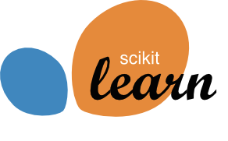
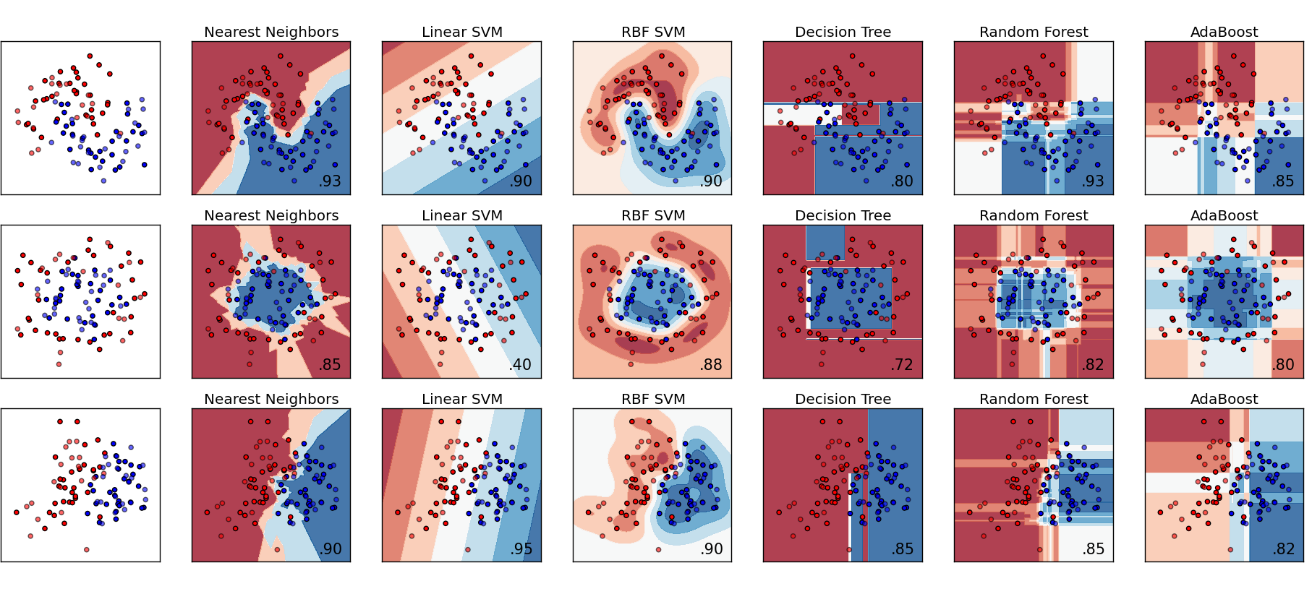
Notes:
But let’s talk more about what scikit-learn can do for you. Scikit-learn implements tens of models for classification, regression, feature extraction, feature selection, signal decomposition and so on.
And scikit-learn not only provides the models, it also provides the tools to evaluate and select models, and the glue to make them work together.

Slide 26
Fit()
Predict()
pipelines
Notes:
Two of the most helpful tools are GridSearchCV, which implements grid-search with cross-validation, and pipeline, which allows chaining together multiple algorithms.
Both of these tools are implemented as so-called estimator classes themselves, meaning they have the same fit, predict and transform methods as the algorithms themselves!

Slide 27
Third party methods
Notes:
Because people liked scikit-learn, but we’re relative conservative about what we want to include in the library, many people built their own extensions for specific models. It’s really easy to built your own scikit-learn extensions and it’s something we highly encourage.
To give more visibility to these projects we created the “scikit-learn-contrib” umbrella, a github organization to which people can submit their projects.
We have an automated test-suite that checks whether your algorithms fulfill the scikit-learn API and generally behave nicely. Then you can submit your project to the scikit-learn-contrib organization, and others can easily find it when they look for more algorithms!

Slide 28
(near) Future
Notes:
So enough about the present. Let’s talk about the future. First I want to talk about the near future. Actually the very near future, like, say, tomorrow. Or maybe Tuesday.

Slide 29
0.18
For the rc:
Pip install scikit-learn==0.18rc2
Notes:
Because next week, scikit-learn 0.18 will come out!
And it will have some awesome new features.
We already have a release candidate out, which you can install via pip (if you normally use conda, make sure you uninstall the conda version first) if you’re impatient and want to try it today!
Otherwise, wait until next week and you’ll get 0.18 with pip, conda and conda-forge.
For several reasons 0.18 took us a bit longer than we like our releases to take. It’s been about a year since we released 0.17, so there is really a lot of new stuff! So let’s see what there is.

Slide 30
Reorganization model_selection
(some renames)
Notes:
One of the things that will affect all users is our reorganization of the model selection tools.
From 0.18 on, everything relating to cross-validation, grid search and model selection will be inside the new model_selection module. Previously, the organization was a bit odd, with RandomizedSearchCV being in the grid_search module. Another reason we did the move was because we wanted to do a couple of API changes that wouldn’t have been possible otherwise.
So change all your imports from cross_validation, grid_search and learning_curve to model_selection.

Slide 31
cv_results_
Notes:
One of the changes we did was restructuring the results of grid-search, which are now stored in the cv_results_ attribute. This is now a dictionary where each value is an array that is number of parameters long. And you can easily convert it to a pandas dataframe, which makes it much easier to use.
It will also (at least probably) contain training scores, training time and prediction time.

Slide 32
cv.split
Notes:
The biggest change we did to the model selection was to the cross-validation splitters. This is a bit technical, so if you haven’t worked with scikit-learn a lot, you might not have seen this.
Scikit-learn has classes that specify how to do cross-validaiton splits. So far, these were more or less iterators, which needed to know how much data there was before you could instantiate them.
Now, at instantiation you don’t need to know about the data. Only when you actually want to split some particular data, the generators are created.
That allows us to do more complex nested cross-validation or other constructs where you don’t know the data when you create your workflow.

Slide 33
Label→ group
n_folds → n_splits
Notes:
We also did a bit of renaming of some of the cross-validation related functions and classes.
There are some cross-validation splitters which are able to handle groups of correlated data, like multiple samples coming from the same patient or the same customer. Previously they were LabelKFold and LabelShuffleSplit, where label meant the group label. That was pretty confusing, so we renamed them to GroupKFold and GroupShuffleSplit. We also renamed the labels parameter to groups.
So yeah, a lot of renaming going on in this release, I hope for the better. We really try and not do this very often, but many people didn’t find this functionality under the old name.

Slide 34
from sklearn.mixture import GaussianMixture
from sklearn.mixture import BayesianGaussianMixture
Notes:
One of the more exciting additions is two new classes for Gaussian Mixture models, called GaussianMixture and BayesianGaussianMixture. The old classes are deprecated. The new classes have a simpler interface, are numerically more stable and have many bugfixes. The GaussianMixture class implements standard Gaussian mixtures with expectation-maximization, while the BayesianGaussianMixture class implements – surprise – a Bayesian model, either with a dirichlet prior, or with an infinite dirichlet process prior.

Slide 35
PCA()
RandomizedPCA()
PCA()
Notes:
Another change that I think is quite cool is that we collapsed the PCA class and the Randomized PCA class, and now it’s just called PCA, and it will automatically use the fasted algorithm based on the shape of your data and how many components you want.

Slide 36

Gaussian Process Rewrite
Notes:
One of the most exciting changes for me is the rewrite of the Gaussian process module. There are two new classes, GaussianProcessRegressor and GaussianProcessClassifier, and a whole bunch of different kernel functions that you can use to create new custom kernels. Now it is also much easier to learn the parameters of complex kernels with scikit-learn. You see an example of that here, with the classical Mauna Loa CO2 dataset.

Slide 37
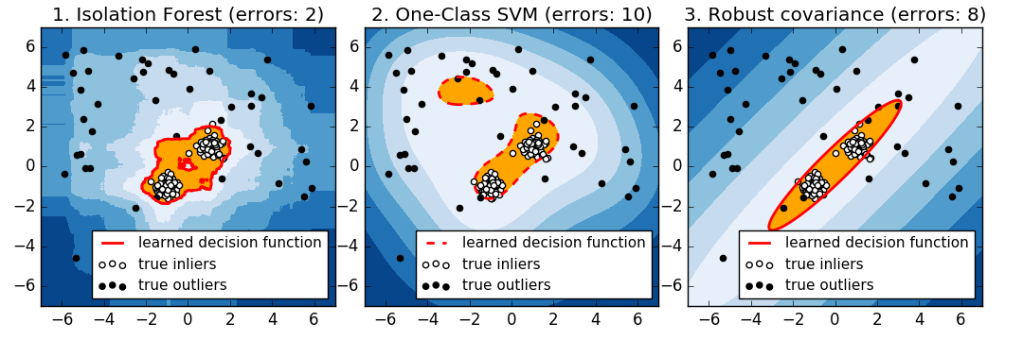
Isolation Forests
Notes:
Another great new addition are Isolation Forests. Isolation Forests are a new outlier detection method. In case you’re unfamiliar, outlier detection tries to find data that looks different from “normal”. This can be used, for example, for fraud detection in finance or for intrusion or failure detection in distributed systems.
Isolation forests are great because they work very well without a lot of parameter tuning, and they are very flexible. Recently I was at a conference where there was a fraud detection challenge by a credit card provider. I was kind of trolling and seeing how well I could do without looking at the data. So loaded their CSV in pandas, trained a isolation forest and submitted the result. I made second place.

Slide 38
Play:
from sklearn.neural_network import MLPClassifier
Work:
import keras
Notes:
Another thing many people have been waiting for is the multilayer perceptron, also known as vanilla neural network, implemented in MLPClassifier and MLPRegressor.
This is meant as an easy way for you to get into deep learning. However, this is not a high performance implementation, so it’s more just for playing around. Scikit-learn doesn’t want to add GPU support, and there are great deep learning libraries out there. So if you are serious about deep learning, definitely try out keras or maybe even tensorflow directly.
We support several training methods, in particular Adam, but currently we don’t have drop-out or batch normalization, and we don’t support convolutional layers. This is really meant as a bare bones implementation.

Slide 39
pipe = Pipeline([('preprocessing', StandardScaler()),
('classifier', SVC())])
param_grid = {'preprocessing': [StandardScaler(), None]}
grid = GridSearchCV(pipe, param_grid)
Notes:
The last change that I want to mention is that we improved how pipelines and grid-search interact. You can now search over the steps in a pipeline! This means you can not only search the parameters of a classifier, for example, you can also search over which classifier, or which preprocessing to use!
I’m quite excited about that.
This list is not exhaustive, and if you are interested in knowing about all the changes, check out the whatsnew on the website.
There is another thing relating to the very near future that I want to talk about, and that you might have heard about already. Basically, what I want to say is..

Slide 40

Notes:
Buy my book. It’s about machine learning and scikit-learn. It has no math, because there are great books that have all the machine learning math.
This book is different, there are no formulas, but a lot of code. It’s actually using the 0.18 release, so it contains a lot of the stuff I just talked about.
The goal of the book is to enable you to apply machine learning, without wading through a lot of theory first, and just dive in, but still do the right thing and be successful
The e-book comes out next week, the paper copy in two weeks. If you’re impatient, you can get an early release ebook now and get the final e-book for free.
I wish I could have brought some copies with me, but unfortunately the timing wasn’t right. I have some discount codes, though, if you’re interested.
So, again, to summarize: Buy my book! It’s great!

Slide 41
(further) Future
Notes:
So now, lets talk to the somewhat further-out future.
What are the plans and ideas we have?

Slide 42
Feature / column names
Notes:
One thing that I think will help users a lot is better support of feature names or column names. Scikit-learn builds on numpy, which doesn’t know about feature names. However in many applications, the features or column have semantic names that are important to keep track of, like age, gender, time spend online and so on, and you might have stored these as the columns of a pandas dataframe.
Because scikit-learn doesn’t handle these names, it’s sometimes tricky how the original features relate to the output, in particular in complex pipelines.
We are working on making that better.

Slide 43
from __future__ import sklearn.plotting
Notes:
We are also working on more integrated plotting. There are some plots, like confusion matrices, or model coefficients, feature importance or the result of a grid-search, that you need all the time. We will include some of these directly in scikit-learn, to make interactive machine learning easier.

Slide 44
from __future__ import AutoClassifier
Notes:
Another direction that I think will be quite important is more automation in machine learning. Scikit-learn embraces the python paradigm “explicit is better then implicit”.
This behavior is more tuned toward expert users, that want fine-grained control over whats happening. For beginners, it might be more important to get something reasonable done quickly, with little domain expertise and before reading some 366 page book.
I want the machine learning to get out of the way, so that people can focus on their data and the application, instead of tuning parameters and trying out different models.
This might not live inside scikit-learn, but maybe on top. There are already “research quality” implementations, in particular auto-sklearn and hyperband, but I want something more user-friendly.

Slide 45
More transparency
Notes:
Automation helps creating better black box models faster, which is great, but sometimes you really want to open up the black box and understand what’s going on. Why did a particular point get classified in a certain way? Which features are important? What kinds of confusions happen? Can we maybe even compress a complex model down to something a human can fully understand? There is no way to understand a random forest with hundreds of tree, but maybe a small rule-based system can work nearly as well?
Unfortunately there is very little work on this in the machine learning community so far, but it’s something that’s clearly very relevant in practice.
So, this ends my short outlook on what I’m excited about right now.

Slide 46




amueller.github.io
@amuellerml
@amueller
t3kcit@gmail.com
Notes:
Alright, as I said, buy my book.
You can also find a lot of free videos and notebooks on my website. All the code from the book is BSD-licensed and on github.
I’ll hang around for the rest of the day if you want to chat about machine learning.
Or if you want to take a selfie, that seems to be even more popular, too.
Alright, thank you for your attention.

