Slide 1

Machine Learning with Scikit-Learn
Andreas Mueller (NYU Center for Data Science, scikit-learn)

Slide 2



Me

Slide 3
Classification
Regression
Clustering
Semi-Supervised Learning
Feature Selection
Feature Extraction
Manifold Learning
Dimensionality Reduction
Kernel Approximation
Hyperparameter Optimization
Evaluation Metrics
Out-of-core learning
…...

Slide 4
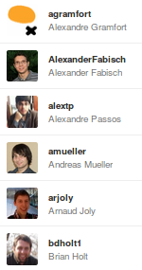
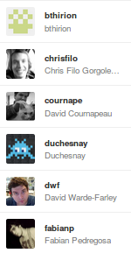
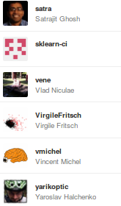
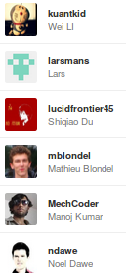
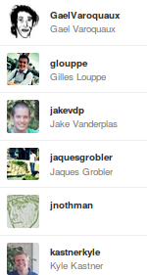
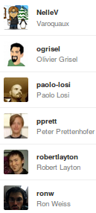

Slide 5
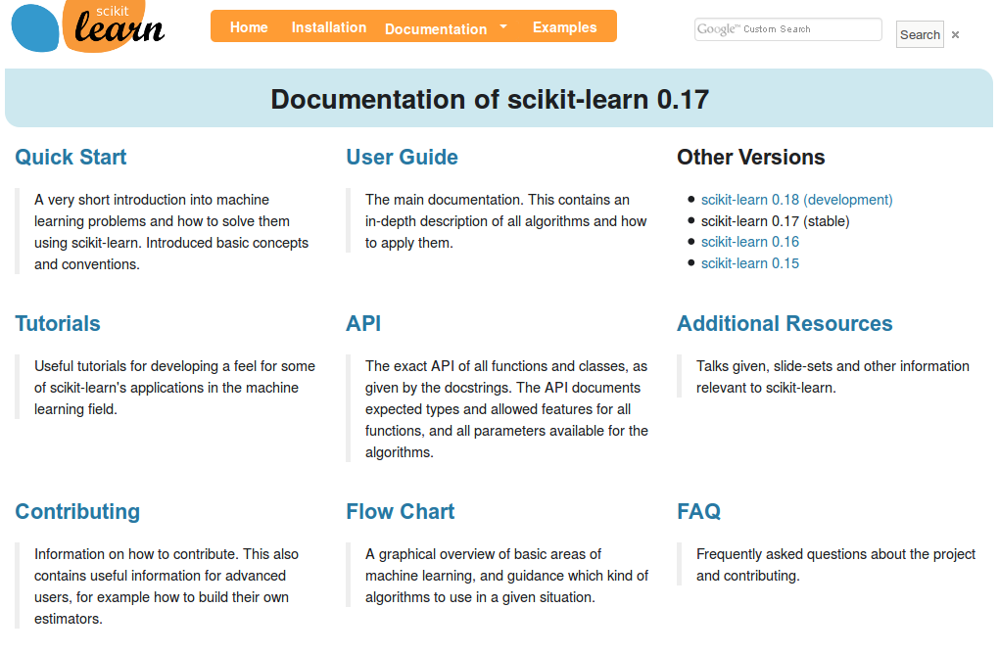
http://scikit-learn.org/

Slide 6
Hi Andy,
I just received an email from the first tutorial speaker, presenting right before you, saying he's ill and won't be able to make it.
I know you have already committed yourself to two presentations, but is there anyway you could increase your tutorial time slot, maybe just offer time to try out what you've taught? Otherwise I have to do some kind of modern dance interpretation of Python in data :-)
-Leah
Hi Andreas,
I am very interested in your Machine Learning background. I work for X Recruiting who have been engaged by Z, a worldwide leading supplier of Y. We are expanding the core engineering team and we are looking for really passionate engineers who want to create their own story and help millions of people.
Can we find a time for a call to chat for a few minutes about this?
Thanks

Slide 7
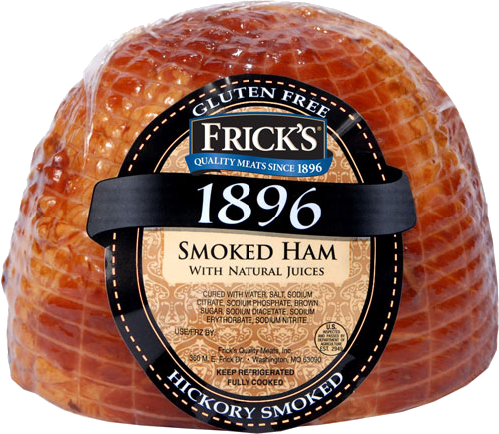
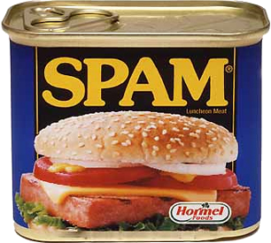
Hi Andy,
I just received an email from the first tutorial speaker, presenting right before you, saying he's ill and won't be able to make it.
I know you have already committed yourself to two presentations, but is there anyway you could increase your tutorial time slot, maybe just offer time to try out what you've taught? Otherwise I have to do some kind of modern dance interpretation of Python in data :-)
-Leah
Hi Andreas,
I am very interested in your Machine Learning background. I work for X Recruiting who have been engaged by Z, a worldwide leading supplier of Y. We are expanding the core engineering team and we are looking for really passionate engineers who want to create their own story and help millions of people.
Can we find a time for a call to chat for a few minutes about this?
Thanks

Slide 8
Doing Machine Learning With Scikit-Learn

Slide 9
Representing Data
one sample
1.1 | 2.2 | 3.4 | 5.6 | 1.0
6.7 | 0.5 | 0.4 | 2.6 | 1.6
2.4 | 9.3 | 7.3 | 6.4 | 2.8
1.5 | 0.0 | 4.3 | 8.3 | 3.4
0.5 | 3.5 | 8.1 | 3.6 | 4.6
5.1 | 9.7 | 3.5 | 7.9 | 5.1
3.7 | 7.8 | 2.6 | 3.2 | 6.3
1.6
2.7
4.4
0.5
0.2
5.6
6.7
X =
y =
one feature
outputs / labels

Slide 10
Training and Testing Data
training set
1.1 | 2.2 | 3.4 | 5.6 | 1.0
6.7 | 0.5 | 0.4 | 2.6 | 1.6
2.4 | 9.3 | 7.3 | 6.4 | 2.8
1.5 | 0.0 | 4.3 | 8.3 | 3.4
0.5 | 3.5 | 8.1 | 3.6 | 4.6
5.1 | 9.7 | 3.5 | 7.9 | 5.1
3.7 | 7.8 | 2.6 | 3.2 | 6.3
1.6
2.7
4.4
0.5
0.2
5.6
6.7
X =
y =
test set

Slide 11
Supervised Machine Learning
Training Data
Model
Training
Training Labels
Test Data
Prediction
Generalization
Test Labels
Evaluation

Slide 12
clf = RandomForestClassifier()
clf.fit(X_train, y_train)
Training Data
Model
Training Labels
y_pred = clf.predict(X_test)
Test Data
Prediction
Test Labels
Evaluation
clf.score(X_test, y_test)

Slide 13
Unsupervised Machine Learning
Training Data
Model
Test Data
New View

Slide 14
Unsupervised Transformations
pca = PCA()
pca.fit(X_train)
X_new = pca.transform(X_test)
Training Data
Model
Test Data
Transformation

Slide 15
Basic API
estimator.fit(X, [y])
estimator.predict | estimator.transform
Classification | Preprocessing
Regression | Dimensionality reduction
Clustering | Feature selection
 | Feature extraction

Slide 16
Model Evaluation and Model Selection

Slide 17
All Data
Training data
Test data
Fold 1
Fold 2
Fold 3
Fold 4
Fold 5
Split 1
Fold 1
Fold 2
Fold 3
Fold 4
Fold 5
Split 2
Fold 1
Fold 2
Fold 3
Fold 4
Fold 5
Split 3
Fold 1
Fold 2
Fold 3
Fold 4
Fold 5
Split 4
Fold 1
Fold 2
Fold 3
Fold 4
Fold 5
Split 5
Fold 1
Fold 2
Fold 3
Fold 4
Fold 5

Slide 18
Cross-Validation
from sklearn.cross_validation import cross_val_score
scores = cross_val_score(SVC(), X, y, cv=5)
print(scores)
>> [ 0.92 1. 1. 1. 1. ]

Slide 19
All Data
Training data
Test data
Fold 1
Fold 2
Fold 3
Fold 4
Fold 5
Split 1
Fold 1
Fold 2
Fold 3
Fold 4
Fold 5
Split 2
Fold 1
Fold 2
Fold 3
Fold 4
Fold 5
Finding Parameters
Split 3
Fold 1
Fold 2
Fold 3
Fold 4
Fold 5
Split 4
Fold 1
Fold 2
Fold 3
Fold 4
Fold 5
Split 5
Fold 1
Fold 2
Fold 3
Fold 4
Fold 5
Final evaluation
Test data

Slide 20
Cross -Validated Grid Search
from sklearn.grid_search import GridSearchCV
from sklearn.cross_validation import train_test_split
X_train, X_test, y_train, y_test = train_test_split(X, y)
param_grid = {'C': 10. ** np.arange(-3, 3),
'gamma': 10. ** np.arange(-3, 3)}
grid = GridSearchCV(SVC(), param_grid=param_grid)
grid.fit(X_train, y_train)
grid.predict(X_test)
grid.score(X_test, y_test)

Slide 21
Training Labels
Training Data
Model

Slide 22
Training Labels
Training Data
Feature
Extraction
Scaling
Feature
Selection
Model
Cross Validation

Slide 23
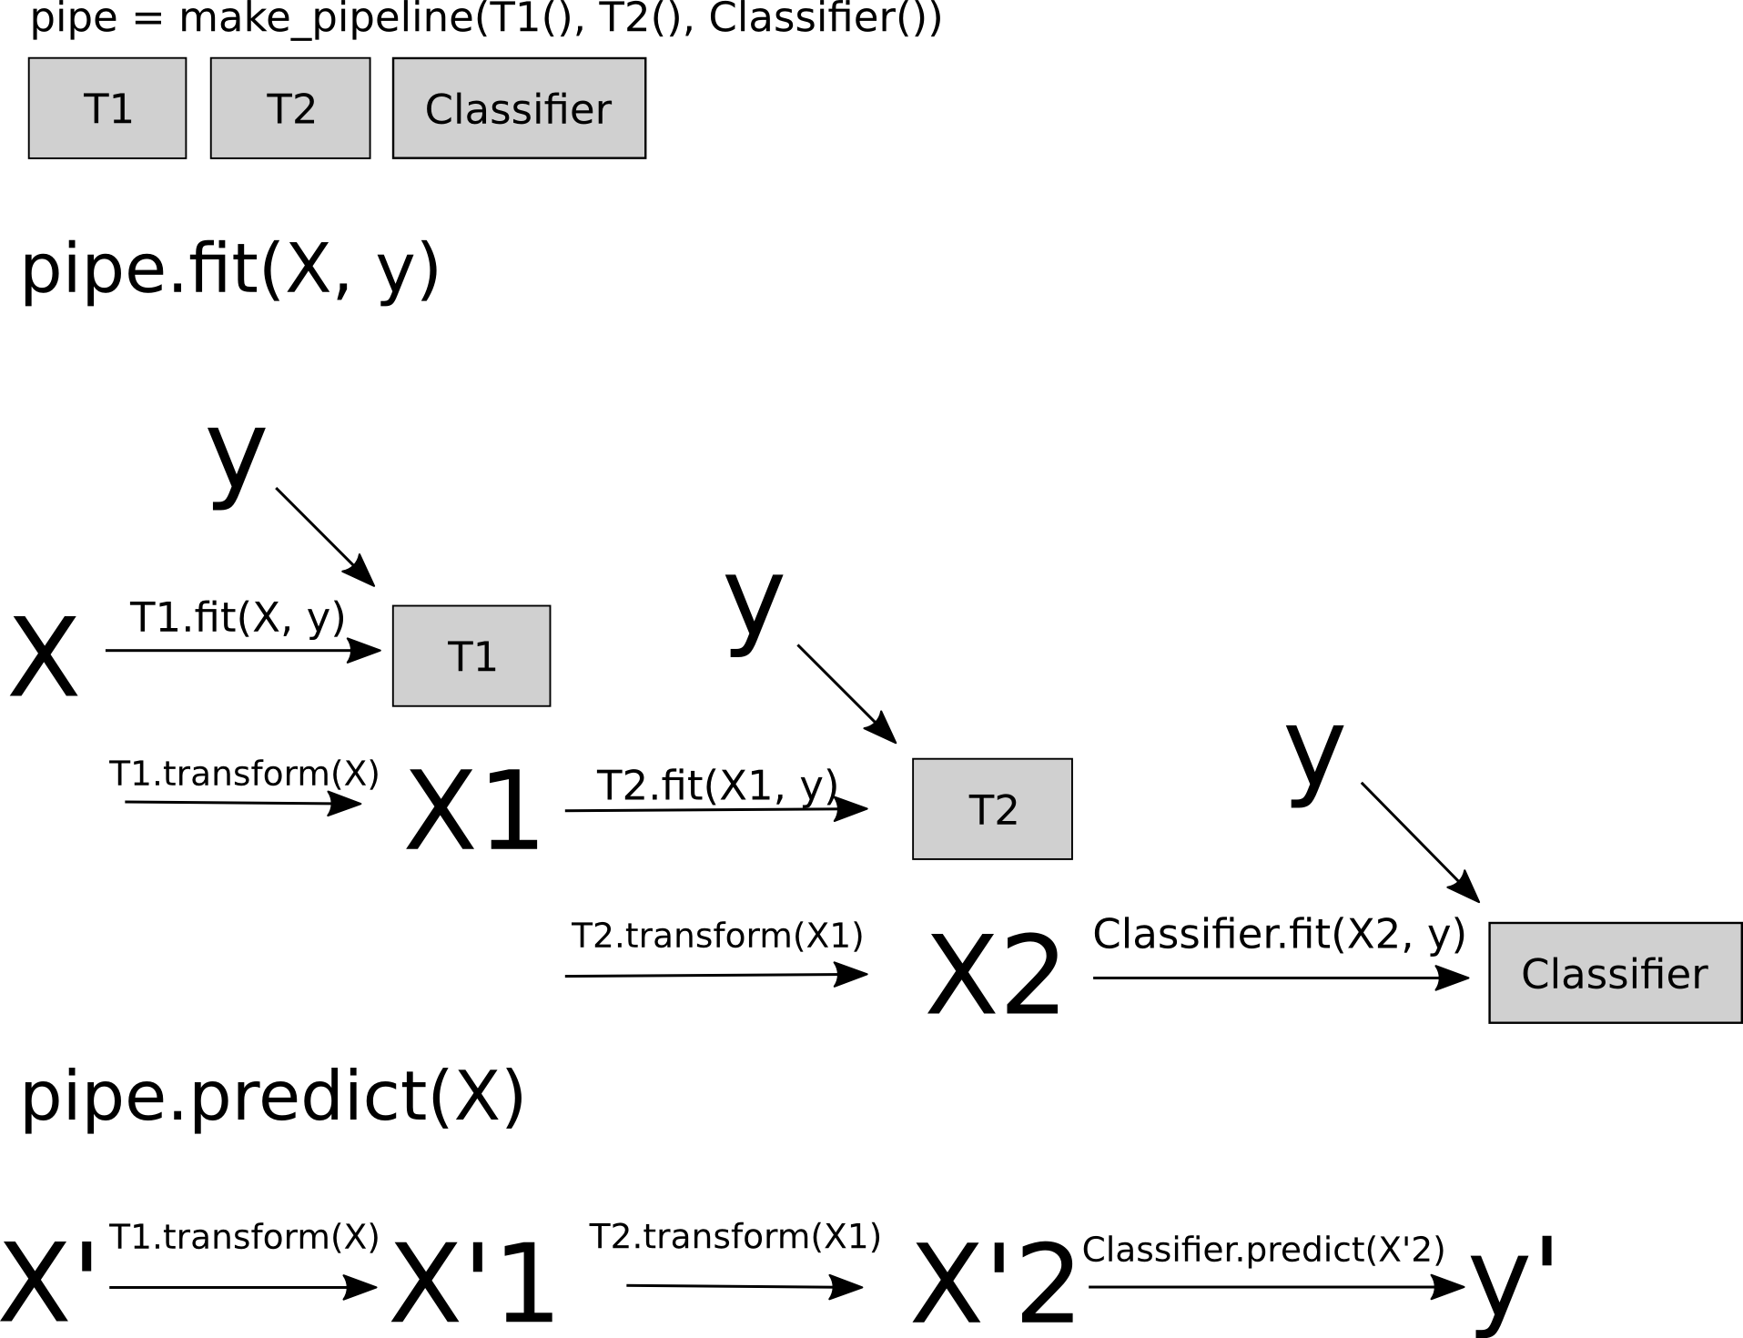
Pipelines

Slide 24
Combining Pipelines and
Grid Search
Proper cross-validation
param_grid = {'svc__C': 10. ** np.arange(-3, 3),
'svc__gamma': 10. ** np.arange(-3, 3)}
scaler_pipe = make_pipeline(StandardScaler(), SVC())
grid = GridSearchCV(scaler_pipe, param_grid=param_grid, cv=5)
grid.fit(X_train, y_train)

Slide 25
Combining Pipelines and
Grid Search II
Searching over parameters of the preprocessing step
param_grid = {'selectkbest__k': [1, 2, 3, 4],
'svc__C': 10. ** np.arange(-3, 3),
'svc__gamma': 10. ** np.arange(-3, 3)}
scaler_pipe = make_pipeline(SelectKBest(), SVC())
grid = GridSearchCV(scaler_pipe, param_grid=param_grid, cv=5)
grid.fit(X_train, y_train)

Slide 26
Do cross-validation over all steps jointly.
Keep a separate test set until the very end.

Slide 27
Sample application: Sentiment Analysis

Slide 28
IMDB Movie Reviews Data
Review:
One of the worst movies I've ever rented. Sorry it had one of my favorite actors on it (Travolta) in a nonsense role. In fact, anything made sense in this movie.
Who can say there was true love between Eddy and Maureen? Don't you remember the beginning of the movie ?
Is she so lovely? Ask her daughters. I don't think so.
Label: negative
Training data: 12500 positive, 12500 negative

Slide 29
Bag Of Word Representations
CountVectorizer / TfidfVectorizer
“This is how you get ants.”
tokenizer
['this', 'is', 'how', 'you', 'get', 'ants']
Build a vocabulary over all documents
['aardvak', 'amsterdam', 'ants', ... 'you', 'your', 'zyxst']
Sparse matrix encoding
aardvak
ants
get
you
zyxst
[0, …, 0, 1, 0, … , 0, 1 , 0, …, 0, 1, 0, …., 0 ]

Slide 30
N-grams (unigrams and bigrams)
CountVectorizer / TfidfVectorizer
“This is how you get ants.”
Unigram tokenizer
['this', 'is', 'how', 'you', 'get', 'ants']
“This is how you get ants.”
Bigram tokenizer
['this is', 'is how', 'how you', 'you get', 'get ants']

Slide 31
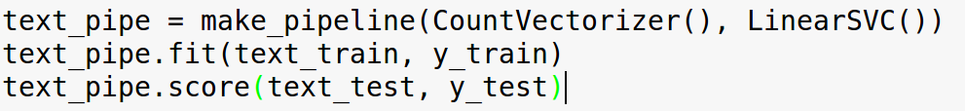
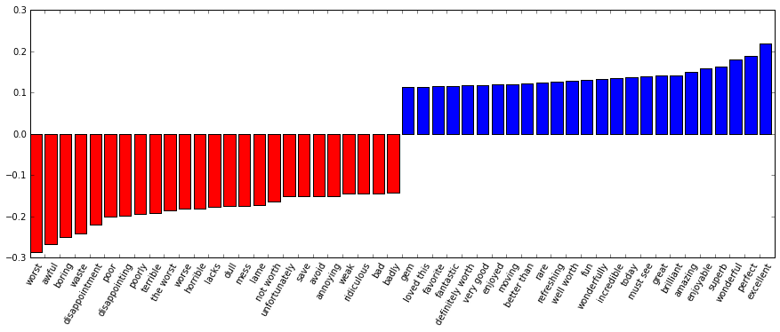

Slide 32
Scaling Up

Slide 33
Three regimes of data
Fits in RAM
Fits on a Hard Drive
Doesn't fit on a single PC

Slide 34
Three regimes of data
Fits in RAM (up to 256 GB?)
Fits on a Hard Drive (up to 6TB?)
Doesn't fit on a single PC

Slide 35
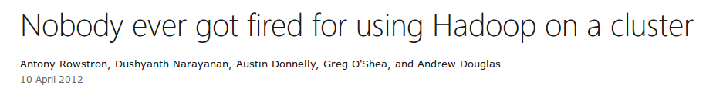

Slide 36
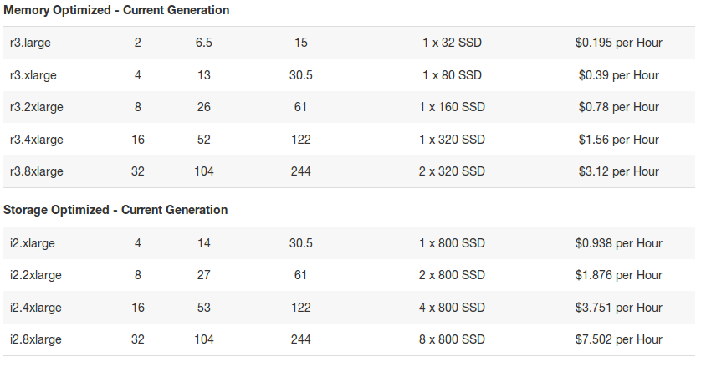

Slide 37
"256Gb ought to be enough for anybody."
- me
(for machine learning)

Slide 38
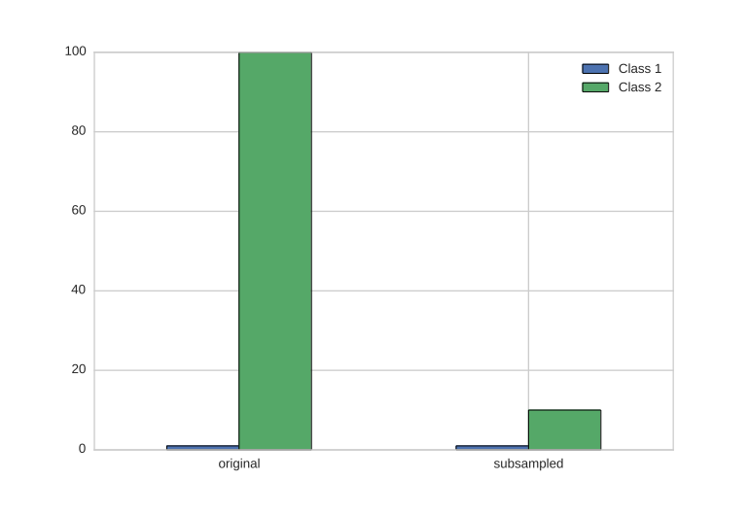
Subsample!

Slide 39
Out of core: The scikit-learn way

Slide 40
The Partial Fit Interface
HDD
Your for-loop / polling
estimator.partial_fit(X_batch, y_batch)
Trained
Scikit-learn
estimator
Network

Slide 41
Supported Algorithms
SGDClassifier/Regressor, Perceptron
Naive Bayes
MinibatchKMeans
Birch
IncrementalPCA
MiniBatchDictionaryLearning
Scalers
Latent Dirichlet Allocation
Stateless transformations

Slide 42
Hashing Trick
HashingVectorizer
“This is how you get ants.”
tokenizer
['this', 'is', 'how', 'you', 'get', 'ants']
hashing
[hash('this'), hash('is'), hash('how'), hash('you'), hash('get'), hash('ants')]
= [832412, 223788, 366226, 81185, 835749, 173092]
Sparse matrix encoding
aardvak
ants
get
you
zyxst
[0, …, 0, 1, 0, … , 0, 1 , 0, …, 0, 1, 0, …., 0 ]

Slide 43
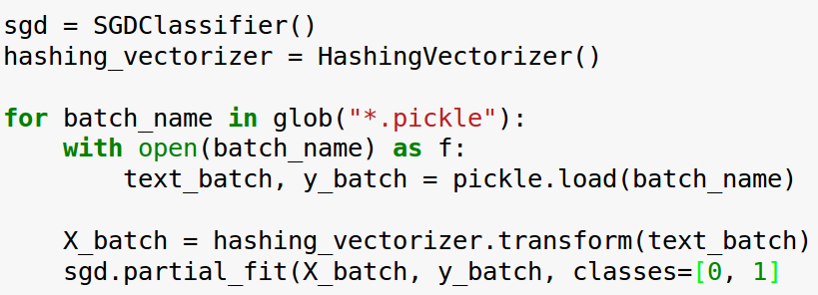
Text Classification: Hashing Trick

Slide 44
What's new?
0.17 (stable)
Latent Dirichlet Allocation
Faster NMF
Faster T-SNE
FunctionTransformer
VotingClassifier
0.18 (development)
Neural Network
Gaussian Process rewrite
Faster PCA

Slide 45
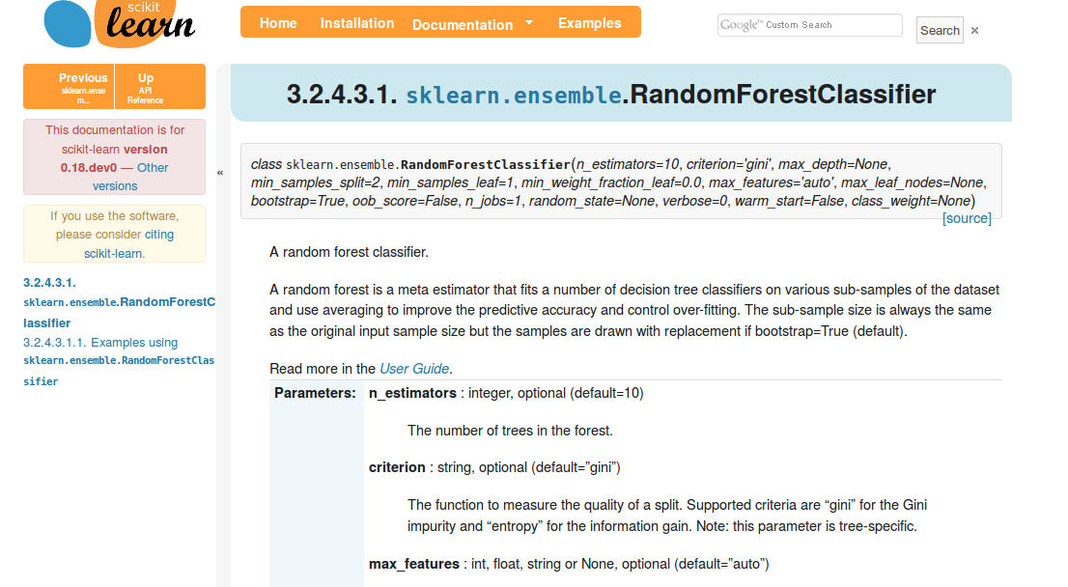
Add Backlinks to Docs

Slide 46
Engineering Scikit-Learn

Slide 47
Goal:
High quality, easy to use machine learning library.

Slide 48
Goal:
High quality, easy to use machine learning library.
Keep it usable, keep it maintainable.

Slide 49
Simple things should be simple, complex things should be possible.
Alan Kay

Slide 50
Methods

Slide 51
Scoping
Well established
Widely
useful
sklearn
Matrix in,
matrix out

Slide 52
Simplicity
est = Est()
est.fit(X_train, y_train)
est.score(X_test, y_test)

Slide 53
Consistency
grid = GridSearchCV(svm,param_grid)
grid.fit(X_train, y_train)
grid.score(X_test, y_test)

Slide 54
Sensible Defaults
Everything is default constructible!
for clf in [KneighborsClassifier(),
SVC(),
DecisionTreeClassifier(),
RandomForestClassifier(),
AdaBoostClassifier(),
GaussianNB(),
LDA(),
QDA()]:
clf.fit(X_train, y_train)
print(clf.score(X_test, y_test))

Slide 55
Common Tests
classifiers = all_estimators(type_filter='classifier')
for name, Classifier in classifiers:
# test classfiers can handle non-array data
yield check_classifier_data_not_an_array, name, Classifier
# test classifiers trained on a single label
# always return this label
yield check_classifiers_one_label, name, Classifier
yield check_classifiers_classes, name, Classifier
yield check_classifiers_pickle, name, Classifier
yield check_estimators_partial_fit_n_features, name, Classifier

Slide 56
Flat Class Hierarchy, Few Types
Numpy arrays / sparse matrices
Estimators
[Cross-validation objects]
[Scorers]

Slide 57
No Framework
“This looks frameworkish.” means “try again.”

Slide 58

Avoid Code
Code rots!
Hail all code deleters!

Slide 59



Three-Way Documentation

Slide 60
Challenges

Slide 61

Feature Creep

Slide 62


Two Language Problem

Slide 63
Backward compatibility
from sklearn.cross_validation import Bootstrap
Bootstrap(10)
sklearn/cross_validation.py:685:
DeprecationWarning: Bootstrap will no longer
be supported as a cross-validation method as of
version 0.15 and will be removed in 0.17.

Slide 64
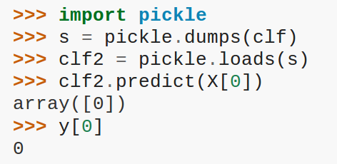
Backward compatibility

Slide 65
Correctness Testing
?

Slide 66


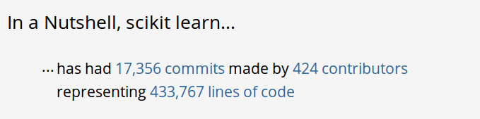
Project Size

Slide 67
Developer churn
Two Full time devs (Oliver Grisel & Myself)
Hundereds of “drive by” contributors

Slide 68
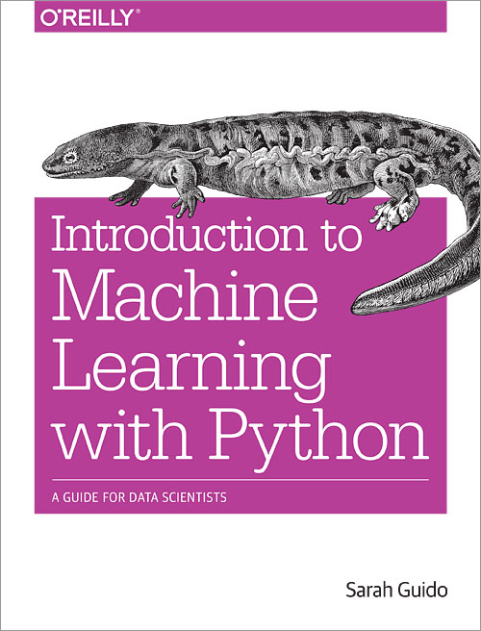
Video Series
Advanced Machine Learning with scikit-learn
50% Off Coupon Code: AUTHD

Slide 69




Thank you for your attention.
@t3kcit
@amueller
importamueller@gmail.com
http://amueller.github.io

