Slide 1




A whirlwind tour of scikit-learn
Andreas Müller
Columbia University, scikit-learn
Notes:
Hi and thank you for coming to my talk today.
I’m andreas mueller, I work at the NYU center for data science, and I’ll talk a bit about the scikit-learn project I’ve been working on in the last couple of years, and my recent work at NYU.
Let me start by giving you first a bit of background on my self, and then on scikit-learn.

Slide 2





Slide 3
What is scikit-learn?

Slide 4

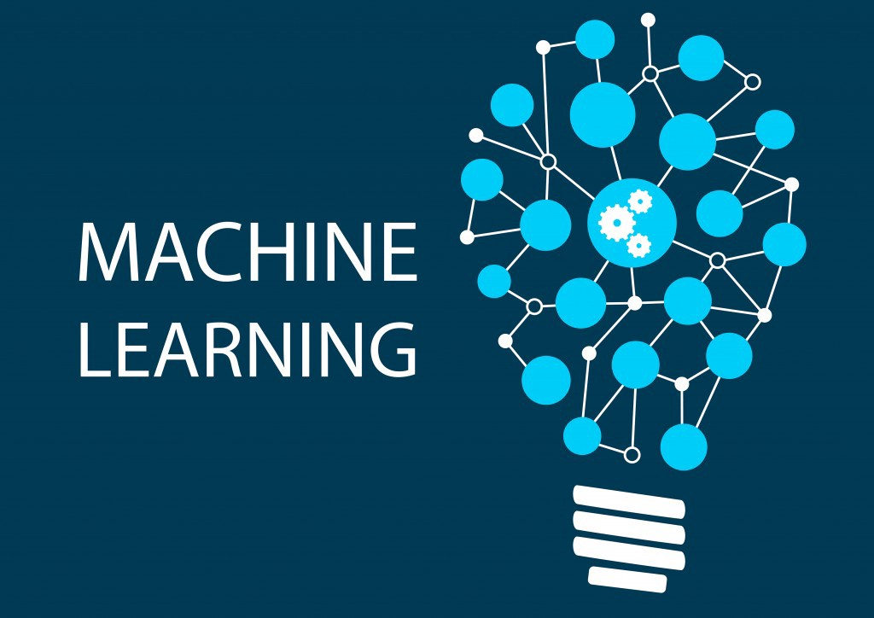


Slide 5
Mission
Commoditize and Democratize Machine Learning
Notes:
So why this project? To me, and I think to many others in the project, the mission of scikit-learn is to create effective and easy to use machine learning solutions, and make them accessible to everybody. In other words, we want to commoditize and democratize machine learning.
That is quite different from just putting a collection of algorithms out there, and I think it’s one of the reasons why the project has been so successful.

Slide 6

Classification
Regression
Clustering
Semi-Supervised Learning
Feature Selection
Feature Extraction
Manifold Learning
Dimensionality Reduction
Kernel Approximation
Hyperparameter Optimization
Evaluation Metrics
Out-of-core learning
…...

Slide 7






1000+ research papers

Slide 8
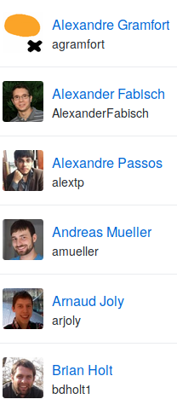
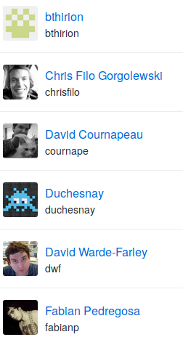
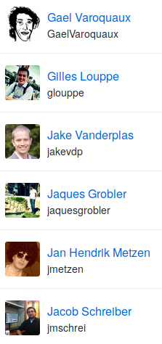
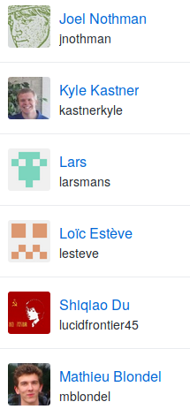
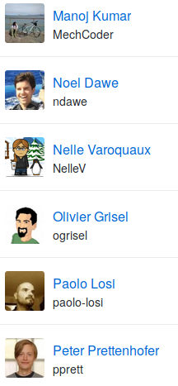
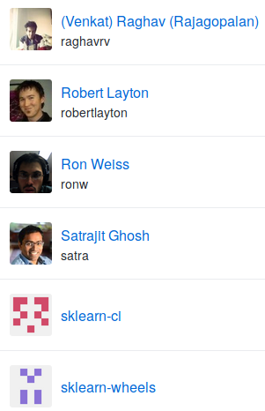
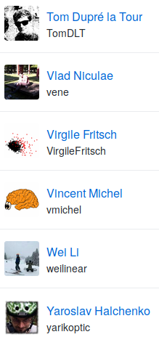

Slide 9
Basic API

Slide 10

Representing Data
one sample
1.1 | 2.2 | 3.4 | 5.6 | 1.0
6.7 | 0.5 | 0.4 | 2.6 | 1.6
2.4 | 9.3 | 7.3 | 6.4 | 2.8
1.5 | 0.0 | 4.3 | 8.3 | 3.4
0.5 | 3.5 | 8.1 | 3.6 | 4.6
5.1 | 9.7 | 3.5 | 7.9 | 5.1
3.7 | 7.8 | 2.6 | 3.2 | 6.3
1.6
2.7
4.4
0.5
0.2
5.6
6.7
X =
y =
one feature
outputs / labels

Slide 11
clf = RandomForestClassifier()
clf.fit(X_train, y_train)
Training Data
Model
Training Labels
y_pred = clf.predict(X_test)
Test Data
Prediction
Test Labels
Evaluation
clf.score(X_test, y_test)

Slide 12
Unsupervised Transformations
pca = PCA()
pca.fit(X_train)
X_new = pca.transform(X_test)
Training Data
Model
Test Data
Transformation

Slide 13
Core API Summary
estimator.fit(X, [y])
estimator.predict | estimator.transform
Classification | Preprocessing
Regression | Dimensionality reduction
Clustering | Feature selection
 | Feature extraction

Slide 14
Model Evaluation and Model Selection

Slide 15
All Data
Training data
Test data
Fold 1
Fold 2
Fold 3
Fold 4
Fold 5
Split 1
Fold 1
Fold 2
Fold 3
Fold 4
Fold 5
Split 2
Fold 1
Fold 2
Fold 3
Fold 4
Fold 5
Split 3
Fold 1
Fold 2
Fold 3
Fold 4
Fold 5
Split 4
Fold 1
Fold 2
Fold 3
Fold 4
Fold 5
Split 5
Fold 1
Fold 2
Fold 3
Fold 4
Fold 5

Slide 16
Cross-Validation
from sklearn.model_selection import cross_val_score
scores = cross_val_score(SVC(), X, y, cv=5)
print(scores)
>> [ 0.92 1. 1. 1. 1. ]

Slide 17
All Data
Training data
Test data
Fold 1
Fold 2
Fold 3
Fold 4
Fold 5
Split 1
Fold 1
Fold 2
Fold 3
Fold 4
Fold 5
Split 2
Fold 1
Fold 2
Fold 3
Fold 4
Fold 5
Finding Parameters
Split 3
Fold 1
Fold 2
Fold 3
Fold 4
Fold 5
Split 4
Fold 1
Fold 2
Fold 3
Fold 4
Fold 5
Split 5
Fold 1
Fold 2
Fold 3
Fold 4
Fold 5
Final evaluation
Test data

Slide 18
Cross -Validated Grid Search
from sklearn.model_selection import GridSearchCV
from sklearn.model_selection import train_test_split
X_train, X_test, y_train, y_test = train_test_split(X, y)
param_grid = {'C': 10. ** np.arange(-3, 3),
'gamma': 10. ** np.arange(-3, 3)}
grid = GridSearchCV(SVC(), param_grid=param_grid)
grid.fit(X_train, y_train)
grid.predict(X_test)
grid.score(X_test, y_test)

Slide 19
Training Labels
Training Data
Model

Slide 20
Training Labels
Training Data
Feature
Extraction
Scaling
Feature
Selection
Model
Cross Validation

Slide 21
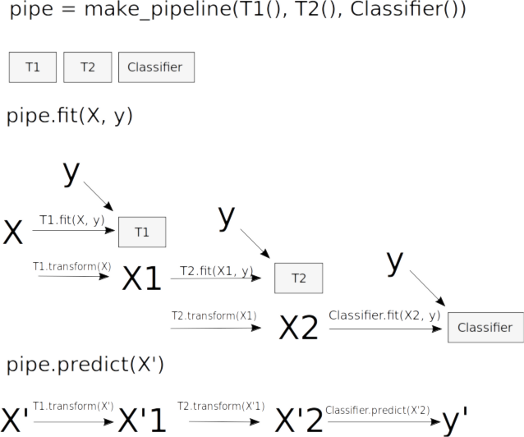
Pipelines

Slide 22
Pipelines
from sklearn.pipeline import make_pipeline
pipe = make_pipeline(StandardScaler(), SVC())
pipe.fit(X_train, y_train)
pipe.predict(X_test)
param_grid = {'svc__C': 10. ** np.arange(-3, 3),
'svc__gamma': 10. ** np.arange(-3, 3)}
scaler_pipe = make_pipeline(StandardScaler(), SVC())
grid = GridSearchCV(scaler_pipe, param_grid=param_grid, cv=5)
grid.fit(X_train, y_train)

Slide 23
Combining Pipelines and
Grid Search
Proper cross-validation
param_grid = {'svc__C': 10. ** np.arange(-3, 3),
'svc__gamma': 10. ** np.arange(-3, 3)}
scaler_pipe = make_pipeline(StandardScaler(), SVC())
grid = GridSearchCV(scaler_pipe, param_grid=param_grid, cv=5)
grid.fit(X_train, y_train)

Slide 24
Combining Pipelines and
Grid Search II
Searching over parameters of the preprocessing step
param_grid = {'selectkbest__k': [1, 2, 3, 4],
'svc__C': 10. ** np.arange(-3, 3),
'svc__gamma': 10. ** np.arange(-3, 3)}
scaler_pipe = make_pipeline(SelectKBest(), SVC())
grid = GridSearchCV(scaler_pipe, param_grid=param_grid, cv=5)
grid.fit(X_train, y_train)

Slide 25
More API

Slide 26
Scorers
grid = GridSearchCV(SVC(), params, scoring=’roc_auc’)
def my_acc_scorer(est, X, y):
y_pred = est.predict(X)
return (y == y_pred).mean()
grid = GridSearchCV(SVC(), params,
scoring=my_acc_scorer)

Slide 27
Cross-validation iterators
grid = GridSearchCV(SVC(), param_grid, cv=5)
cv = KFold(n_split=5, shuffle=True, random_state=3)
grid = GridSearchCV(SVC(), param_grid, cv=cv)
cv = RepeatedKFold(n_split=5, n_repeats=10)
grid = GridSearchCV(SVC(), param_grid, cv=cv)

Slide 28

Simple things should be simple,
complex things should be possible.
Alan Kay
Notes:
There is this nice quote here by alan kay, which says “simple things should be simple, complex things should be possible”. Whenever I think about a new feature or a new api, I keep that in mind. When in doubt, in scikit-learn we err on the side of keeping simple things simple, sometimes sacrificing some of the power of more complex designs. But I’ll talk about that more later.

Slide 29
Simplicity
lr = LogisticRegression()
lr.fit(X_train, y_train)
lr.score(X_test, y_test)
Notes:
To make scikit-learn usable, we really focus on simplicity. You can build really powerful machine learning experiments and pipelines with scikit-learn with just a couple of lines of code. And doing a standard supervised machine learning task boils down to just these three lines: instantiate a model, fit the model on the training data, evaluate it on the test data. We want to keep simple things simple.
Here, I used the logistic regression classifier, but I could replace that first line with any other algorithm and the code would be exactly the same.

Slide 30
Consistency
grid = GridSearchCV(svm,param_grid)
grid.fit(X_train, y_train)
grid.score(X_test, y_test)
Notes:
And not only is the scikit-learn api designed to be simple, it’s also designed to be consistent, and only have a few basic building blocks. The grid-search for example acts as a model (which we call estimator), and has exactly the same interface as any other model.

Slide 31
Composition
feature_selection = RFECV(NaiveBayes())
pipe = make_pipeline(feature_selection,
RandomForestClassifier())
grid = GridSearchCV(pipe, param_grid)

Slide 32
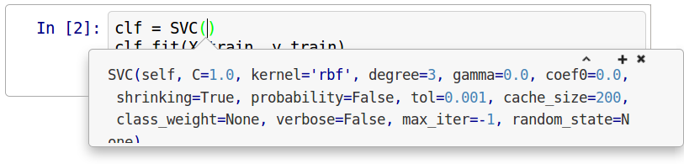
Default Parameters

Slide 33
Flat Class Hierarchy, Few Types
Numpy arrays / sparse matrices
Estimators
Cross-validation objects
Scorers
Notes:
But the simplicity goes further. There are very few types of objects in scikit-learn. Data is always numpy arrays, and basically every building block in scikit-learn is an “Estimator”. And that’s it. That’s more or less the only two types of objects you have to deal with in scikit-learn. There is no dataset object, for example. There also two kinds of object for model evaluation, but these are only interesting to expert users.
Having few types and a flat class hierarchy not only makes the project easier to use, it also makes it easier for new contributors to join the project, and simplifies maintaining the project.

Slide 34
Development Practices

Slide 35
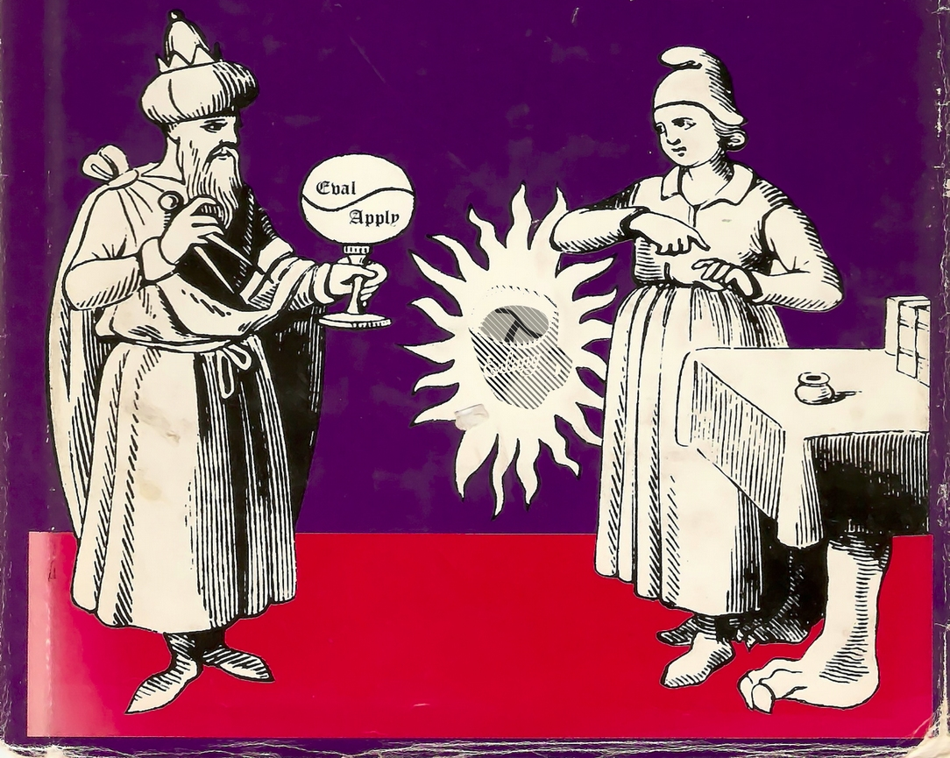
Programs should be written for people to read,
and only incidentally for machines to execute.
Harold Abelson
Notes:
Maintainable code is easy to read and understand for someone new to the code base. You should keep in mind this classic quote from the classic wizzard book.

Slide 36
Standards for OSS
Everything discussed in the open.
Every convention and process documented.

Slide 37
Development guide
http://scikit-learn.org/dev/developers/contributing.html
Contains:
API details
Bug report guidelines
PR guidelines
Reviewing guidelines
How to find issues
Details of CI
Even more at http://scikit-learn.org/dev/developers/

Slide 38
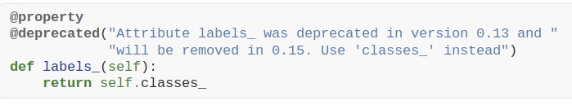
Deprecations / backward compatibility
Don’t change any behavior (except bug fixes)

Slide 39
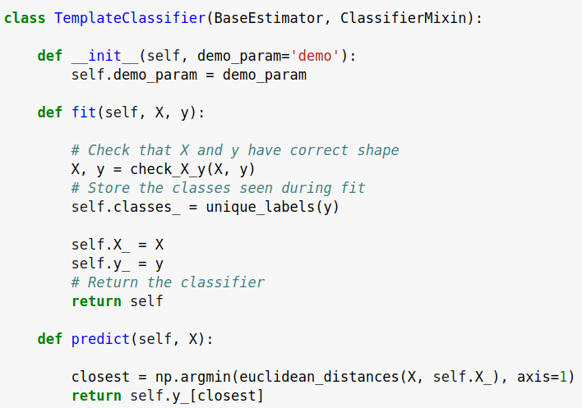
check_estimator
AssertionError: Error message does not include the expected string: 'fit'.
Observed error message: "'TemplateClassifier' object has no attribute 'X_'"

Slide 40
Coming up for 0.20
(July / August 2018)

Slide 41
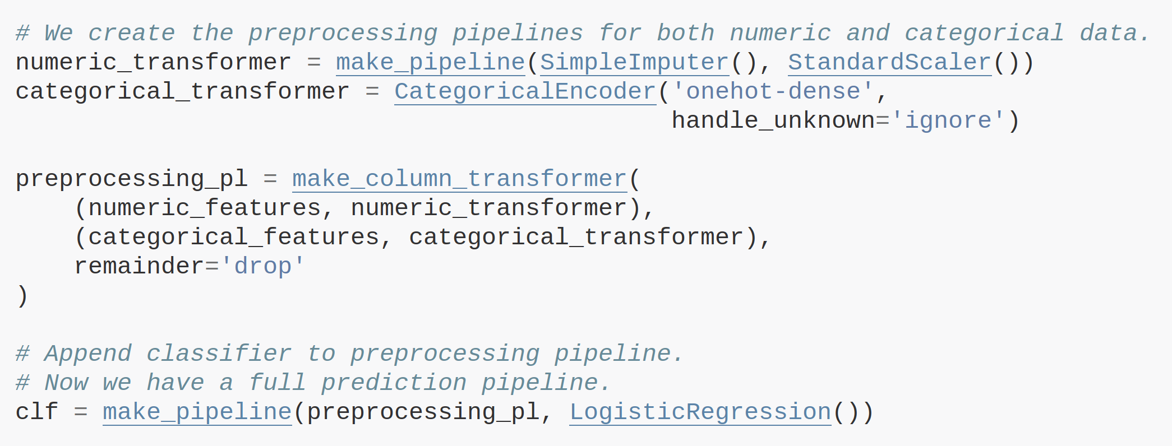
ColumnTransformer

Slide 42
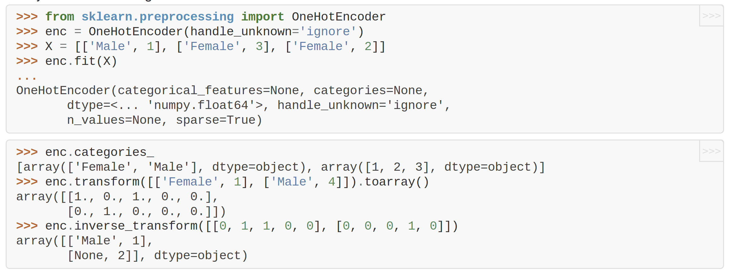
OneHotEncoder for Strings

Slide 43
NaN handling in Scalers
Better imputation

Slide 44
(my personal) Roadmap

Slide 45
Make simple things simple again!
Pandas Integration
Feature Names
More convenient preprocessing
Plotting Tools
Estimator Tags

Slide 46





amueller.github.io
@amuellerml
@amueller
importamueller
@gmail.com
Notes:
Alright, as I said, buy my book.
You can also find a lot of free videos and notebooks about machine learning and scikit-learn on my website. All the code from the book is BSD-licensed and on github.
I’ll hang around for the rest of the day if you want to chat about machine learning.
Or if you want to take a selfie, that seems to be even more popular than machine learning these days.
Alright, thank you for your attention.

