Slide 1


Andreas Mueller
NYU Center for Data Science amueller@nyu.edu

Slide 2


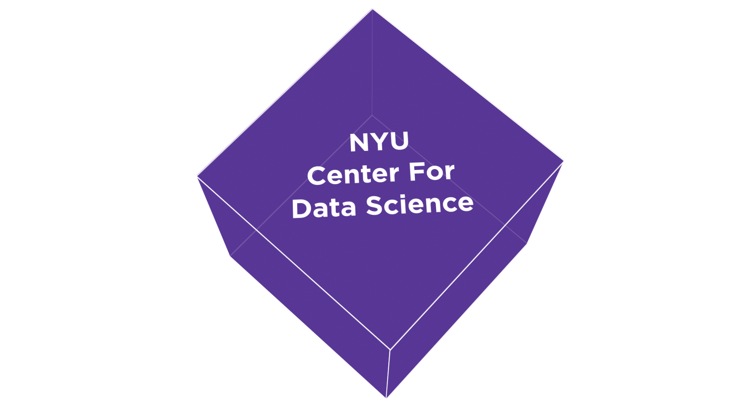
Me

Slide 3
Machine Learning in Python

Slide 4
Classification
Regression
Clustering
Semi-Supervised Learning
Feature Selection
Feature Extraction
Manifold Learning
Dimensionality Reduction
Kernel Approximation
Hyperparameter Optimization
Evaluation Metrics
Out-of-core learning
…...

Slide 5







Slide 6


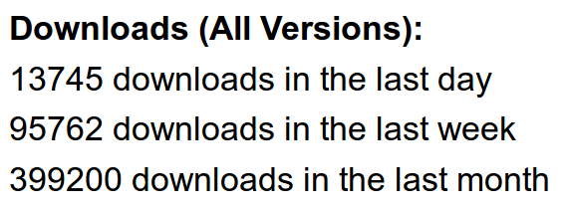



Slide 7
Research Uses
Astronomy (finding planets)
Physics (detecting the Higgs boson)
Medicine (predicting medicine efficacy)
Politics (predicting elections)
Linguistics (translation, part of speech tagging, parsing trees, language detection, …)
...

Slide 8
We’ve been using it quite a lot for music recommendations at Spotify and I think it’s the most well-designed ML package I’ve seen so far.
- spotify
scikit-learn in one word: Awesome.
- machinalis
I’m constantly recommending that more developers and scientists try scikit-learn.
- lovely
The documentation is really thorough, as well, which makes the library quite easy to use.
- OkCupid
scikit-learn makes doing advanced analysis in Python accessible to anyone.
- yhat

Slide 9









Slide 10

http://scikit-learn.org/

Slide 11
“The scikit-learn tutorials / documentation is so good, one doesn't need a textbook anymore to learn a new machine learning method.”

Slide 12
clf = RandomForestClassifier()
clf.fit(X_train, y_train)
clf.predict(X_test)

Slide 13
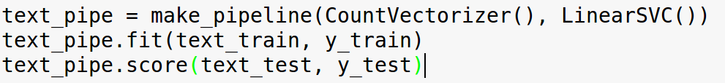
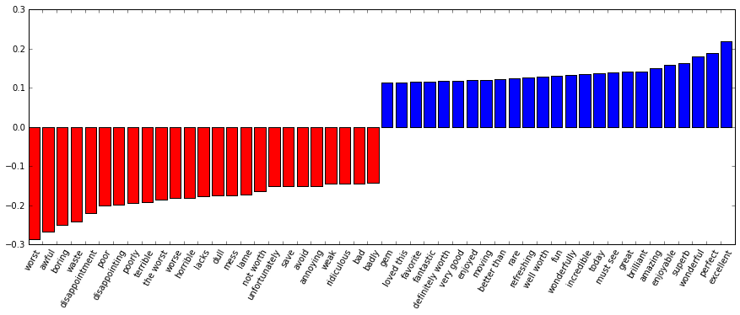

Slide 14




Thank you!
@amuellerml
@amueller
amueller@nyu.edu
http://amueller.io

