Slide 1




Building
scikit-learn
Andreas Müller
Columbia University, scikit-learn

Slide 2






Slide 3

Me
Notes:
So my career is not entirely run-of-the-mill for academia.
I did my masters and PhD at the University of Bonn in Germany, where I studied first pure math, and then moved to machine learning and computer vision for my PhD. During my PhD, I started contributing to open source, in particular scikit-learn.
After my PhD I spend a year at Amazon Machine Learning in Berlin and Seattle, where I worked on computer vision applications and time series forecasting. In the last two years, I have been a Research Engineer at the NYU Center for Data Science. At NYU, I’ve continued working on scikit-learn and creating instructional materials for machine learning and scikit-learn, but I also worked with students and researchers on ML related problems.
So let me tell you a bit more about scikit-learn.

Slide 4

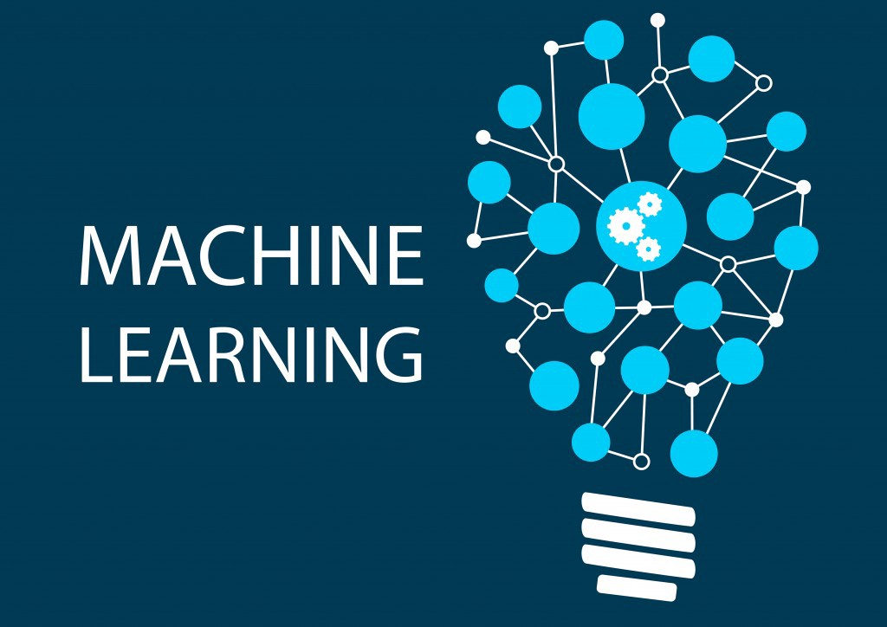


Slide 5

Classification
Regression
Clustering
Semi-Supervised Learning
Feature Selection
Feature Extraction
Manifold Learning
Dimensionality Reduction
Kernel Approximation
Hyperparameter Optimization
Evaluation Metrics
Out-of-core learning
…...
Notes:
Scikit-learn is a machine learning library for python that implements many different algorithms, as well as tools to tune and evaluate machine learning models.
You’ll find all the standard text-book algorithms like linear models, random forest, SVMs, neural networks, PCA, NMF, ICA, t-SNE, K-Means, and so on. In addition, scikit-learn also contains tools to build machine learning pipelines and tools for cross-validation and parameter searches.
Scikit-learn is a library, and there’s no official graphical interface or command line interface, so to use it, you need to write python code. Though not very much as I’ll show you in a bit.

Slide 6
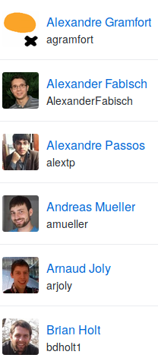
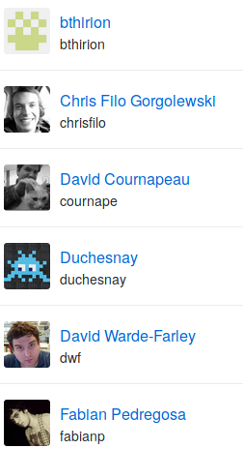
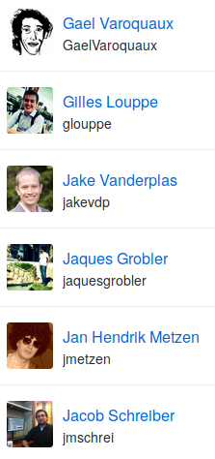
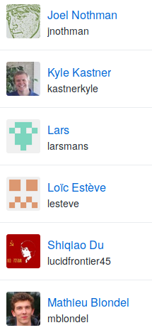
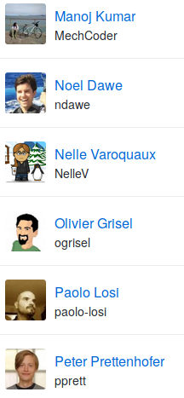
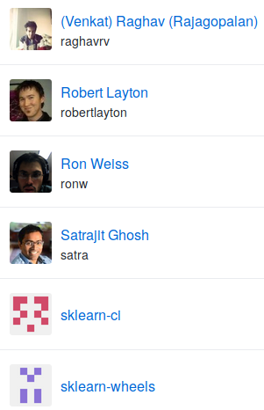
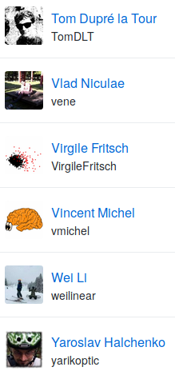

Slide 7
Mission
Commoditize and Democratize Machine Learning
Notes:
So why this project? To me, and I think to many others in the project, the mission of scikit-learn is to create effective and easy to use machine learning solutions, and make them accessible to everybody. In other words, we want to commoditize and democratize machine learning.
That is quite different from just putting a collection of algorithms out there, and I think it’s one of the reasons why the project has been so successful.

Slide 8
Basic API

Slide 9

Representing Data
one sample
1.1 | 2.2 | 3.4 | 5.6 | 1.0
6.7 | 0.5 | 0.4 | 2.6 | 1.6
2.4 | 9.3 | 7.3 | 6.4 | 2.8
1.5 | 0.0 | 4.3 | 8.3 | 3.4
0.5 | 3.5 | 8.1 | 3.6 | 4.6
5.1 | 9.7 | 3.5 | 7.9 | 5.1
3.7 | 7.8 | 2.6 | 3.2 | 6.3
1.6
2.7
4.4
0.5
0.2
5.6
6.7
X =
y =
one feature
outputs / labels

Slide 10
clf = RandomForestClassifier()
clf.fit(X_train, y_train)
Training Data
Model
Training Labels
y_pred = clf.predict(X_test)
Test Data
Prediction
Test Labels
Evaluation
clf.score(X_test, y_test)

Slide 11
Unsupervised Transformations
pca = PCA()
pca.fit(X_train)
X_new = pca.transform(X_test)
Training Data
Model
Test Data
Transformation

Slide 12
Core API Summary
estimator.fit(X, [y])
estimator.predict | estimator.transform
Classification | Preprocessing
Regression | Dimensionality reduction
Clustering | Feature selection
 | Feature extraction

Slide 13
Guiding Ideas

Slide 14
Goals:
Maintainability
Ease of use
Notes:
Which brings us to the next point, which is particularly important for an open source project: maintainability. Scikit-learn was built with maintainability in mind from the start, to make this a sustainable project. If me, or the people in Paris, would stop working on the project, it would still live on. Creating software that can be taken over by someone else is quite challenging, and you should ask yourself how much of your research software holds up to that bar.
Maintainability helps us create a thriving ecosystem of contributors, even though the barrier of entry inevitably keeps rising over time.

Slide 15

Simple things should be simple,
complex things should be possible.
Alan Kay
Notes:
There is this nice quote here by alan kay, which says “simple things should be simple, complex things should be possible”. Whenever I think about a new feature or a new api, I keep that in mind. When in doubt, in scikit-learn we err on the side of keeping simple things simple, sometimes sacrificing some of the power of more complex designs. But I’ll talk about that more later.

Slide 16



Three way documentation
Notes:
Another thing that’s very important, both for maintainability and usability is extensive documentation. We document each feature in three ways: we have a user guide that explains algorithms in a text-book style and provides references. We also have an API documentation that explains all the parameters, and finally we have examples that illustrate particular properties of the algorithms and compare their strength and weaknesses.

Slide 17
Ease of Installation

Slide 18
Simplicity
lr = LogisticRegression()
lr.fit(X_train, y_train)
lr.score(X_test, y_test)
Notes:
To make scikit-learn usable, we really focus on simplicity. You can build really powerful machine learning experiments and pipelines with scikit-learn with just a couple of lines of code. And doing a standard supervised machine learning task boils down to just these three lines: instantiate a model, fit the model on the training data, evaluate it on the test data. We want to keep simple things simple.
Here, I used the logistic regression classifier, but I could replace that first line with any other algorithm and the code would be exactly the same.

Slide 19
Consistency
grid = GridSearchCV(svm,param_grid)
grid.fit(X_train, y_train)
grid.score(X_test, y_test)
Notes:
And not only is the scikit-learn api designed to be simple, it’s also designed to be consistent, and only have a few basic building blocks. The grid-search for example acts as a model (which we call estimator), and has exactly the same interface as any other model.

Slide 20
Composition
feature_selection = RFECV(NaiveBayes())
pipe = make_pipeline(feature_selection,
RandomForestClassifier())
grid = GridSearchCV(pipe, param_grid)

Slide 21
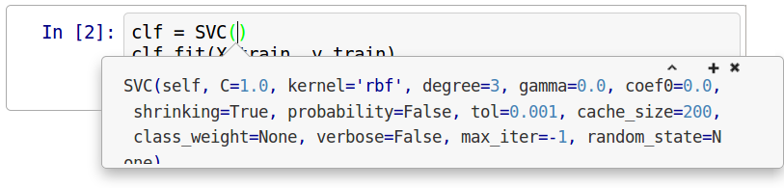
Default Parameters

Slide 22
Flat Class Hierarchy, Few Types
Numpy arrays / sparse matrices
Estimators
[Cross-validation objects]
[Scorers]
Notes:
But the simplicity goes further. There are very few types of objects in scikit-learn. Data is always numpy arrays, and basically every building block in scikit-learn is an “Estimator”. And that’s it. That’s more or less the only two types of objects you have to deal with in scikit-learn. There is no dataset object, for example. There also two kinds of object for model evaluation, but these are only interesting to expert users.
Having few types and a flat class hierarchy not only makes the project easier to use, it also makes it easier for new contributors to join the project, and simplifies maintaining the project.

Slide 23
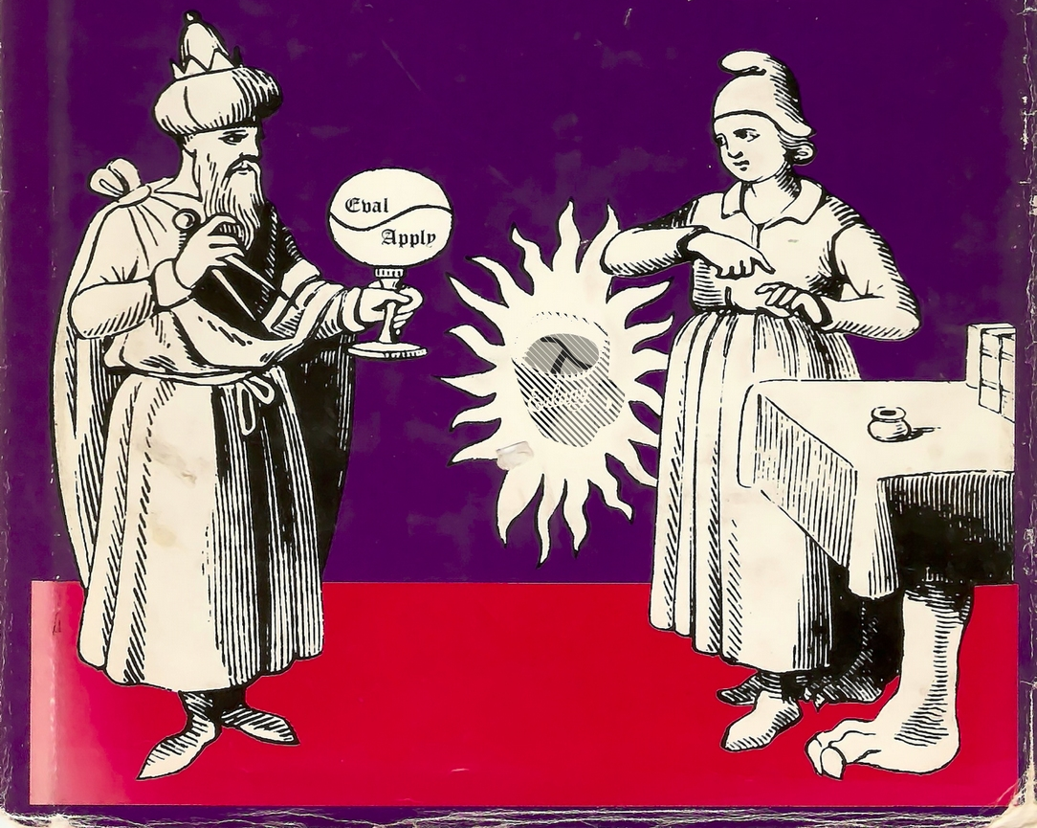
Programs should be written for people to read,
and only incidentally for machines to execute.
Harold Abelson
Notes:
Maintainable code is easy to read and understand for someone new to the code base. You should keep in mind this classic quote from the classic wizzard book.

Slide 24
Maintainability
Notes:
Which brings us to the next point, which is particularly important for an open source project: maintainability. Scikit-learn was built with maintainability in mind from the start, to make this a sustainable project. If me, or the people in Paris, would stop working on the project, it would still live on. Creating software that can be taken over by someone else is quite challenging, and you should ask yourself how much of your research software holds up to that bar.
Maintainability helps us create a thriving ecosystem of contributors, even though the barrier of entry inevitably keeps rising over time.

Slide 25

Feature Creep
Notes:
I’m not sure if you know this comic, it’s from bokersworld. If you don’t know bonkersworld, definitely check it out. So, you know, whenever you start a new project, you think to yourself: This time I’ll do it right. And then at some point you end up with some frankenstein monster. The comic says “much later”, but in my experience, it usually doesn’t take that long. Even though we have pretty strict scoping, feature creep is a problem, and we constantly fight with the tradeoff of adding features and keeping complexity of the project reasonable.

Slide 26
Scoping
Well established
Widely
useful
sklearn
Matrix in,
matrix out
Notes:
One of the most important tools to help with maintainability is scoping. We only include methods that are well established and widely useful. We don’t have methods that are only good in biology, or that are only good for financial data. We aim to have a very broad spectrum. We also limit ourselves to well-established methods. One of the reasons we don’t want to implement the cutting edge is that the field of Machine learning is very fast moving, and what looked promising half a year ago might no longer be any good. Basically everything in scikit-learn stood the test of time. Another very important restriction to scope is that we only have algorithms that work on a fixed matrix of data, and produce some matrix or array of results. This basically excludes active learning, reinforcement learning and collaborative filtering. It also excludes working on structured data, and allows us to have such a simple interface.

Slide 27
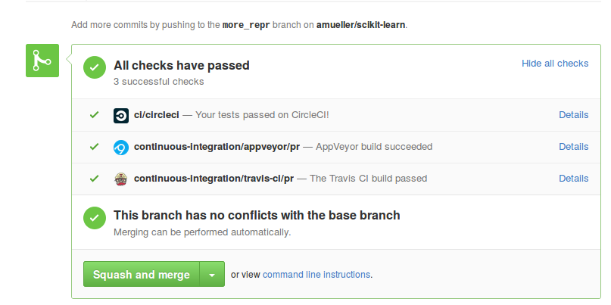
Testing & Continuous Integration
Notes:
Another tool that helps with maintainability and usability is extensive testing. We have tests for everything. Every option is tested, every edge case.
We also have automatic tests to check that everything has the same interface and all parts play nicely together.
What I mean by testing here might be slightly unfamiliar for the people without an software engineering background. Often when I asked researchers if they test their code they answer with “yes, I tried it”. That’s not what testing is about.
I’m talking about continuous integration and unit tests.
Whenever anyone suggests a change to the package, an automated service starts and runs all our tests against the changed version, and makes sure they all pass. That ensures that all additions are sane.

Slide 28

avoid code;
avoid code rot!
Notes:
One of the easiest way to keep a project maintainable is to avoid code. I really don’t like code, and I like to delete as much of it as I can. Some people really love writing long and complex code. But some day some poor soul has to read that and understand it. Every time you add a new feature, you add more complexity, and more moving parts to a project. Stop writing so much code, and start deleting more code. For every feature you add, ask yourself: is this worth the added burden for my future self, maintaining this code to the end of time?

Slide 29
API implementation & contracts

Slide 30
Method Chaining
Fit must return self:
X_scaled = StandardScaler().fit(X).transform(X)
pred = SVC().fit(X_train, y_train).score(
X_test, y_test)

Slide 31
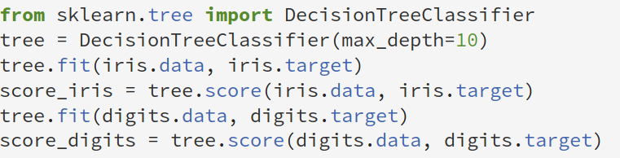
fit resets

Slide 32
(only) fit mutates self
__init__ only remembers construction parameters
Transform / score etc don’t change object
Fit returns self but mutates object!

Slide 33
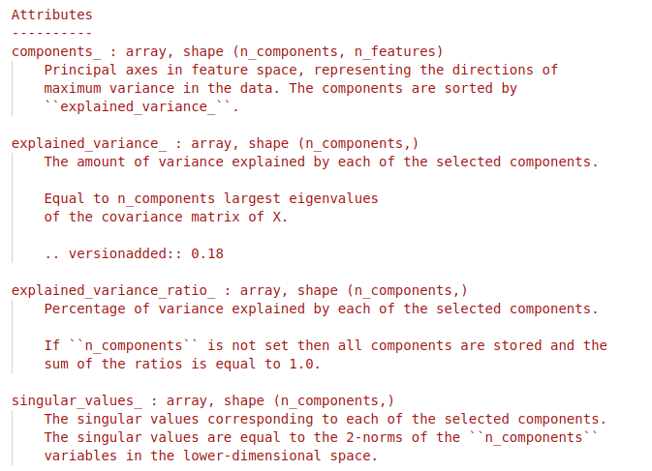
Estimated attributes
Leaves two kinds of attributes:
arguments to __init__; things estimated during fit

Slide 34
fit_transform / fit_predict
In general: computational shortcut:
pca = PCA()
pca.fit(X)
X_pca = pca.transform(X)
X_pca2 = pca.fit_transform(X)
Clustering / Manifold learning: Not inductive.
tsne = TSNE()
X_tsne = tsne.fit_transform(X)
dbscan = DBSCAN()
cluster_labels = dbscan.fit_predict(X)

Slide 35
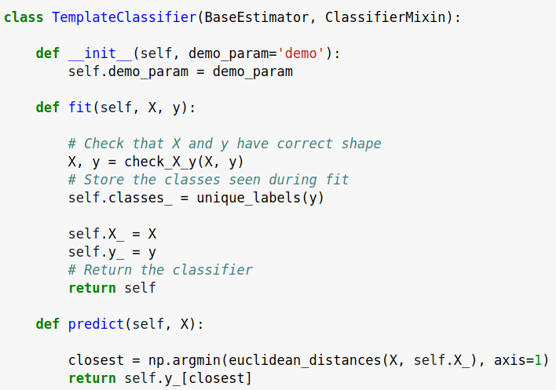
check_estimator
AssertionError: Error message does not include the expected string: 'fit'.
Observed error message: "'TemplateClassifier' object has no attribute 'X_'"

Slide 36
Development Practices

Slide 37
Standards for OSS
Everything discussed in the open.
Every convention and process documented.

Slide 38
Development guide
http://scikit-learn.org/dev/developers/contributing.html
Contains:
API details
Bug report guidelines
PR guidelines
Reviewing guidelines
How to find issues
Details of CI
Even more at http://scikit-learn.org/dev/developers/

Slide 39
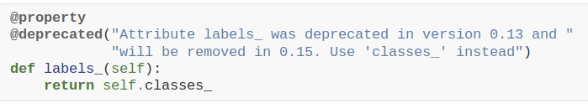
Deprecations / backward compatibility
Don’t change any behavior (except bug fixes)

Slide 40
(my personal) Roadmap

Slide 41
Make simple things simple again!
Missing Values
Categorical Variables
Plotting Tools
Pandas Integration
Feature Names

Slide 42




amueller.github.io
@amuellerml
@amueller
t3kcit@gmail.com
Notes:
Alright, as I said, buy my book.
You can also find a lot of free videos and notebooks about machine learning and scikit-learn on my website. All the code from the book is BSD-licensed and on github.
I’ll hang around for the rest of the day if you want to chat about machine learning.
Or if you want to take a selfie, that seems to be even more popular than machine learning these days.
Alright, thank you for your attention.

