Slide 1


Cool new stuff
with Scikit-Learn
Andreas Müller
Columbia University, scikit-learn
Notes:
Hey and welcome to my talk on machine learning and how to do it with python.
My goal for the next 45 minutes is to convince you that machine learning can help you in your research, make your life easier, and allow you to process much more data than you could before – and that it’s all pretty easy to do.
I’m andy, I work at Columbia and I’ve been contributing to the scikit-learn project for a couple of years now. Scikit-learn is the main machine learning tool in python and I’ll tell you a bit more about it later.

Slide 2
Basic API review

Slide 3
Representing Data
one sample
1.1 | 2.2 | 3.4 | 5.6 | 1.0
6.7 | 0.5 | 0.4 | 2.6 | 1.6
2.4 | 9.3 | 7.3 | 6.4 | 2.8
1.5 | 0.0 | 4.3 | 8.3 | 3.4
0.5 | 3.5 | 8.1 | 3.6 | 4.6
5.1 | 9.7 | 3.5 | 7.9 | 5.1
3.7 | 7.8 | 2.6 | 3.2 | 6.3
1.6
2.7
4.4
0.5
0.2
5.6
6.7
X =
y =
one feature
outputs / labels

Slide 4
clf = RandomForestClassifier()
clf.fit(X_train, y_train)
Training Data
Model
Training Labels
y_pred = clf.predict(X_test)
Test Data
Prediction
Test Labels
Evaluation
clf.score(X_test, y_test)

Slide 5
Basic API
estimator.fit(X, [y])
estimator.predict | estimator.transform
Classification | Preprocessing
Regression | Dimensionality reduction
Clustering | Feature selection
 | Feature extraction

Slide 6
Cross -Validated Grid Search
from sklearn.grid_search import GridSearchCV
from sklearn.cross_validation import train_test_split
X_train, X_test, y_train, y_test = train_test_split(X, y)
param_grid = {'C': 10. ** np.arange(-3, 3),
'gamma': 10. ** np.arange(-3, 3)}
grid = GridSearchCV(SVC(), param_grid=param_grid)
grid.fit(X_train, y_train)
grid.predict(X_test)
grid.score(X_test, y_test)

Slide 7
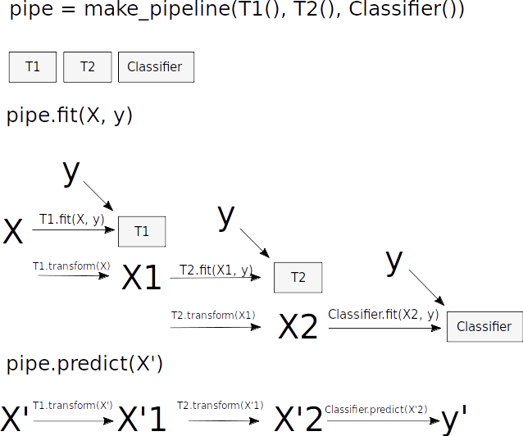
Pipelines

Slide 8
Pipelines
from sklearn.pipeline import make_pipeline
pipe = make_pipeline(StandardScaler(), SVC())
pipe.fit(X_train, y_train)
pipe.predict(X_test)
param_grid = {'svc__C': 10. ** np.arange(-3, 3),
'svc__gamma': 10. ** np.arange(-3, 3)}
scaler_pipe = make_pipeline(StandardScaler(), SVC())
grid = GridSearchCV(scaler_pipe, param_grid=param_grid, cv=5)
grid.fit(X_train, y_train)

Slide 9
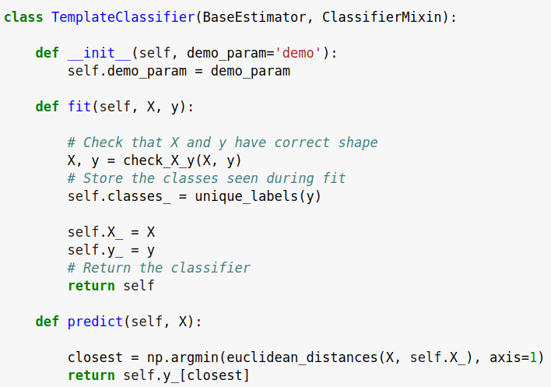
check_estimator
AssertionError: Error message does not include the expected string: 'fit'.
Observed error message: "'TemplateClassifier' object has no attribute 'X_'"

Slide 10
Scikit-Learn 0.18

Slide 11
sklearn.cross_validation
sklearn.grid_search
sklearn.learning_curve
sklearn.model_selection
Notes:
One of the things that will affect all users is our reorganization of the model selection tools.
From 0.18 on, everything relating to cross-validation, grid search and model selection will be inside the new model_selection module. Previously, the organization was a bit odd, with RandomizedSearchCV being in the grid_search module. Another reason we did the move was because we wanted to do a couple of API changes that wouldn’t have been possible otherwise.
So change all your imports from cross_validation, grid_search and learning_curve to model_selection.

Slide 12
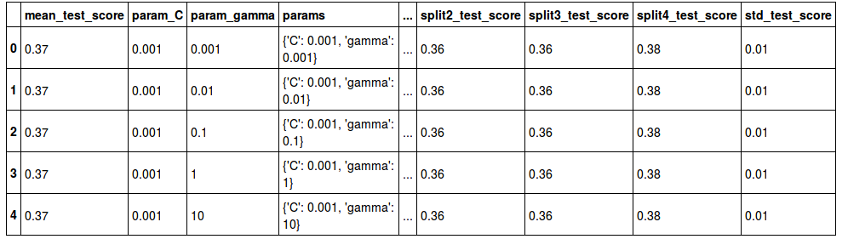
results = pd.DataFrame(grid_search.results_)
table = pd.privot_table(
results, index=[‘params_C’, ‘params_gamma’],
values=[‘mean_train_score’, ‘mean_test_score’])
Notes:
One of the changes to the grid-search that we did was restructuring the results of grid-search, which are now stored in the cv_results_ attribute. This is now a dictionary where each value is an array with an entry for every parameter setting. From this format, you can easily convert it to a pandas dataframe, which makes it much easier to use.
It will also (at least probably) contain training scores, training time and prediction time.

Slide 13
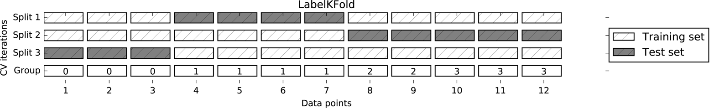
labels → groups
n_folds → n_splits
Notes:
We also did a bit of renaming of some of the cross-validation related functions and classes.
There are some cross-validation splitters which are able to handle groups of correlated data, like multiple samples coming from the same patient or the same customer. Previously they were called LabelKFold, LeavePLabelOut and LabelShuffleSplit, where label meant the group label. That was pretty confusing, so we renamed them to GroupKFold, GroupShuffleSplit and so on. We also renamed the labels parameter to groups.
So yeah, a lot of renaming is going on in this release, I hope for the better. We really try and not do this very often, but many people didn’t find this functionality under the old name.

Slide 14
from sklearn.cross_validation import KFold
cv = KFold(n_samples, n_folds)
for train, test in cv:
...
from sklearn.model_selection import KFold
cv = KFold(n_folds)
for train, test in cv.split(X, y):
...
Notes:
The biggest change we did to the model selection was to the cross-validation splitters. This is a bit technical, so if you haven’t worked with scikit-learn a lot, you might not have seen this.
Scikit-learn has classes that specify how to do cross-validation splits. So far, these were more or less generators, which needed to know how much data there was before you could instantiate them.
Now, at instantiation you don’t need to know about the data. Only when you actually want to split some particular data, the generators are created.
That allows us to do more complex nested cross-validation or other constructs in which you don’t know the data when you create your workflow.

Slide 15
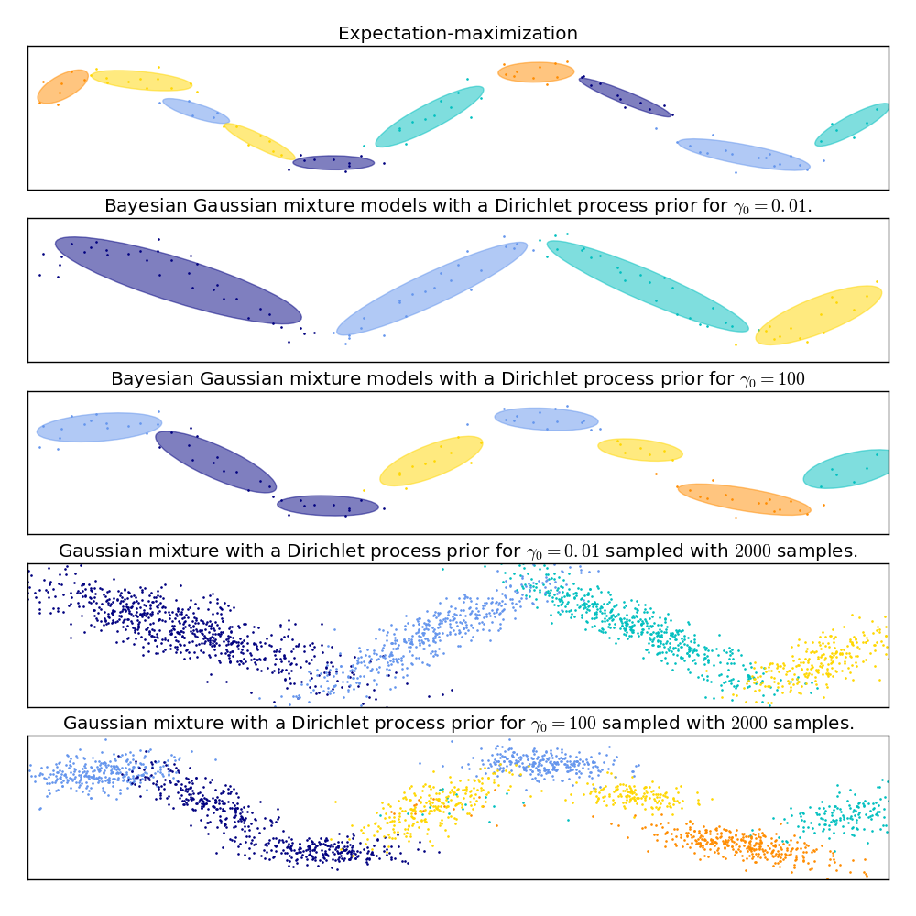
from sklearn.mixture import GaussianMixture
from sklearn.mixture import BayesianGaussianMixture
Notes:
One of the more exciting additions is two new classes for Gaussian Mixture models, called GaussianMixture and BayesianGaussianMixture. The old classes are deprecated. The new classes have a simpler interface, are numerically more stable and have many bugfixes. The GaussianMixture class implements standard Gaussian mixtures with expectation-maximization, while the BayesianGaussianMixture class implements – surprise – a Bayesian model, either with a dirichlet prior, or with an infinite dirichlet process prior.

Slide 16
PCA()
RandomizedPCA()
PCA()
Notes:
Another change that I think is quite cool is that we collapsed the PCA class and the Randomized PCA class, and now it’s just called PCA, and it will automatically use the fasted algorithm based on the shape of your data and how many components you want.

Slide 17

Gaussian Process Rewrite
Notes:
One of the most exciting changes for me is the rewrite of the Gaussian process module. There are two new classes, GaussianProcessRegressor and GaussianProcessClassifier, and a whole bunch of different kernel functions that you can use to create new custom kernels. Now it is also much easier to learn the parameters of complex kernels with scikit-learn. You see an example of that here, with the classical Mauna Loa CO2 dataset.

Slide 18
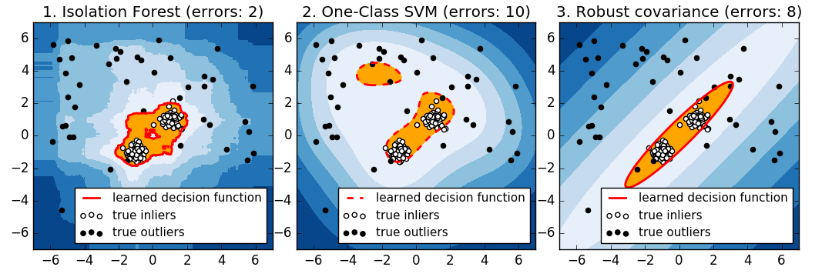
Isolation Forests
Notes:
Another great new addition are Isolation Forests. Isolation Forests are a outlier detection method. In case you’re unfamiliar, outlier detection tries to find data that looks different from “normal”. This can be used, for example, for fraud detection in finance or for intrusion or failure detection in distributed systems.
Here you can see Isolation forest compared to two methods that we had previously.
Isolation forests are great because they work very well without a lot of parameter tuning, and they are very flexible. Recently I was at a conference where there was a fraud detection challenge by a credit card company. I trolling a bit and trying to see how well I could do without looking at the data. So loaded their CSV in pandas, trained a isolation forest and submitted the result. I made second place.

Slide 19
pipe = Pipeline([('preprocessing', StandardScaler()),
('classifier', SVC())])
param_grid = {'preprocessing': [StandardScaler(), None]}
grid = GridSearchCV(pipe, param_grid)
Notes:
The last change that I want to mention is that we improved how pipelines and grid-search interact. You can now search over the steps in a pipeline! This means you can not only search the parameters of a classifier, for example, you can also search over which classifier, or which preprocessing to use!
I’m quite excited about that.
This list of additions is not exhaustive, and if you are interested in knowing about all the changes, check out the whatsnew on the scikit-learn website.
There is another thing relating to the very near future that I want to talk about, and that you might have heard about already. Basically, what I want to say is..

Slide 20
Scikit-Learn 0.19
(like, in two weeks or something)

Slide 21
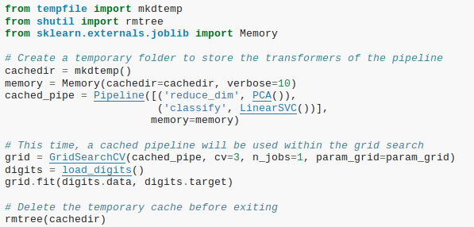
Caching Pipeline

Slide 22
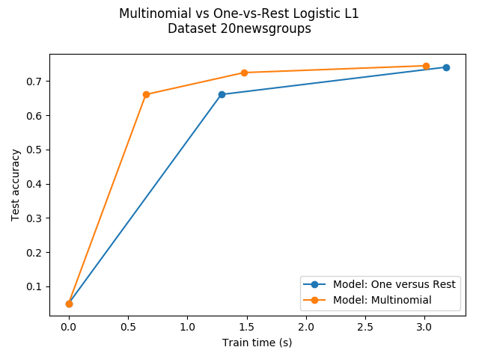
SAGA

Slide 23
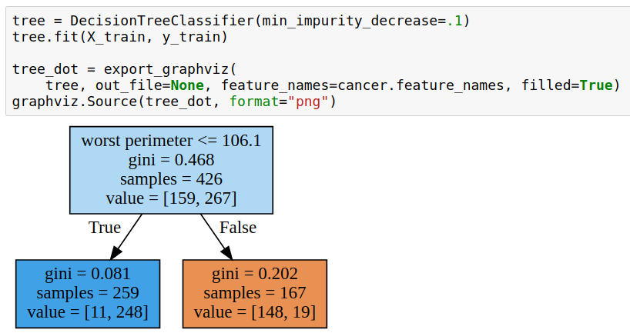
More Tree Regularization

Slide 24
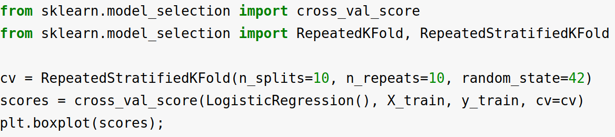
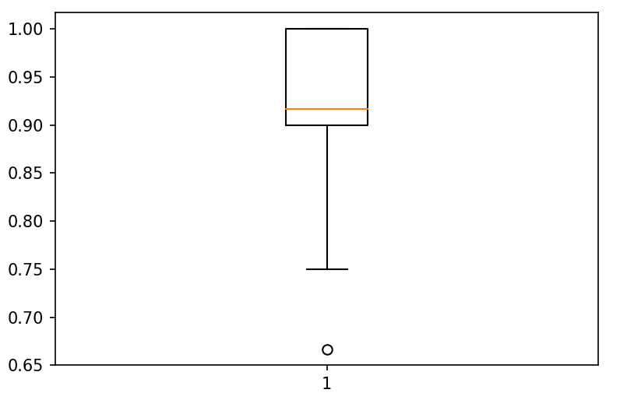
Repeated KFold

Slide 25
Estimator Tags
est._get_tags()
input_validation
multioutput
multilabel
stateless
missing_values
...

Slide 26
Testing Meta-Estimators
check_estimator(
  make_pipeline(NMF(), LogisticRegression()))
  Can pass instances now!

Slide 27
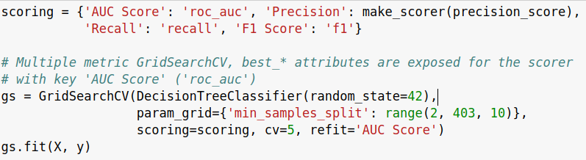
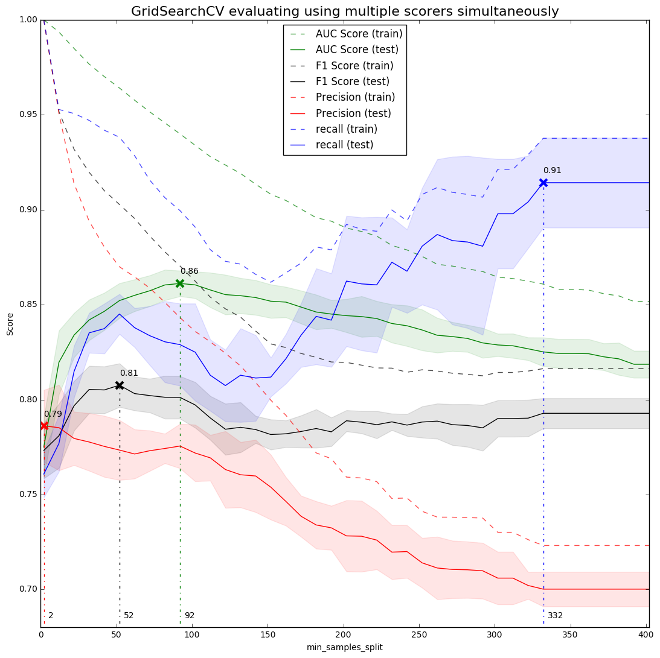
Multiple Metric Search

Slide 28
Around Scikit-learn

Slide 29
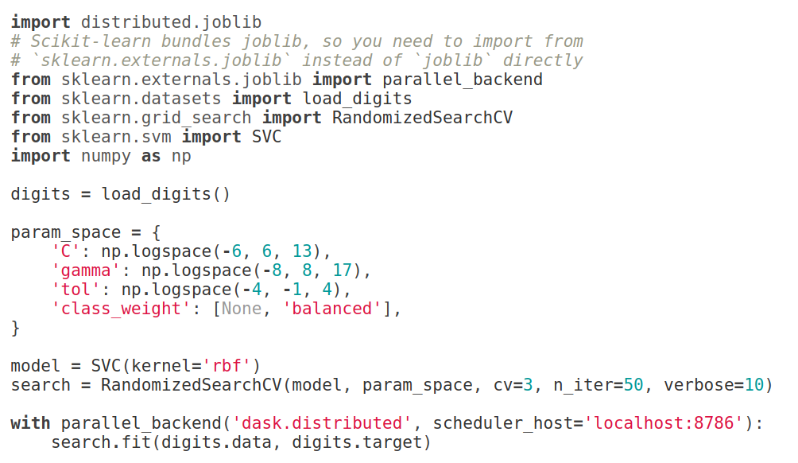
Joblib Distributed Backend

Slide 30
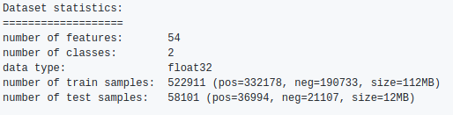
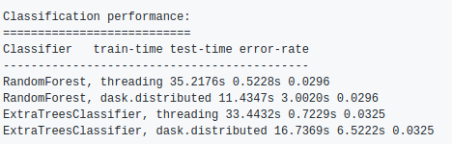
Distributed Random Forests
https://github.com/dask/distributed/pull/1022#issuecomment-297550998

Slide 31
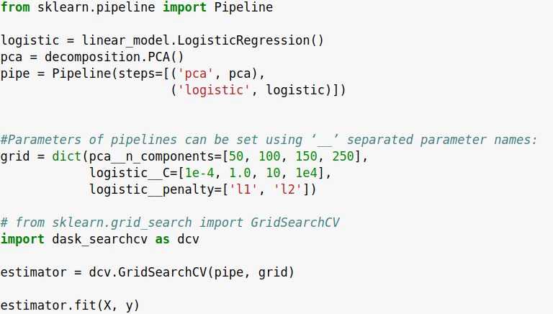
dask_searchcv – lazy pipelines!

Slide 32
(further) Future
Notes:
So now, lets talk to the somewhat further-out future.
What are the plans and ideas we have?

Slide 33
Feature / Column names
Notes:
One thing that I think will help users a lot is better support of feature names or column names. Scikit-learn builds on numpy, which doesn’t know about feature names. However in many applications, the features or column have semantic names that are important to keep track of, like age, gender, time spend online and so on. You might have stored these in a pandas dataframe, where each column has an associated header.
Because scikit-learn doesn’t handle these names, it’s sometimes tricky how the original features relate to the output, in particular in complex pipelines.
We are working on making that better.

Slide 34
from __future__ import sklearn.plotting
Notes:
We are also working on more integrated plotting. There are some plots, like confusion matrices, or model coefficients, feature importance or the result of a grid-search, that you need all the time. We will include some of these directly in scikit-learn, to make machine learning even more interactive.

Slide 35
from __future__ import AutoClassifier
Notes:
Another direction that I think will be quite important is more automation in machine learning. Scikit-learn embraces the python paradigm “explicit is better then implicit”.
This behavior is more tuned toward expert users, that want fine-grained control over whats happening. For beginners, it might be more important to get something reasonable done quickly, with little domain expertise and before reading some 366 page book.
I want the machine learning to get out of the way, so that people can focus on their data and the application, instead of tuning parameters and trying out different models.
This might not live inside scikit-learn, but maybe on top of it. There are already “research quality” implementations, in particular auto-sklearn and hyperband, but I want something more user-friendly.

Slide 36
More Transparency
Notes:
Automation helps creating better black box models faster, which is great, but sometimes you really want to open up the black box and understand what’s going on. Why did a particular point get classified in a certain way? Which features are important? What kinds of confusions happen? Can we maybe even replace a complex model by something a human can fully understand? There is no way to understand a random forest with hundreds of tree, but maybe a small rule-based system can work nearly as well.
Unfortunately there is very little work on this in the machine learning community so far, but it’s something that’s clearly very relevant in practice.
So, this ends my short outlook on what I’m excited about right now.

Slide 37





amueller.github.io
@amuellerml
@amueller
t3kcit@gmail.com
Notes:
Alright, as I said, buy my book.
You can also find a lot of free videos and notebooks about machine learning and scikit-learn on my website. All the code from the book is BSD-licensed and on github.
I’ll hang around for the rest of the day if you want to chat about machine learning.
Or if you want to take a selfie, that seems to be even more popular than machine learning these days.
Alright, thank you for your attention.

