Slide 1





An update on Scikit-learn
0.21 and beyond
Andreas Müller
Associate Research Scientist
Columbia University
Scikit-learn Technical Committee
Notes:
Hi, I’m Andreas Mueller. I’m grateful for the opportunity to talk to you today about my work here at the DSI, and about Open Source for Science and Data Science.
I’m an Associate Research Scientist, and I mostly work on open source software for machine learning, in particular the scikit-learn library.
My talk will have two parts: first, I want to talk a bit about the importance of software for science, and the scientific python ecosystem.
Then I’ll talk more about the particular project I’m working on, scikit-learn, and my group here at Columbia.

Slide 2
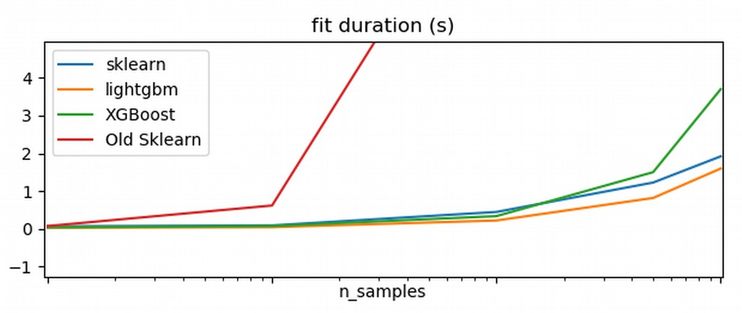
Extreme Gradient Boosting
HistGradientBoostingClassifier
Notes:
One of the recent additions by my team is an implementation of extreme gradient boosting by Nicolas Hug. This is much, much faster than what was in scikit-learn before and it will have a huge impact on the ML community.
You can see here that it’s comparable to two existing tools, xgboost and lightgbm. LightGBM was released by microsoft and it’s quite great, but by including our own implementation into scikit-learn, we make it available to a much wider audience.

Slide 3
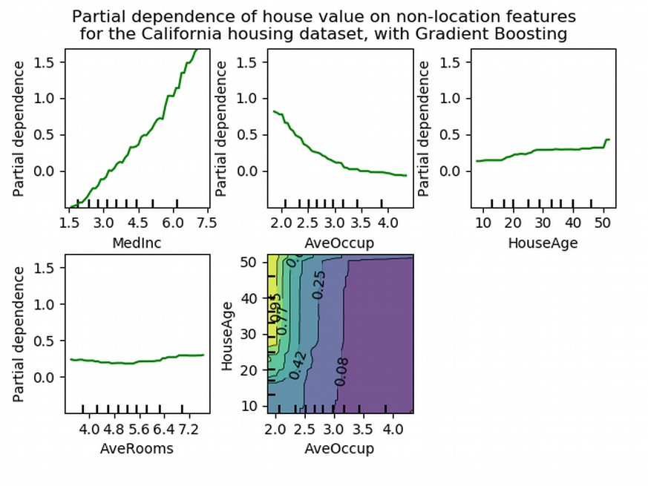
Model understanding and inspection
sklearn.inspect.partial_dependence
sklearn.inspect.permutation_importance
Notes:
Related to visualization is model understanding and inspection.
We’re building tools that allow users to validate and debug their models, and understand their data better.
This allows our users to better judge when and why their model might work or fail, or how to improve data quality and data collection.

Slide 4
A Roadmap
https://scikit-learn.org/dev/roadmap.html
Governance
https://scikit-learn.org/dev/governance.html

Slide 5
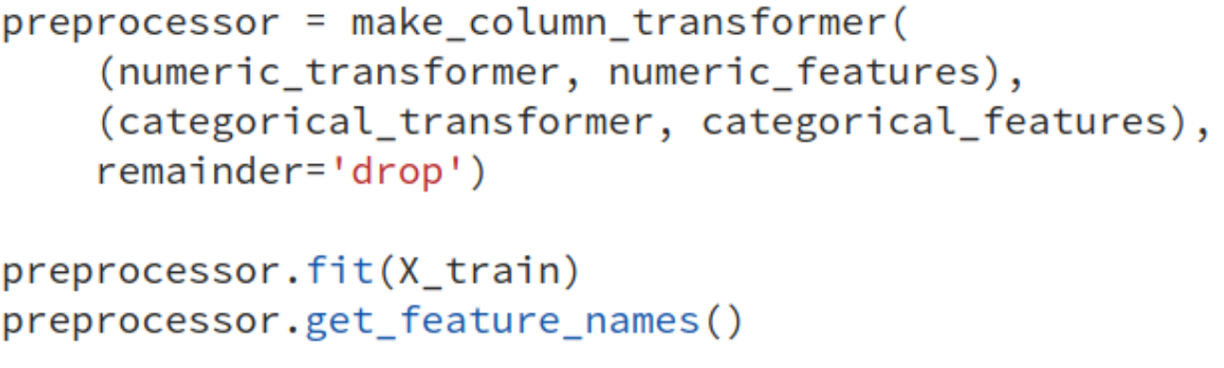
Pandas & Feature Names

