Slide 1


What's new in
0.17
Andreas Mueller

Slide 2
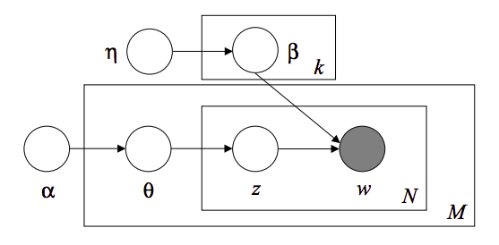
Latent Dirichlet Allocation
using online variational inference
Topic #0:
government people mr law gun state president states public use right rights national new control american security encryption health united
Topic #1:
drive card disk bit scsi use mac memory thanks pc does video hard speed apple problem used data monitor software
Topic #2:
said people armenian armenians turkish did saw went came women killed children turkey told dead didn left started greek war
Topic #3:
year good just time game car team years like think don got new play games ago did season better ll
Topic #4:
10 00 15 25 12 11 20 14 17 16 db 13 18 24 30 19 27 50 21 40
Topic #5:
windows window program version file dos use files available display server using application set edu motif package code ms software
Topic #6:
edu file space com information mail data send available program ftp email entry info list output nasa address anonymous internet
Topic #7:
ax max b8f g9v a86 pl 145 1d9 0t 34u 1t 3t giz bhj wm 2di 75u 2tm bxn 7ey
Topic #8:
god people jesus believe does say think israel christian true life jews did bible don just know world way church
Topic #9:
don know like just think ve want does use good people key time way make problem really work say need
By Chyi-Kwei Yau, based on code by Matt Hoffman

Slide 3
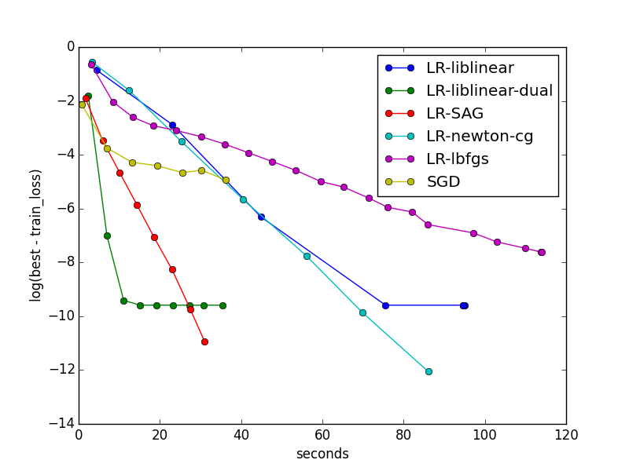
SAG for Logistic Regression and Ridge Regression
By Danny Sullivan and Tom Dupre la Tour

Slide 4
Coordinate Descent Solver for Non-Negative Matrix Factorization
Topics in NMF model:
Topic #0:
don people just like think know time good right ve make say want did really way new use going said
Topic #1:
windows file dos files window program use running using version ms problem server pc screen ftp run application os software
Topic #2:
god jesus bible christ faith believe christians christian heaven sin hell life church truth lord say belief does existence man
Topic #3:
geb dsl n3jxp chastity cadre shameful pitt intellect skepticism surrender gordon banks soon edu lyme blood weight patients medical probably
Topic #4:
key chip encryption clipper keys escrow government algorithm secure security encrypted public des nsa enforcement bit privacy law secret use
Topic #5:
drive scsi ide drives disk hard controller floppy hd cd mac boot rom cable internal tape bus seagate bios quantum
Topic #6:
game team games players year hockey season play win league teams nhl baseball player detroit toronto runs pitching best playoffs
Topic #7:
thanks mail does know advance hi info looking anybody address appreciated help email information send ftp post interested list appreciate
Topic #8:
card video monitor vga bus drivers cards color driver ram ati mode memory isa graphics vesa pc vlb diamond bit
Topic #9:
00 sale 50 shipping 20 10 price 15 new 25 30 dos offer condition 40 cover asking 75 interested 01
By Tom Dupre la Tour and Mathieu Blondel

Slide 5
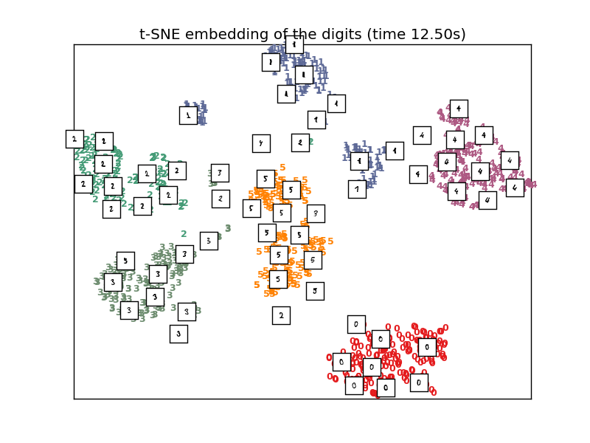
Barnes-Hut Approximation for
T-SNE manifold learning

Slide 6
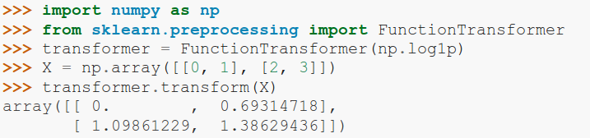
FunctionTransformer

Slide 7
VotingClassifier
clf1 = LogisticRegression()
clf2 = RandomForestClassifier()
clf3 = GaussianNB()
eclf = VotingClassifier(
estimators=[('lr', clf1), ('rf', clf2), ('gbn', clf3)],
voting=”hard”)

Slide 8
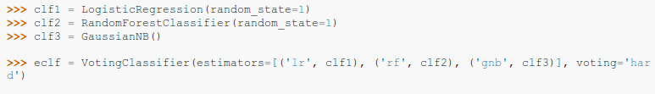
VotingClassifier

Slide 9
Scalers
RobustScaler
MaxAbsScaler
By Thomas Unterthiner.

Slide 10
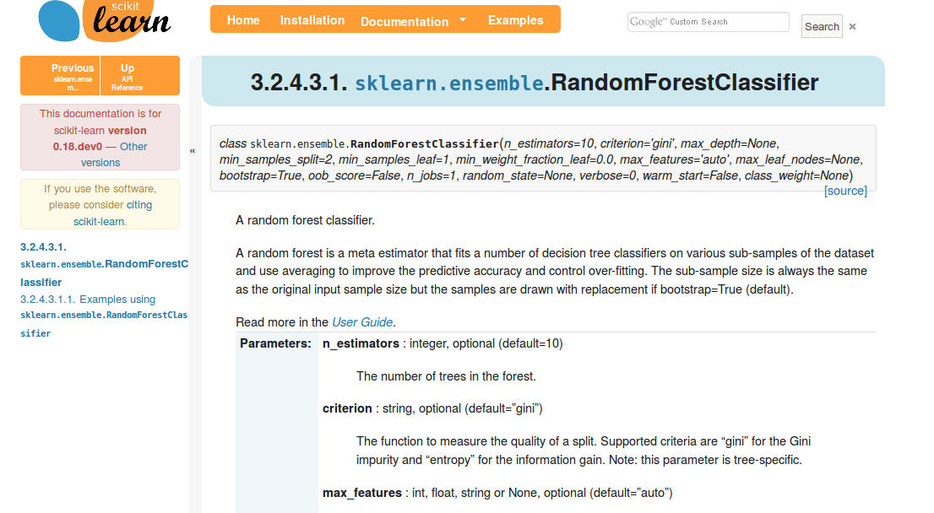
Add Backlinks to Docs

Slide 11
What the future will bring (0.18)

Slide 12

Gaussian Process Rewrite
34.4**2 * RBF(length_scale=41.8)
+ 3.27**2 * RBF(length_scale=180)
* ExpSineSquared(length_scale=1.44, periodicity=1)
+ 0.446**2 * RationalQuadratic(alpha=17.7, length_scale=0.957)
+ 0.197**2 * RBF(length_scale=0.138) + WhiteKernel(noise_level=0.0336)
By Jan Hendrik Metzen.

Slide 13
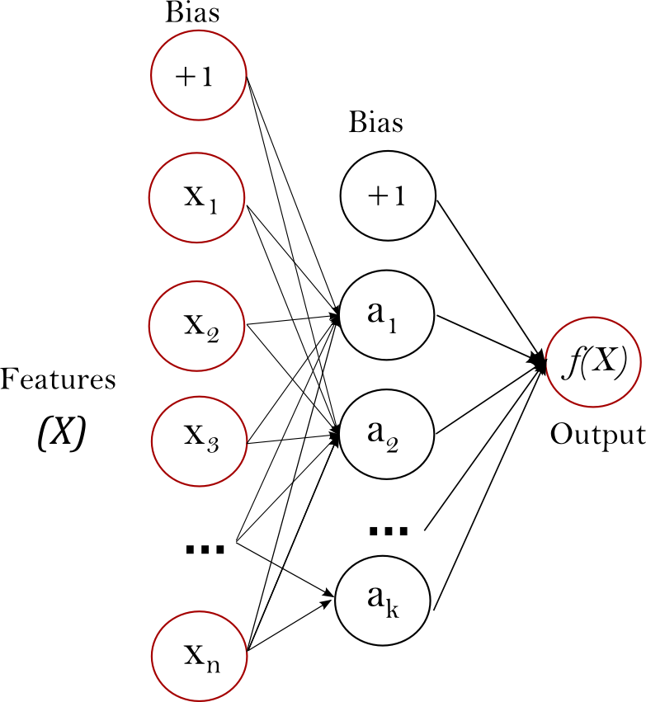
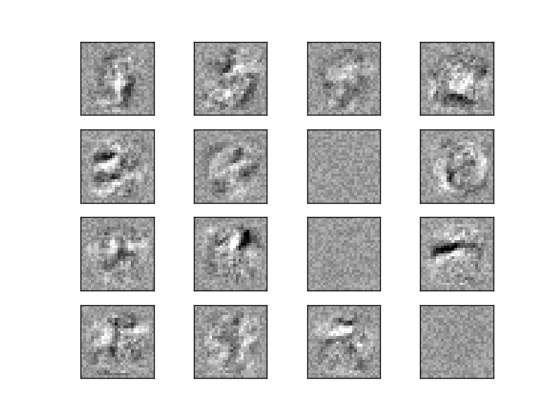
Neural Networks
By Jiyuan Qian and Issam Laradji

Slide 14
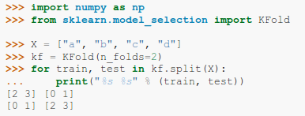
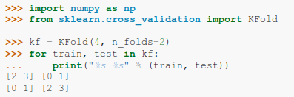

Improved Cross-Validation
current
future
By Ragav RV

Slide 15
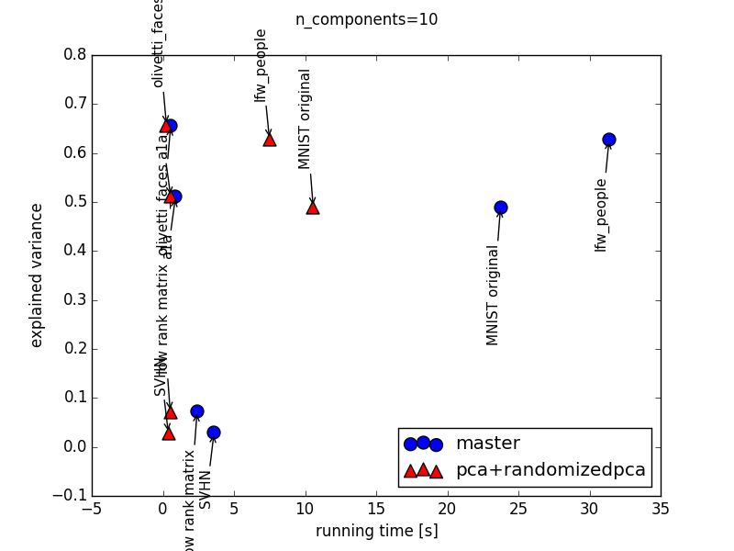
Faster PCA
By Giorgio Patrini

