Slide 1

Engineering
Andreas Mueller (NYU Center for Data Science, scikit-learn)

Slide 2
Goals
Achievements
Methods
Challenges

Slide 3
Goals

Slide 4
Goal:
High quality, easy to use machine learning library.

Slide 5
Goal:
High quality, easy to use machine learning library.
Keep it usable, keep it maintainable.

Slide 6
Interoperability
X = pd.read_csv(“data.csv”).values
X_2d = PCA(n_components=2).fit_transform(X)
plt.scatter(X_2d[:, 0], X_2d[:, 1])

Slide 7
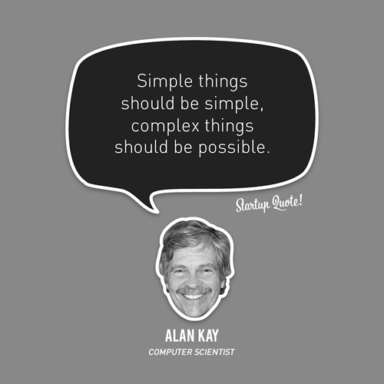
Simple things should be simple, complex things should be possible.
Alan Kay

Slide 8
Non-Goals
Non-programmatic interfaces
Algorithm development
Bleeding edge algorithms
Structured, online, or reinforcement learning.
“I thought it was more like CRAN”

Slide 9
Achievements

Slide 10


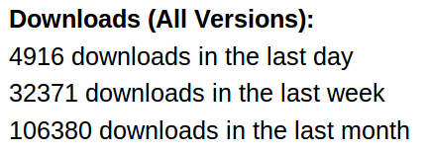
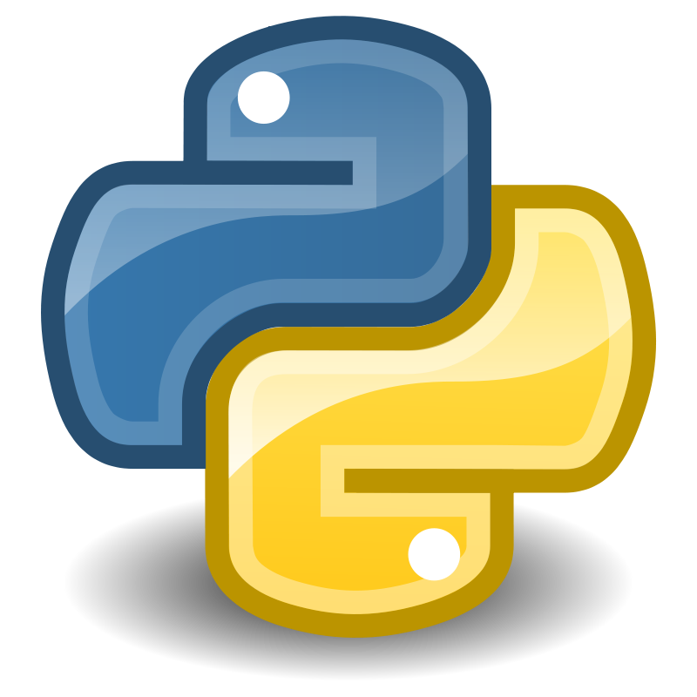



Slide 11
We’ve been using it quite a lot for music recommendations at Spotify and I think it’s the most well-designed ML package I’ve seen so far.
- spotify
Scikit-learn in one word: Awesome.
- machinalis
I’m constantly recommending that more developers and scientists try scikit-learn.
- lovely
The documentation is really thorough, as well, which makes the library quite easy to use.
- OkCupid
scikit-learn makes doing advanced analysis in Python accessible to anyone.
- yhat

Slide 12
Methods

Slide 13
Simplicity
est = Est()
est.fit(X_train, y_train)
est.score(X_test, y_test)

Slide 14
Consistency
svm.fit(X_train, y_train)
grid = GridSearchCV(svm, param_grid)
grid.fit(X_train, y_train)
grid.score(X_train, y_train)

Slide 15
Sensible Defaults
Everything is default constructible!
for clf in [KneighborsClassifier(),
SVC(),
DecisionTreeClassifier(),
RandomForestClassifier(),
AdaBoostClassifier(),
GaussianNB(),
LDA(),
QDA()]:
clf.fit(X_train, y_train)
print(clf.score(X_test, y_test))

Slide 16
Flat Class Hierarchy, Few Types
Numpy arrays / sparse matrices
Estimators
[Cross-validation objects]
[Scorers]

Slide 17
Scoping
Well established
Widely
useful
sklearn
X → X or X → y

Slide 18
Common Tests
classifiers = all_estimators(type_filter='classifier')
for name, Classifier in classifiers:
# test classfiers can handle non-array data
yield check_classifier_data_not_an_array, name, Classifier
# test classifiers trained on a single label
# always return this label
yield check_classifiers_one_label, name, Classifier
yield check_classifiers_classes, name, Classifier
yield check_classifiers_pickle, name, Classifier
yield check_estimators_partial_fit_n_features, name, Classifier

Slide 19



Three-Way Documentation

Slide 20
No Framework
“This looks frameworkish.” means “try again.”

Slide 21

Avoid Code
Code rots!
Hail all code deleters!

Slide 22
Challenges

Slide 23

Feature Creep

Slide 24
Multi-Platform Support
Linux / Mac / Windows / Solaris (no kidding)
32bit / 64bit
Python2.6 / Python2.7 / Python 3.4
GCC, Clang, MSVC
Blas dependency...
And we want “one click” install

Slide 25


Two Language Problem

Slide 26
Two Language Problem
C / C++

Slide 27
Backward compatibility
from sklearn.cross_validation import Bootstrap
Bootstrap(10)
sklearn/cross_validation.py:685:
DeprecationWarning: Bootstrap will no longer
be supported as a cross-validation method as of
version 0.15 and will be removed in 0.17.

Slide 28
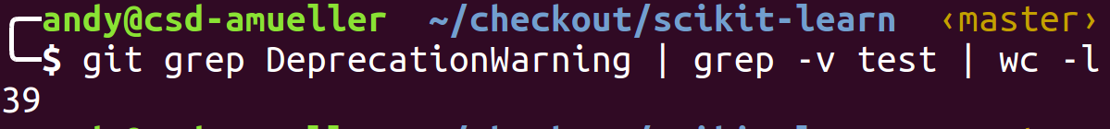
Backward compatibility

Slide 29
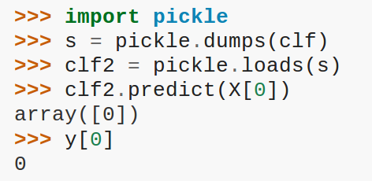
Backward compatibility

Slide 30
Correctness Testing
?

Slide 31


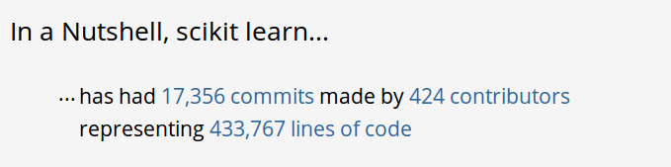
Project Size

Slide 32



@t3kcit
@amueller
amueller@nyu.edu

