Slide 1
(Applied)
Machine Learning
for Data Science
02/6/17
Andreas Müller

Slide 2
Supervised Learning
i.i.d.
Notes:
In supervised learning, the dataset we learn form is input-output pairs (x_i, y_i), where x_i is some n_dimensional input, or feature vector, and y_i is the desired output we want to learn.
We assume these samples are drawn from some unknown joint distribution p(x, y).
You can think of this as there being some (not necessarily deterministic) process that goes from x_i to y_i, but that we don’t know.
The goal is to learn a function f so that for new inputs x , and unobserved y, f(x) is approximately y.
This Is very closely related to function approximation.
The name supervised comes from the fact that during learning, a supervisor gives you the correct answers y_i.

Slide 3
Generalization
Not only
Also for new data:
Notes:
Ok, so I want to talk in more depth about supervised learning, and I want to get a little more formal.
Let’s say we have a regression task. We have features, that is data vectors x_i and targets y_i drawn from a joint distribution.
We now want to learn a function f, such that f(x) is approximately y, not on this training data, but on new data drawn from this distribution. This is called generalization, and this is a core distinction to function approximation. In principle we don’t care about how well we do on x_i, we only care how well we do on new samples from the distribution.

Slide 4
training set
1.1 | 2.2 | 3.4 | 5.6 | 1.0
6.7 | 0.5 | 0.4 | 2.6 | 1.6
2.4 | 9.3 | 7.3 | 6.4 | 2.8
1.5 | 0.0 | 4.3 | 8.3 | 3.4
0.5 | 3.5 | 8.1 | 3.6 | 4.6
5.1 | 9.7 | 3.5 | 7.9 | 5.1
3.7 | 7.8 | 2.6 | 3.2 | 6.3
1.6
2.7
4.4
0.5
0.2
5.6
6.7
X =
y =
test set
Notes:
So in the previous example, I asked you whether you think a model will generalize well to new data from eyeballing it. That’s clearly not a good way to test a model, and usually impossible in higher dimensions.
The standard method to evaluate the generalization capabilities is with a hold-out set, also known as test-set or validation set.
The way this works it that we split our initial dataset into one part that is used for actually building the model, which we call the training set, and another part, the test set, which will be our “pretend future data”. The essential point here is that we have the true outputs, or ground truth, for this data, so we can measure how well our model did on this “new” data.

Slide 5
Preprocessing

Slide 6
Categorical Variables
?
Notes:
Before we can apply a machine learning algorithm, we first need to think about how we represent our data.
Earlier, I said x \in R^n. That’s not how you usually get data. Often data has units, possibly different units for different sensors, it has a mixture of continuous values and discrete values, and different measurements might be on totally different scales.
First, let me explain how to deal with discrete input variables, also known as categorical features. They come up in nearly all applications.
Let’s say you have three possible values for a given measurement, whether you used setup1 setup2 or setup3. You could try to encode these into a single real number, say 0, 1 and 2, or e, \pi, \tau.
However, that would be a bad idea for algorithms like linear regression.

Slide 7
Categorical Variables
Setup1 Setup2 Setup3
1 0 0
0 1 0
0 0 1
Notes:
If you encode all three values using the same feature, then you are imposing a linear relation between them, and in particular you define an order between the categories. Usually, there is no semantic ordering of the categories, and so we shouldn’t introduce one in our representation of the data.
Instead, we add one new feature for each category,
And that feature encodes whether a sample belongs to this category or not.
That’s called a one-hot encoding, because only one of the three features in this example is active at a time.
You could actually get away with n-1 features, but in machine learning that usually doesn’t matter.

Slide 8
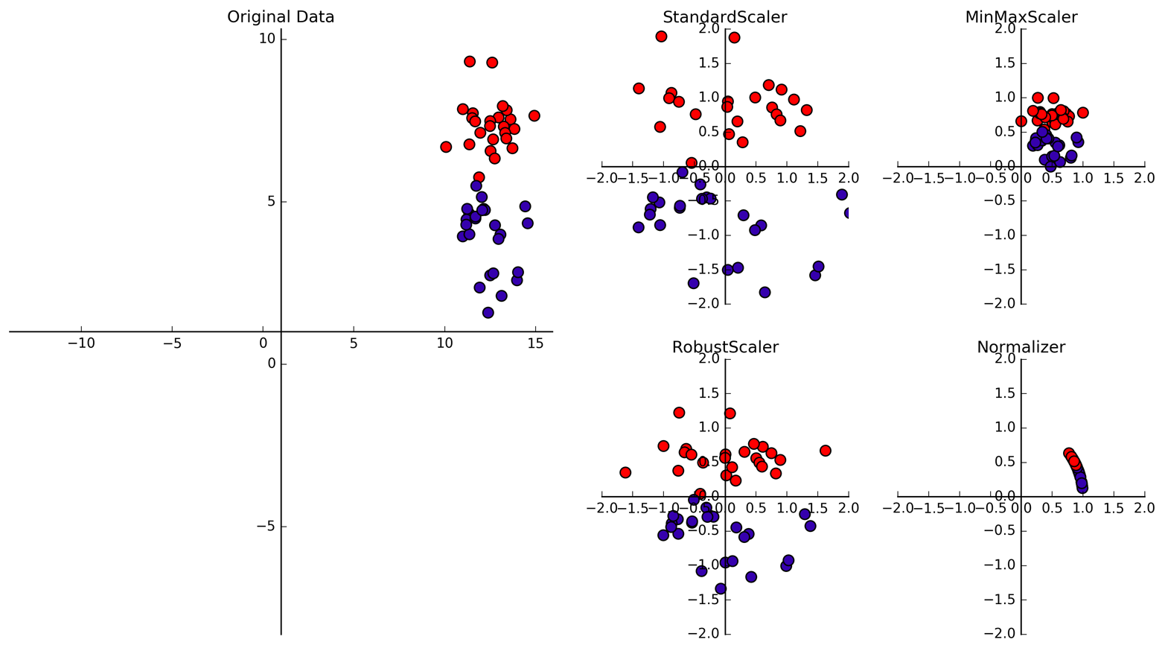
Data Scaling
Data Scaling
Notes:
The other issue is relative scaling. The outcome of our prediction clearly shouldn’t depend on whether we represent a measurement in millimeters or kilometers. If you use linear regression, this doesn’t matter, but for most machine learning algorithms, it does. Let’s have another look at ridge regression that I introduced earlier. It tries to pull all coefficients in w towards zero. Because we’re using the two-norm, large coefficients are penalized more, which means that changing the scale of a feature changes the amount of regularization that is applied.
Unless we have some prior information about how informative each feature is, we should ensure all features are treated equally. We can do that by scaling them all between -1 and 1 or transforming them to have zero mean and unit variance.

Slide 9
Linear Models

Slide 10

Linear Regression
Notes:
I want to tie this principle to something your are probably familiar with, linear regression.
That’s even simpler than polynomial fitting, but one of the really simple and successful methods in statistics and machine learning.
Linear regression, or ordinary least squares means finding a vector w such that w * x – y is minimized.
This is basically only the first part of the principle I just showed you, the data fitting part.
And if you look at this in 2d, it looks like a great idea.
This is mostly because linear models in 2d are inherently simple.
However, if you go to higher dimensional spaces, linear models can become quite complex.

Slide 11
Linear Models for Regression
Ridge Regression
Lasso
Notes:
In terms of regression with linear models, we had linear regression, which you should basically never use, ridge-regression and which is a form of regularized linear regression. There is another one that I want to mention, which is called Lasso.
Lasso is the same as Ridge, only with an L1 norm instead of an L2 norm.
Interestingly, that leads to some of the coefficients being exactly zero, which means the model automatically selects which features are important, and which are not. This can be helpful if you suspect many features might not be informative.

Slide 12
Overfitting and Underfitting
Training
Sweet spot
Accuracy
Generalization
Underfitting
Overfitting
Model complexity
Notes:
This chart has accuracy on the y axis, and an abstract concept of model complexity on the x axis.
If we make our machine learning models more complex, we will get better training set accuracy, as the model will be able to capture more of the variations in the data.
But if we look at the generalization performance, we get a different story. If the model complexity is too low, the model will not be able to capture the main trends, and a more complex model means better generalization.
However, if we make the model too complex, generalization performance drops again, because we basically learn to memorize the dataset.
If we use too simple a model, this is often called underfitting, while if we use to complex a model, this is called overfitting. And somewhere in the middle is a sweet spot.
Most models have some way to tune model complexity, and we’ll see many of them in the next couple of weeks.
So going back to nearest neighbors, what parameters correspond to high model complexity and what to low model complexity? high n_neighbors = low complexity!

Slide 13
Linear models for binary classfiication

Slide 14


Slide 15

Logistic Regression

Slide 16
Penalized Logistic Regression
C is inverse to alpha (or alpha / n_samples)
All points contribute to w (dense solution to dual).

Slide 17
(soft margin) linear SVM
Only some points contribute (the support vectors) to w (sparse solution to dual).

Slide 18
SVM or LogReg?
Do you need probability estimates?
ou
yes
It doesn’t matter
- try either / both
Logistic Regression
Need compact model or believe solution is sparse? Use L1.

Slide 19
Prediction with One Vs Rest
“Class with highest score”
Unclear why it even works, but work well.

Slide 20

One vs Rest Prediction

Slide 21
Multinomial Logistic Regression
Probabilistic multi-class model:
Same prediction rule as OvR!

Slide 22
Linear models in practice
Good with P > n : because simple!
(work well with sparse data)
Good on very large : because fast!
Very robust, always use as baseline!
Relatively interpretable
Try adding interaction or polynomial features

Slide 23
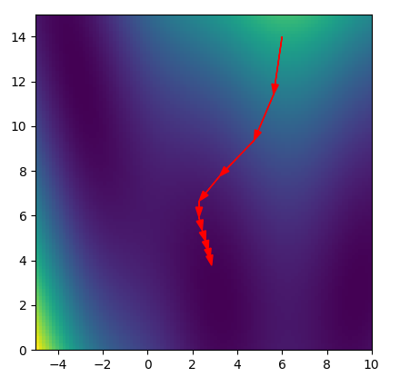
Reminder: Gradient Descent

Slide 24
Stochastic Gradient Descent
Logistic Regression:
Sum over data-points
Independent of data
Pick x_i randomly, then
Is a stochastic approximation of gradient of F with expectation the actual gradient.
In practice: just iterate over i.

Slide 25
SGD in Practice
Vopalwabbit (vw)
Scikit-learn’s SGDClassifier / SGDRegressor
Can work with data larger than ram
VERY fast
Picking / tuning learning rates can be hard. Scale data!

Slide 26
Tree-based models

Slide 27



Models
Decision
Trees
Model complexity controlled by depth or number of leafs
Notes:
The second family of models I want to talk about is decision-tree based models.
A decision tree is basically the same as a sequence of if-else branches, that ultimately lead to a decision. The point is that the question that are asked are learned, though.
A decision tree is build recursively by asking a series of questions of the form “is feature “i” greater than threshold t”. In each iteration, the question is chosen that yields the most information about the target variable. Then, the data is split according to this question, and we start again. This yields a hierarchical partitioning of the data, where each section of the partitioning becomes more and more “pure”, that is their content becomes more and more the same.
After you build the tree, you can make a prediction by checking which part of the partition a new point lies in and assigning the mean of the datapoints in this part.

Slide 28

Random Forests
Notes:
So decision trees are a great idea, but unfortunately they don’t work that well in practice. However, there is a modification of the algorithm that works very well, called random forest.
The idea behind random forest is that we build many decision trees, but we inject some randomness into each tree, so that they are all different.
Then, to make a prediction, we look at the prediction of all the decision trees and take the average.

Slide 29
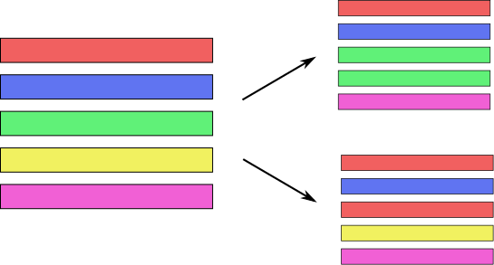
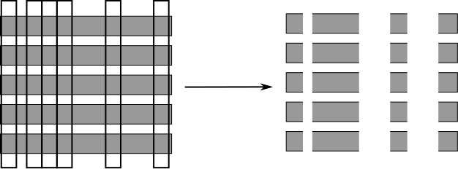
Randomize in two ways
For each tree:
Pick bootstrap sample of data
For each split:
Pick random sample of features
More tree are always better

Slide 30



Gradient Boosting
0.1 *
+ 0.1 *
+ 0.1 *
Many shallow trees
learning_rate ↔ n_estimators
Look at XGBoost package

Slide 31
When to use tree-based models
Model non-linear relationships
Single tree: very interpretable (if small)
Random forests very robust, good benchmark
Gradient boosting often best performance with careful tuning
Doesn’t care about scaling, no need for feature engineering!

Slide 32
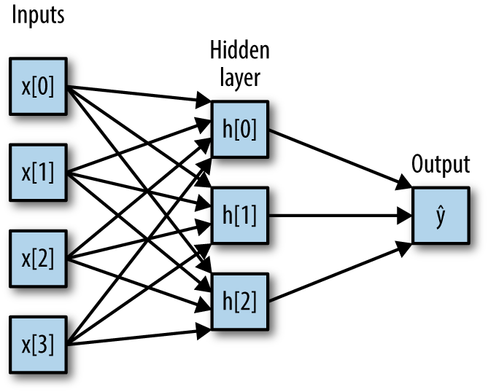
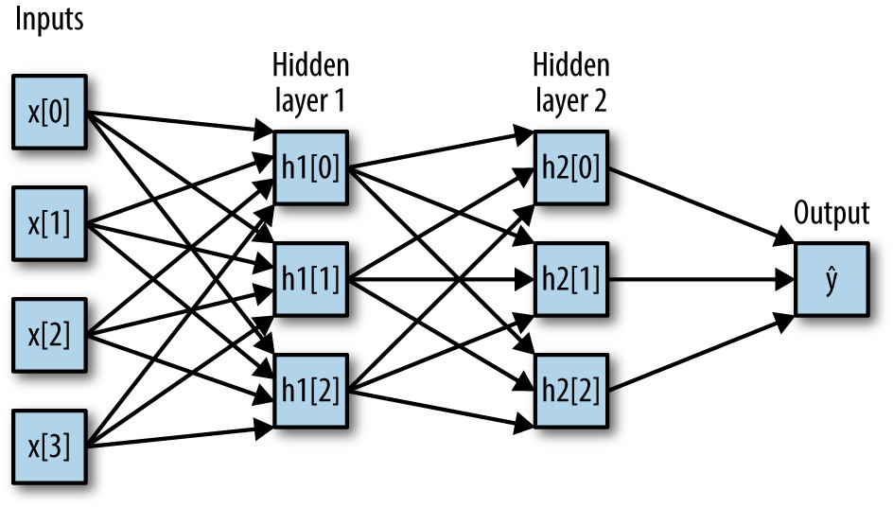
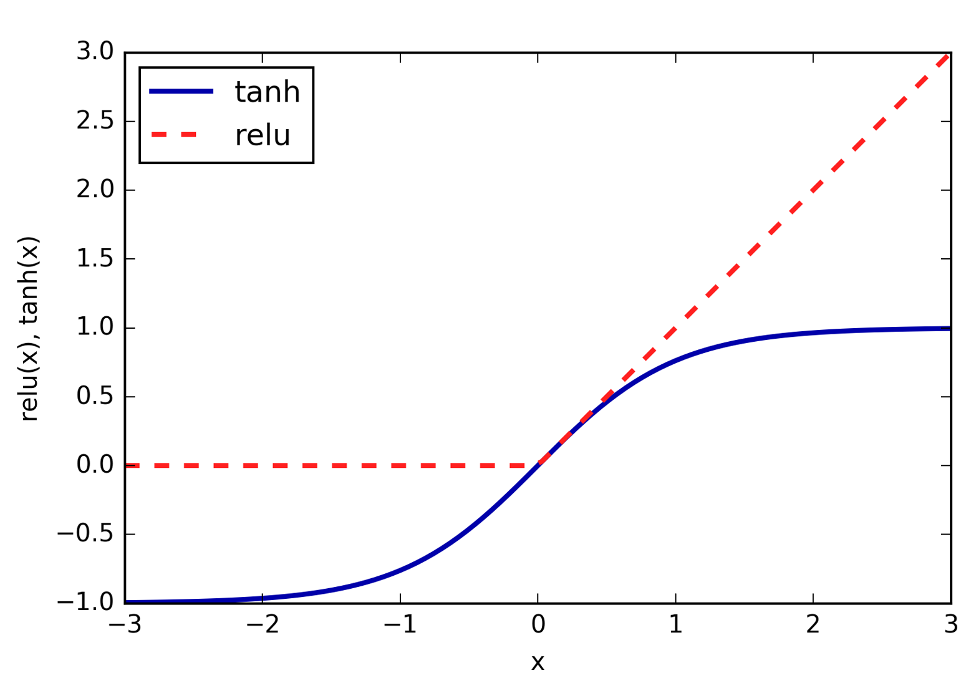
Neural Networks

Slide 33
When to use neural networks
Feed-forward vanilla: lots of data, to get the last couple %.
Convolutional neural nets: Images, audio, video
Recurrent neural nets: sequence prediction
Word-embeddings: text classification
Usually need lots of tuning and preprocessing.

Slide 34
Neural Network / Deep Learning Packages
Keras (Python)
Tensorflow (tf.learn) – (mainly Python)
Caffe (for convolutional nets maybe)
torch.nn (lua)

Slide 35
Parameter and Model selection

Slide 36

Three-fold split
pro: fast, simple
con: high variance, bad use of data.
Notes:
The simplest way to combat this overfitting to the test set is by using a three-fold split of the data, into a training, a validation and a test set.
We use the training set for model building, the validation set for parameter selection and the test set for a final evaluation of the model.
So how many models should you try out on the test set? Only one! Ideally use use the test-set exactly once, otherwise you make a multiple hypothesis testing error!
What are downsides of this? We lose a lot of data for evaluation, and the results depend on the particular sampling.

Slide 37

Cross-validation
Pro: more stable, more data
con: slower
Notes:
The answer is of course cross-validation. In cross-validation, you split your data into multiple folds, usually 5 or 10, and built multiple models.
You start by using fold1 as the test data, and the remaining ones as the training data. You build your model on the training data, and evaluate it on the test fold.
For each of the splits of the data, you get a model evaluation and a score. In the end, you can aggregate the scores, for example by taking the mean.
What are the pros and cons of this?
Each data point is in the test-set exactly once!
Takes 5 or 10 times longer!
Better data use (larger training sets).
Does that solve all problems? No, it replaces only one of the splits, usually the inner one!

Slide 38

Cross-validation + test-set
Notes:
Here is how the workflow looks like when we are using five-fold cross-validation together with a test-set split for adjusting parameters.
We start out by splitting of the test data, and then we perform cross-validation on the training set.
Once we found the right setting of the parameters, we retrain on the whole training set and evaluate on the test set.

Slide 39

Workflow
Notes:
Here is a conceptual overview of this way of tuning parameters, we start of with the dataset and a candidate set of parameters we want to try, labeled parameter grid, for example the number of neighbors.
We split the dataset in to training and test set. We use cross-validation and the parameter grid to find the best parameters.
We use the best parameters and the training set to build a model with the best parameters,
and finally evaluate it on the test set.

Slide 40
Sample application: Sentiment Analysis
see e.g. https://github.com/amueller/introduction_to_ml_with_python/blob/master/07-working-with-text-data.ipynb

Slide 41
IMDB Movie Reviews Data
Review:
One of the worst movies I've ever rented. Sorry it had one of my favorite actors on it (Travolta) in a nonsense role. In fact, anything made sense in this movie.
Who can say there was true love between Eddy and Maureen? Don't you remember the beginning of the movie ?
Is she so lovely? Ask her daughters. I don't think so.
Label: negative
Training data: 12500 positive, 12500 negative

Slide 42
Bag Of Word Representations
CountVectorizer / TfidfVectorizer
“This is how you get ants.”
tokenizer
['this', 'is', 'how', 'you', 'get', 'ants']
Build a vocabulary over all documents
['aardvak', 'amsterdam', 'ants', ... 'you', 'your', 'zyxst']
Sparse matrix encoding
aardvak
ants
get
you
zyxst
[0, …, 0, 1, 0, … , 0, 1 , 0, …, 0, 1, 0, …., 0 ]

Slide 43
N-grams (unigrams and bigrams)
CountVectorizer / TfidfVectorizer
“This is how you get ants.”
Unigram tokenizer
['this', 'is', 'how', 'you', 'get', 'ants']
“This is how you get ants.”
Bigram tokenizer
['this is', 'is how', 'how you', 'you get', 'get ants']

Slide 44
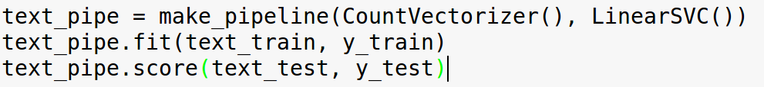
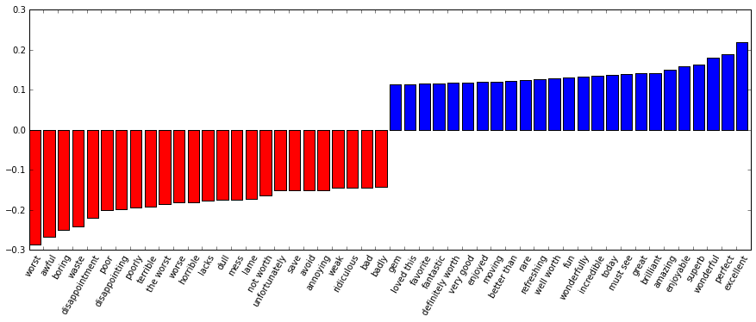

Slide 45
Take-aways
Try linear models first, random forest second
Preprocess your data.
Always keep a hold-out test set
Do either cross-validation on training set or three-fold split.
Are you underfitting or overfitting?

