Slide 1




Bootstrapping
Machine Learning
importamueller@gmail.com
@t3kcit
@amueller
peekaboo-vision.blogspot.com
Andreas Müller

Slide 2
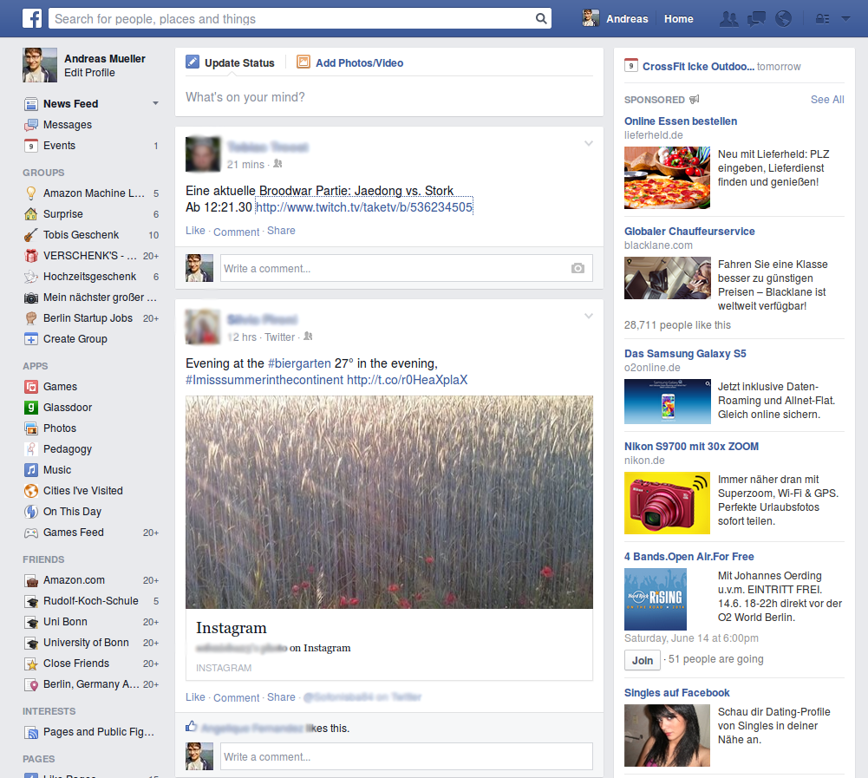

Slide 3
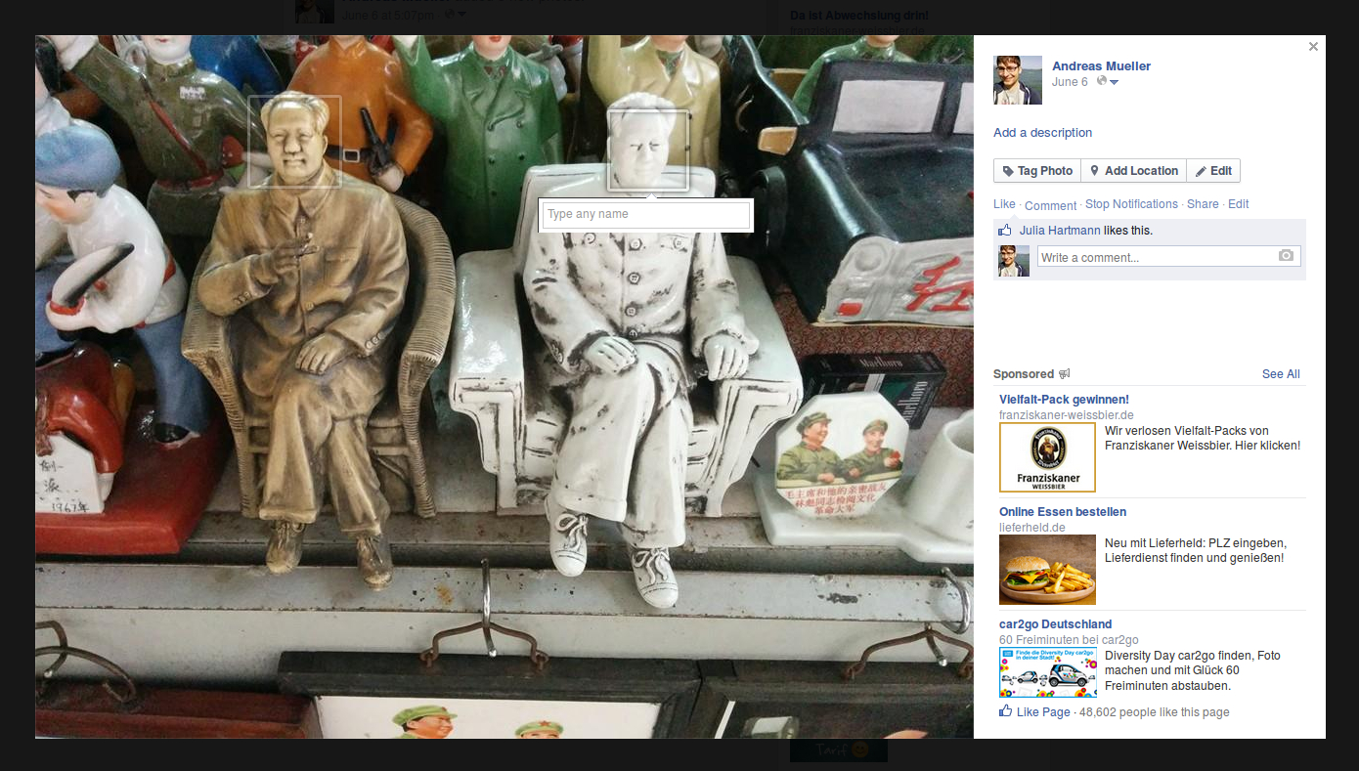

Slide 4
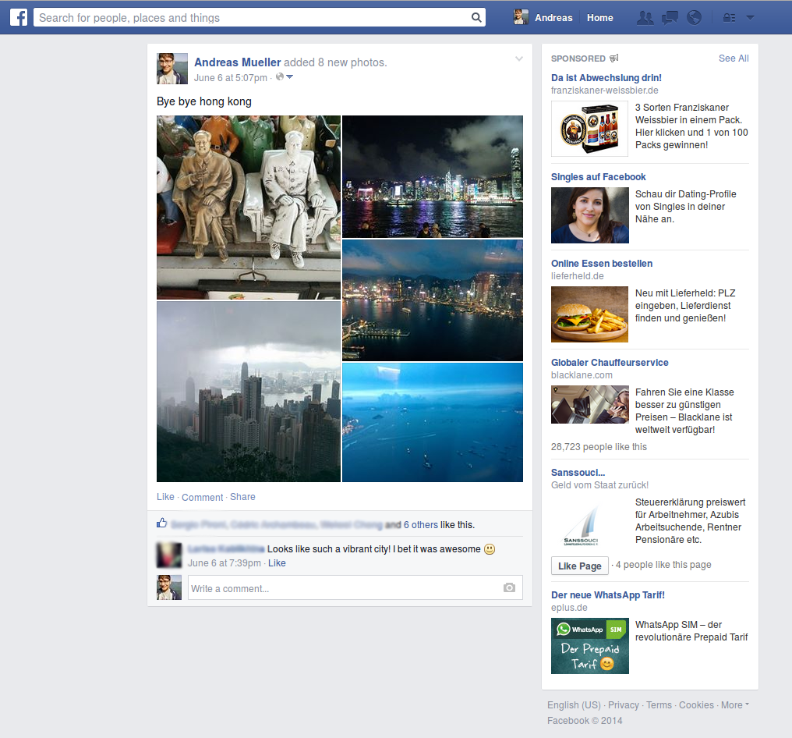

Slide 5
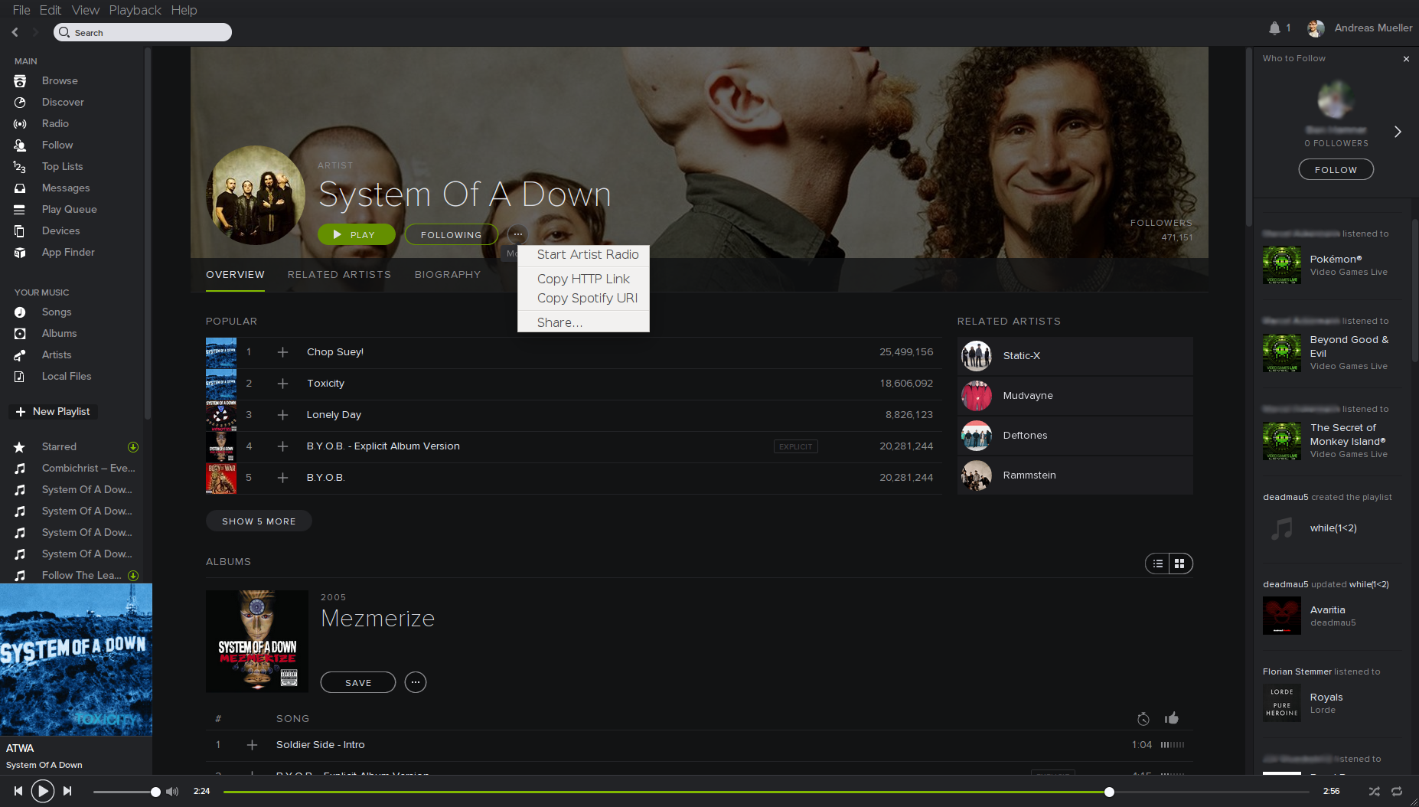

Slide 6
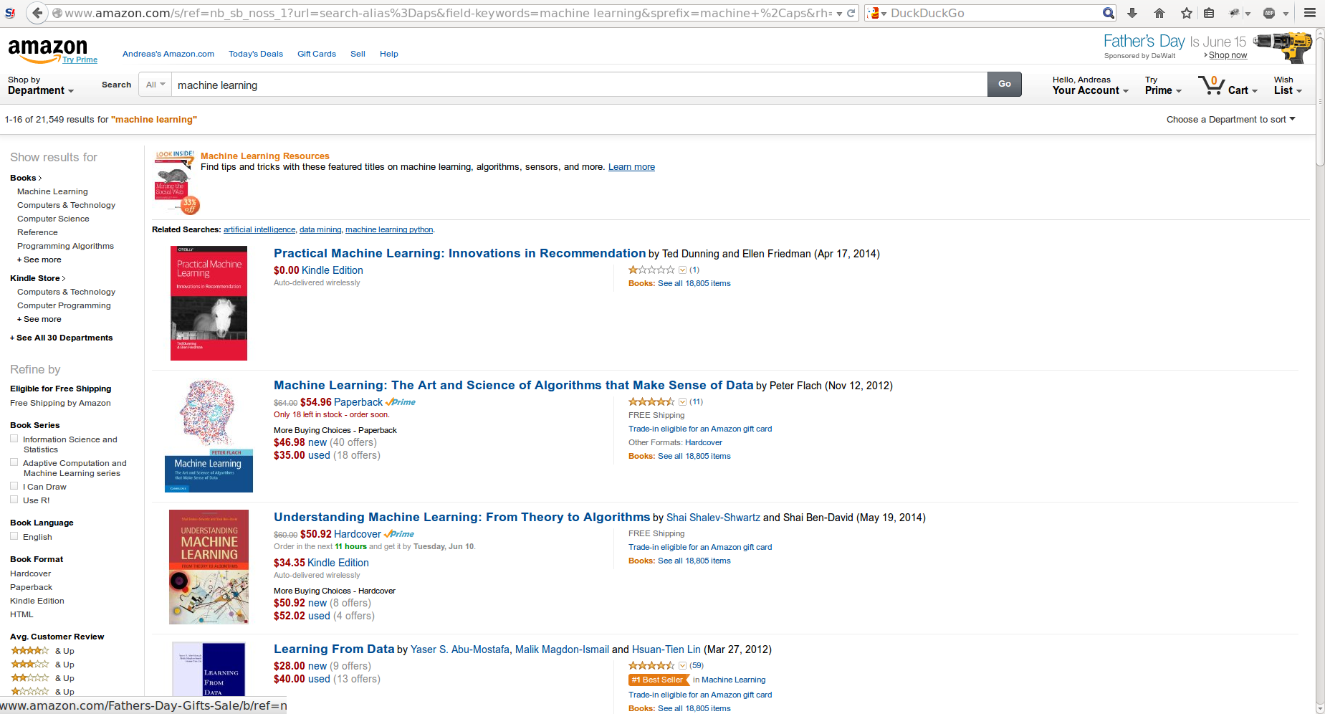

Slide 7
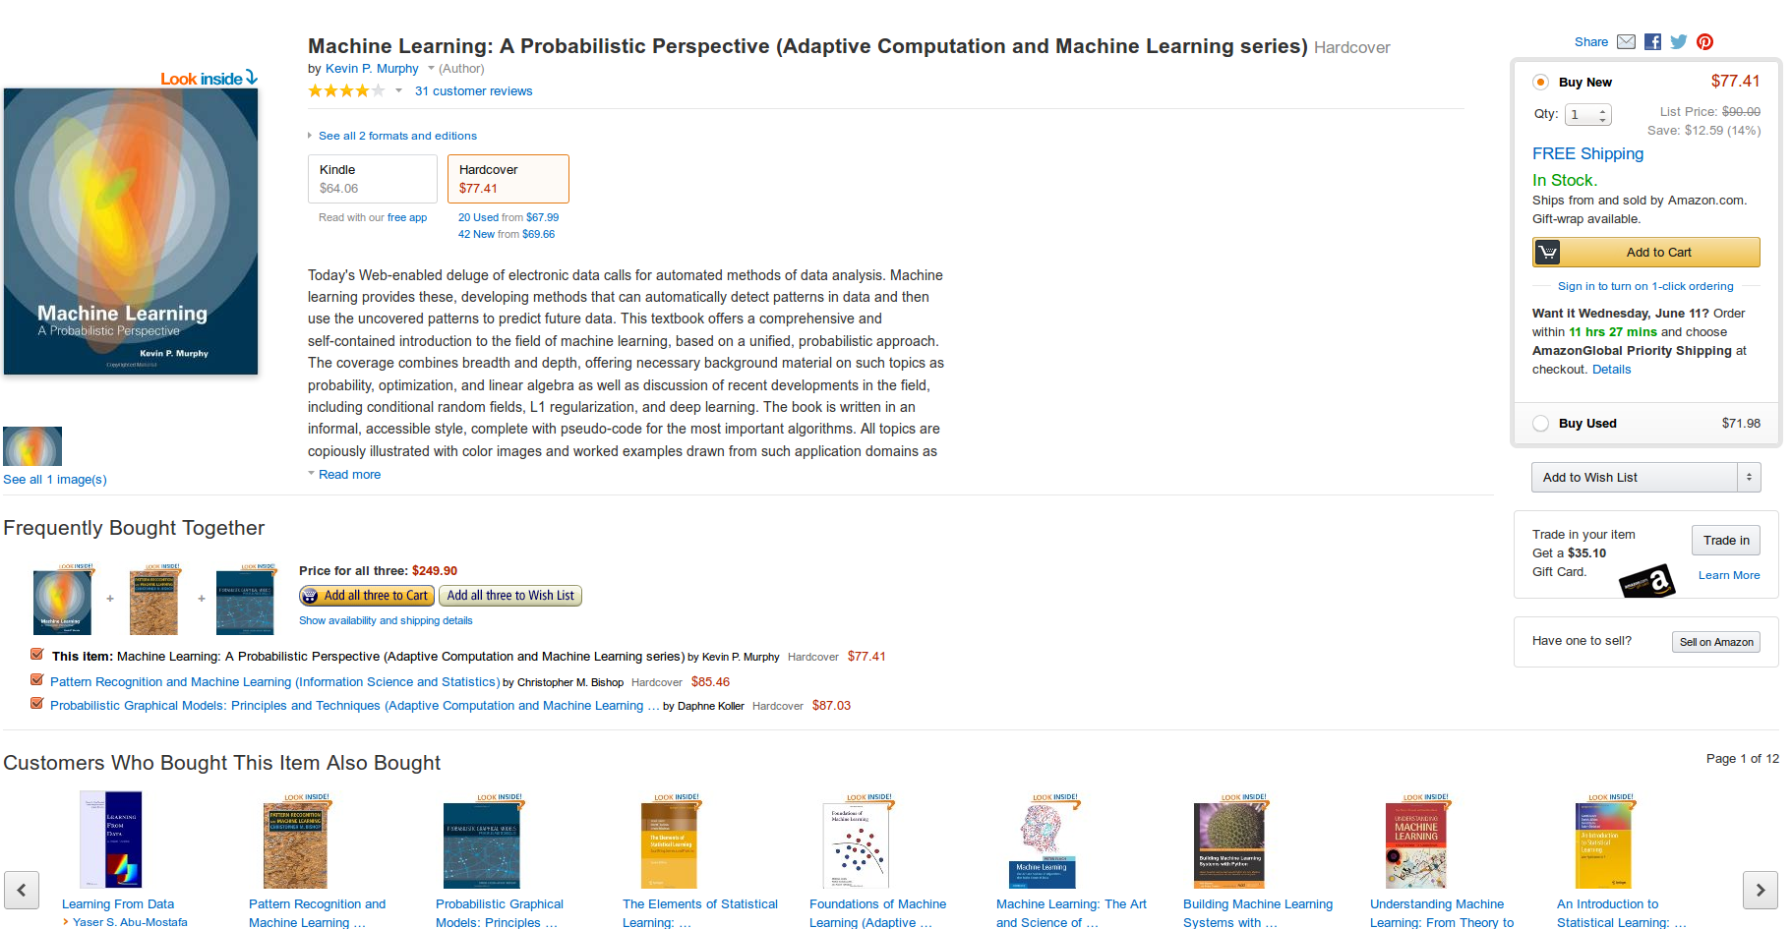

Slide 8
Smart, not Big

Slide 9
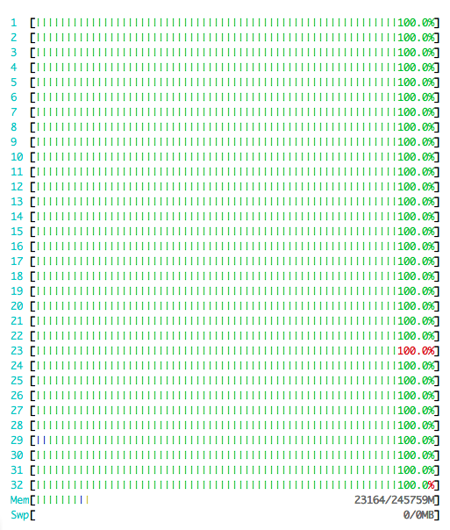

Slide 10




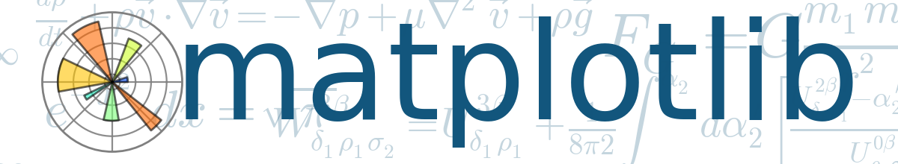



Slide 11
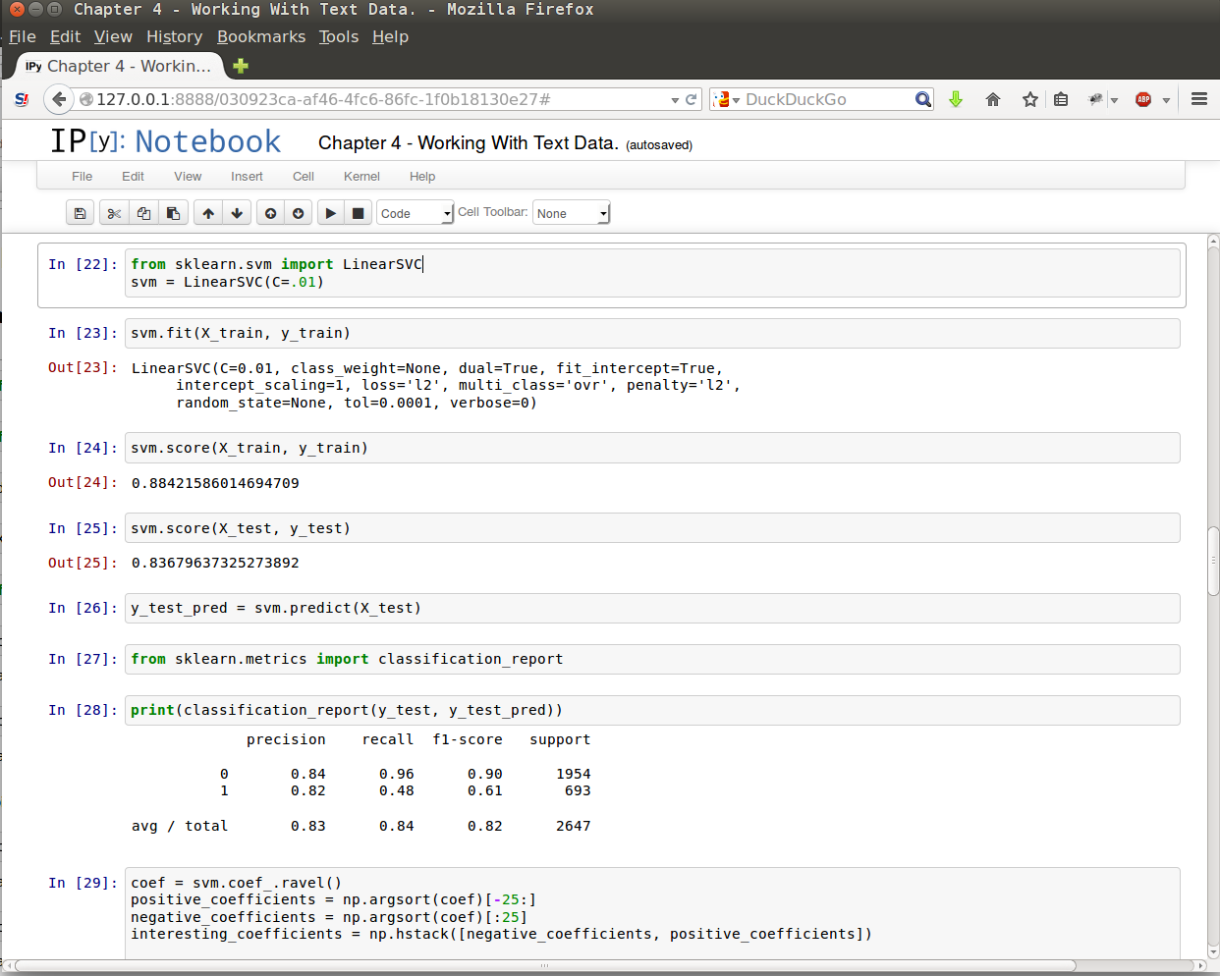
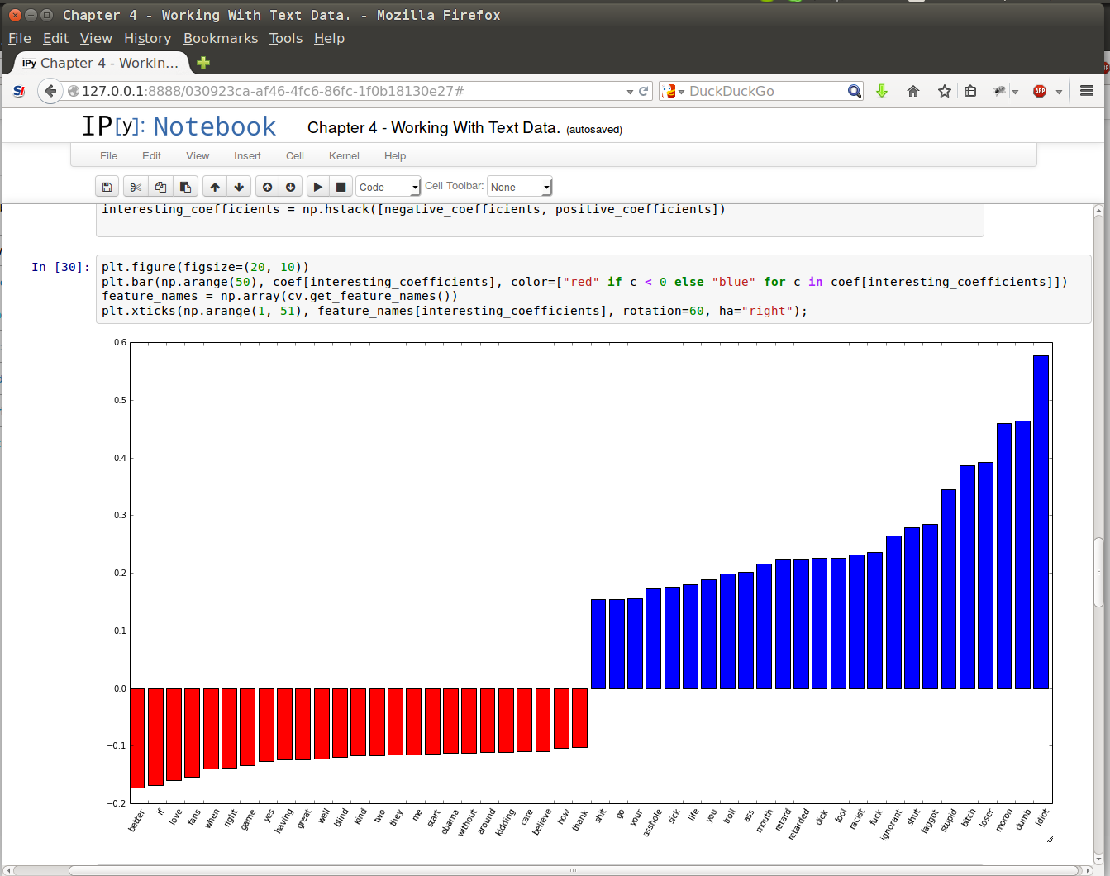

Slide 12
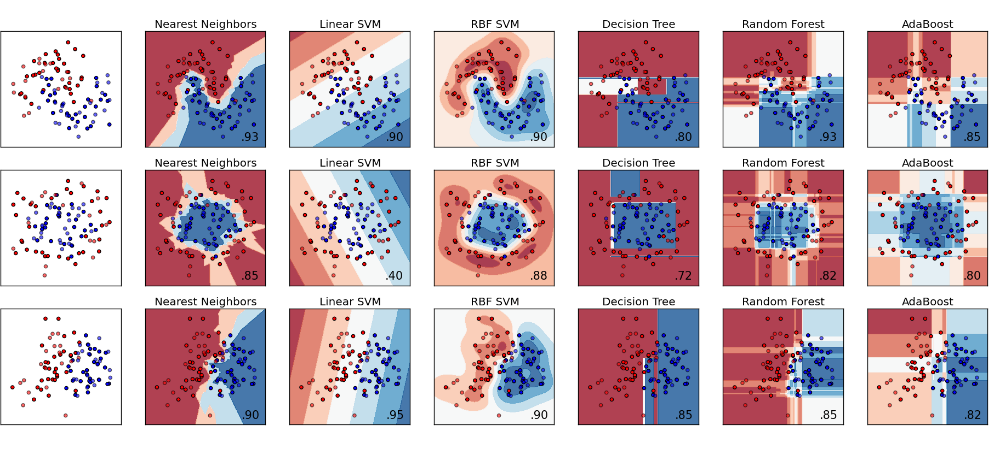

Slide 13








500+ research papers

Slide 14



Slide 15
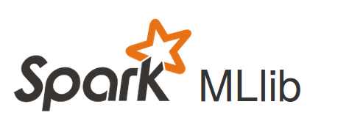
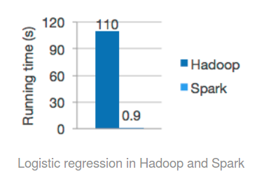

Slide 16

predict

Slide 17
Thank you.
importamueller@gmail.com
@t3kcit
@amueller
peekaboo-vision.blogspot.com
Andreas Müller

