Slide 1

Machine Learning with Scikit-Learn
Andreas Mueller (NYU Center for Data Science, scikit-learn)

Slide 2



Me

Slide 3
Classification
Regression
Clustering
Semi-Supervised Learning
Feature Selection
Feature Extraction
Manifold Learning
Dimensionality Reduction
Kernel Approximation
Hyperparameter Optimization
Evaluation Metrics
Out-of-core learning
…...

Slide 4
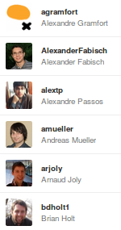
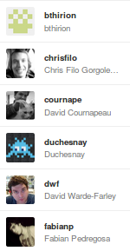
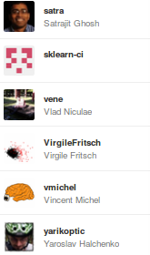
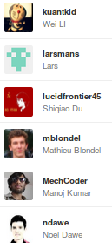
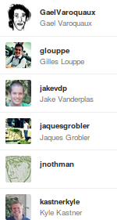
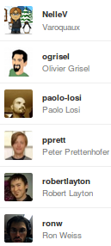

Slide 5
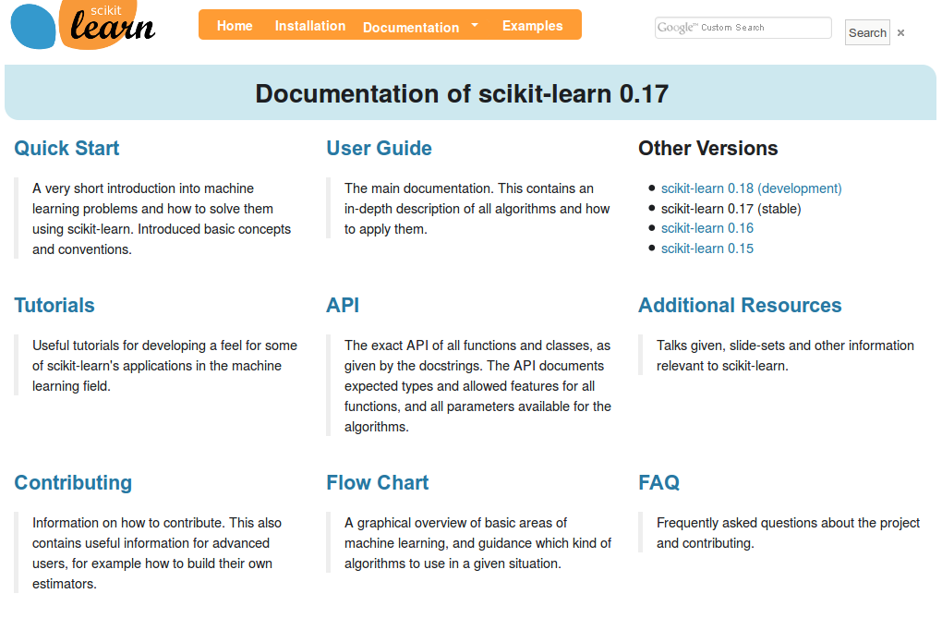
http://scikit-learn.org/

Slide 6
Doing Machine Learning With Scikit-Learn

Slide 7
Representing Data
one sample
1.1 | 2.2 | 3.4 | 5.6 | 1.0
6.7 | 0.5 | 0.4 | 2.6 | 1.6
2.4 | 9.3 | 7.3 | 6.4 | 2.8
1.5 | 0.0 | 4.3 | 8.3 | 3.4
0.5 | 3.5 | 8.1 | 3.6 | 4.6
5.1 | 9.7 | 3.5 | 7.9 | 5.1
3.7 | 7.8 | 2.6 | 3.2 | 6.3
1.6
2.7
4.4
0.5
0.2
5.6
6.7
X =
y =
one feature
outputs / labels

Slide 8
Supervised Machine Learning
clf = RandomForestClassifier()
clf.fit(X_train, y_train)
Training Data
Model
Training Labels
y_pred = clf.predict(X_test)
Test Data
Prediction
Test Labels
Evaluation
clf.score(X_test, y_test)

Slide 9
Unsupervised Transformations
pca = PCA()
pca.fit(X_train)
X_new = pca.transform(X_test)
Training Data
Model
Test Data
Transformation

Slide 10
Basic API
estimator.fit(X, [y])
estimator.predict | estimator.transform
Classification | Preprocessing
Regression | Dimensionality reduction
Clustering | Feature selection
 | Feature extraction

Slide 11
Model Evaluation and Model Selection

Slide 12
All Data
Training data
Test data
Fold 1
Fold 2
Fold 3
Fold 4
Fold 5
Split 1
Fold 1
Fold 2
Fold 3
Fold 4
Fold 5
Split 2
Fold 1
Fold 2
Fold 3
Fold 4
Fold 5
Split 3
Fold 1
Fold 2
Fold 3
Fold 4
Fold 5
Split 4
Fold 1
Fold 2
Fold 3
Fold 4
Fold 5
Split 5
Fold 1
Fold 2
Fold 3
Fold 4
Fold 5

Slide 13
Cross-Validation
from sklearn.cross_validation import cross_val_score
scores = cross_val_score(SVC(), X, y, cv=5)
print(scores)
>> [ 0.92 1. 1. 1. 1. ]

Slide 14
All Data
Training data
Test data
Fold 1
Fold 2
Fold 3
Fold 4
Fold 5
Split 1
Fold 1
Fold 2
Fold 3
Fold 4
Fold 5
Split 2
Fold 1
Fold 2
Fold 3
Fold 4
Fold 5
Finding Parameters
Split 3
Fold 1
Fold 2
Fold 3
Fold 4
Fold 5
Split 4
Fold 1
Fold 2
Fold 3
Fold 4
Fold 5
Split 5
Fold 1
Fold 2
Fold 3
Fold 4
Fold 5
Final evaluation
Test data

Slide 15
Cross -Validated Grid Search
from sklearn.grid_search import GridSearchCV
from sklearn.cross_validation import train_test_split
X_train, X_test, y_train, y_test = train_test_split(X, y)
param_grid = {'C': 10. ** np.arange(-3, 3),
'gamma': 10. ** np.arange(-3, 3)}
grid = GridSearchCV(SVC(), param_grid=param_grid)
grid.fit(X_train, y_train)
grid.predict(X_test)
grid.score(X_test, y_test)

Slide 16
Training Labels
Training Data
Model

Slide 17
Training Labels
Training Data
Feature
Extraction
Scaling
Feature
Selection
Model
Cross Validation

Slide 18
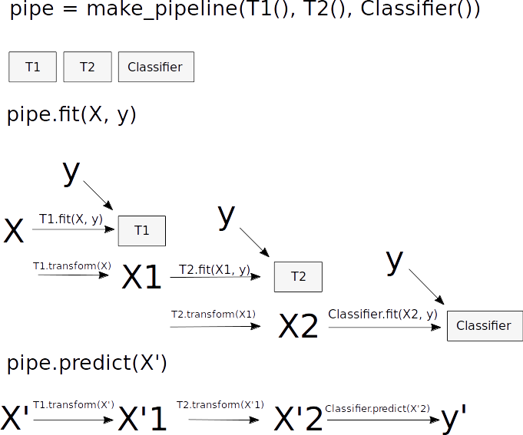
Pipelines

Slide 19
Combining Pipelines and
Grid Search
param_grid = {'svc__C': 10. ** np.arange(-3, 3),
'svc__gamma': 10. ** np.arange(-3, 3)}
scaler_pipe = make_pipeline(StandardScaler(), SVC())
grid = GridSearchCV(scaler_pipe, param_grid=param_grid, cv=5)
grid.fit(X_train, y_train)

Slide 20
Combining Pipelines and
Grid Search II
Searching over parameters of the preprocessing step
param_grid = {'selectkbest__k': [1, 2, 3, 4],
'svc__C': 10. ** np.arange(-3, 3),
'svc__gamma': 10. ** np.arange(-3, 3)}
scaler_pipe = make_pipeline(SelectKBest(), SVC())
grid = GridSearchCV(scaler_pipe, param_grid=param_grid, cv=5)
grid.fit(X_train, y_train)

Slide 21
Do cross-validation over all steps jointly.
Keep a separate test set until the very end.

Slide 22
Sample application: Sentiment Analysis

Slide 23
IMDB Movie Reviews Data
Review:
One of the worst movies I've ever rented. Sorry it had one of my favorite actors on it (Travolta) in a nonsense role. In fact, anything made sense in this movie.
Who can say there was true love between Eddy and Maureen? Don't you remember the beginning of the movie ?
Is she so lovely? Ask her daughters. I don't think so.
Label: negative
Training data: 12500 positive, 12500 negative

Slide 24
Bag Of Word Representations
CountVectorizer / TfidfVectorizer
“This is how you get ants.”
tokenizer
['this', 'is', 'how', 'you', 'get', 'ants']
Build a vocabulary over all documents
['aardvak', 'amsterdam', 'ants', ... 'you', 'your', 'zyxst']
Sparse matrix encoding
aardvak
ants
get
you
zyxst
[0, …, 0, 1, 0, … , 0, 1 , 0, …, 0, 1, 0, …., 0 ]

Slide 25
N-grams (unigrams and bigrams)
CountVectorizer / TfidfVectorizer
“This is how you get ants.”
Unigram tokenizer
['this', 'is', 'how', 'you', 'get', 'ants']
“This is how you get ants.”
Bigram tokenizer
['this is', 'is how', 'how you', 'you get', 'get ants']

Slide 26
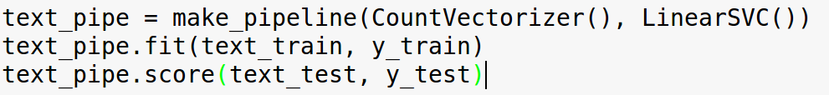
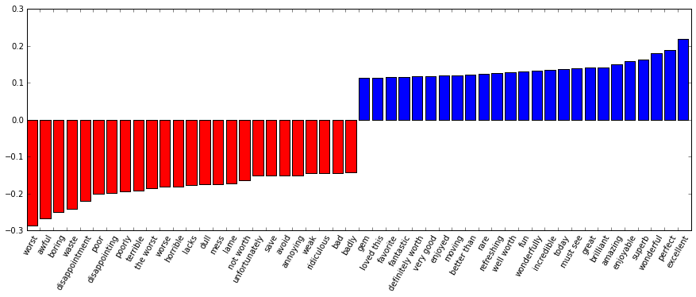

Slide 27
Scaling Up

Slide 28
Three regimes of data
Fits in RAM
Fits on a Hard Drive
Doesn't fit on a single PC

Slide 29
Three regimes of data
Fits in RAM (up to 256 GB?)
Fits on a Hard Drive (up to 6TB?)
Doesn't fit on a single PC

Slide 30
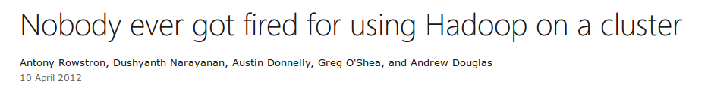

Slide 31
"256Gb ought to be enough for anybody."
- me
(for machine learning)

Slide 32
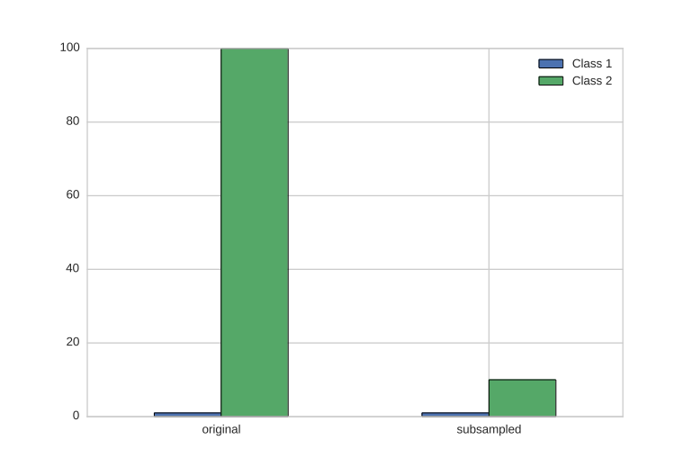
Subsample!

Slide 33
Out of core: The scikit-learn way

Slide 34
The Partial Fit Interface
HDD
Your for-loop / polling
estimator.partial_fit(X_batch, y_batch)
Trained
Scikit-learn
estimator
Network

Slide 35
Supported Algorithms
SGDClassifier/Regressor, Perceptron
Naive Bayes
MinibatchKMeans
Birch
IncrementalPCA
MiniBatchDictionaryLearning
Scalers
Latent Dirichlet Allocation
Stateless transformations

Slide 36
Hashing Trick
HashingVectorizer
“This is how you get ants.”
tokenizer
['this', 'is', 'how', 'you', 'get', 'ants']
hashing
[hash('this'), hash('is'), hash('how'), hash('you'), hash('get'), hash('ants')]
= [832412, 223788, 366226, 81185, 835749, 173092]
Sparse matrix encoding
[0, …, 0, 1, 0, … , 0, 1 , 0, …, 0, 1, 0, …., 0 ]

Slide 37
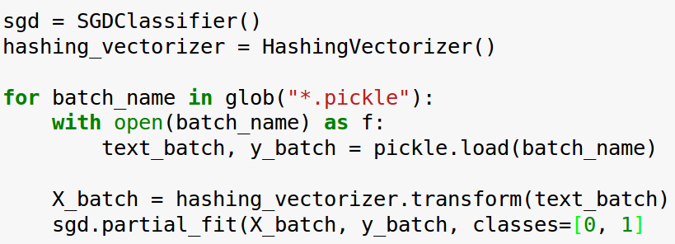
Text Classification: Hashing Trick

Slide 38
What's new?
0.17 (stable)
Latent Dirichlet Allocation
Faster NMF
Faster T-SNE
FunctionTransformer
VotingClassifier
0.18 (development)
Neural Network
Gaussian Process rewrite
Faster PCA

Slide 39
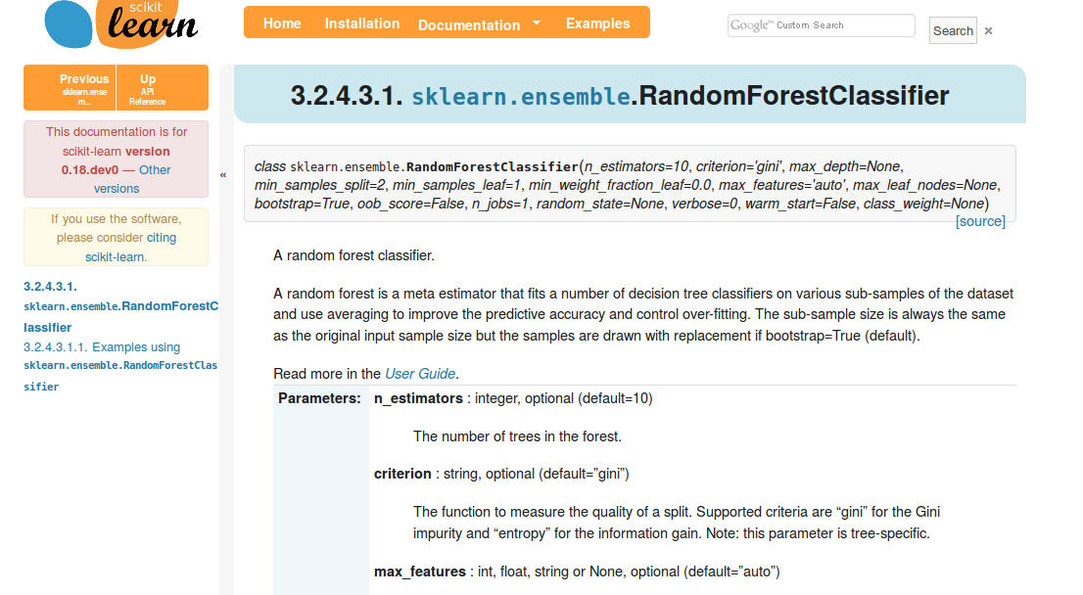
Add Backlinks to Docs

Slide 40
Engineering Scikit-Learn

Slide 41
Goal:
High quality, easy to use machine learning library.

Slide 42
Goal:
High quality, easy to use machine learning library.
Keep it usable, keep it maintainable.

Slide 43
Simple things should be simple, complex things should be possible.
Alan Kay

Slide 44
Methods

Slide 45
Scoping
Well established
Widely
useful
sklearn
Matrix in,
matrix out

Slide 46
Simplicity
est = Est()
est.fit(X_train, y_train)
est.score(X_test, y_test)

Slide 47
Consistency
grid = GridSearchCV(svm,param_grid)
grid.fit(X_train, y_train)
grid.score(X_test, y_test)

Slide 48
Sensible Defaults
Everything is default constructible!
for clf in [KneighborsClassifier(),
SVC(),
DecisionTreeClassifier(),
RandomForestClassifier(),
AdaBoostClassifier(),
GaussianNB(),
LDA(),
QDA()]:
clf.fit(X_train, y_train)
print(clf.score(X_test, y_test))

Slide 49
Common Tests
classifiers = all_estimators(type_filter='classifier')
for name, Classifier in classifiers:
# test classfiers can handle non-array data
yield check_classifier_data_not_an_array, name, Classifier
# test classifiers trained on a single label
# always return this label
yield check_classifiers_one_label, name, Classifier
yield check_classifiers_classes, name, Classifier
yield check_classifiers_pickle, name, Classifier
yield check_estimators_partial_fit_n_features, name, Classifier

Slide 50
Flat Class Hierarchy, Few Types
Numpy arrays / sparse matrices
Estimators
[Cross-validation objects]
[Scorers]

Slide 51
No Framework
“This looks frameworkish.” means “try again.”

Slide 52

Avoid Code
Code rots!
Hail all code deleters!

Slide 53



Three-Way Documentation

Slide 54
Challenges

Slide 55

Feature Creep

Slide 56


Two Language Problem

Slide 57
Backward compatibility
from sklearn.cross_validation import Bootstrap
Bootstrap(10)
sklearn/cross_validation.py:685:
DeprecationWarning: Bootstrap will no longer
be supported as a cross-validation method as of
version 0.15 and will be removed in 0.17.

Slide 58
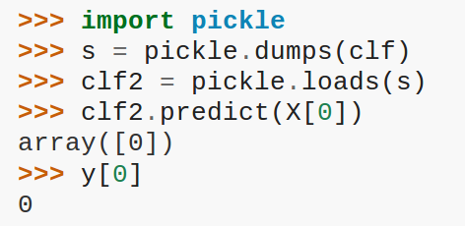
Backward compatibility

Slide 59
Correctness Testing
?

Slide 60


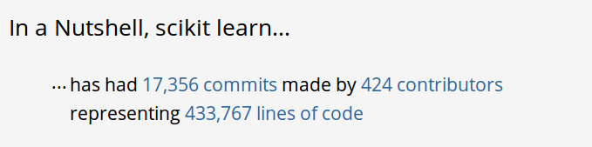
Project Size

Slide 61
Developer churn
Two Full time devs (Oliver Grisel & Myself)
Hundereds of “drive by” contributors

Slide 62
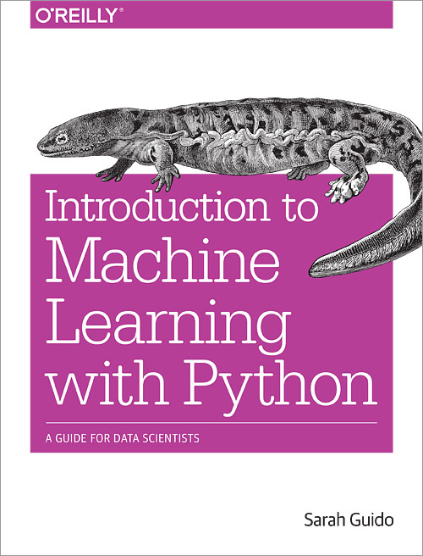
Video Series
Advanced Machine Learning with scikit-learn
50% Off Coupon Code: AUTHD

Slide 63




Thank you for your attention.
@t3kcit
@amueller
importamueller@gmail.com
http://amueller.github.io

