Slide 1

Advanced Scikit-Learn
Andreas Mueller (NYU Center for Data Science, scikit-learn)

Slide 2



Me

Slide 3
Classification
Regression
Clustering
Semi-Supervised Learning
Feature Selection
Feature Extraction
Manifold Learning
Dimensionality Reduction
Kernel Approximation
Hyperparameter Optimization
Evaluation Metrics
Out-of-core learning
…...

Slide 4






Slide 5
Overview
Reminder: Basic sklearn concepts
Model building and evaluation:
  Pipelines and Feature Unions
  Randomized Parameter Search
  Scoring Interface
Out of Core learning
  Feature Hashing
  Kernel Approximation
New stuff in 0.16.0
  Overview
  Calibration

Slide 6
Supervised Machine Learning
clf = RandomForestClassifier()
clf.fit(X_train, y_train)
y_pred = clf.predict(X_test)
Training Data
Model
Training Labels
Test Data
Prediction
Test Labels
Evaluation
clf.score(X_test, y_test)

Slide 7
Unsupervised Transformations
pca = PCA(n_components=3)
pca.fit(X_train)
X_new = pca.transform(X_test)
Training Data
Model
Test Data
Transformation

Slide 8
Basic API
estimator.fit(X, [y])
estimator.predict | estimator.transform
Classification | Preprocessing
Regression | Dimensionality reduction
Clustering | Feature selection
 | Feature extraction

Slide 9
Cross-Validation
from sklearn.cross_validation import cross_val_score
scores = cross_val_score(SVC(), X, y, cv=5)
print(scores)
>> [ 0.92 1. 1. 1. 1. ]

Slide 10
Cross-Validation
from sklearn.cross_validation import cross_val_score
scores = cross_val_score(SVC(), X, y, cv=5)
print(scores)
>> [ 0.92 1. 1. 1. 1. ]
cv_ss = ShuffleSplit(len(X_train), test_size=.3,
n_iter=10)
scores_shuffle_split = cross_val_score(SVC(), X, y,
cv=cv_ss)

Slide 11
Cross-Validation
from sklearn.cross_validation import cross_val_score
scores = cross_val_score(SVC(), X, y, cv=5)
print(scores)
>> [ 0.92 1. 1. 1. 1. ]
cv_ss = ShuffleSplit(len(X_train), test_size=.3,
n_iter=10)
scores_shuffle_split = cross_val_score(SVC(), X, y,
cv=cv_ss)
cv_labels = LeaveOneLabelOut(labels)
scores_pout = cross_val_score(SVC(), X, y, cv=cv_labels)

Slide 12

Cross -Validated Grid Search

Slide 13
Cross -Validated Grid Search
from sklearn.grid_search import GridSearchCV
from sklearn.cross_validation import train_test_split
X_train, X_test, y_train, y_test = train_test_split(X, y)
param_grid = {'C': 10. ** np.arange(-3, 3),
'gamma': 10. ** np.arange(-3, 3)}
grid = GridSearchCV(SVC(), param_grid=param_grid)
grid.fit(X_train, y_train)
grid.predict(X_test)
grid.score(X_test, y_test)

Slide 14
Training Labels
Training Data
Model

Slide 15
Training Labels
Training Data
Feature
Extraction
Scaling
Feature
Selection
Model
Cross Validation

Slide 16
Pipelines
from sklearn.pipeline import make_pipeline
pipe = make_pipeline(StandardScaler(), SVC())
pipe.fit(X_train, y_train)
pipe.predict(X_test)

Slide 17
Combining Pipelines and
Grid Search
Proper cross-validation
param_grid = {'svc__C': 10. ** np.arange(-3, 3),
'svc__gamma': 10. ** np.arange(-3, 3)}
scaler_pipe = make_pipeline(StandardScaler(), SVC())
grid = GridSearchCV(scaler_pipe, param_grid=param_grid, cv=5)
grid.fit(X_train, y_train)

Slide 18
Combining Pipelines and
Grid Search II
Searching over parameters of the preprocessing step
param_grid = {'selectkbest__k': [1, 2, 3, 4],
'svc__C': 10. ** np.arange(-3, 3),
'svc__gamma': 10. ** np.arange(-3, 3)}
scaler_pipe = make_pipeline(SelectKBest(), SVC())
grid = GridSearchCV(scaler_pipe, param_grid=param_grid, cv=5)
grid.fit(X_train, y_train)

Slide 19
Feature Union
Training Labels
Training Data
Feature
Extraction I
Feature
Extraction II
Model

Slide 20
Feature Union
char_and_word = make_union(CountVectorizer(analyzer="char"), CountVectorizer(analyzer="word"))
text_pipe = make_pipeline(char_and_word, LinearSVC(dual=False))
param_grid = {'linearsvc__C': 10. ** np.arange(-3, 3)}
grid = GridSearchCV(text_pipe, param_grid=param_grid, cv=5)
param_grid2 = {'featureunion__countvectorizer-1__ngram_range': [(1, 3), (1, 5), (2, 5)],
'featureunion__countvectorizer-2__ngram_range': [(1, 1), (1, 2), (2, 2)],
'linearsvc__C': 10. ** np.arange(-3, 3)}

Slide 21
Randomized Parameter Search

Slide 22

Randomized Parameter Search
Step-size free for continuous parameters
Decouples runtime from search-space size
Robust against irrelevant parameters
Source: Bergstra and Bengio

Slide 23
Randomized Parameter Search
params = {'featureunion__countvectorizer-1__ngram_range':
[(1, 3), (1, 5), (2, 5)],
'featureunion__countvectorizer-2__ngram_range':
[(1, 1), (1, 2), (2, 2)],
'linearsvc__C': 10. ** np.arange(-3, 3)}

Slide 24
Randomized Parameter Search
params = {'featureunion__countvectorizer-1__ngram_range':
[(1, 3), (1, 5), (2, 5)],
'featureunion__countvectorizer-2__ngram_range':
[(1, 1), (1, 2), (2, 2)],
'linearsvc__C': expon()}

Slide 25

Randomized Parameter Search
params = {'featureunion__countvectorizer-1__ngram_range':
[(1, 3), (1, 5), (2, 5)],
'featureunion__countvectorizer-2__ngram_range':
[(1, 1), (1, 2), (2, 2)],
'linearsvc__C': expon()}
rs = RandomizedSearchCV(text_pipe,
param_distributions=param_distributins, n_iter=50)

Slide 26
Randomized Parameter Search
Always use distributions for continuous variables.
Don't use for low dimensional spaces.
Future: Bayesian optimization based search.

Slide 27
Generalized Cross-Validation and Path Algorithms

Slide 28
rfe = RFE(LogisticRegression())
param_grid = {'n_features_to_select': range(1, n_features)}
gridsearch = GridSearchCV(rfe, param_grid)
grid.fit(X, y)
rfecv = RFECV(LogisticRegression())
rfecv.fit(X, y)

Slide 29
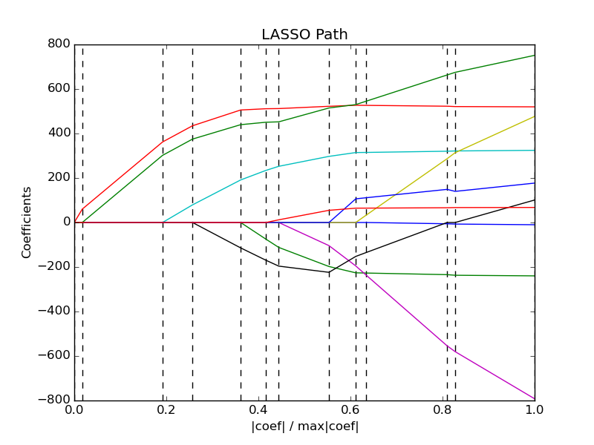

Slide 30
Linear Models | Feature Selection | Tree-Based models [possible]
LogisticRegressionCV [new] | RFECV | [DecisionTreeCV]
RidgeCV |  | [RandomForestClassifierCV]
RidgeClassifierCV |  | [GradientBoostingClassifierCV]
LarsCV
ElasticNetCV ...

Slide 31
Scoring Functions

Slide 32
GridSeachCV
RandomizedSearchCV
cross_val_score
...CV
Default:
Accuracy (classification)
R2 (regression)
For GridSeachCV
cross_val_score
validation_curve
Typical: accuracy

Slide 33

Scoring with imbalanced data
cross_val_score(SVC(), X_train, y_train)
>>> array([ 0.9, 0.9, 0.9])
cross_val_score(DummyClassifier("most_frequent"), X_train, y_train)
>>> array([ 0.9, 0.9, 0.9])
cross_val_score(SVC(), X_train, y_train, scoring="roc_auc")
array([ 0.99961591, 0.99983498, 0.99966247])

Slide 34
Available metrics
print(SCORERS.keys())
>> ['adjusted_rand_score',
'f1',
'mean_absolute_error',
'r2',
'recall',
'median_absolute_error',
'precision',
'log_loss',
'mean_squared_error',
'roc_auc',
'average_precision',
'accuracy']

Slide 35
Defining your own scoring
def my_super_scoring(est, X, y):
return accuracy_scorer(est, X, y) - np.sum(est.coef_ != 0)

Slide 36
Out of Core Learning

Slide 37

Or: save ourself the effort

Slide 38
Think twice!
Old laptop: 4GB Ram
1073741824 float32
Or 1mio data points with 1000 features
EC2 : 256 GB Ram
68719476736 float32
Or 68mio data points with 1000 features

Slide 39
Supported Algorithms
All SGDClassifier derivatives
Naive Bayes
MinibatchKMeans
IncrementalPCA
MiniBatchDictionaryLearning

Slide 40
Out of Core Learning
sgd = SGDClassifier()
for i in range(9):
X_batch, y_batch = cPickle.load(open("batch_%02d" % i))
sgd.partial_fit(X_batch, y_batch, classes=range(10))
Possibly go over the data multiple times.

Slide 41
Stateless Transformers
Normalizer
HashingVectorizer
RBFSampler (and other kernel approx)

Slide 42
Text data and the hashing trick

Slide 43
Bag Of Word Representations
CountVectorizer / TfidfVectorizer
“You better call Kenny Loggins”

Slide 44
Bag Of Word Representations
CountVectorizer / TfidfVectorizer
“You better call Kenny Loggins”
tokenizer
['you', 'better', 'call', 'kenny', 'loggins']

Slide 45
Bag Of Word Representations
CountVectorizer / TfidfVectorizer
“You better call Kenny Loggins”
tokenizer
['you', 'better', 'call', 'kenny', 'loggins']
Sparse matrix encoding
aardvak
better
call
you
zyxst
[0, …, 0, 1, 0, … , 0, 1 , 0, …, 0, 1, 0, …., 0 ]

Slide 46
Hashing Trick
HashingVectorizer
“You better call Kenny Loggins”
tokenizer
['you', 'better', 'call', 'kenny', 'loggins']
hashing
[hash('you'), hash('better'), hash('call'), hash('kenny'), hash('loggins')]
= [832412, 223788, 366226, 81185, 835749]
Sparse matrix encoding
[0, …, 0, 1, 0, … , 0, 1 , 0, …, 0, 1, 0, ... 0 ]

Slide 47
Out of Core Text Classification
sgd = SGDClassifier()
hashing_vectorizer = HashingVectorizer()
for i in range(9):
text_batch, y_batch = cPickle.load(open("text_%02d" % I))
X_batch = hashing_vectorizer.transform(text_batch)
sgd.partial_fit(X_batch, y_batch, classes=range(10))

Slide 48
Kernel Approximations

Slide 49

Reminder: Kernel Trick
x

Slide 50

Reminder: Kernel Trick

Slide 51
Reminder: Kernel Trick
Classifier linear → need only

Slide 52
Reminder: Kernel Trick
Classifier linear → need only
Linear:
Polynomial:
RBF:
Sigmoid:

Slide 53
Complexity
Solving kernelized SVM:
~O(n_samples ** 3)
Solving linear (primal) SVM:
~O(n_samples * n_features)
n_samples large? Go primal!

Slide 54
Undoing the Kernel Trick
Kernel approximation:
k =
= RBFSampler

Slide 55
Usage
sgd = SGDClassifier()
kernel_approximation = RBFSampler(gamma=.001, n_components=400)
for i in range(9):
X_batch, y_batch = cPickle.load(open("batch_%02d" % i))
if i == 0:
kernel_approximation.fit(X_batch)
X_transformed = kernel_approximation.transform(X_batch)
sgd.partial_fit(X_transformed, y_batch, classes=range(10))

Slide 56
Highlights from 0.16.0

Slide 57
Highlights from 0.16.0
Multinomial Logistic Regression, LogisticRegressionCV.
IncrementalPCA.
Probability callibration of classifiers.
Birch clustering.
LSHForest.
More robust integration with pandas.

Slide 58
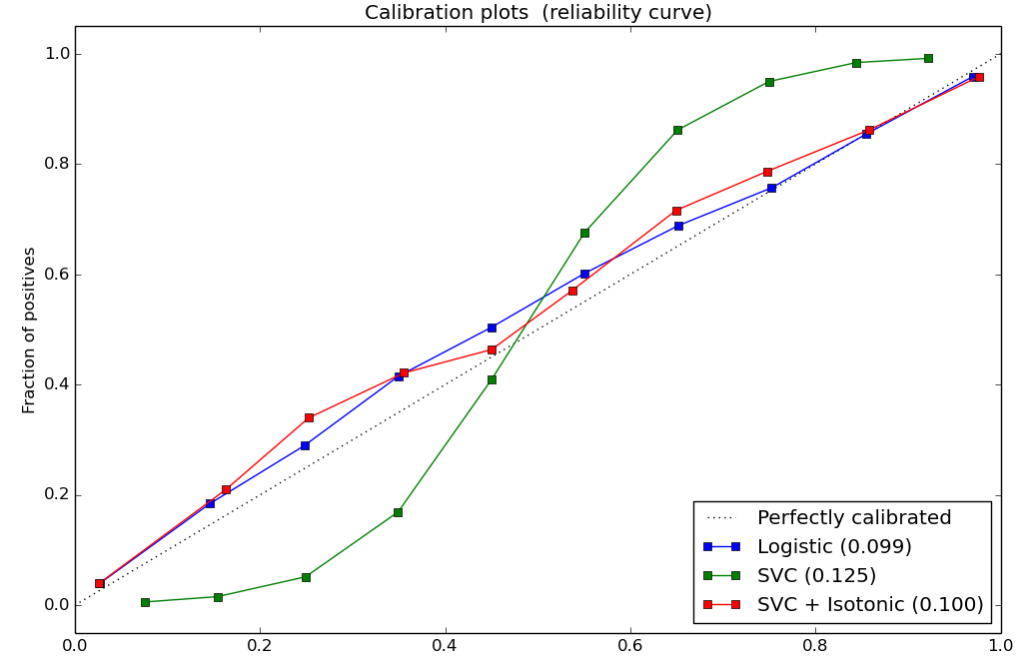
Probability Calibration
SVC().decision_function()
→ CalibratedClassifierCV(SVC()).predict_proba()
RandomForestClassifier().predict_proba()
→ CalibratedClassifierCV(RandomForestClassifier()).predict_proba()

Slide 59


Slide 60
CDS is hiring Research Engineers

Slide 61



Thank you for your attention.
@t3kcit
@amueller
t3kcit@gmail.com

Slide 62
Bias Variance Tradeoff
(why we do cross validation and grid searches)

Slide 63
Overfitting and Underfitting
Training
Sweet spot
Accuracy
Generalization
Underfitting
Overfitting
Model complexity

Slide 64

Linear SVM

Slide 65


(RBF) Kernel SVM

Slide 66











Decision Trees

Slide 67




Random Forests

Slide 68
Know where you are on the bias-variance tradeoff

Slide 69

Validation Curves
train_scores, test_scores = validation_curve(SVC(), X, y, param_name="gamma", param_range=param_range)

Slide 70

Learning Curves
train_sizes, train_scores, test_scores = learning_curve(
estimator, X, y,train_sizes=train_sizes)

