Slide 1
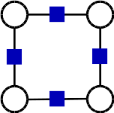
PyStruct
Structured Prediction in Python
Andreas Mueller (NYU Center for Data Science, scikit-learn)

Slide 2
Structured Prediction

Slide 3
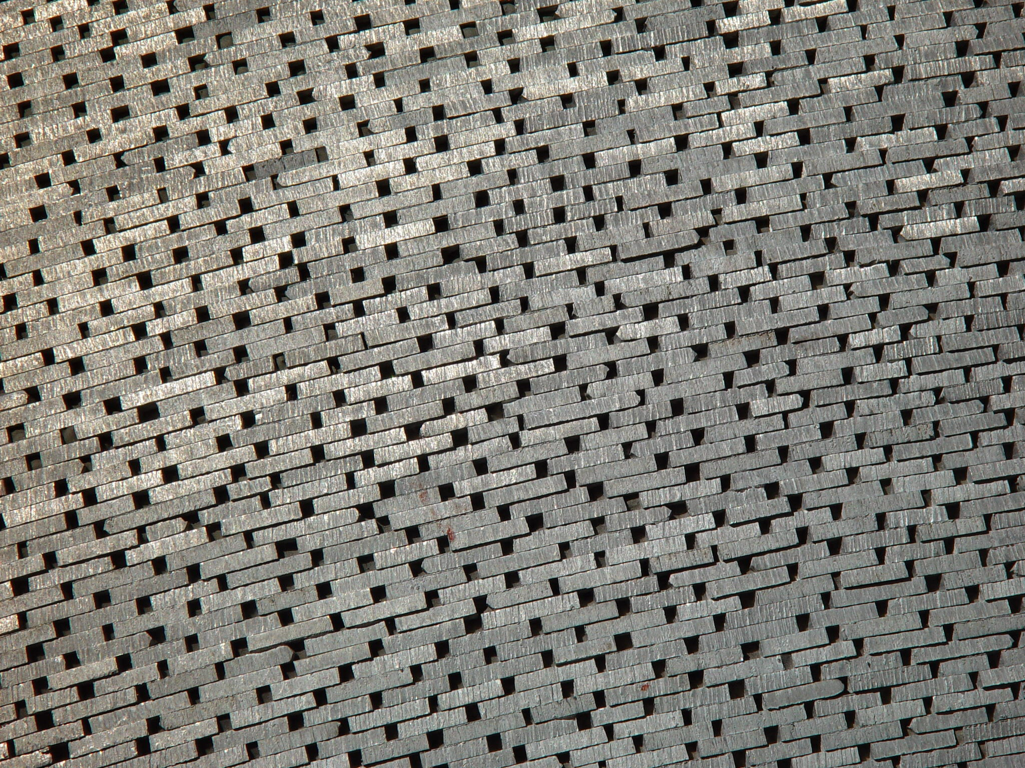
Why structure?

Slide 4
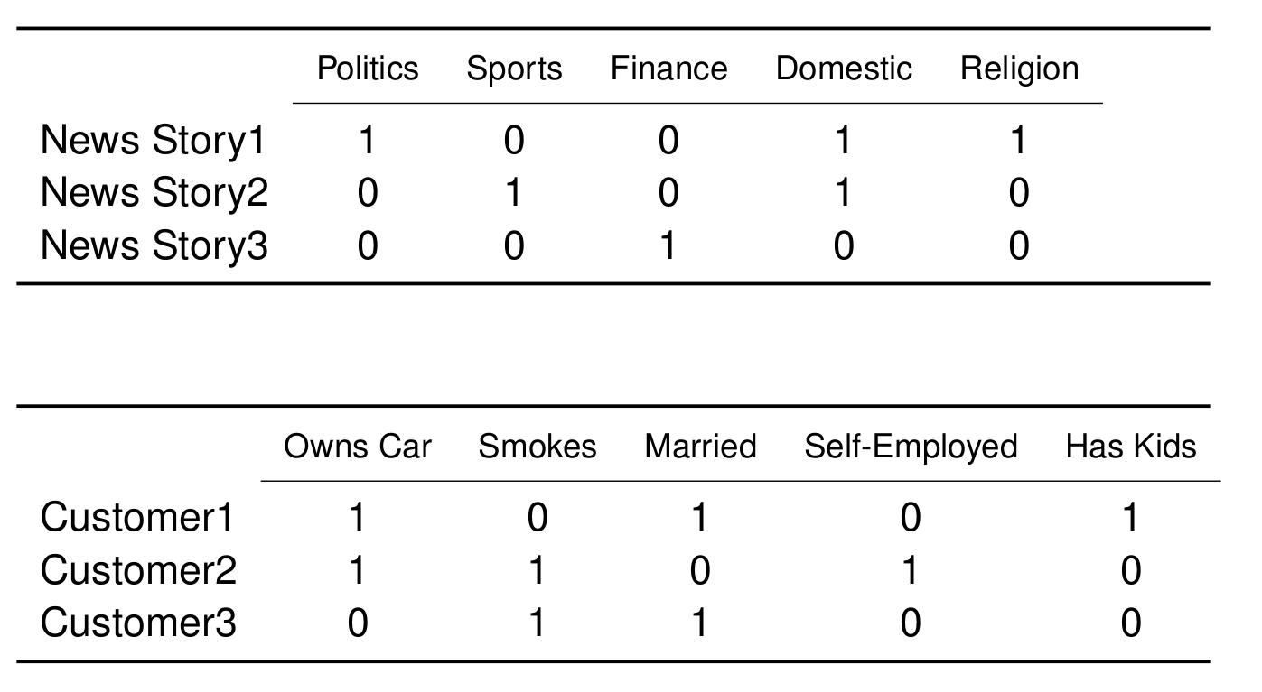
Applications: Multi-Label Classification

Slide 5
Applications: Multi-Label Classification

Slide 6
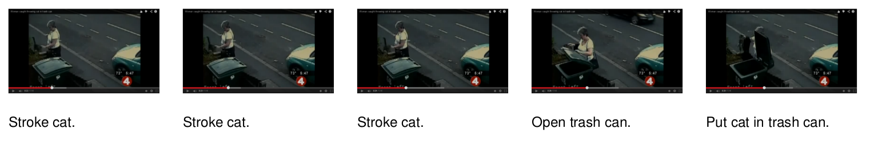
Applications: Sequence Tagging

Slide 7
Applications: Sequence Tagging

Slide 8
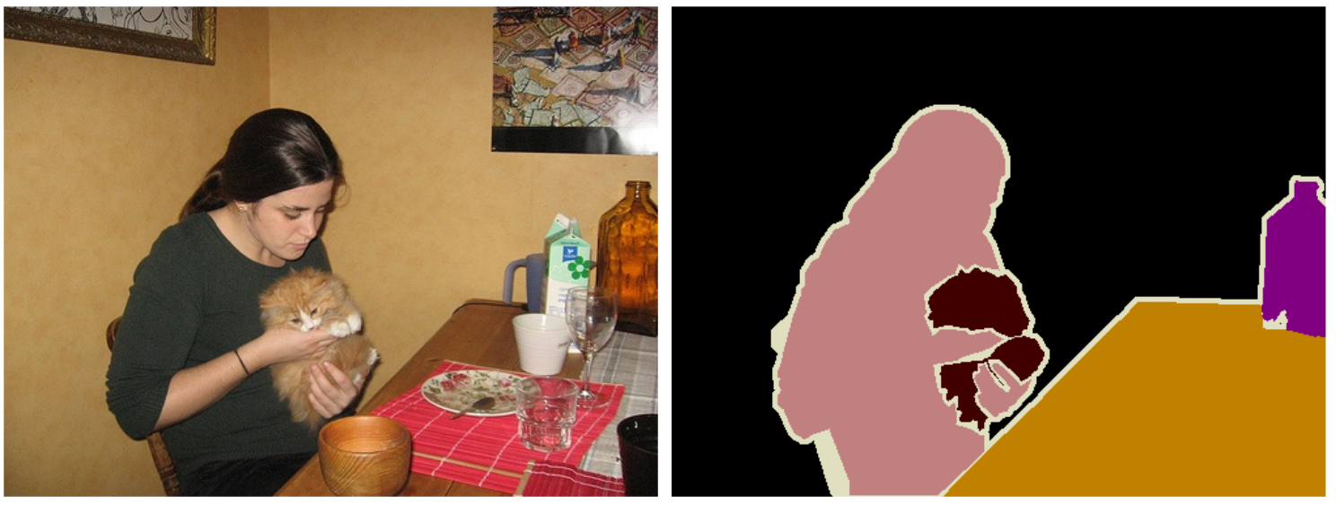
Applications: Image Segmentation

Slide 9

Careful: Math ahead

Slide 10
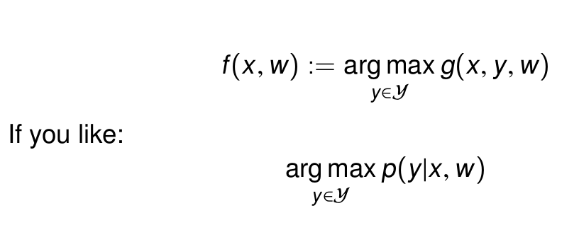
The Essence of
Structured Prediction

Slide 11
The Essence of
Structured Prediction

Slide 12
Pairwise Structured Models

Slide 13
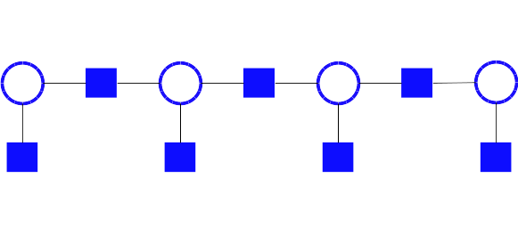
Pairwise Structured Models

Slide 14

Architecture

Slide 15
PyStruct Architecture
Estimator = Learner + Model + Inference

Slide 16
PyStruct Architecture
Estimator = Learner + Model + Inference
model = ChainCRF(inference="max_product")
ssvm = OneSlackSSVM(model=model, C=.1, inference_cache=50,, tol=0.1, verbose=3)
ssvm.fit(X_train, y_train)

Slide 17
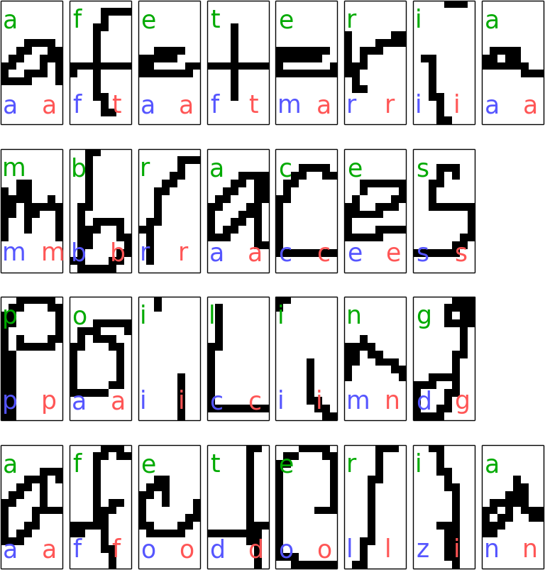
Sequence Tagging example
model = ChainCRF(inference="max_product")
ssvm = OneSlackSSVM(model=model, C=.1, inference_cache=50,, tol=0.1, verbose=3)
ssvm.fit(X_train, y_train)

Slide 18
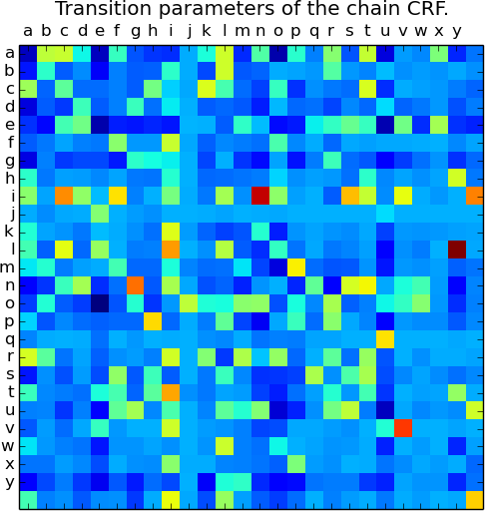
Sequence Tagging example
model = ChainCRF(inference="max_product")
ssvm = OneSlackSSVM(model=model, C=.1, inference_cache=50,, tol=0.1, verbose=3)
ssvm.fit(X_train, y_train)

Slide 19
The Devil is in the Inference
Easy: Dynamic Programming

Slide 20
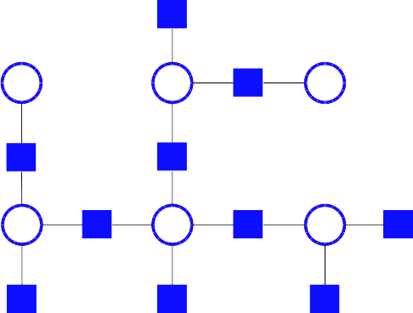
The Devil is in the Inference
Easy: Dynamic Programming

Slide 21
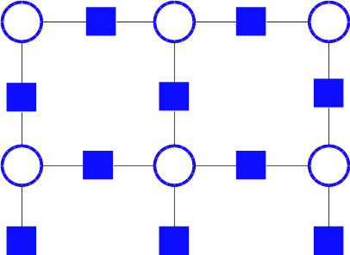
The Devil is in the Inference
HARD!
AD3, QPBO, LP, Loopy BP, ….

Slide 22
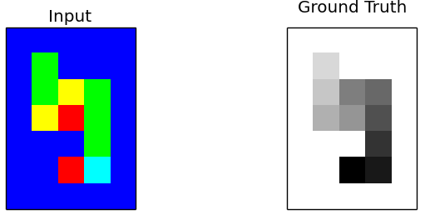
Grid Graphs: Snakes

Slide 23
Grid Graphs: Snakes
crf = EdgeFeatureGraphCRF(inference_method='qpbo')
ssvm = OneSlackSSVM(crf, inference_cache=50, C=.1, tol=.1,
switch_to='ad3', n_jobs=1)
ssvm.fit(X_train_edge_features, Y_train_flat)

Slide 24
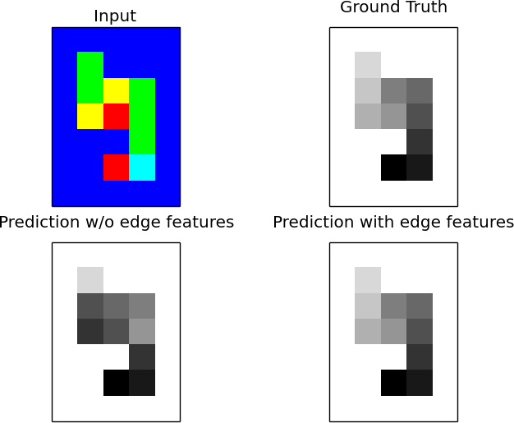
Grid Graphs: Snakes

Slide 25
Implemented Methods
Estimator = Learner + Model + Inference
Learner: SubgradientSSVM, StructuredPerceptron, OneSlackSSVM, LatentSSVM
Model: BinaryClf, MultiLabelClf, ChainCRF, GraphCRF, EdgeFeatureGraphCRF
Inference: Linear Programming, QPBO (PyQPBO), Dual Decomposition (AD3), Message Passing, everything (OpenGM)

Slide 26
Classes of Inference Algorithms
Exact Algorithms
Max-Product (Chains, Trees) 'max-product'
Exhaustive (usually too expensive)
Relaxed algorithms + branch & bound
('ad3', {'branch_and_bound': True})
Relaxed
Linear Programming (slooow) 'lp'
Dual Decomposition 'ad3'
Approximate / heuristics
Loopy message passing 'max-product'
QPBO 'qpbo'

Slide 27
Classes of Inference Algorithms
Exact Algorithms
Max-Product (Chains, Trees) 'max-product'
Exhaustive (usually too expensive)
Relaxed algorithms + branch & bound
('ad3', {'branch_and_bound': True})
Relaxed
Linear Programming (slooow) 'lp'
Dual Decomposition 'ad3'
Approximate / heuristics
Loopy message passing 'max-product'
QPBO 'qpbo'
Install OpenGM for many more!

Slide 28
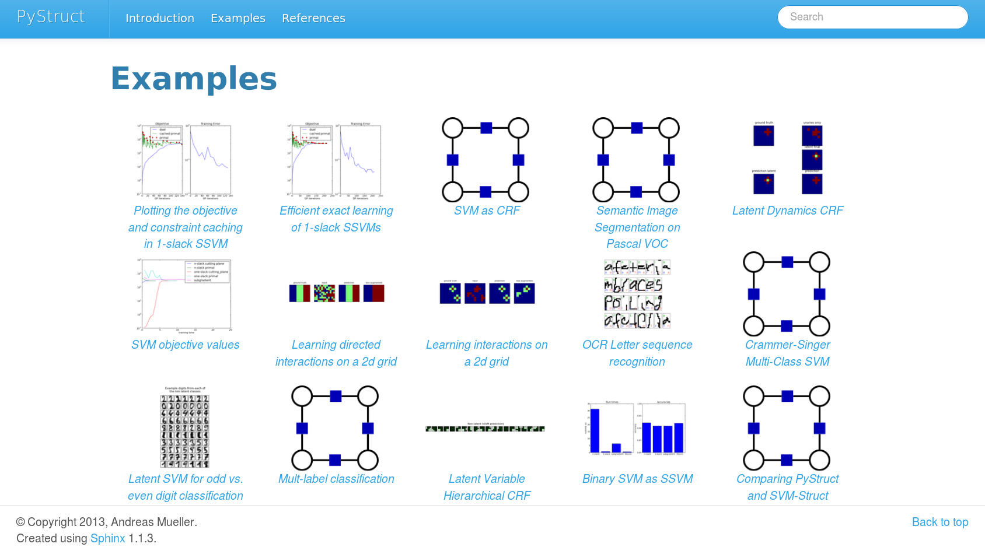

Slide 29




Thank you for your attention.
@t3kcit
@amueller
t3kcit@gmail.com
http://amueller.github.io

