Slide 1

Engineering
Andreas Mueller (NYU Center for Data Science, scikit-learn)

Slide 2
Goals
Achievements
Methods
Challenges
Open Questions
Outlook

Slide 3
Goals

Slide 4
High quality, easy to use machine learning library.
Keep it usable, keep it maintainable.

Slide 5
Simple things should be simple, complex things should be possible.
Alan Kay

Slide 6
Non-Goals
Non-programmatic interfaces
Algorithm development
Cutting edge algorithms
Structured, active, or reinforcement learning.

Slide 7
Achievements

Slide 8


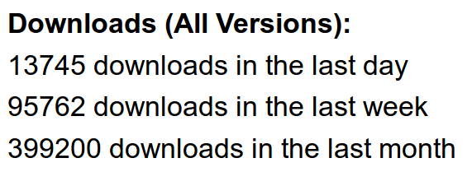



Slide 9
We’ve been using it quite a lot for music recommendations at Spotify and I think it’s the most well-designed ML package I’ve seen so far.
- spotify
scikit-learn in one word: Awesome.
- machinalis
I’m constantly recommending that more developers and scientists try scikit-learn.
- lovely
The documentation is really thorough, as well, which makes the library quite easy to use.
- OkCupid
scikit-learn makes doing advanced analysis in Python accessible to anyone.
- yhat

Slide 10
Methods

Slide 11
Scoping
Well established
Widely
useful
sklearn
Matrix in,
matrix out

Slide 12
Simplicity
est = Est()
est.fit(X_train, y_train)
est.score(X_test, y_test)

Slide 13
Consistency
grid = GridSearchCV(svm,param_grid)
grid.fit(X_train, y_train)
grid.score(X_test, y_test)

Slide 14
Sensible Defaults
Everything is default constructible!
for clf in [KneighborsClassifier(),
SVC(),
DecisionTreeClassifier(),
RandomForestClassifier(),
AdaBoostClassifier(),
GaussianNB(),
LDA(),
QDA()]:
clf.fit(X_train, y_train)
print(clf.score(X_test, y_test))

Slide 15
Common Tests
classifiers = all_estimators(type_filter='classifier')
for name, Classifier in classifiers:
# test classfiers can handle non-array data
yield check_classifier_data_not_an_array, name, Classifier
# test classifiers trained on a single label
# always return this label
yield check_classifiers_one_label, name, Classifier
yield check_classifiers_classes, name, Classifier
yield check_classifiers_pickle, name, Classifier
yield check_estimators_partial_fit_n_features, name, Classifier

Slide 16
Flat Class Hierarchy, Few Types
Numpy arrays / sparse matrices
Estimators
[Cross-validation objects]
[Scorers]

Slide 17
No Framework
“This looks frameworkish.” means “try again.”

Slide 18

Avoid Code
Code rots!
Hail all code deleters!

Slide 19



Three-Way Documentation

Slide 20
Challenges

Slide 21

Feature Creep

Slide 22
Multi-Platform Support
Linux / Mac / Windows / Solaris (no kidding)
32bit / 64bit
Python2.6 / Python2.7 / Python3.4 / Python3.5
GCC, Clang, MSVC
OpenBLAS, ATLAS, Accelerate
And we want “one click” install

Slide 23


Two Language Problem

Slide 24
Two Language Problem
C / C++

Slide 25


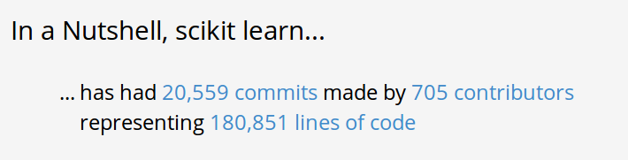
Project Size

Slide 26
Open Questions

Slide 27
Backward compatibility
from sklearn.cross_validation import Bootstrap
Bootstrap(10)
sklearn/cross_validation.py:685:
DeprecationWarning: Bootstrap will no longer
be supported as a cross-validation method as of
version 0.15 and will be removed in 0.17.

Slide 28
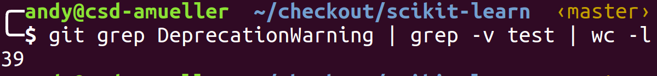
Backward compatibility

Slide 29
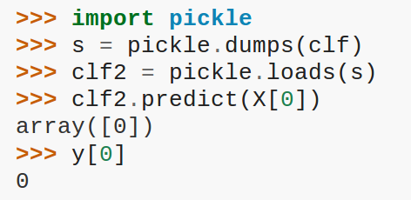
Backward compatibility

Slide 30
Categorical Variables?

Slide 31
Data Structures?
Pandas vs Numpy?

Slide 32
Parallelization
OpenMP? Spark? Hadoop?

Slide 33
CRAN vs PyPi vs scikit-learn

Slide 34
Better Defaults? Benchmarking?

Slide 35
Plotting

Slide 36
Sample Props?

Slide 37
Streaming Pipelines

Slide 38
Correctness Testing
?

Slide 39
Closed Questions

Slide 40
Deep Learning and GPUs

Slide 41
Recommenders?

Slide 42
Outlook

Slide 43
Default Grids

Slide 44
GP based parameter optimization

Slide 45
Better OneHotEncoder

Slide 46
Better Feature Name Support

Slide 47
Smarter GridSearch

Slide 48



@amuellerml
@amueller
amueller@nyu.edu

