Slide 1


Introduction to
Machine Learning
with Python
Andreas Müller
Columbia University, scikit-learn
Notes:
Hey and welcome to my talk on machine learning and how to do it with python.
My goal for the next 45 minutes is to convince you that machine learning can help you in your research, make your life easier, and allow you to process much more data than you could before – and that it’s all pretty easy to do.
I’m andy, I work at Columbia and I’ve been contributing to the scikit-learn project for a couple of years now. Scikit-learn is the main machine learning tool in python and I’ll tell you a bit more about it later.

Slide 2
What is machine learning?
Notes:
So let’s dive right in and talk about what machine learning is. Machine learning is about extracting knowledge from data. It is closely related to statistics and optimization.
What distinguishes machine learning is that it is very focused on prediction.
We want to learn from a large dataset how to make decisions based on future observations.
You could say that the input to a machine learning program is the dataset, and the output is a program that can make decisions on future observations.

Slide 3
Types of machine learning:
- supervised
- unsupervised
- reinforcement
Notes:
There are three main branches of machine learning, called supervised learning, unsupervised learning and reinforcement learning.
I will talk mostly about supervised learning, but I want to briefly give an overview of the other two types.

Slide 4
Supervised Learning
i.i.d.
Notes:
In supervised learning, the dataset we learn form is input-output pairs (x_i, y_i), where x_i is some n_dimensional input, or feature vector, and y_i is the desired output we want to learn.
We assume these samples are drawn from some unknown joint distribution p(x, y).
You can think of this as there being some (not necessarily deterministic) process that goes from x_i to y_i, but that we don’t know.
The goal is to learn a function f so that for new inputs x , and unobserved y, f(x) is approximately y.
This Is very closely related to function approximation.
The name supervised comes from the fact that during learning, a supervisor gives you the correct answers y_i.

Slide 5
Examples of Supervised Learning
Notes:
Here are some examples of supervised learning.
Given an array of test results from a patient, does this patient have diabetes? The x_i would be the different test results, and y_i would be diabetes or no diabetes.
Given a piece of a satellite image, what is the terrain in this image? Here x_i would be the pixels of the image, and y_i would be the terrain types.
In your setting, it’s probably good to think of each x_i as an experiment, and each entry of x_i as one sensor measurement.
This is often used to automate manual labor. For example, you might annotate part of a dataset manually, then learn a machine learning model from this annotations, and use the model to annotate the rest of your data.

Slide 6
Unsupervised Learning
Learn about p
Notes:
In unsupervised machine learning, we are just given data points x_i, that are assumed to be drawn from an unknown distribution. Usually we want to learn something about these, such as whether they lie on a low-dimensional subspace, or whether the data clusters in several groups, or find ways to represent the distribution compactly.
The goal in unsupervised learning is often much less clear than in supervised learning, and there is no “correct” answers and no supervisor.
Common examples of unsupervised learning is discovering topics in news articles or on twitter, or grouping data into clusters for easier analysis.

Slide 7
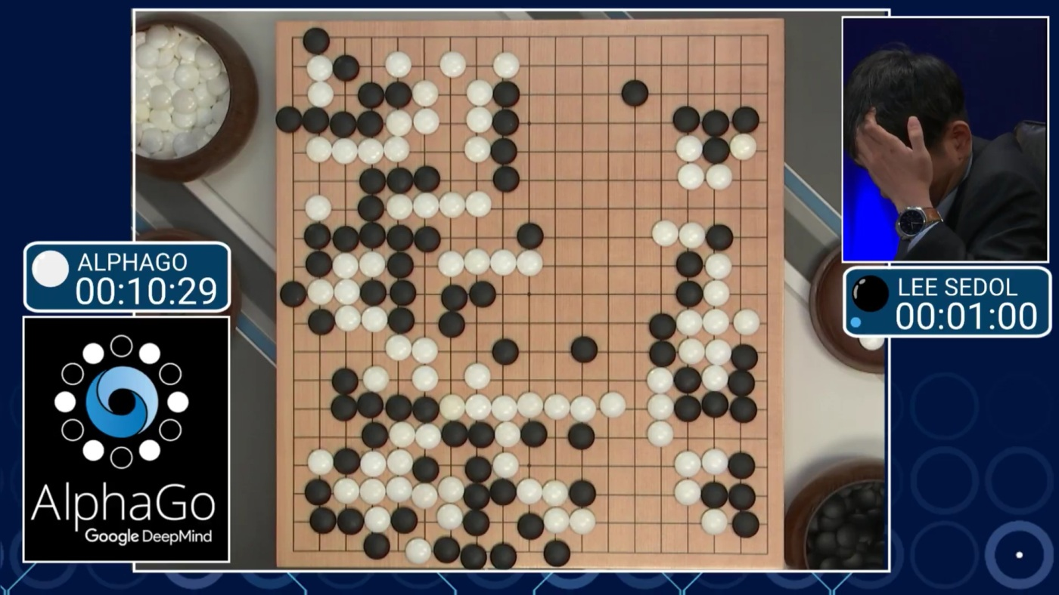
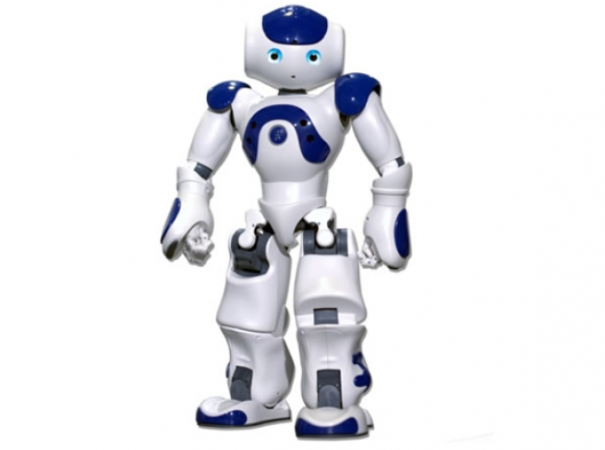
Reinforcement Learning
Notes:
The third kind, reinforcement learning, recently had a great success, when alpha go beat the world champion in go.
Reinforcement learning is about an agent learning to interact with an environment, with some ultimate goal. The environment could be a go board, and the goal to win the game.
For self-driving cars, the the environment could be roads, sensed by cameras and laser sensors, and the goal would be to get you somewhere quickly and safely.
Or, the environment could be a social media platform, and the goal could be to provide you such great content that you never remove your eyes from your phone again!

Slide 8
Classification and Regression
Classification:
y discrete
Regression:
y continuous
Notes:
As I said, I want to focus on supervised learning, though.
There are two basic kind of supervised learning, called classification and regression.
The difference is quite simple, if y is continuous, then it’s regression, and if y is discrete, it’s classification.
To this audience that’s probably pretty clear, but let me give you two examples.
If I want to learn how much energy a reaction releases, that’s regression. If I want to learn whether it releases energy above a certain threshold, it is classification, because the output is just a yes-no decision.
This distinction into classification and regression might seem a bit trivial, but measuring “how good” a prediction is is quite different for discrete and continuous y.

Slide 9
Generalization
Not only
Also for new data:
Notes:
Ok, so I want to talk in more depth about supervised learning, and I want to get a little more formal.
Let’s say we have a regression task. We have features, that is data vectors x_i and targets y_i drawn from a joint distribution.
We now want to learn a function f, such that f(x) is approximately y, not on this training data, but on new data drawn from this distribution. This is called generalization, and this is a core distinction to function approximation. In principle we don’t care about how well we do on x_i, we only care how well we do on new samples from the distribution.

Slide 10
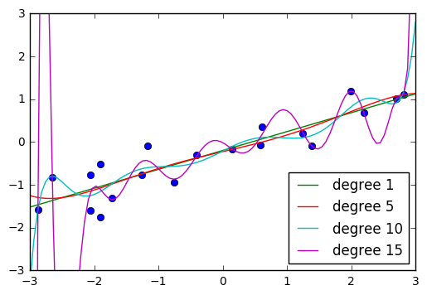
Notes:
So let’s give a brief example of this.
You are probably all somewhat familiar with polynomial curve fitting.
Let’s say my input x is just one-dimensional, and I try to fit a polynomial f(x) such that f(x) is approximately y.
I could try to fit a linear function, but that would not be able to fit the data very well. I could try to fit a higher order polynomial, say of order 5, and that would work much better. I could fit the data even better with this polynomial of order 15, and hit all the data points exactly.
But now, which one will work best on new data?
You can probably see the pattern in the data, and you would expect the polynomial of order 5 to work better.
The polynomial of order 15 is clearly too complex for this dataset. This is called overfitting: We are fitting the data perfectly, but with a model that is too complex, and will perform poorly on new data.

Slide 11
(regularized) Empirical Risk Minimization
Notes:
This leads us to one of the core principles of machine learning, which I will only sketch here, but which is the essence of all the machine learning theory.
If we can find a model that fits the training data well, and that is “simple” then we are guaranteed that it will work well on new data.
The machine learning problem can then be formalized as minimizing the error on the training set, say the squared error, while constraining the model to be simple.
This is called “regularized empirical risk minimization” and that’s basically what all machine learning algorithms do, with different choices of the domain of f, and different choices of the regularizer R.

Slide 12

Linear Regression as ERM
Notes:
I want to tie this principle to something your are probably familiar with, linear regression.
That’s even simpler than polynomial fitting, but one of the really simple and successful methods in statistics and machine learning.
Linear regression, or ordinary least squares means finding a vector w such that w * x – y is minimized.
This is basically only the first part of the principle I just showed you, the data fitting part.
And if you look at this in 2d, it looks like a great idea.
This is mostly because linear models in 2d are inherently simple.
However, if you go to higher dimensional spaces, linear models can become quite complex.

Slide 13
training set
1.1 | 2.2 | 3.4 | 5.6 | 1.0
6.7 | 0.5 | 0.4 | 2.6 | 1.6
2.4 | 9.3 | 7.3 | 6.4 | 2.8
1.5 | 0.0 | 4.3 | 8.3 | 3.4
0.5 | 3.5 | 8.1 | 3.6 | 4.6
5.1 | 9.7 | 3.5 | 7.9 | 5.1
3.7 | 7.8 | 2.6 | 3.2 | 6.3
1.6
2.7
4.4
0.5
0.2
5.6
6.7
X =
y =
test set
Notes:
So in the previous example, I asked you whether you think a model will generalize well to new data from eyeballing it. That’s clearly not a good way to test a model, and usually impossible in higher dimensions.
The standard method to evaluate the generalization capabilities is with a hold-out set, also known as test-set or validation set.
The way this works it that we split our initial dataset into one part that is used for actually building the model, which we call the training set, and another part, the test set, which will be our “pretend future data”. The essential point here is that we have the true outputs, or ground truth, for this data, so we can measure how well our model did on this “new” data.

Slide 14
Regularized Linear Regression: Ridge
Notes:
If you have more features (so sensor measurements) than observations, you can find a linear model that fits any possible outcome y perfectly! You might call this an underspecified linear system.
But I don’t want to give up, I still want to learn. And I can. I just need to add in the second part, the regularization, that tells me to keep the model simple.
For linear regression, the easiest way to do that is by adding the l2 norm of w to the objective, and we get what’s called ridge regression. This basically says “I want to fit the data, but don’t make w too long” - or in other words, don’t make any particular entry of w too large.
This will make the optimization problem well-specified, and lead to a more “simple” model that generalizes better.
You might notice that the formula also has an alpha in it, which balances between data fitting and regularization, and you probably want to ask: what’s alpha? Well, it’s a real number, and I’ll tell you how to set it later.

Slide 15
Relationship to Statistics
Statistics
Model first
Inference
Machine Learning
Data first
Prediction
Generalization
Notes:
Before I go more into the nuts and bolts of machine learning, I want to do a brief interlude on how what I’m talking about relates to statistics. There’s really no clear boundary between statistics and machine learning, and anyone that tells you otherwise is lying.
But I can tell you how the tools that I’m talking about today differ from what you’d learn in a stats course.
Statistics is usually about inference. You have a yes-no-question, such as “are women less likely to work in a national laboratory (p=0.05)”, and you have a sample of the population that you use to make an inference.
Machine learning is about prediction and generalization. We want to learn from past data to predict outcomes on future, unseen data.

Slide 16
Relationship to Statistics
Statistics
Model first
Inference
Machine Learning
Data first
Prediction
Generalization
Notes:
And I’m not saying one or the other is better, I’m just saying that you should know what kind of problem you are trying to solve, and what the right tool for the problem is. And then you can call it machine learning or statistics or probabilistic inference or data science.

Slide 17
Problem Formulation & Data Collection
Notes:
So now, hopefully you have a reasonable idea what machine learning, in particular supervised machine learning is, and we can get into how you can actually apply it do your problems.
First you need to formulate your problem. That can be tricky but it’s very dependent on your application.
Once you decided that, for example, you have a classification problem with two classes, you need to get the appropriate training data. Depending on the task, this can either mean manual annotation of data, or possibly running some expensive experiment that you want to avoid in the future. If you’re automating an already existing process, you usually have this data already.

Slide 18
Categorical Variables
?
Notes:
Before we can apply a machine learning algorithm, we first need to think about how we represent our data.
Earlier, I said x \in R^n. That’s not how you usually get data. Often data has units, possibly different units for different sensors, it has a mixture of continuous values and discrete values, and different measurements might be on totally different scales.
First, let me explain how to deal with discrete input variables, also known as categorical features. They come up in nearly all applications.
Let’s say you have three possible values for a given measurement, whether you used setup1 setup2 or setup3. You could try to encode these into a single real number, say 0, 1 and 2, or e, \pi, \tau.
However, that would be a bad idea for algorithms like linear regression.

Slide 19
Categorical Variables
Setup1 Setup2 Setup3
1 0 0
0 1 0
0 0 1
Notes:
If you encode all three values using the same feature, then you are imposing a linear relation between them, and in particular you define an order between the categories. Usually, there is no semantic ordering of the categories, and so we shouldn’t introduce one in our representation of the data.
Instead, we add one new feature for each category,
And that feature encodes whether a sample belongs to this category or not.
That’s called a one-hot encoding, because only one of the three features in this example is active at a time.
You could actually get away with n-1 features, but in machine learning that usually doesn’t matter.

Slide 20
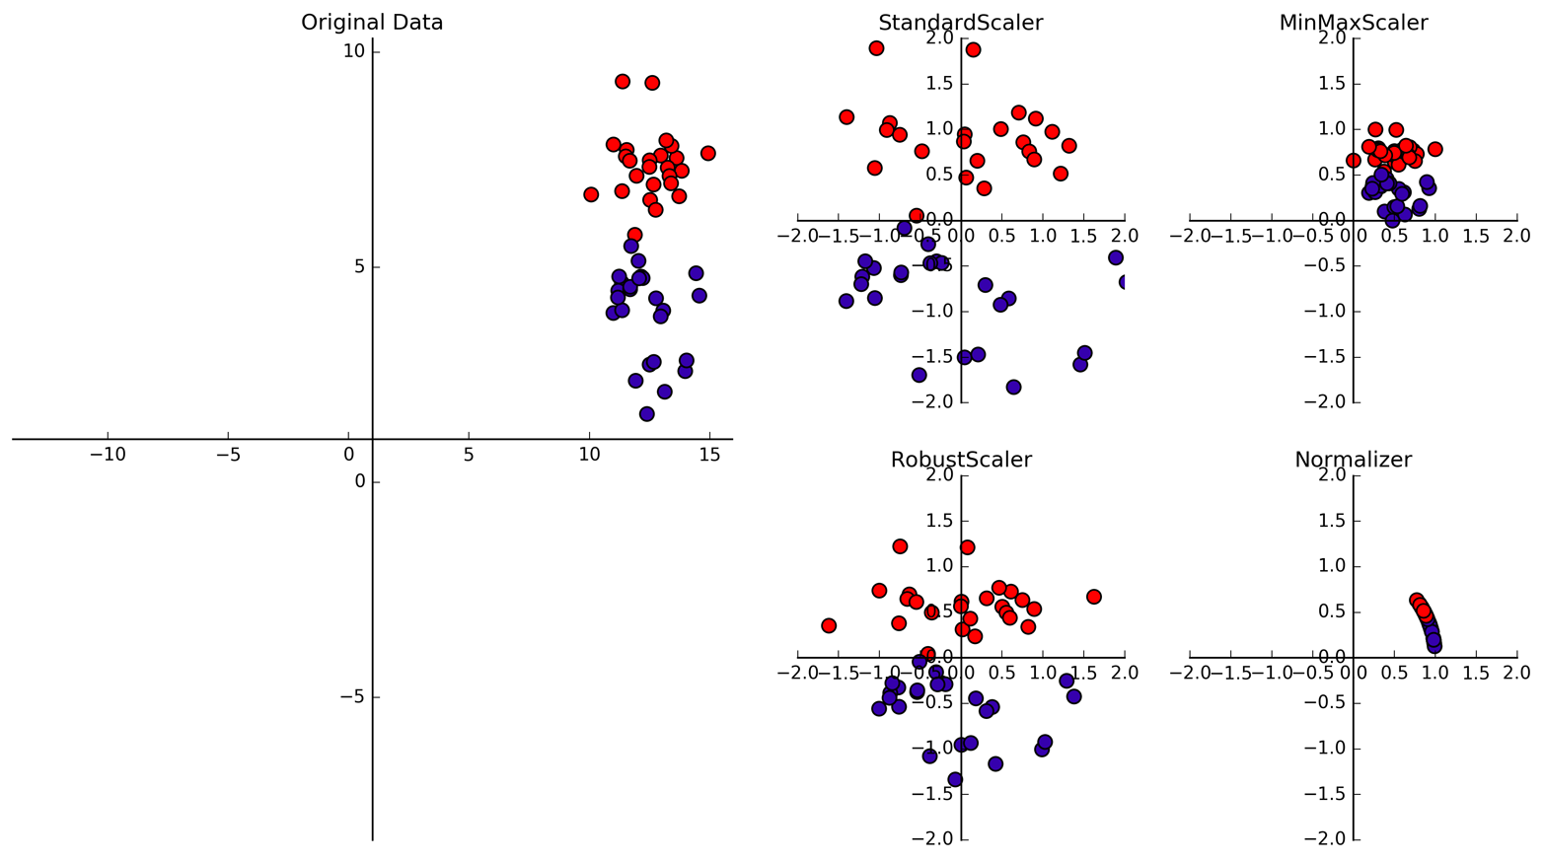
Data Scaling
Data Scaling
Notes:
The other issue is relative scaling. The outcome of our prediction clearly shouldn’t depend on whether we represent a measurement in millimeters or kilometers. If you use linear regression, this doesn’t matter, but for most machine learning algorithms, it does. Let’s have another look at ridge regression that I introduced earlier. It tries to pull all coefficients in w towards zero. Because we’re using the two-norm, large coefficients are penalized more, which means that changing the scale of a feature changes the amount of regularization that is applied.
Unless we have some prior information about how informative each feature is, we should ensure all features are treated equally. We can do that by scaling them all between -1 and 1 or transforming them to have zero mean and unit variance.

Slide 21

Notes:
So if you want to do machine learning in python, your go-to library is scikit-learn. And I’m only saying that because I’m one of the maintainer ;)
The rest of my talk I want to spend on how to apply scikit-learn to do machine learning, and discuss some methods and best practices.
Scikit-learn is built upon numpy and scipy, and the main data structures it works with are numpy arrays, and I hope you’re all familiar with them.

Slide 22
one sample
1.1 | 2.2 | 3.4 | 5.6 | 1.0
6.7 | 0.5 | 0.4 | 2.6 | 1.6
2.4 | 9.3 | 7.3 | 6.4 | 2.8
1.5 | 0.0 | 4.3 | 8.3 | 3.4
0.5 | 3.5 | 8.1 | 3.6 | 4.6
5.1 | 9.7 | 3.5 | 7.9 | 5.1
3.7 | 7.8 | 2.6 | 3.2 | 6.3
1.6
2.7
4.4
0.5
0.2
5.6
6.7
X =
y =
one feature
Notes:
So before we get started, here’s what data typically looks like. We have a 2d array or matrix X, in which each row corresponds to one sample, or one data point, and in each column we have one feature, or one particular property we measured.
Scikit-learn assumes that you preprocessed everything to be continuous or one-hot-encoded.
For each sample, we also have a desired output y, that can be either continuous as it is here, or categorical.

Slide 23
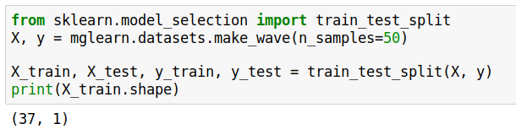
Notes:
In scikit-learn, all algorithms are implemented as classes, and the classes contain the learning algorithm, and store everything that is estimated from the data.
They all have the same interface, which makes them very easy to use.
Let’s start again with a simple one-dimensional regression problem that you can see here.
It’s best practice to separate out a test set before doing any learning. Typically we use around 25% of the data.
Theres a convenience function for that in scikit-learn, that randomly splits data, called train_test_split:
So first, we split our data, and then we build the model on the training set. Let’s start with linear regression.

Slide 24
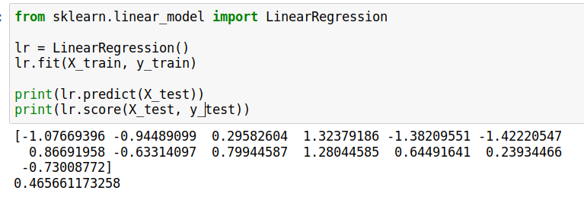
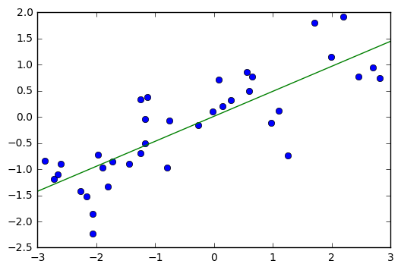
Notes:
We import linear regression and instantiate the class
Then we can fit the model on the training data and the training targets with the fit method.
This estimates slope and offset of the linear regression, which are stored in the lr object.
We can access them as lr.coef_ and lr.intercept_.
We can then make prediction using this linear regression model using the ``predict`` function.
Here are the predictions for the training set.
We can also make predictions for the unseen data, the test set.
To evaluate how well we do on either the training set
or the test set, we can use the score method, which for regression computes the R^2.
So here you can see the three central methods of scikit-learn: fit, predict and score.

Slide 25
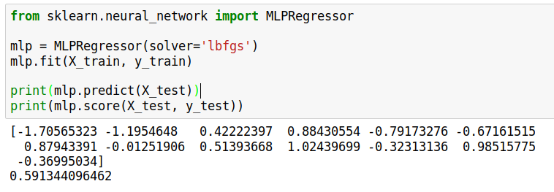
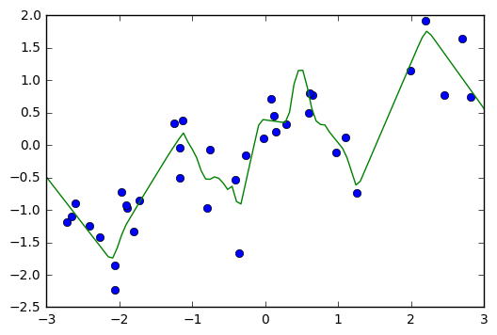
Notes:
Ok, now you say “well I already knew how to do linear regression”. Well, scikit-learn has a whole lot more!
You can import any number of regression models and apply them exactly the same way.
You heard neural networks are cool?
Let’s import MLPRegressor and see what that does.
Same thing as before, fit on the training data, predict on the test data, score to evaluate.
This fit looks like it’s a lot closer to the data.

Slide 26
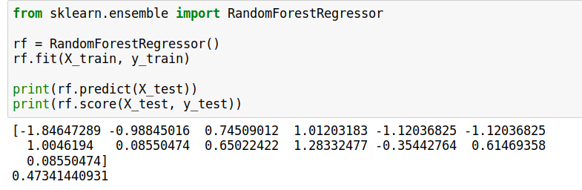
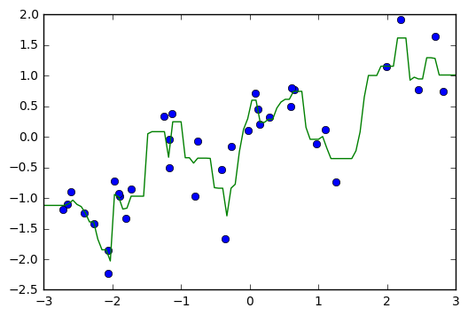
Notes:
You heard random forests are all the rage? Sure, let’s try a random forest. Import the RandomForestRegressor, and the same thing again: fit, predict, score.

Slide 27
Diving into the models
Notes:
Since you’re all scientists you obviously want to know what’s going on there behind the scenes, though, and not only blindly apply some methods.
We already talked a little bit about linear methods for regression in the beginning.
There are two families of algorithms that I want to give you a glimpse of: linear models and tree-based models. I don’t think I’ll have time for neural networks, but maybe if we have some time left over at the end.

Slide 28
Linear Models for Regression
Ridge Regression
Lasso
Notes:
In terms of regression with linear models, we had linear regression, which you should basically never use, ridge-regression and which is a form of regularized linear regression. There is another one that I want to mention, which is called Lasso.
Lasso is the same as Ridge, only with an L1 norm instead of an L2 norm.
Interestingly, that leads to some of the coefficients being exactly zero, which means the model automatically selects which features are important, and which are not. This can be helpful if you suspect many features might not be informative.

Slide 29
Logistic regression
Notes:
Then we have linear models for classification, which work very similarly to the regression models, consisting of a data fitting term and a regularization term.
However, the data fitting term is not squared error any more, because that doesn’t really make sense. There are some different choices for the data fitting term, also known as the loss function. One of the most commonly used ones is the logistic loss, which leads to logistic regression.
Again, we can apply l2 regularization or l1 regularization to ensure the model does not overfit.

Slide 30
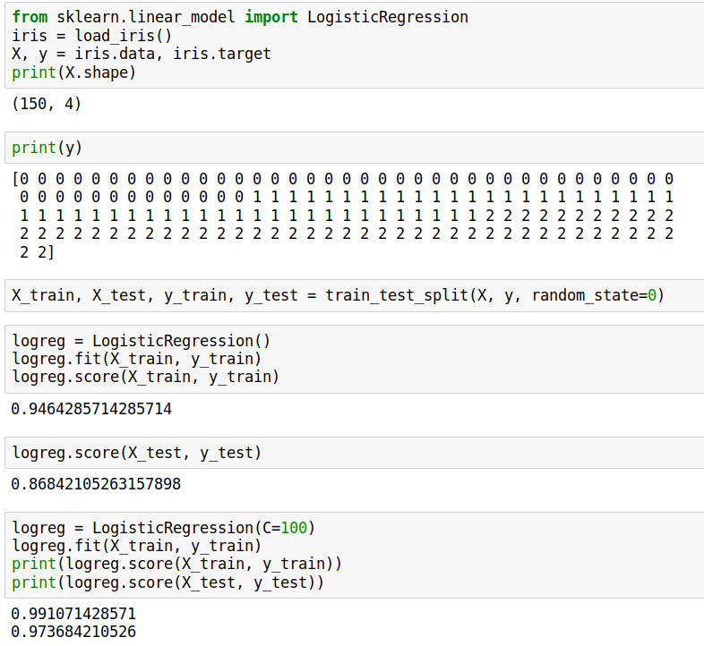
Logistic Regression on Iris data
Notes:
Let’s try this out on this classical dataset for classifying irises. Here, the measurements are the dimensions of different parts of the flower, height and width of petal and sepal, so there are four features.
There are three different species of iris which we want to distinguish using these measurements, represented using the number 0, 1 and 2
There are 150 samples here, which we again split into a training and a test part.
We call fit in on the training set, and then we can call predict or score.
However, there’s this parameter C that says how much we want to regularize, and if we change this, for example to less regularization in this case, we might get better results.

Slide 31



Models
Decision
Trees
Notes:
The second family of models I want to talk about is decision-tree based models.
A decision tree is basically the same as a sequence of if-else branches, that ultimately lead to a decision. The point is that the question that are asked are learned, though.
A decision tree is build recursively by asking a series of questions of the form “is feature “i” greater than threshold t”. In each iteration, the question is chosen that yields the most information about the target variable. Then, the data is split according to this question, and we start again. This yields a hierarchical partitioning of the data, where each section of the partitioning becomes more and more “pure”, that is their content becomes more and more the same.
After you build the tree, you can make a prediction by checking which part of the partition a new point lies in and assigning the mean of the datapoints in this part.

Slide 32

Random Forests
Notes:
So decision trees are a great idea, but unfortunately they don’t work that well in practice. However, there is a modification of the algorithm that works very well, called random forest.
The idea behind random forest is that we build many decision trees, but we inject some randomness into each tree, so that they are all different.
Then, to make a prediction, we look at the prediction of all the decision trees and take the average.

Slide 33
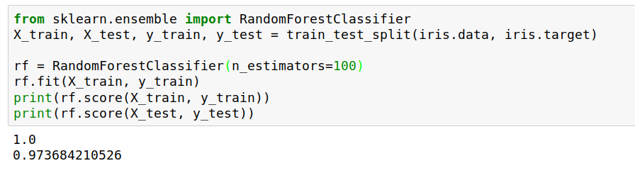
Models
Notes:
So let’s apply a random forest to the iris dataset...

Slide 34
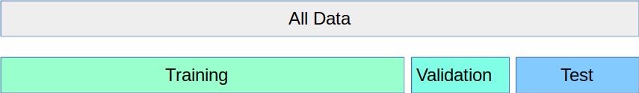
Training, validation and testing
Notes:
Ok, so I promised you earlier that I’ll explain how to choose the hyper-parameters for a model. So the first think you need to be aware of is that you should not use the test set to tune the hyper-parameters of your model. If you check two different hyper-parameter settings, you are basically making a multiple-hypotheses testing error. Your test-data is not independent test any more if you use it to tune the model.
Therefore, you need to split your data into three parts: the training part to build the model, the validation part to tune the parameters, and the test part, to make sure your model generalizes. Ideally you only evaluate on the test data once.

Slide 35
Cross-Validation
Fold 1
Fold 2
Fold 3
Fold 4
Fold 5
Split 1
Fold 1
Fold 2
Fold 3
Fold 4
Fold 5
Split 2
Fold 1
Fold 2
Fold 3
Fold 4
Fold 5
Split 3
Fold 1
Fold 2
Fold 3
Fold 4
Fold 5
Split 4
Fold 1
Fold 2
Fold 3
Fold 4
Fold 5
Split 5
Fold 1
Fold 2
Fold 3
Fold 4
Fold 5
Notes:
There’s one problem with this splitting of the data though: your outcome might depend a lot on how you split your data, and might not be very robust.
So instead of splitting the data once into a training and a validation set, in machine learning we often use cross-validation to see how good a model is.
Cross-validation is basically repeatedly splitting the data into training and validation set. For that, we start by splitting our data into equally-sized pieces called folds, usually 5 or 10. Then, we declare the first fold the validation set, and the remaining ones the training set. Next, we declare the second fold the validation set and so on. That yields as many evaluations of the model as we have folds, and provides a much better estimate of how well our models does.

Slide 36
Grid-Search
Notes:
So now we know how to evaluate, but how do you pick the right parameter values? The somewhat unsatisfying answer is: by brute force.
Usually the best way to find good hyper-parameters is using what is called grid-search, which is just another name for exhaustive search on a fixed grid.
For the linear models, the parameters to search are the regularization parameters C or alpha, which are usually searched on a logarithmic scale, while for random forests, you might want to search the depth of the trees or the minimum impurity for a split.
And because this is such a common task, there is a tool in scikit-learn for it GridSearchCV, which does grid-search with cross-validation to pick the best parameters for you.

Slide 37
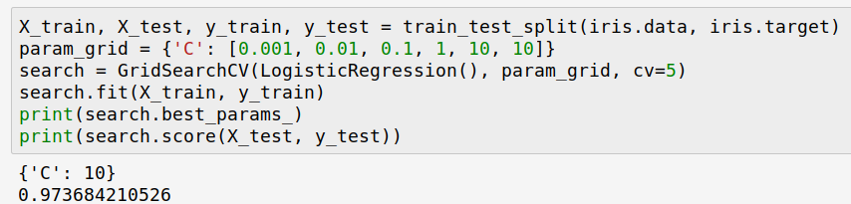
Notes:
So let’s say you want to apply GridSearchCV to find the best parameter C for logistic regression applied to the iris dataset.
First, we split the data into a training and a test set, as we always to. We keep the test set until the very end for evaluation.
Then, we declare the parameter that we want to search, in this case C, and we want to try the values 0.001, 0.01, and so on. We store these parameters In a dictionary.
We instantiate GridSearchCV with this dictionary and the model we want to use, LogisticRegression.
We also tell it how many folds we want to use, say 5.
Then we call fit on the training set. Fit internally uses cross-validation and tries out all the different parameter settings, and picks the one with the best mean cross-validation accuracy.
We can check out what this best parameter is in the best_params_ attribute.
Then we can use the score method on the held-out test set to see how well this logistic regression model with the adjusted C works on new data that it hasn’t seen yet.
This is basically the work-flow you should always use for picking a model and parameters!

Slide 38

Notes:
So this was sort-of a whirl-wind tour of the how and why of machine learning.
If you want to learn more, check out my book. It’s all in python and takes a very practical approach. I have one with me if you want to check it out.
It doesn’t really contain any math though. If you want the math behind the methods, check out the book elements of statistical learning, which you can get online from the authors for free.

Slide 39




Thank you.
@amuellerml
@amueller
importamueller@gmail.com
http://amueller.io
Notes:
That’s all I had for today, thanks a lot for your attention.

