Slide 1
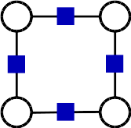
PyStruct
Structured Prediction in Python
Andreas Mueller (NYU Center for Data Science, scikit-learn)

Slide 2
Structured Prediction

Slide 3
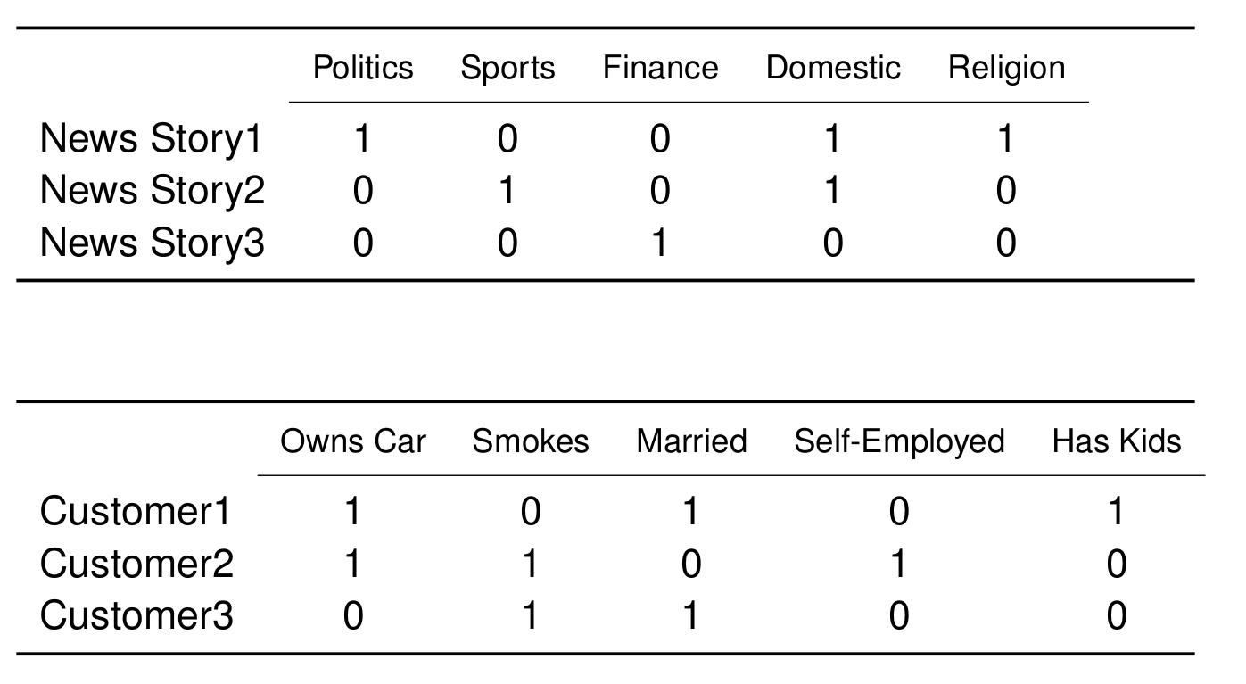
Applications: Multi-Label Classification

Slide 4
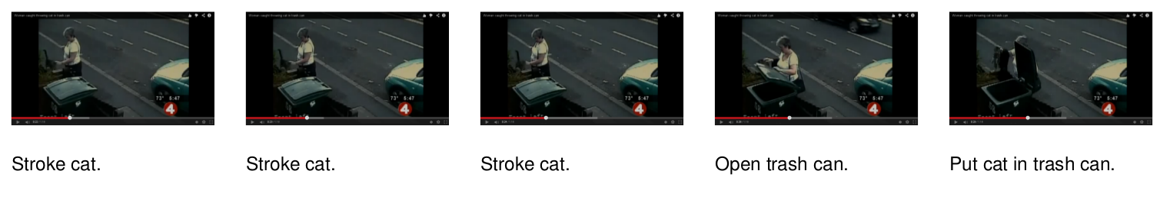
Applications: Sequence Tagging

Slide 5
Applications: Sequence Tagging

Slide 6
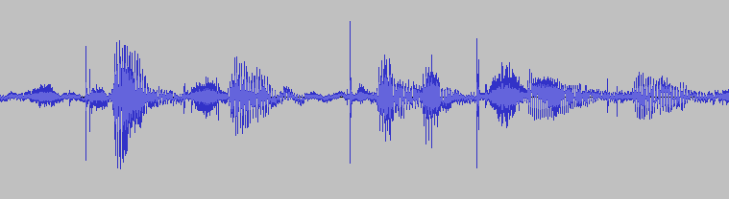
Applications: Sequence Tagging
Struc - tured pre-diction in Py - thon

Slide 7
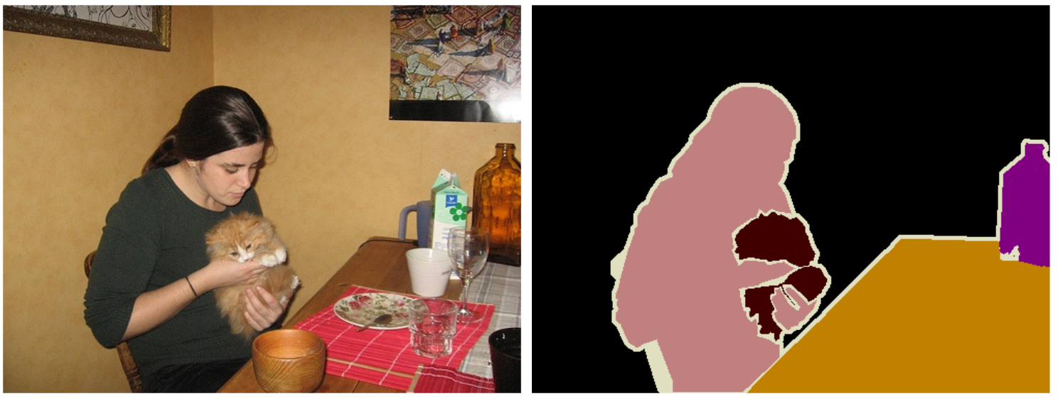
Applications: Image Segmentation

Slide 8
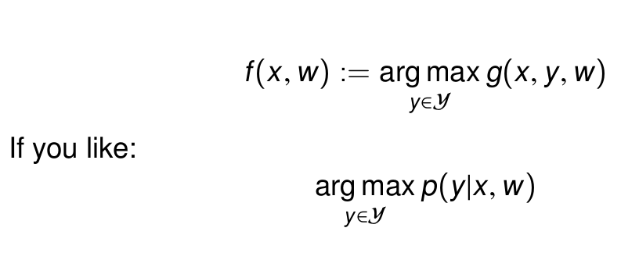
The Essence of
Structured Prediction

Slide 9
Pairwise Structured Models

Slide 10
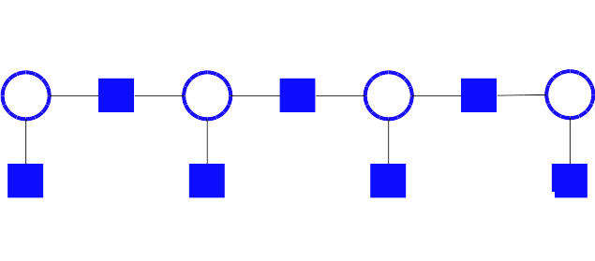
Pairwise Structured Models

Slide 11
PyStruct Architecture
Estimator = Learner + Model + Inference

Slide 12
PyStruct Architecture
Estimator = Learner + Model + Inference
model = ChainCRF(inference="max_product")
ssvm = OneSlackSSVM(model=model, C=.1, inference_cache=50,, tol=0.1, verbose=3)
ssvm.fit(X_train, y_train)

Slide 13
Implemented Methods
Estimator = Learner + Model + Inference
Learner: SubgradientSSVM, StructuredPerceptron, OneSlackSSVM, LatentSSVM
Model: BinaryClf, MultiLabelClf, ChainCRF, GraphCRF, EdgeFeatureGraphCRF
Inference: Linear Programming, QPBO (PyQPBO), Dual Decomposition (AD3), Message Passing, everything (OpenGM)

Slide 14
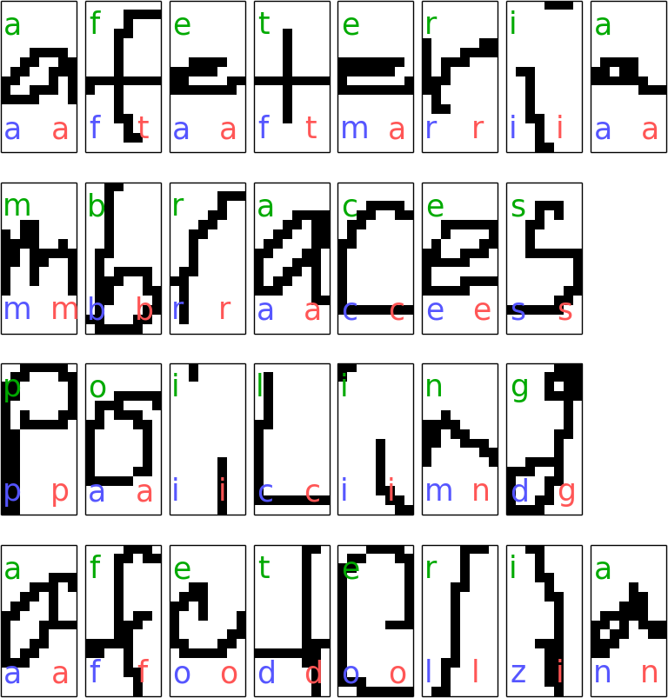
Sequence Tagging example
model = ChainCRF(inference="max_product")
ssvm = OneSlackSSVM(model=model, C=.1, inference_cache=50,, tol=0.1, verbose=3)
ssvm.fit(X_train, y_train)

Slide 15
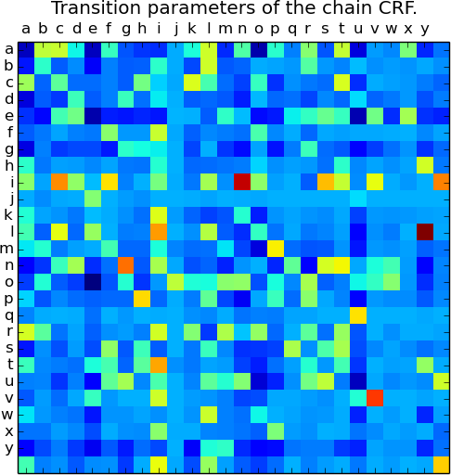
Sequence Tagging example
model = ChainCRF(inference="max_product")
ssvm = OneSlackSSVM(model=model, C=.1, inference_cache=50,, tol=0.1, verbose=3)
ssvm.fit(X_train, y_train)

Slide 16
The Devil is in the Inference
Easy: Dynamic Programming

Slide 17
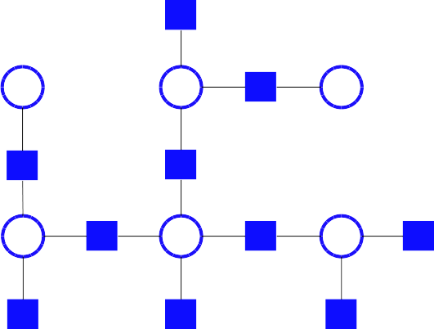
The Devil is in the Inference
Easy: Dynamic Programming

Slide 18
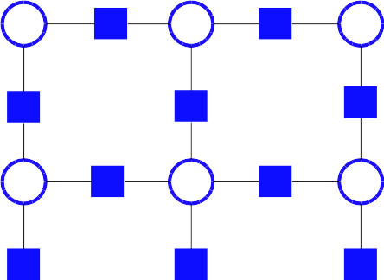
The Devil is in the Inference
HARD!
AD3, QPBO, LP, Loopy BP, ….

Slide 19
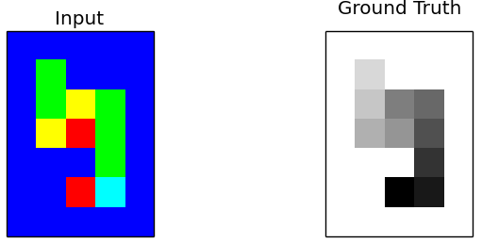
Grid Graphs: Snakes

Slide 20
Grid Graphs: Snakes
crf = EdgeFeatureGraphCRF(inference_method='qpbo')
ssvm = OneSlackSSVM(crf, inference_cache=50, C=.1, tol=.1,
switch_to='ad3', n_jobs=1)
ssvm.fit(X_train_edge_features, Y_train_flat)

Slide 21
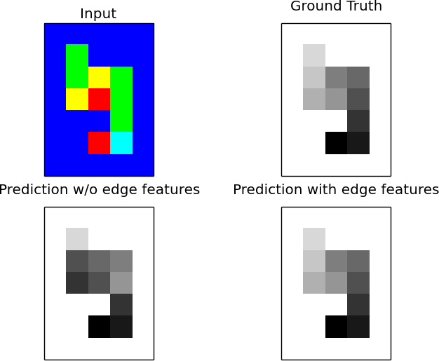
Grid Graphs: Snakes

Slide 22
Classes of Inference Algorithms
Exact Algorithms
Max-Product (Chains, Trees) 'max-product'
Exhaustive (usually too expensive)
Relaxed algorithms + branch & bound
('ad3', {'branch_and_bound': True})
Relaxed
Linear Programming (slooow) 'lp'
Dual Decomposition 'ad3'
Approximate / heuristics
Loopy message passing 'max-product'
QPBO 'qpbo'

Slide 23
Classes of Inference Algorithms
Exact Algorithms
Max-Product (Chains, Trees) 'max-product'
Exhaustive (usually too expensive)
Relaxed algorithms + branch & bound
('ad3', {'branch_and_bound': True})
Relaxed
Linear Programming (slooow) 'lp'
Dual Decomposition 'ad3'
Approximate / heuristics
Loopy message passing 'max-product'
QPBO 'qpbo'
Install OpenGM for many more!

Slide 24
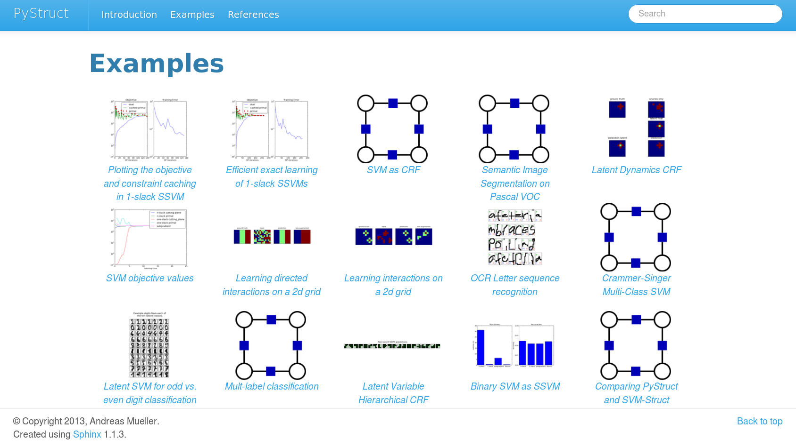

Slide 25




Thank you for your attention.
@t3kcit
@amueller
t3kcit@gmail.com
http://amueller.github.io

