Slide 1
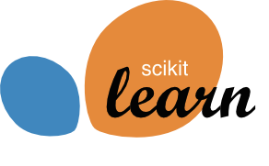


Promises and Perils
in Artificial Intelligence
and why you shouldn’t trust anyone that uses the phrase Artificial Intelligence
Andreas Müller
Columbia University, scikit-learn
Notes:
So I work in data science and machine learning, and I like to write software and solve data driven problems. I’m also one of the core developers of scikit-learn and I teach at Columbia. Recently the Alfred P. Sloan foundation has given me money to work on scikit-learn while I sit in my office in Columbia, so that’s really great!

Slide 2
Promises and Perils
in Artificial Intelligence
and why you shouldn’t trust anyone that uses the phrase Artificial Intelligence
Andreas Müller
Columbia University, scikit-learn
Notes:
Most of my talk will be about where machine learning is right now and it’s future potential and pitfalls. The last part of my talk will be about work that hasn’t been done yet, so really none of it will be about anything I have done.
Because what I actually do most of the time is write unit tests. I think the last three times we did a scikit-learn sprint, I refactored the unit tests, and I don’t think anyone wants to hear about that.

Slide 3
Promises and Perils
in Artificial Intelligence
and why you shouldn’t trust anyone that uses the phrase Artificial Intelligence
Andreas Müller
Columbia University, scikit-learn
Notes:
Instead I will be talking about what AI is, and why you shouldn’t trust anyone who uses that word. So I’m gonna stop that now and say “machine learning”. I will talk about where machine learning is used today, where it has great impact and where it will have even more impact soon.
I also want to talk about challenges in applying machine learning and large scale data analysis, today and in the near future.
So I wonder at what point the organizers will regret putting me up on stage as the last speaker delivering 40 minutes of dad jokes and ranting, but we’ll see...

Slide 4
Promises and Perils
in Artificial Intelligence
and why you shouldn’t trust anyone that uses the phrase Artificial Intelligence
Andreas Müller
Columbia University, scikit-learn
Notes:
So there’s this big fear that, AI and data science is trying to take away people’s jobs, by automating them. And it does. I’m pretty sure a lot of jobs driving cars will be automated in the not-so-far future. But making other people’s job obsolete seems a bit mean. So what I’m trying to do most of the time is to make my own job obsolete. I want data science to be so easy anyone can do it, and they don’t need an expert data scientist like myself any more. And then I can go lie on a beach. That’s what happens with you if your job becomes obsolete, right?

Slide 5
Promises and Perils
in Artificial Intelligence
and why you shouldn’t trust anyone that uses the phrase Artificial Intelligence
Andreas Müller
Columbia University, scikit-learn
Notes:
Clearly there’s a lot of knowledge involved in doing data analysis, and some statistical knowledge for example is extremely important to create valid predictions and models, so there is a certain bar for using AI, but that bar should be as low as possible, and ideally only require the core concepts, and not some programming details.

Slide 6
Hope and Hype
Notes:
I’m a machine learning enthusiast, and I think data driven computing and machine learning can help in countless applications. So I’m really hopeful for making an impact in many areas. But there’s also a lot of hype out there, created by companies to sell their products, and by the media to sell their articles.
There has also been some fear-mongering about computers becoming our robotic overlords, but fortunately, that has diminished a bit – mostly because it doesn’t sell anything but maybe some bad pop science books.
So I want do bisect what data driven reasoning and machine learning will be able to do in the future, and what is hype and hyperbole.

Slide 7
What is Data Science?
Notes:
Before I go into any detail, I want to explain to terms, or at least give my personal working definition: Data Science and machine learning.
I don’t particular like the term data science, but I think it’s here to stay, so I’m gonna use it, and I want to explain briefly what I mean by it.

Slide 8
What is Data Science?
“The practice of, and methods for, reporting, inference, and decision making based on data.”
Notes:
Usually data science is used as a very big umbrella term, and I like to phrase it pretty widely: <read>
Some people might argue that’s just all of empirical science. Or maybe that’s just statistics. And maybe that’s right. Oh and feel free to entirely disagree with this definition, I don’t claim it’s universal, I just want to define what I mean when I say this.
One important aspect here is that there are kind of two sides: there is a practical side, which tries to gain understanding, and there’s a methods side, where people are working on improving the tools, which could be mathematical and statistical tools, or tools for data bases and distributed computing.
So this includes SQL queries and hypothesis testing and, most importantly counting. Counting is probably the most commonly used and most important data science technique.

Slide 9
What is Machine Learning?
Notes:
The other term I want to define is machine learning, which sometimes people call artificial intelligence.
That’s a much narrower field and the area I mostly work in. It’s also hard to define, and I don’t aim for a general definition here, just a useful one.

Slide 10
What is (supervised) Machine Learning?
“Extracting information from data to make predictions on new observations.”

Slide 11

Data Science
How many people clicked on this ad?
Are men more likely to click on this ad then women?
Machine learning
Will Andy click on this add given his history of facebook activity, profile information, and social network?
Notes:
Btw, just to put the fear of AI into perspective: facebook has one of the worlds best AI research teams and basically unlimited resources, and still they think I’m gonna click on this? I think we’re safe for a while.

Slide 12
Generalization
Observe the past – predict for the future
Given examples: generalize the pattern
Notes:
One of the core concepts in machine learning is generalization. In (supervised) machine learning, we collect a datasets of observations that have some inputs and some outputs that we’re interested in. For the ad example, that could be a history of facebook users, together with whether they clicked on the add or not. Then, the goal is to predict, for a user who we haven’t shown the ad so far, whether they will click on it. So here make use of past observations to try and predict what will happen in future events.
Another common examples is that we want to automate a process. For example we can collect patient data, together with a medical diagnosis from a doctor. Then we can try to learn from this data, and automate the diagnosis process, effectively replacing, or at least augmenting, the expert.

Slide 13
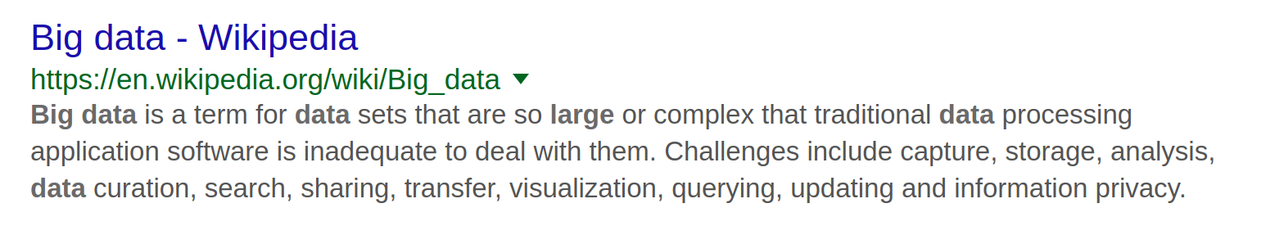
Notes:
Ok so why do I not like the term Big Data?
Two reasons:
First, it is not about the amount of data you have, but about information content and your ability to extract this information.
Second, it is abused ad absurdum.
There are people that have a lot of data. Let’s say traditional computing and data processing software is a single machine with python. I boot up an could instance and get half a terrabyte of ram. I can do a whole lot with that. Most businesses have less data than that. Most scientists have less data then that.
Sure, if you’re facebook, you might have “big data” and terrabyte scale doesn’t cut it.
Or you’re working on the sloan digital sky survey and get high resolution pictures of the whole sky. Sure, you need more than a workstation for that.

Slide 14
Notes:
And I’m not saying these are not important problems, but these are not the problems most people have. I see people with 500mb of data setting up a hadoop cluster. Why?
Some people have a table with 10.000 rows and 100 columns and they call it big data because excel crashes on them.
So a lot of people throw this term around to a point where it’s meaningless. Yes, there is big data, and yes, there are very interesting big data applications, but that’s not what most people do, and it’s not where we’ll see the biggest impact.

Slide 15
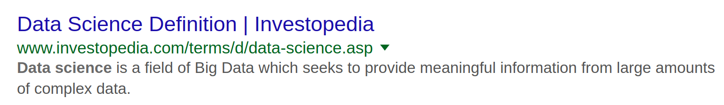
Notes:
Researching this talk I looked for other definitions of data science online, and I found this one from investopedia – this was the second hit, I think.
It defines data science as a subfield of big data.
So it’s not science unless it’s petabyte scale?
Or maybe they don’t know what big is?
I don’t know.
But ok, please don’t mention big data to me, you can see, it’s not good for my heart.

Slide 16
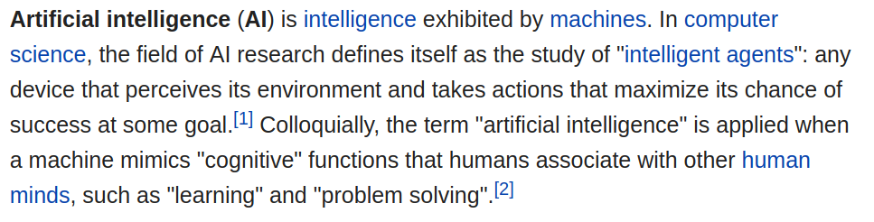
Notes:
The other term that I really don’t like, as least as it is used now, is Artificial Intelligence.
So here’s a good definition, from wikipedia.
The problem with this is that it is so general. It’s at least as general as my definition of data science.
Any program with an “if” clause can be claimed to behave intelligently, because it reacts to input.
Right now, often, when people say artificial intelligence, they mean machine learning. But sometimes, they mean they wrote an if clause.
Artificial intelligence is anything that anyone perceives as intelligent, which really can be anything.
It’s also misused, in that it is often related to giving the impression of human-like agents, even if these agents just to a text search.

Slide 17
Notes:
There are companies with AI in their title that do much less learning that what the face detection in your phone does. That’s actually some quite interesting machine learning right there. But it’s so common place now, that probably few of you think of this as intelligent.

Slide 18
Hope
Hype
Data Visualization
Big data
Deep Learning
Machine Learning
AI
Data Science
Counting
Bots
Statistics

Slide 19
Where we are in ML
Notes:
Ok after all this ranting, I want to talk about about what machine learning can do today, because it is really amazing. One area where there has been huge progress in recent years is computer vision, the area of my phd. The class of problems that most easy to understand in machine learning, and one of the most useful ones, is classification.

Slide 20


Ball Python
Carpet Python
Notes:
So lets say, I have pictures of snakes, and I want to know whether the little guy in the picture is a ball python or a carpet python. So as I said earlier, to build a machine learning model, we need to collect a bunch of data for which we know the right answer. So I collect a bunch of images for which I know they contain a ball python, and others for which I know they contain a carpet python.

Slide 21
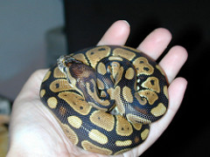
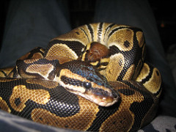

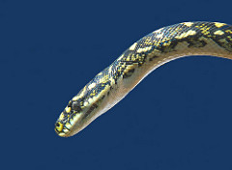
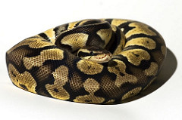
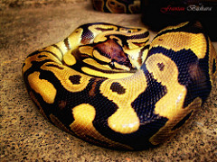
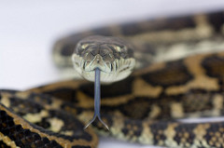

Ball Python
Carpet Python
x 1000
x 1000
Notes:
So here are 4 each, but more realistically, you’d have a couple of thousands or tens of thousands usually.
If you collected this data, you can probably build a pretty good classifier to distinguish these two kinds of pythons.
That might seem like a lot of images, and there’s a good reason for that: each new machine learning model basically learns from scratch. Any time we solve a new task, we basically start with a newborn baby, that known nothing about the world, and that doesn’t even really know how it’s own eyes work.
If we start from literally zero knowledge, we need much more data then when I would want to try to teach you to distinguish these to snakes – I’m pretty sure you already have some idea what a snake is, and how perspective and color work, for example.

Slide 22
Ball Python
Carpet Python
x 1000
x 1000
Notes:
One of the big advances in computer vision in recent years was that people build models that were generic enough about learning to “see” that you could start learning new concepts much more easily, say using hundreds instead of tens of thousands of images, and that was a pretty big break-through.
Now you can use one of these ready-made models off-the-shelf, by just using pip install keras, for example, and you can learn new concepts easily.
Still, this is not how humans learn. You still need hundreds of examples, and these models don’t know anything about scale or rotation or perspective or any of these things that are important for understanding the world.
It’s like taking a newborn baby, and flipping hundreds of photographs in front of its face and telling it what everything is, instead of the baby interacting with the world.

Slide 23
Ball Python
Carpet Python
x 1000
x 1000
Notes:
People built similar generic models for audio and text processing, that allow you to learn more easily from less data, by allowing you to not start from scratch. But these are all still very rudimentary, and are no-where near what humans can learn.
However, these algorithms have a big advantage over people: they are very patient, and they can look at a lot of data.
Maybe you can learn to distinguish these snakes from 10 pictures, and a computer needs 10 thousand.
But if you show the computer 10 million (and these were the right pictures) the computer could become much better than any human. But only at doing this exact single repetitive task of labeling snakes, and only these two kinds.
It would still not know that all that that these snakes actually live in 3d, or that they can move or anything else.

Slide 24
Human learning vs machine learning
Notes:
So to summarize, machines generally need to start from scratch when learning any new task, though there is some progress in vision, text and audio to improve this.
Still, the algorithms need a lot more data than a human would, and what they learn usually applies only to the very narrow task they were trained to do.
This is partially caused by the inability of most algorithms to interact with the world, which would allow building rich “mental” models of what they perceive.
However, because computers can potentially ingest much more data, the computers can become better than humans at this narrow task.

Slide 25
The power of more data
Notes:
One example that I like to give here is medical imaging. Finding cancer in medical images is often very hard, and requires expert training, and doctors are expensive, so having computer assist with this kind of diagnosis seems a good idea.
But any doctor will only see so many tumors in her lifetime. They might have a vast knowledge of how the human body and the cancer works, but if the computer can look at 1000 times more images, it might become better in the end.

Slide 26
Structure is hard
Notes:
So if you have enough data, you can probably do pretty well today if your task is to answer a yes-no question, like sick or healthy. Or if you want to distinguish two kinds of snakes.
Actually, researchers can even train systems that can distinguish 10,000 or more different object categories reasonable! That’s pretty impressive, I think.
But 10,000 different possible answers is not that many, if you think about real-life questions.
Producing a whole sentence has many more possibilities, and so can be much more tricky. There are many tasks where machine learning is used to generate text or other structured output. Think for example about google translate. This is a pretty impressive system, but it’s no-where near a human.
Similarly, there are systems that try to answer general questions, or that try to summarize text, and even with millions of examples, they are no-where near human level.

Slide 27
Structure is hard
Notes:
There are some areas where generating text is easy, like sports and business. There are automatically written business reports or reports on sports games, and they read like a humans. But that’s because they are really, really boring. Player x scored for team X in minute X. Team X won by x points.
Or: “The quaterly earnings went up by X, the stock went up by X, production went up by X”.
You don’t even need machine learning for that, you can just use text replacement. But people also call that AI.

Slide 28
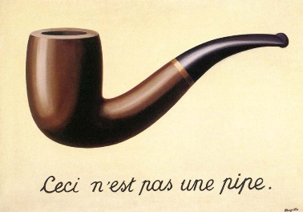
Knowledge is hard
Notes:
I already mentioned that most algorithms only learn about very restricted tasks. That often leads to very strange mistakes, and means they can’t solve some tasks. We often use an amazing amount of knowledge of the world to understand our surroundings, without noticing it.
So the snake classifier hasn’t learned that there is a 3d world. Or about animals, or anything, really. So if I show it a picture of a hand holding a photo of a ball snake, it will tell me it’s a picture of a ball snake. It has not concept of what a photo is or how a hand could be holding one.

Slide 29
Knowledge is hard
Notes:
Generally, that prevents algorithms from any tasks that involves inferences or knowledge about real world object. Often objects are defined by their function, not their appearance and as long as algorithms don’t have any concept of how the world works, they can not resolve these. I’m not aware of any system that really successfully integrates learning with a knowledge system in any wider application.

Slide 30
Classifying with many examples | Works in the real world, sometimes superhuman
Generalizing to new concepts using few examples | “works” in papers
Producing text or complex objects | “works” in papers
Reasoning with world-knowledge | no-one knows
Notes:
So let me summarize a little bit where we are today. If we have a narrow, repetitive task, and we have a lot of data, there’s a good chance a machine can become better than a human.
And since a while a go, narrow repetitive task not only includes chess but also go. It does not include driving a car yet, but maybe soon.
Creating any complex output, like language, is still very challenging, and only works well in narrow fields.
And finally, anything that requires knowledge of the world, or reasoning about function or behavior of things in the world is basically unsolved, and I speculate that it will be for a while.
This is simply because of the very narrow way task and data are defined right now, and the inability of algorithms to interact with the world.
It’s very hard to find out that there’s gravity if you can not drop and hold something.

Slide 31
Applications of ML
Notes:
I briefly want to highlight some of the

Slide 32
Applications of ML

Slide 33
Perils
(in ML and counting)
Notes:
So while I outlined some areas where ML is very helpful and successful applications, there are still some issues that come up in these tasks.
These are shared by most current machine learning methods and applications, and most of them will need consideration for the foreseeable future.
Maybe these are not so much perils, but ongoing challenges that we need to take into consideration.

Slide 34
Interpretability / Understandability
Notes:
One of the biggest issues that people have with machine learning is understanding how the algorithm works, and why a particular decision was made.
The problem is, the more powerful an algorithm the more complex it is, and the less open to interpretation. Any algorithm that is powerful enough to categorize natural images will be very hard to understand and introspect.
For some applications it’s ok to have a black box that provides answers that are usually correct. For other applications it’s crucial that each decision can be introspected. If facebook suggests to tag the wrong friend in my selfie, that might not be so bad. But if tesla misses a pedestrian in front of my car, we might want to understand why, and make sure to fix the problem.

Slide 35
Interpretability / Understandability
Notes:
In many situations we might need to explain a decision – or ideally we should. For example if a loan is not granted, or maybe even if bail is not posted.
Both the financial system and the criminal justice system make wide use of machine learning, but often without the ability to understand why a particular decision was made.
On the other hand, regulation in some areas of finance require very strict explanations of the models, which means that only very simple models can be used, resulting in overly simple models, for example for credit scoring.
Apart from the actual application, there is an important point for interpretable results for the engineers and researchers developing a system: there is currently no real debugger for ML, and if a system doesn’t work, it’s really hard to find out why.

Slide 36
Interpretability / Understandability
Notes:
So as I said, the most powerful models are really hard to understand and hard to interpret. But actually, most machine learning models are.
There are two main questions: given the data, what knowledge has the model learned, and why?
For a particular example, why did this model make this decision?
You can always write down a formula for why a model made a decision, but for most models, the result can’ t be understood by even the most skilled scientists.
Finding out what the model has learned can be even harder, and understanding how the data influenced what the model has learned is usually near impossible.
People are working on it, but right now, most machine learning is black-box.

Slide 37
Bias
Notes:
Another issue that’s closely related to interpretability is bias. Again, if we are making life changing decisions for people based on these algorithms, we better make sure they are not biased. We all have our more or less conscious biases, and ideally we’d like machines to be more objective then us. But often machines learn from past decisions made by humans, and so they inherit the societal biases.
There was this example, featured a while a go in politico, on bias in the US justice system. There were clearly racially biased decisions, but arguably the worst thing here was is not the bias, but the fact that these decisions are made by a company by a proprietary algorithm whose workings are not available to the public, or even to the justice system.

Slide 38
Bias
Notes:
Actually, if you look in their specifications, their definition of fairness is that the likelihood of bail given their score should be independent of race, which is the same as saying that their score is maximally racially discriminative….
Bias in machine learning systems is very tricky, but there’s actually a whole annual conference on fairness and transparency in machine learning, called fatml, and you should check out their papers and talks.
The great thing with algorithms is that in many cases, if we do it right, we can actually make sure that no bias is present, which we can’t really do for people. But only if we agree on what bias means.
By the way, even completely transparent systems, that just count, can easily be biased. You only need a single “if”, no fancy machine learning.

Slide 39
Privacy

Slide 40
Where does Python (and scikit-learn fit in)?

Slide 41
Curation, contrib, ...

Slide 42





amueller.github.io
@amuellerml
@amueller
t3kcit@gmail.com
Notes:
Buy my book. It’s about machine learning. It’s written for programmers, and should be a pretty easy read for anyone that knows a bit of numpy. I avoided adding to much math. If you want math, there are many awesome books to check out. This one is more about coding and how to get started with ml in python…. Which, you know, is why that’s the title…
I hope my rant was a bit informative, or at least entertaining. A big shout out to the organizers for putting together such a great conference, and thanks again for having me!

