Slide 1

Machine Learning with Scikit-Learn
Andreas Mueller (NYU Center for Data Science, scikit-learn)
Material: http://bit.ly/sklsf

Slide 2



Me

Slide 3
Classification
Regression
Clustering
Semi-Supervised Learning
Feature Selection
Feature Extraction
Manifold Learning
Dimensionality Reduction
Kernel Approximation
Hyperparameter Optimization
Evaluation Metrics
Out-of-core learning
…...

Slide 4







Slide 5

Get the notebooks!
http://bit.ly/sklsf

Slide 6

http://scikit-learn.org/

Slide 7
Hi Andy,
I just received an email from the first tutorial speaker, presenting right before you, saying he's ill and won't be able to make it.
I know you have already committed yourself to two presentations, but is there anyway you could increase your tutorial time slot, maybe just offer time to try out what you've taught? Otherwise I have to do some kind of modern dance interpretation of Python in data :-)
-Leah
Hi Andreas,
I am very interested in your Machine Learning background. I work for X Recruiting who have been engaged by Z, a worldwide leading supplier of Y. We are expanding the core engineering team and we are looking for really passionate engineers who want to create their own story and help millions of people.
Can we find a time for a call to chat for a few minutes about this?
Thanks

Slide 8


Hi Andy,
I just received an email from the first tutorial speaker, presenting right before you, saying he's ill and won't be able to make it.
I know you have already committed yourself to two presentations, but is there anyway you could increase your tutorial time slot, maybe just offer time to try out what you've taught? Otherwise I have to do some kind of modern dance interpretation of Python in data :-)
-Leah
Hi Andreas,
I am very interested in your Machine Learning background. I work for X Recruiting who have been engaged by Z, a worldwide leading supplier of Y. We are expanding the core engineering team and we are looking for really passionate engineers who want to create their own story and help millions of people.
Can we find a time for a call to chat for a few minutes about this?
Thanks

Slide 9
Doing Machine Learning With Scikit-Learn

Slide 10
Representing Data
one sample
1.1 | 2.2 | 3.4 | 5.6 | 1.0
6.7 | 0.5 | 0.4 | 2.6 | 1.6
2.4 | 9.3 | 7.3 | 6.4 | 2.8
1.5 | 0.0 | 4.3 | 8.3 | 3.4
0.5 | 3.5 | 8.1 | 3.6 | 4.6
5.1 | 9.7 | 3.5 | 7.9 | 5.1
3.7 | 7.8 | 2.6 | 3.2 | 6.3
1.6
2.7
4.4
0.5
0.2
5.6
6.7
X =
y =
one feature
outputs / labels

Slide 11
Training and Testing Data
training set
1.1 | 2.2 | 3.4 | 5.6 | 1.0
6.7 | 0.5 | 0.4 | 2.6 | 1.6
2.4 | 9.3 | 7.3 | 6.4 | 2.8
1.5 | 0.0 | 4.3 | 8.3 | 3.4
0.5 | 3.5 | 8.1 | 3.6 | 4.6
5.1 | 9.7 | 3.5 | 7.9 | 5.1
3.7 | 7.8 | 2.6 | 3.2 | 6.3
1.6
2.7
4.4
0.5
0.2
5.6
6.7
X =
y =
test set
from sklearn.cross_validation import train_test_split
X_train, X_test, y_train, y_test = train_test_split(X, y)

Slide 12
Supervised Machine Learning
Training Data
Model
Training
Training Labels
Test Data
Prediction
Generalization
Test Labels
Evaluation

Slide 13
clf = RandomForestClassifier()
clf.fit(X_train, y_train)
Training Data
Model
Training Labels
y_pred = clf.predict(X_test)
Test Data
Prediction
Test Labels
Evaluation
clf.score(X_test, y_test)

Slide 14
IPython Notebook:
Part 1 - Introduction to Scikit-learn

Slide 15
Unsupervised Machine Learning
Training Data
Model
Test Data
New View

Slide 16
Unsupervised Transformations
pca = PCA()
pca.fit(X_train)
X_new = pca.transform(X_test)
Training Data
Model
Test Data
Transformation

Slide 17
IPython Notebook:
Part 2 – Unsupervised Transformers

Slide 18
Basic API
estimator.fit(X, [y])
estimator.predict | estimator.transform
Classification | Preprocessing
Regression | Dimensionality reduction
Clustering | Feature selection
 | Feature extraction

Slide 19
All Data
Training data
Test data
Fold 1
Fold 2
Fold 3
Fold 4
Fold 5
Split 1
Fold 1
Fold 2
Fold 3
Fold 4
Fold 5
Split 2
Fold 1
Fold 2
Fold 3
Fold 4
Fold 5
Split 3
Fold 1
Fold 2
Fold 3
Fold 4
Fold 5
Split 4
Fold 1
Fold 2
Fold 3
Fold 4
Fold 5
Split 5
Fold 1
Fold 2
Fold 3
Fold 4
Fold 5

Slide 20
IPython Notebook:
Part 3 - Cross-validation

Slide 21



Slide 22
All Data
Training data
Test data
Fold 1
Fold 2
Fold 3
Fold 4
Fold 5
Split 1
Fold 1
Fold 2
Fold 3
Fold 4
Fold 5
Split 2
Fold 1
Fold 2
Fold 3
Fold 4
Fold 5
Finding Parameters
Split 3
Fold 1
Fold 2
Fold 3
Fold 4
Fold 5
Split 4
Fold 1
Fold 2
Fold 3
Fold 4
Fold 5
Split 5
Fold 1
Fold 2
Fold 3
Fold 4
Fold 5
Final evaluation
Test data

Slide 23
SVC(C=0.001, gamma=0.001)
SVC(C=0.01, gamma=0.001)
SVC(C=0.1, gamma=0.001)
SVC(C=1, gamma=0.001)
SVC(C=10, gamma=0.001)
SVC(C=0.001, gamma=0.01)
SVC(C=0.01, gamma=0.01)
SVC(C=0.1, gamma=0.01)
SVC(C=1, gamma=0.01)
SVC(C=10, gamma=0.01)
SVC(C=0.001, gamma=0.1)
SVC(C=0.01, gamma=0.1)
SVC(C=0.1, gamma=0.1)
SVC(C=1, gamma=0.1)
SVC(C=10, gamma=0.1)
SVC(C=0.001, gamma=1)
SVC(C=0.01, gamma=1)
SVC(C=0.1, gamma=1)
SVC(C=1, gamma=1)
SVC(C=10, gamma=1)
SVC(C=0.001, gamma=10)
SVC(C=0.01, gamma=10)
SVC(C=0.1, gamma=10)
SVC(C=1, gamma=10)
SVC(C=10, gamma=10)

Slide 24
IPython Notebook:
Part 4 – Grid Searches

Slide 25
Training Labels
Training Data
Model

Slide 26
Training Labels
Training Data
Feature
Extraction
Scaling
Feature
Selection
Model
Cross Validation

Slide 27
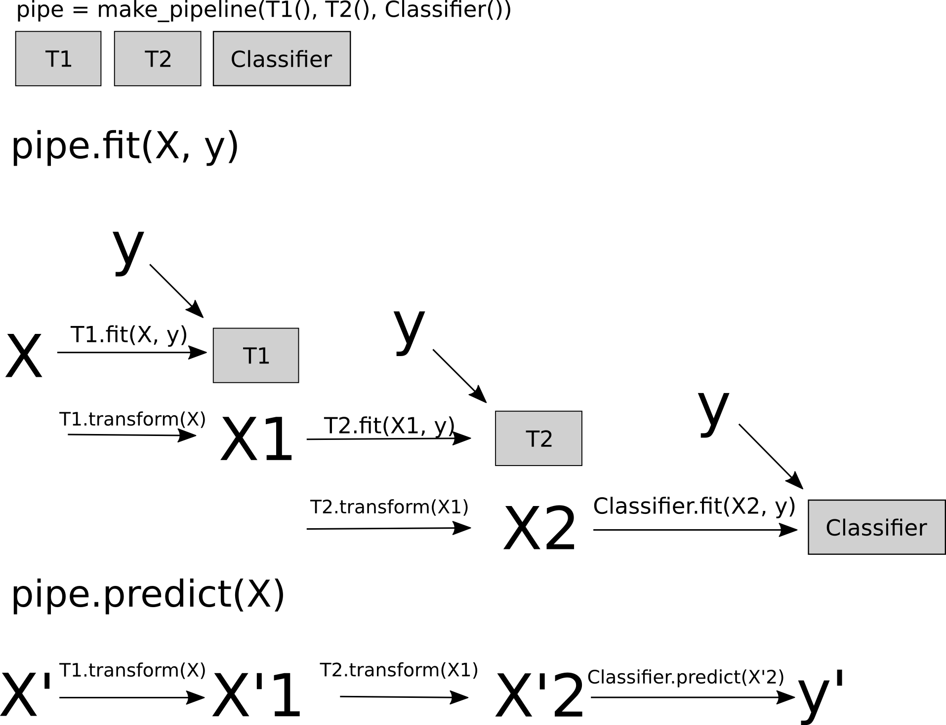
Pipelines

Slide 28
IPython Notebook:
Part 5 - Preprocessing and Pipelines

Slide 29
Do cross-validation over all steps jointly.
Keep a separate test set until the very end.

Slide 30
Sample application: Sentiment Analysis

Slide 31
IMDB Movie Reviews Data
Review:
One of the worst movies I've ever rented. Sorry it had one of my favorite actors on it (Travolta) in a nonsense role. In fact, anything made sense in this movie.
Who can say there was true love between Eddy and Maureen? Don't you remember the beginning of the movie ?
Is she so lovely? Ask her daughters. I don't think so.
Label: negative
Training data: 12500 positive, 12500 negative

Slide 32
Bag Of Word Representations
CountVectorizer / TfidfVectorizer
“This is how you get ants.”
tokenizer
['this', 'is', 'how', 'you', 'get', 'ants']
Build a vocabulary over all documents
['aardvak', 'amsterdam', 'ants', ... 'you', 'your', 'zyxst']
Sparse matrix encoding
aardvak
ants
get
you
zyxst
[0, …, 0, 1, 0, … , 0, 1 , 0, …, 0, 1, 0, …., 0 ]

Slide 33
IPython Notebook:
Part 6 - Working With Text Data

Slide 34
Feature Union
Training Labels
Training Data
Feature
Extraction I
Feature
Extraction II
Model

Slide 35
IPython Notebook:
Part 7 – FeatureUnion

Slide 36
Overfitting and Underfitting
Training
Sweet spot
Accuracy
Generalization
Underfitting
Overfitting
Model complexity

Slide 37

Linear SVM

Slide 38


(RBF) Kernel SVM

Slide 39











Decision Trees

Slide 40




Random Forests

Slide 41

Validation Curves
train_scores, test_scores = validation_curve(SVC(), X, y,
param_name="gamma", param_range=param_range)

Slide 42
Scaling Up

Slide 43
Three regimes of data
Fits in RAM
Fits on a Hard Drive
Doesn't fit on a single PC

Slide 44
Three regimes of data
Fits in RAM (up to 256 GB?)
Fits on a Hard Drive (up to 6TB?)
Doesn't fit on a single PC

Slide 45


Slide 46


Slide 47
"256Gb ought to be enough for anybody."
- me
(for machine learning)

Slide 48

Subsample!

Slide 49
The scikit-learn way

Slide 50
HDD
Your for-loop / polling
estimator.partial_fit(X_batch, y_batch)
Trained
Scikit-learn
estimator
Network

Slide 51
Supported Algorithms
All SGDClassifier derivatives
Naive Bayes
MinibatchKMeans
Birch
IncrementalPCA
MiniBatchDictionaryLearning

Slide 52
IPython Notebook:
Part 8 – Out Of Core Learning

Slide 53
Stateless Transformers
Normalizer
HashingVectorizer
RBFSampler (and other kernel approx)

Slide 54
Bag Of Word Representations
CountVectorizer / TfidfVectorizer
“This is how you get ants.”
tokenizer
['this', 'is', 'how', 'you', 'get', 'ants']
Build a vocabulary over all documents
['aardvak', 'amsterdam', 'ants', ... 'you', 'your', 'zyxst']
Sparse matrix encoding
aardvak
ants
get
you
zyxst
[0, …, 0, 1, 0, … , 0, 1 , 0, …, 0, 1, 0, …., 0 ]

Slide 55
Hashing Trick
HashingVectorizer
“This is how you get ants.”
tokenizer
['this', 'is', 'how', 'you', 'get', 'ants']
hashing
[hash('this'), hash('is'), hash('how'), hash('you'), hash('get'), hash('ants')]
= [832412, 223788, 366226, 81185, 835749, 173092]
Sparse matrix encoding
aardvak
ants
get
you
zyxst
[0, …, 0, 1, 0, … , 0, 1 , 0, …, 0, 1, 0, …., 0 ]

Slide 56
IPython Notebook:
Part 9 – Out Of Core Learning for Text

Slide 57

Video Series
Advanced Machine Learning with scikit-learn
50% Off Coupon Code: AUTHD

Slide 58




Thank you for your attention.
@t3kcit
@amueller
importamueller@gmail.com
http://amueller.github.io

