Slide 1
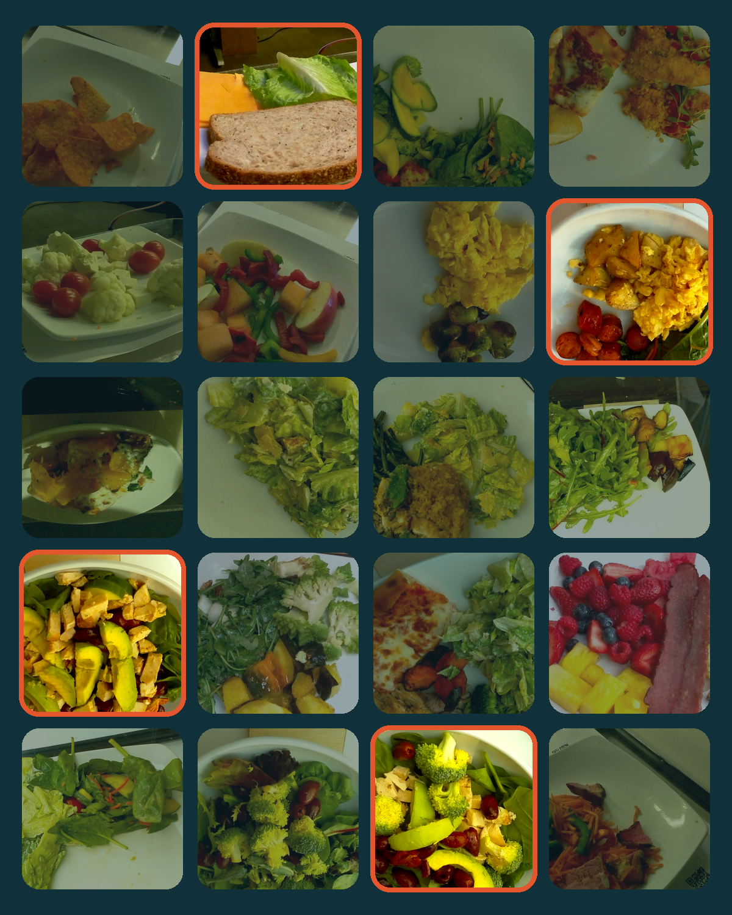
RASS
NeurIPS 2026 · Evaluations & Datasets Track
Risk-Audited Budget Selection for Compact NeRF Benchmark Subsets
48 scenes instead of 3,521, backed by a statistical audit
Ahmad AlMughrabi · Flavià Serret · Ricardo Marques · Petia Radeva
Universitat de Barcelona · Universitat Pompeu Fabra ·
Institut de Neurosciències, Barcelona
Notes:
What if you could benchmark on 48 scenes instead of 3,521, with a statistical audit behind that choice? Hello, I'm Ahmad AlMughrabi from the University of Barcelona, presenting RASS, joint work with Flavià Serret, Ricardo Marques and Petia Radeva.

Slide 2

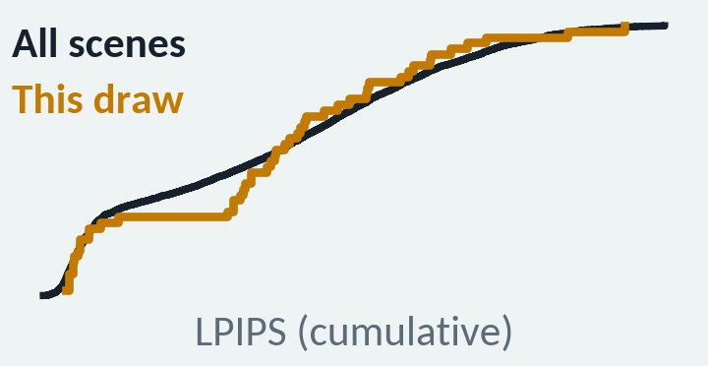

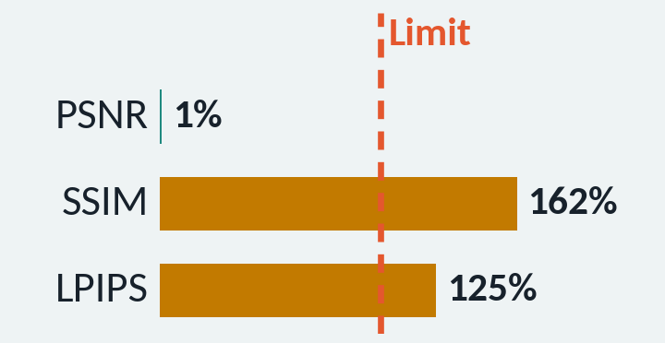


Full NeRF benchmarks are too costly to rerun for every idea
3,521
Ad hoc subsets can look right for the wrong reasons
Tail shift
NeRF trainings for every ablation on the full benchmark
A real 48-scene draw: every mean matches, but its LPIPS distribution (amber) drifts from the full set
512
Metric leakage
Another real draw: PSNR uses 1% of its tolerance, while SSIM and LPIPS exceed theirs
H100 GPUs, at most, to produce the full logs once
Sampling luck
One subset passes by chance; the next draw does not
Our question: what is the smallest subset that preserves the full-benchmark summaries, under explicit fidelity constraints?
Notes:
NeRF methods are trained per scene, so every ablation on our full benchmark means 3,521 trainings; producing the full logs once took a supercomputer with up to 512 H100 GPUs. So people evaluate on small ad hoc subsets, which can look right for the wrong reasons. These are real 48-scene draws: one matches every mean, yet its LPIPS distribution drifts; another matches PSNR almost exactly, while SSIM and LPIPS miss. And any single pass may be luck. So we ask: what is the smallest subset that preserves the full-benchmark summaries under explicit constraints?

Slide 3
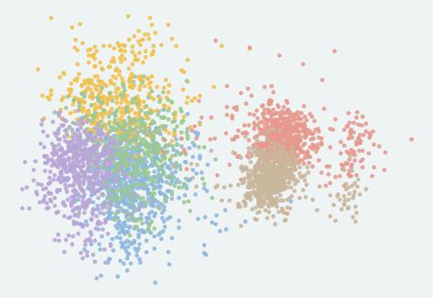
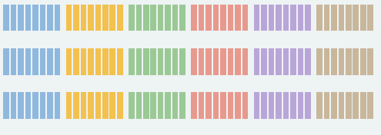



RASS audits a subset-generation procedure, not one lucky subset
1
2
3
4
Describe
Generate
Test
Audit
57-D descriptor per scene
K-Means → 6 regimes
Draw M = 400 candidates per budget B
Balanced: equal scenes per regime
All six must hold:
|ΔPSNR| ≤ 0.5 dB
|ΔSSIM| ≤ 0.01
|ΔLPIPS| ≤ 0.01
KS ≤ 0.14, per metric
Wilson 95% lower bound (LCB) on the pass rate
Pick the smallest B with LCB ≥ p_{min}
GUARDS AGAINST
GUARDS AGAINST
Tail shift
Sampling luck
× 400 draws
Metric leakage
Export: release one passing draw, picked by a fixed rule, and validate it on its own
Log-based: no GPU training; the audit reruns
on a CPU in minutes
Notes:
RASS answers with an audit. We describe each scene with 57 descriptors and cluster the scenes into six regimes. For each budget, a generator draws 400 candidate subsets, here with equal scenes per regime. Each candidate must pass six constraints at once: the PSNR, SSIM and LPIPS means within tolerance, and a Kolmogorov-Smirnov bound on each distribution. Against luck, we audit the pass rate of the procedure, not a single subset. Once a budget is certified, we export one passing draw by a fixed rule and validate it on its own. All of this runs on existing logs, on a CPU.

Slide 4
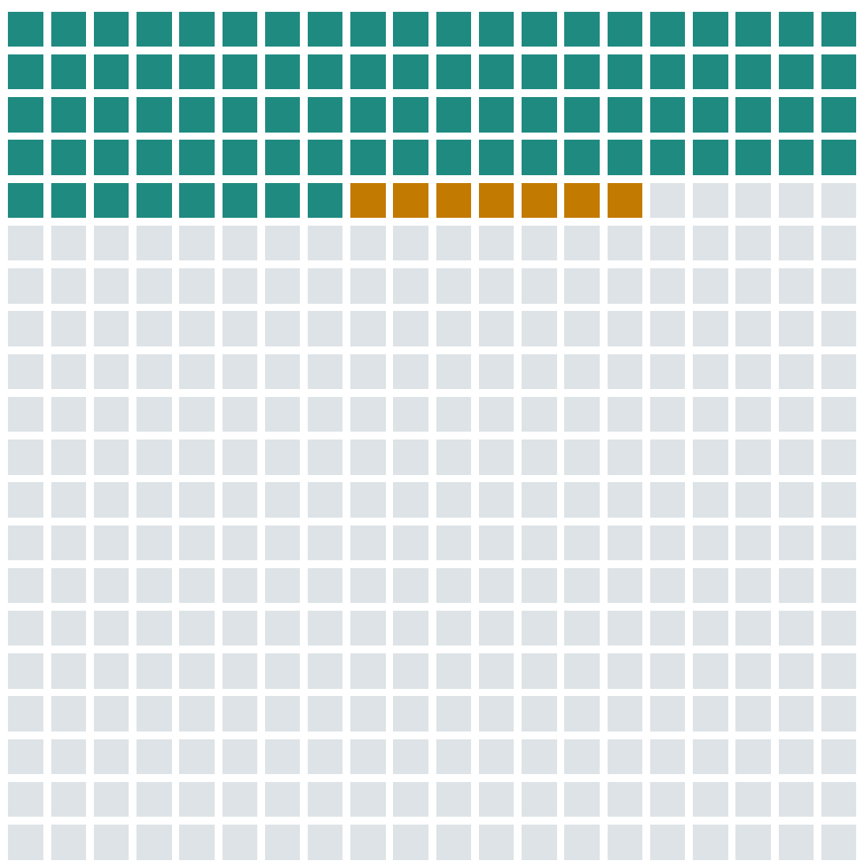

At 48 scenes, even the pessimistic pass rate clears the target
Pass all six constraints (88)
Means match, KS fails: tail shift caught (7)
Fail a mean constraint (305)
Pass rate 88 / 400 = 0.22
Wilson 95% LCB 0.182 ≥ p_{min} = 0.08
48 scenes certified
p_{min} is a yield: on average, at most 12.5 cheap log checks find a passing subset.
The 400 real candidate draws at 48 scenes
Notes:
Here are the 400 real draws at 48 scenes. 88 pass all six constraints, a pass rate of 0.22; the seven amber ones matched every mean but failed the KS bound. The 95% Wilson lower bound, a pessimistic pass rate, is 0.182, above our target of 0.08, so the 48-scene budget is certified. The target is a yield: on average, at most about twelve cheap log checks find a passing subset.

Slide 5
The frontier trades scenes for reliability
Pass rate
Target p_{min} = 0.08
Wilson LCB
RASS-48
48 scenes · LCB 0.182
Screening & ablations
Smallest evaluated budget
Target p_{min} = 0.08
48
60
72
96
120
Subset size (scenes, balanced generator)
Notes:
Repeating this for each budget on our grid gives the cost-reliability frontier. Teal is the pass rate; red is its lower bound. With the target at 0.08, the smallest evaluated budget is 48 scenes: RASS-48, our screening subset for ablations.

Slide 6
The frontier trades scenes for reliability
Pass rate
Target p_{min} = 0.08
Wilson LCB
RASS-48
First LCB ≥ 0.20
48 scenes · LCB 0.182
Target p_{min} = 0.20
Screening & ablations
Target p_{min} = 0.20
Target p_{min} = 0.08
RASS-96
96 scenes · LCB 0.241
48
60
72
96
120
Compact reporting
Subset size (scenes, balanced generator)
Notes:
Raise the target to 0.20, and the lower bound first clears it at 96 scenes: RASS-96. It costs twice the scenes but carries a stronger guarantee, so we recommend it for results you report. You pick the point on the frontier that matches the reliability you need.

Slide 7

RASS-48 passes the global audit with 73× fewer scenes
Share of each tolerance that RASS-48 uses
73×
Limit
fewer scenes: 3,521 → 48
8 scenes from each of the 6 descriptor regimes
Joint pass, all six
Notes:
We then check the exported RASS-48 subset itself. Each bar is the share of a tolerance it uses, and all six stay below the limit; the closest is the LPIPS KS distance, at 80 percent. That is 73 times fewer scenes than the full benchmark, eight from each regime. The guarantee is global: we do not claim per-regime fidelity.

Slide 8



One audit covers more methods, generators, and datasets
RASS-96 passes the
3- and 4-method audits
Any candidate
generator plugs in
The protocol
transfers to DL3DV
Constraints passed in joint audits
Smallest certified size (scenes)
64 / 140
 | 3 methods | + nerfacto
RASS-48 | 14/16 | 19/22
RASS-96 | 16/16 | 22/22
DL3DV scenes certified for four methods (32 for one)
✓
✓
Contract re-declared for DL3DV; proportional allocation, added post hoc.
✗ k-center fails up to 96
So RASS-96 is our subset
for reported results.
Balanced also passes at 36 on an extended grid.
Notes:
The audit extends to several methods at once. In joint audits, RASS-48 passes 14 of 16 constraints for three methods, while RASS-96 passes all 16, and all 22 with nerfacto added.

Slide 9
One audit covers more methods, generators, and datasets
RASS-96 passes the
3- and 4-method audits
Any candidate
generator plugs in
The protocol
transfers to DL3DV
Constraints passed in joint audits
Smallest certified size (scenes)
64 / 140
 | 3 methods | + nerfacto
RASS-48 | 14/16 | 19/22
RASS-96 | 16/16 | 22/22
DL3DV scenes certified for four methods (32 for one)
✓
✓
Contract re-declared for DL3DV; proportional allocation, added post hoc.
✗ k-center fails up to 96
So RASS-96 is our subset
for reported results.
Balanced also passes at 36 on an extended grid.
Notes:
Any generator plugs in. Random and balanced sampling certify at 48 scenes and facility location at 36, though its reimplementation is unstable across seeds, and balanced sampling also passes at 36 on an extended grid. k-center coverage fails up to 96 scenes, so coverage alone is not fidelity.

Slide 10
One audit covers more methods, generators, and datasets
RASS-96 passes the
3- and 4-method audits
Any candidate
generator plugs in
The protocol
transfers to DL3DV
Constraints passed in joint audits
Smallest certified size (scenes)
64 / 140
 | 3 methods | + nerfacto
RASS-48 | 14/16 | 19/22
RASS-96 | 16/16 | 22/22
DL3DV scenes certified for four methods (32 for one)
✓
✓
Contract re-declared for DL3DV; proportional allocation, added post hoc.
✗ k-center fails up to 96
So RASS-96 is our subset
for reported results.
Balanced also passes at 36 on an extended grid.
Notes:
And the protocol transfers: on DL3DV, a contract re-declared for that dataset certifies 64 of 140 scenes for four methods.

Slide 11



Certify the procedure, not one lucky subset
RASS-48
RASS-96
Screening & ablations
Compact reporting
Smallest evaluated budget with LCB ≥ 0.08
LCB ≥ 0.20; passes the 3- and 4-method joint audits
How to use: train only on RASS-48 or RASS-96, compare with our released logs on the same scenes, and report the subset version.
github.com/GCVCG/RASS
kaggle.com/datasets/nobodyeh/rass-nerf-benchmark-artifact
Code & data
Thank you
Notes:
To use RASS, train on RASS-48 to screen ideas or on RASS-96 to report results, and compare with our released logs on the same scenes. The guarantee is global, and neither subset replaces a full leaderboard. Everything is released, so you can rerun the audit for your own methods. So next time you shrink a benchmark, audit it. Thank you.

