Slide 1
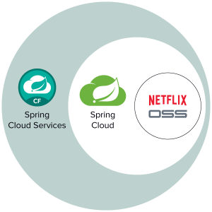
Spring Cloud Netflix+
Eureka, Hystrix, Zuul, Ribbon, Spring Retry

Slide 2
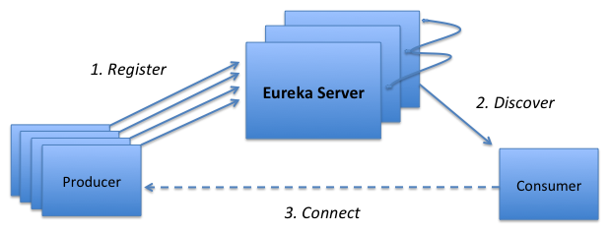
Eureka
Eureka is a REST (Representational State Transfer) based service that is primarily used in the AWS cloud for locating services for the purpose of load balancing and failover of middle-tier servers.
Notes:
show code
pom configuration
@EnableEurekaServer
show Eureka page
@EnableDiscoveryClient
show Eureka page

Slide 3
Eureka
Timeouts

