Slide 1
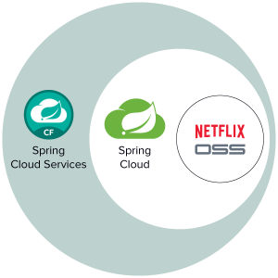
Spring Cloud Netflix
Eureka, Ribbon, Feign

Slide 2
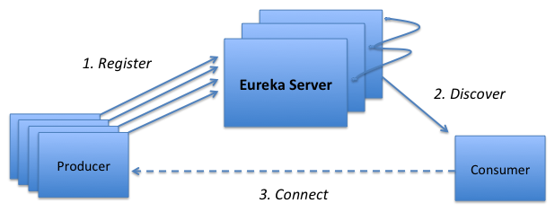
Eureka
Eureka is a REST (Representational State Transfer) based service that is primarily used in the AWS cloud for locating services for the purpose of load balancing and failover of middle-tier servers.
Notes:
show code
pom configuration
@EnableEurekaServer
show Eureka page
@EnableDiscoveryClient
show Eureka page

Slide 3
Ribbon
The library includes the Netflix client side load balancers and clients for middle tier services. Resolves services from Eureka.

Slide 4
Feign
Feign is a declarative web service client. It makes writing web service clients easier. To use Feign create an interface and annotate it.

