Slide 1
HIBERNATE PERFORMACE TUNING TIPS

Slide 2
Agenda
CREATE/UPDATE/DELETE Optimizations
Unidirectional vs Bidirectional mappings
Sets over Lists with @ManyToMany
READ Optimizations
N+1 Selects
JOIN FETCH
FetchMode.SUBSELECT
EntityGraphs

Slide 3
[CRUD] - Unidirectional vs Bidirectional mappings
Unidirectional
model *-to-many relationships only on one of the associated entities
@OneToMany annotation on parent side
manage only one collection of child entities
Bidirectional
model *-to-many relationships on both of the associated entities
@OneToMany annotation on parent side + @ManyToOne annotation on child side
manage parent collection + update parent references in child entities

Slide 4
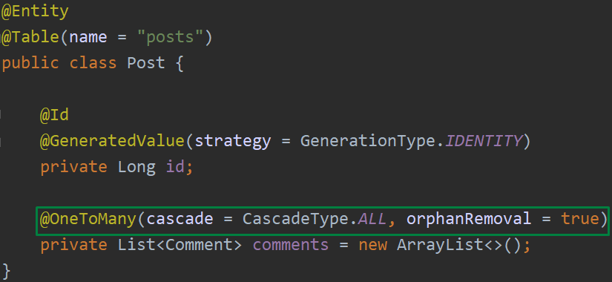
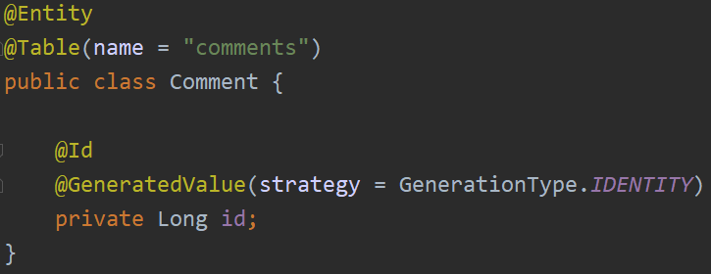
[CRUD] - Unidirectional - intermediary table
Post post = new Post();
post.addComment(new Comment());
post.addComment(new Comment());
post.addComment(new Comment());
postRepository.save(post);
HIBERNATE:
x1 INSERT INTO POSTS
x3 INSERT INTO COMMENTS
x3 INSERT INTO POST_COMMENTS
TOTAL: 7 queries !!

Slide 5
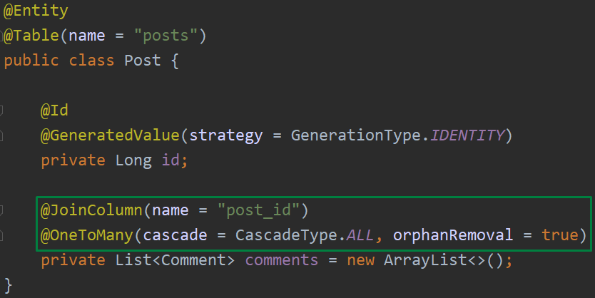
[CRUD] - Unidirectional - @JoinColumn
Post post = new Post(); post.addComment(new Comment()); post.addComment(new Comment()); post.addComment(new Comment());
postRepository.save(post);
HIBERNATE:
x1 INSERT INTO POSTS
x3 INSERT INTO COMMENTS
x3 UPDATE COMMENTS SET POST_ID=POST.ID WHERE ID=:?
TOTAL: 7 queries !!

Slide 6
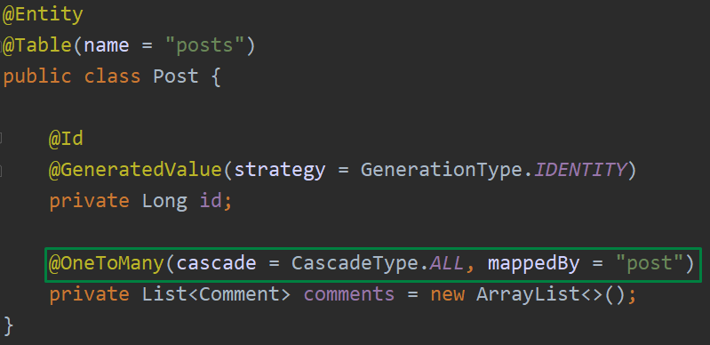
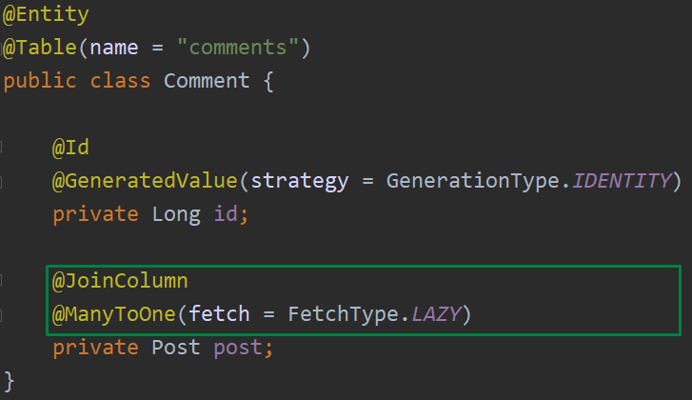
[CRUD] - Bidirectional - @OneToMany/@ManyToOne
Post post = new Post();
Comment comment1, comment2, comment3 = new Comment();
comment1.setPost(post);
comment2.setPost(post);
comment3.setPost(post);
post.addComment(comment1);
post.addComment(comment2);
post.addComment(comment3);
postRepository.save(post);
HIBERNATE:
x1 INSERT INTO POSTS
x3 INSERT INTO COMMENTS
TOTAL: 4 queries !OPTIMAL!

Slide 7
[CRUD] - Unidirectional vs Bidirectional - Conclusion
Bidirectional mappings perform better than unidirectional
In reality, @OneToMany is practical only when many means few
@ManyToOne is more efficient and more natural way for modeling one-to-many database relationaships
Always use FetchType.LAZY on all *-to-many and *-to-one associations.

Slide 8
[CRUD] - Sets over Lists with @ManyToMany
Set
unordered collection that doesn't contain any duplicates
performs better than List when used with @ManyToMany relationships
fewer database queries for standard CRUD operations
you must override equals/hashCode on entities
List
ordered collection that can contain duplicates
when used with @ManyToMany results with too many queries for standard CRUD operations
you can't fetch more than one List collections eagerly

Slide 9
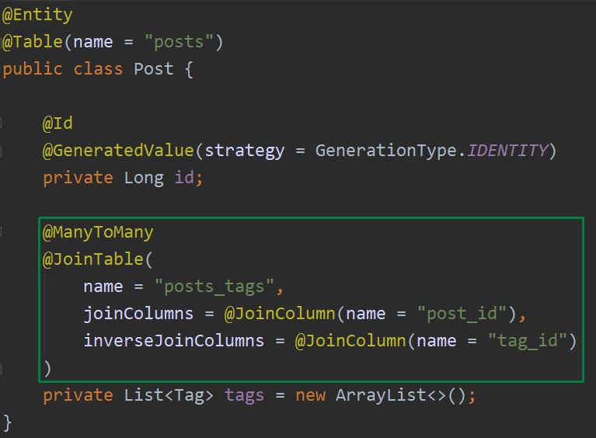
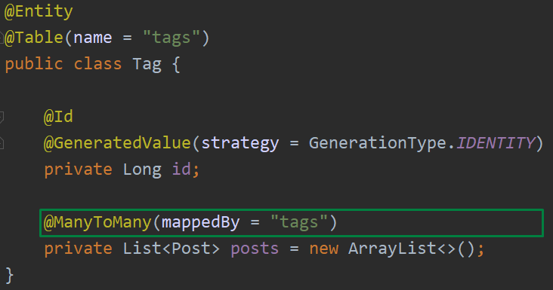
[CRUD] - List with @ManyToMany
// post has 3 tags
post.getTags().remove(0);
postRepository.save(post);
HIBERNATE:
x1 SELECT * POSTS_TAGS JOIN TAGS WHERE POST_ID=:ID
x1 DELETE FROM POSTS_TAGS WHERE POST_ID=:ID
x2 INSERT INTO POSTS_TAGS VALUES(POST_ID,TAG_ID)
TOTAL: 4 queries !!

Slide 10
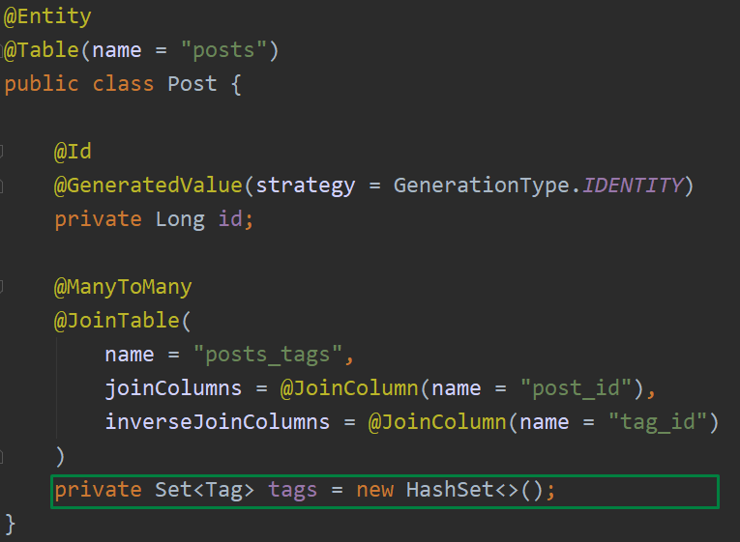
[CRUD] - Set with @ManyToMany
// post has 3 tags post.getTags().removeIf(...); postRepository.save(post);
HIBERNATE:
x1 SELECT * POSTS WHERE ID=:ID
x1 SELECT * POSTS_TAGS JOIN TAGS WHERE POST_ID=:ID
x1 DELETE FROM POSTS_TAGS WHERE POST_ID=:ID
TOTAL: 3 queries !OPTIMAL!

Slide 11
[CRUD] - N+1 Selects
N+1 Selects problem is the main performance issue in Hibernate
Happens when you forget to fetch an association and then you need to access it
Fires multiple select queries in database for a single select query at application layer
Changing the FetchType from LAZY to EAGER will only postpone the N+1 problem
The "issue" is not really an issue it's about how ORMs work
Hibernate provides multiple ways to catch and prevent this problem

Slide 12
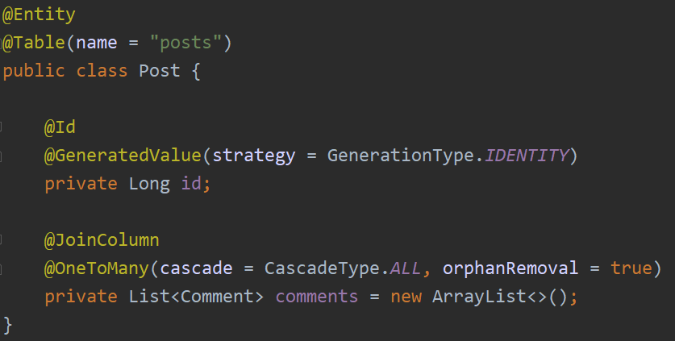
[CRUD] - N+1 Selects
Example: 5 posts in the database
postRepository.findAllPosts();
x1 SELECT * FROM POSTS
x5 SELECT * FROM COMMENTS WHERE POST_ID=POST.ID
TOTAL: 6 queries !!
WHAT IF THERE ARE MORE THAN ONE @OneToMany COLLECTIONS?

Slide 13
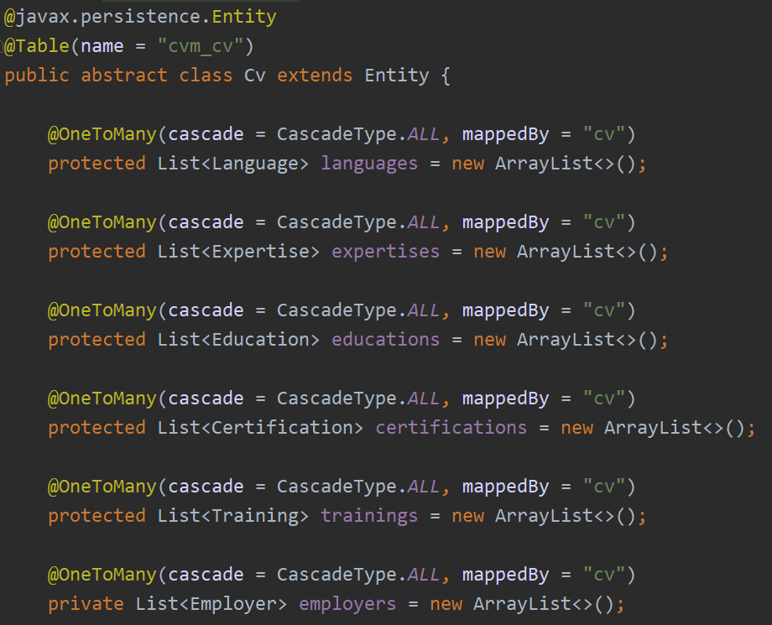
[CRUD] - N+1 Selects
Example: 5 CVs in the database
cvRepository.findAllCvs();
x1 SELECT * FROM CVM_CV
x5 SELECT * LANGUAGES..
x5 SELECT * EXPERTISES...
x5 SELECT * EDUCATIONS...
...
TOTAL: 6 * 5 + 1 = 31 queries !!
31 database round-trips for a request that can be done in a single select!

Slide 14
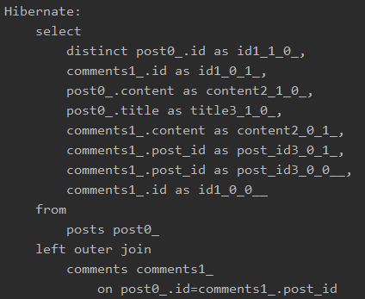
[CRUD] - JOIN FETCH
All in one query
Fetch only data that are actually needed
You can't fetch multiple Lists in one query, use Sets instead
Combine more than one JOIN FETCH to retrieve additional collections
Solves N+1 Selects issue
You shoud manually write the query
Can produce a Cartesian Product

Slide 15
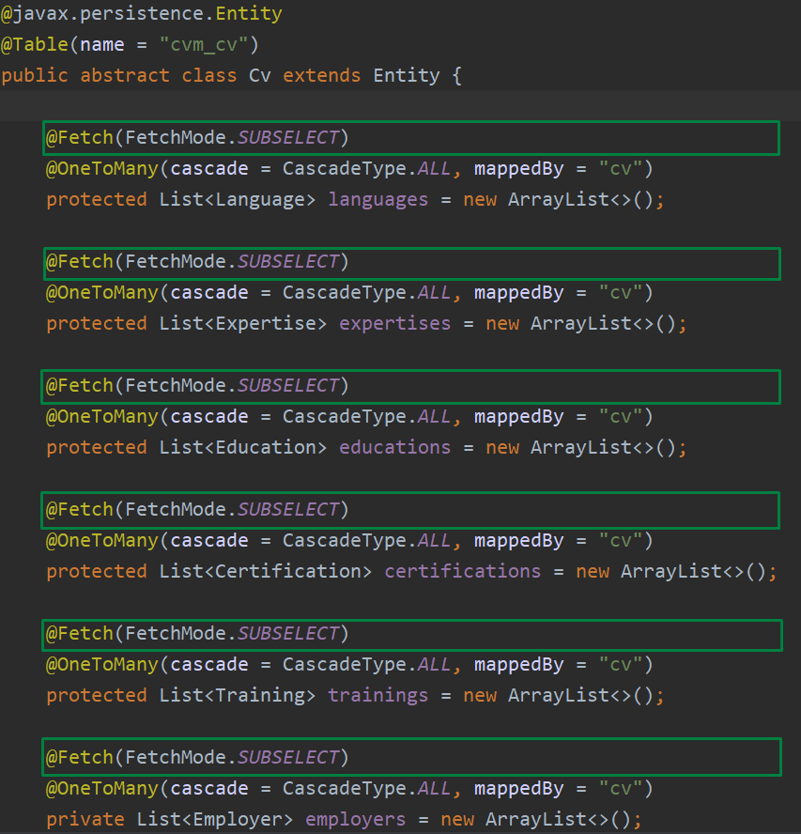
[CRUD] - FetchMode.SUBSELECT
More elegant way than JOIN FETCH
Instead of using additional queries to fetch each child in the collection, you will get only one query for all children by using ID IN (...) sql syntax
Can be considered as an optimal solution
cvRepository.findAllCvs();
x1 SELECT * FROM POSTS x1 SELECT * FROM LANGUAGES WHERE POST_ID IN (..) x1 SELECT * FROM EXPERTISES WHERE POST_ID IN (..) x1 SELECT * FROM EDUCATIONS WHERE POST_ID IN (..) ...

Slide 16
[CRUD] - Entity Graphs
Introduced in JPA v2.1
"fetch plans" for read operations
Entity graphs define a template by grouping related persistence fields that you want to retrieve eagerly
Improve runtime performance when loading entity's related associations
Allow you to switch from LAZY to EAGER fetch at runtime
Two modes: Fetch Graph and Load Graph

Slide 17
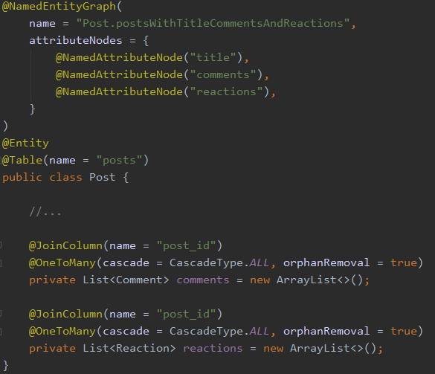
[CRUD] - Defining an Entity Graph
@NamedEntityGraph
name: name of the entity graph
attributeNodes: array of @NamedAttributeNode
includeAllAttributes: include all attributes without listing them inside attributeNodes
subgraphs: array of @NamedSubgraph
@NamedAttributeNode
value: name of the field
subgraph: choose which subgraph to be used when fetching the field
Nothing happens, only a definition!

Slide 18
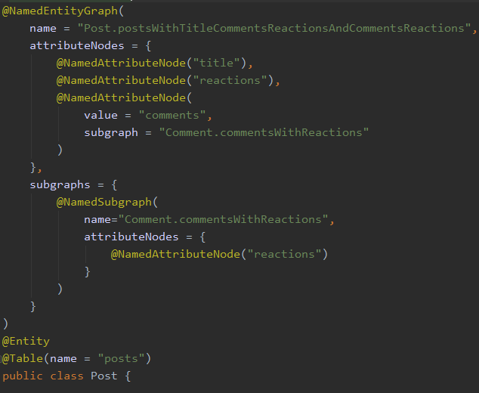
[CRUD] - Defining an Entity Graph with subgraphs
In a single query you will fetch title, reactions and comments and in the same query all the reactions for each comment
You can define more than one @NamedSubgraph
@NamedSubgraph can be further nested with additional subgraphs
Don't overuse!
More than 2 nested levels can produce a Cartesian Product

Slide 19
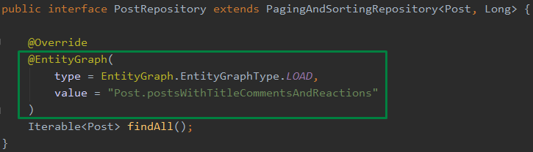
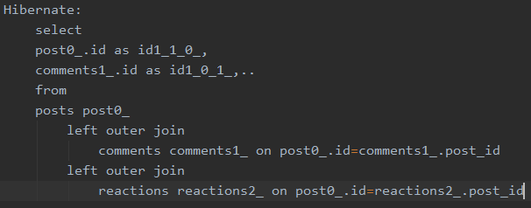
[CRUD] - Using Entity Graphs with Spring Data JPA
@EntityGraph Spring Data annotation
type: define the EntityGraphType
value: @NamedEntityGraph name
findAll method will always use the defined entity graph
All fields placed in the attributeNodes array will be fetched in a single query

Slide 20
[CRUD] - Entity Graph Types
EntityGraphType.LOAD("javax.persistence.loadgraph")
loads eagerly fields that are defined in the attributeNodes array
other fields are loaded by their default/defined FetchType
EntityGraphType.FETCH("javax.persistence.fetchgraph")
loads eagerly fields that are defined in the attributeNodes array
other fields are loaded with FetchType.LAZY
This is not always the case, since Hibernate can decide to fetch additional entity state
JPA providers use these types as hints, not as strict rules!
In most cases, FETCH and LOAD behave the same in HIBERNATE

Slide 21
DEMO

Slide 22
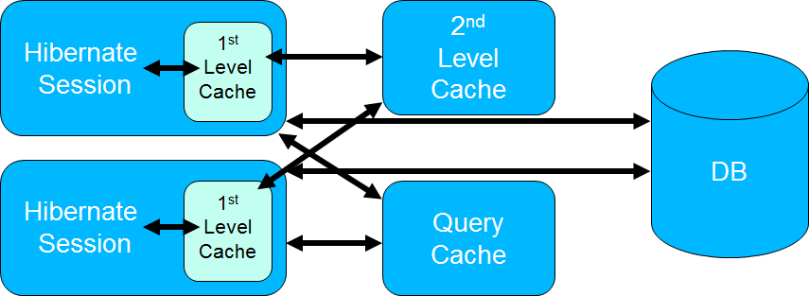
[CRUD] - Hibernate Cache
Reduce the amount of necessary database accesses
Cached objects reside in memory
Flexibility to limit the usage of memory and store cached objects on disk
Easy integreation with second level cache implementations like EH Cache

Slide 23
[CRUD] - Hibernate Cache Types
Session Cache
Enabled by default
Caches objects within the current session
Resides in memory
Second Level Cache
Disabled by default
Can be enabled through configuration
Caches objects across sessions
EH Cache provides implementation for Hibernate second-level cache
Query Cache
Disabled by default
Should be used in conjunction with second-level cache
Caches the results of a query together with query parameters
Doesn't cache the state of the actual entities

Slide 24


Slide 25
References
https://vladmihalcea.com/the-best-way-to-map-a-onetomany-association-with-jpa-and-hibernate
https://vladmihalcea.com/the-best-way-to-use-the-manytomany-annotation-with-jpa-and-hibernate
https://blog.ippon.tech/boost-the-performance-of-your-spring-data-jpa-application
https://dzone.com/articles/all-about-hibernate-second
https://www.radcortez.com/jpa-entity-graphs
https://www.journaldev.com/2969/hibernate-caching-first-level-cache

