Slide 1
TO lead or not to lead?: Choosing the optimal pricing model at Zillow New Construction
Amulya Sharma
Data Scientist, Zillow New Construction Analytics
Link: Github

Slide 2
Contents
Project
Overview
Analysis
Take-Aways
Data & Process Overview

Slide 3
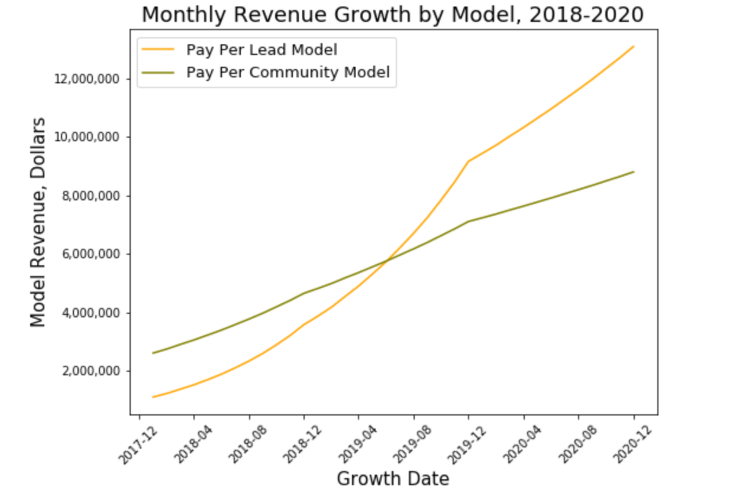
I. Project Overview
Goal: Select Optimal Pricing Model for New Construction listings based on long-term revenue opportunity
Potential Interested Parties:
Zillow Group Data Science Team
Zillow Group Sales leadership
Zillow Group Marketing leadership
Outcome:
Analyze long term revenue growth from January 2018 to December 2020 for Pay Per Lead and Pay Per Community pricing model and assess feasibility

Slide 4
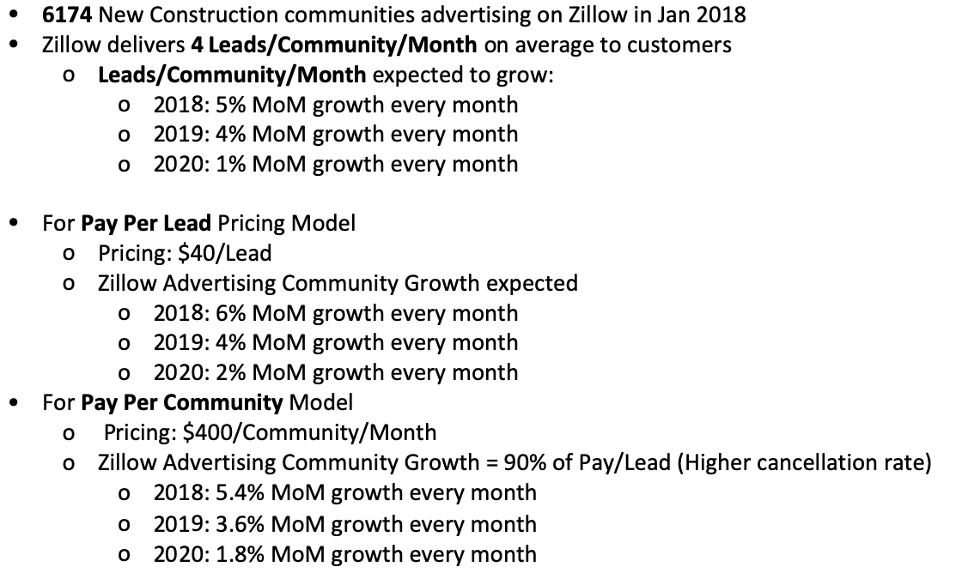
II. Data & Process Overview
Data:
Sources: Decision Science, Sales, Marketing Research, Financial Planning & Analysis
Data spans over 36 months from January 2018 till December 2020
Market Research Data was interesting but was found to be insufficient for comparative analysis
Process:
3 Key Metrics selected for each model:
Monthly Community Growth
Per Community Monthly Revenue Growth
Monthly Overall Revenue Growth
Data generated based on percentage growth rates Month over Month, and cleaned in Python
Time Series Analysis of Key Metrics for Pay Per Lead vs Pay Per Community pricing models

Slide 5
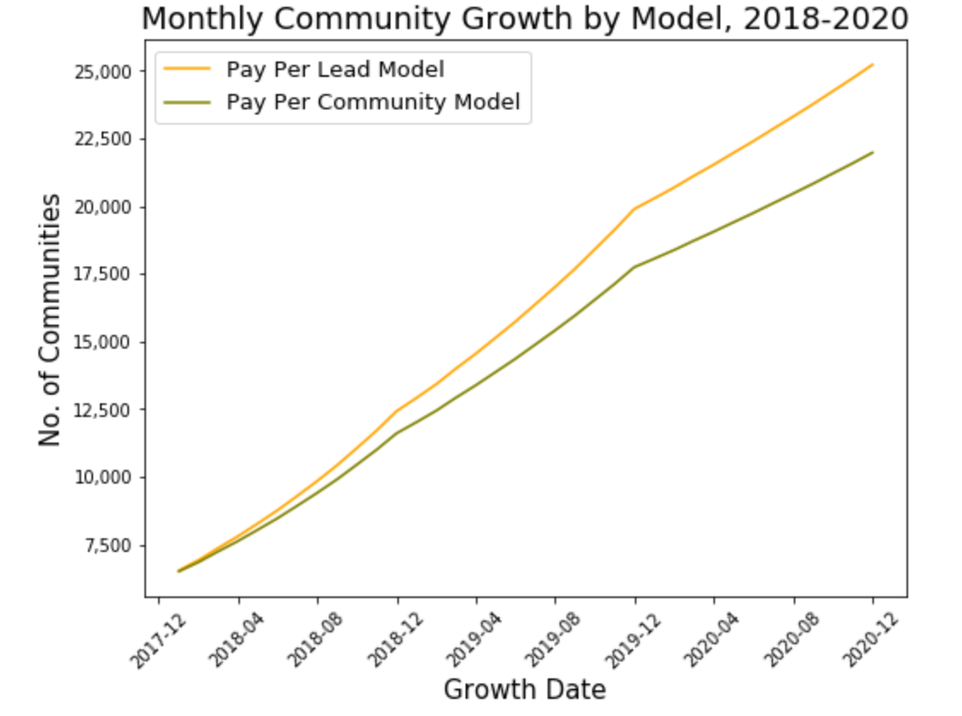
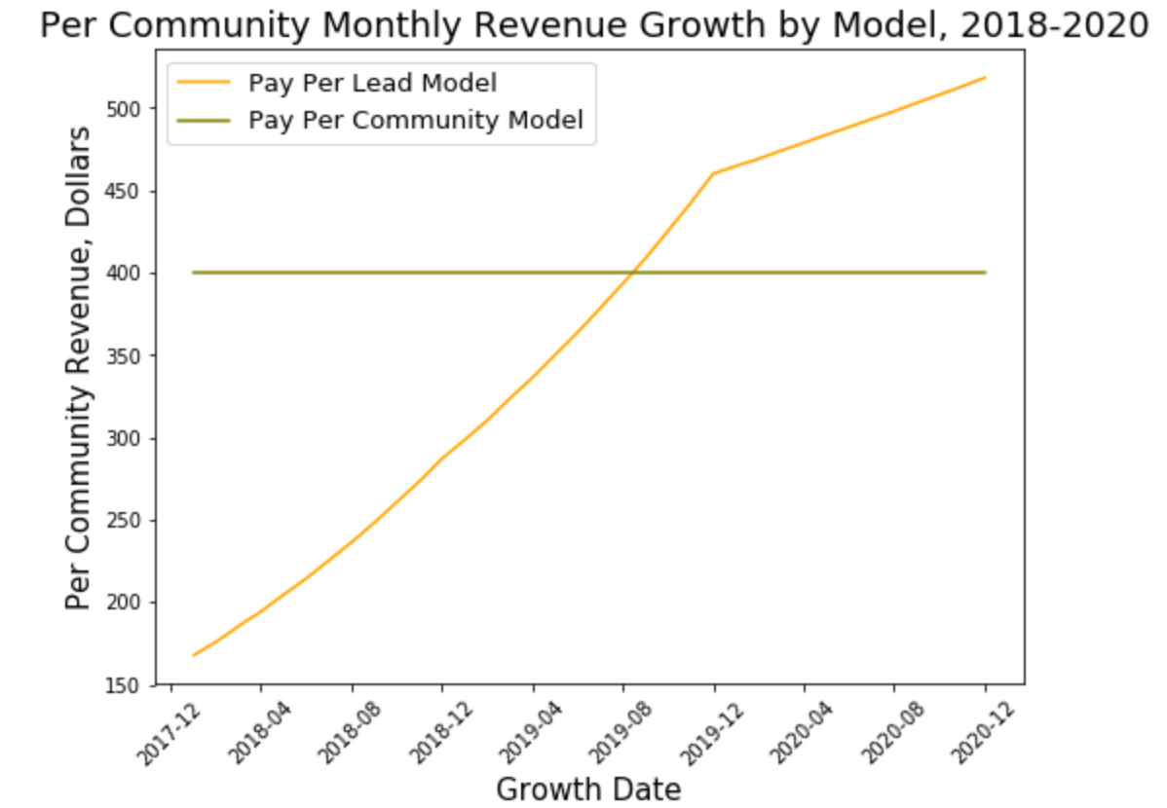
III. Analysis: 1
In December 2020 after MoM growth:
Pay Per Lead Pricing Model would result in 25,225 communities
Pay Per Community Pricing Model would result in 21,976 communities
In December 2020 after MoM growth:
Pay Per Lead Pricing Model would yield on average $518 in revenue per community per month
Pay Per Community Pricing Model would still yield $400 in revenue per community per month

Slide 6
Analysis: 2
In December 2020 after MoM growth:
Pay Per Lead Pricing Model would yield $13,076,372 in overall revenue
Pay Per Community Pricing Model would yield $8,790,313 in overall revenue
Pay Per Lead Model would yield 1.5 times revenue of Pay Per Community Model
Stark Contrast from baseline revenue in January 2018 (Pay Per Community Revenue = 2.5 times Pay Per Lead Revenue)
Zillow should select the Pay Per Lead Pricing Model to generate more revenue
Consistent with prioritizing long-term revenue growth despite losing revenue until mid-2019
More Listings = More Leads
More Profitability assuming similar operating expenses

Slide 7
But is it really that simple?
Strategically, Pay Per Lead Model:
Better for: Booming Economy -> More Leads generated -> More Overall Revenue
”On-Demand” service: Customer pays only for what they get while still advertising whole catalog
‘Riskier’ source of revenue but potential for greater profits
Pay Per Community Model
Better for: Relatively Slower Economy -> Less Leads -> More Revenue from flat rate listings
“Subscription” service: Customer ends up paying for whole catalog despite transacting with few hot properties
Possible missed revenue opportunities but a ‘Safer’ and ‘Steadier’ source during turbulence
Fixed Rate Pricing Model: UNREALISTIC!
Real Estate property costs vary tremendously and fluctuate variably across regions
Cannot charge customer same price per lead or per community in Beverly Hills, LA and Bountiful, UT
Solution: Variable rate model proportional to real estate costs across different communities

Slide 8
IV. Take-Aways
Pay Per Lead Pricing Model works better in the long term to generate more revenue if the Leads keep growing consistently
Variable Rate Pricing Model based on community location is more practical and feasible
Datasets of real estate features across different regions where customers are situated will help determine an appropriate pricing range
Using this data, a multiplicative factor that scales according to property costs can be derived to automate the process of setting a variable price range per region. A regression model can be built using the features of houses and locations of existing communities to predict the ideal price rate per lead of listings of communities in new locations
Selecting an Optimal Pricing Model not as simple as which model makes you more money
Datasets having details of communities advertised by individual builders on Zillow or number of builders will help substantiate the expenses they are willing to pay Zillow at a granular level
This will help to set a threshold or a practical/reasonable pricing strategy and control customer churn by not overcharging them while working towards maximizing revenue/profits
A classifier can then be used to predict if a customer will churn or not based on a rate change in pricing model
A/B Testing can also help determine which factors in the model matter the most to customers and test if a change will positively or negatively impact customer experience before pushing it to production

Slide 9
Thank you

