Slide 1

Carbon Emission Detecting Website
Presented by: Amullyajit Nandi
Institute of Engineering and Management, Kolkata

Slide 2

Why We Are Doing This Project
- To combat climate change by spreading awareness.
- People are unaware of their daily carbon impact.
- This project simplifies emission calculation for individuals.

Slide 3
Related Sustainable Development Goals
- SDG 13: Climate Action – Encourage reduction of carbon footprint.
- SDG 17: Partnerships – Collaboration for sustainable development.
- Our tool supports informed and responsible decisions.

Slide 4
Research Gap
- Existing tools are often too complex or not accessible.
- Lack of user-friendly, web-based carbon calculators.
- Need for real-time, visual, easy-to-use platforms.

Slide 5
Project Objectives
- Build a simple and responsive carbon calculator.
- Educate users through visual feedback (bar chart).
- Promote awareness and responsibility.

Slide 6
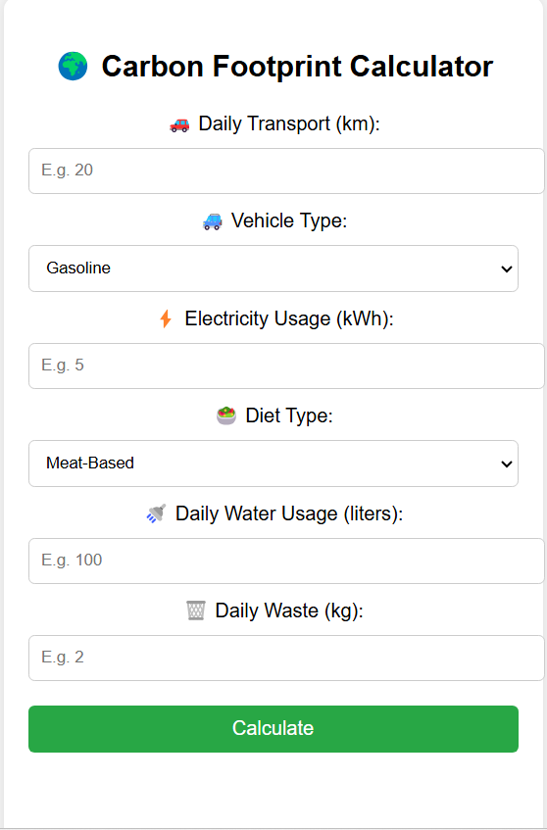
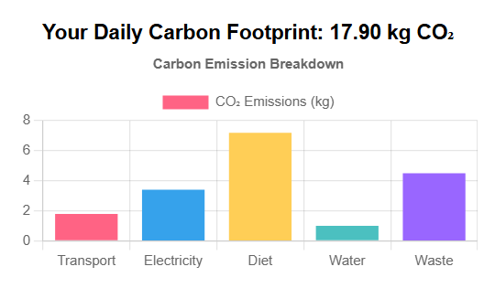
Features of the Website
- Input fields: Transport, Electricity, Diet, Water, Waste.
- Vehicle and diet type selection.
- Instant result display with Chart.js graph.
- Accessible on all modern browsers.

Slide 7
Technology Stack
- HTML, CSS, JavaScript
- Chart.js for visualizing data
- Netlify for hosting the website
- GitHub and VS Code for development

Slide 8
Emission Calculation Logic
- Transport: Distance × Vehicle Emission Factor
- Electricity: kWh × 0.85 kg CO₂
- Diet: Based on diet type (Meat: 7.2, Veg: 3.8, Vegan: 2.9)
- Water: Liters × 0.001 kg CO₂
- Waste: Kg × 1.5 kg CO₂

Slide 9
Live Demo & Challenges
- Website: https://carbonemission-calc.netlify.app/
- Issue: Low visibility of water data → Adjusted Y-axis.
- Input validation added for user safety.

Slide 10
Future Enhancements
- Add mobile responsiveness and progressive web app features.
- Save and track historical data for users.
- Shareable reports and personalized suggestions.
- Include more categories like shopping, travel, etc.

Slide 11
Conclusion
The Carbon Emission Detecting Website is a step toward making environmental awareness accessible and personal. By allowing users to calculate their daily carbon footprint from everyday activities, this tool empowers individuals to make informed lifestyle choices.
It aligns with SDG 13 (Climate Action) by promoting responsible behavior and with SDG 17 (Partnerships) by encouraging collective efforts in combating climate change.
The project demonstrates how simple technology can drive meaningful impact, and with further enhancements, it can evolve into a powerful platform for sustainability education and action.

