Slide 1

Weather Data Analysis using Data Analytics
Institute: Institute of Engineering & Management.

Slide 2
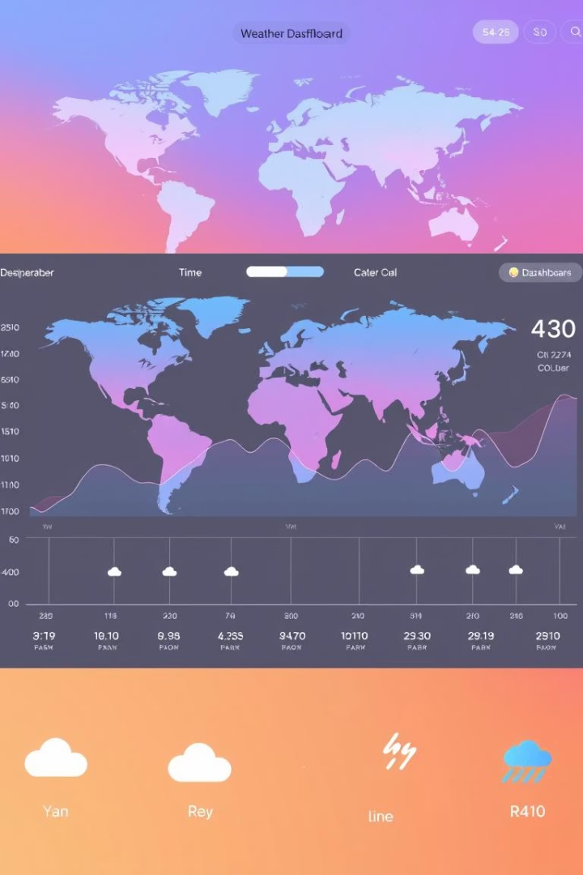
Introduction: Understanding Climate Patterns
Goal
Analyze weather data to understand city-wise climate patterns.
Key Focus Areas
Temperature trends, seasonal variation, precipitation analysis.
Analytical Approach
Use Python and visualization libraries to gain insights.
Why It Matters
Helps in climate research, forecasting, and urban planning.

Slide 3
Dataset Overview
1
Weather.csv
2
25,500 Entries
3
Key Columns
We utilized the Weather.csv dataset for our analysis.
The dataset includes extensive records, totaling 25,500 entries.
Date, Temp Max, Temp Min, and Rain were the core columns analyzed.
4
Time Span
5
Initial Data Cleaning
The dataset covers a significant time span, starting from 1951.
We standardized column names and handled missing values.

Slide 4
Tools & Technologies
1
Programming Language: Python
2
Libraries: Pandas
Python was the core language for data processing.
Pandas was essential for data manipulation.
3
Visualization
4
Environment
Seaborn and Matplotlib aided data visualization.
Google Colab or VS Code supported development.

Slide 5
Data Cleaning & Processing
1
Datetime Conversion
2
Average Temperature
Date column converted to datetime format for time series analysis.
Calculated average temperature from Temp Max and Temp Min.
3
Column Renaming
4
Missing Values
Rain column renamed to Precipitation for clarity and consistency.
Removed rows with missing temperature or precipitation values.

Slide 6
Monthly Temperature Trends
Objective: Understand how temperature behaves throughout the year on a month-by-month basis.
Approach: Organized data by month and calculated the average temperature across all years.
1
Summer months (May to July) consistently show the highest average temperatures.
2
Winter months (December and January) exhibit the lowest average temperatures.
3
The pattern reflects expected seasonal changes and climate consistency across years.

Slide 7
Daily Temperature Variation
Objective: Explore how temperature varies from day to day over a long period.
Approach: Analyzed temperature values recorded on each day to study fluctuations and consistency.
1
Day-to-day changes reveal periods of extreme temperatures and unusual weather.
2
Variations also highlight seasonal transitions such as the gradual warming from winter to summer.
3
Some years show anomalies—potential indicators of climate change effects.

Slide 8
Correlation Analysis
1
Feature Selection
2
Heatmap
3
Insights
Temperature and precipitation were key features. More features could be added.
A heatmap visualized correlation coefficients. This allows for quick interpretation.
A low or inverse correlation exists. It is between rain and temperature.

Slide 9
Key Insights
Seasonal Trends
Temperature Range
Temperature peaks and drops match expected seasonal patterns. Summer shows the highest average temperatures.
Consistent temperature ranges with minor yearly variations. The data reflects stable climate patterns.
Weak Correlation
Outliers
Limited correlation exists between rain and average temperature. This suggests other factors influence climate.
Specific periods show unusual weather, indicating unique events. These periods require more detailed analysis.

Slide 10
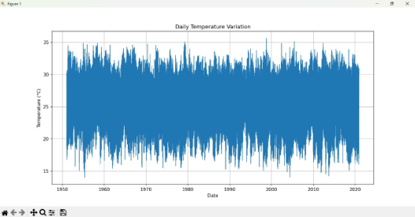
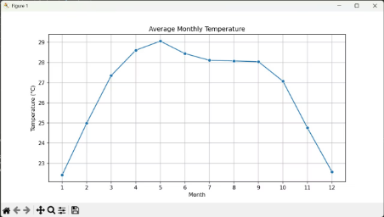
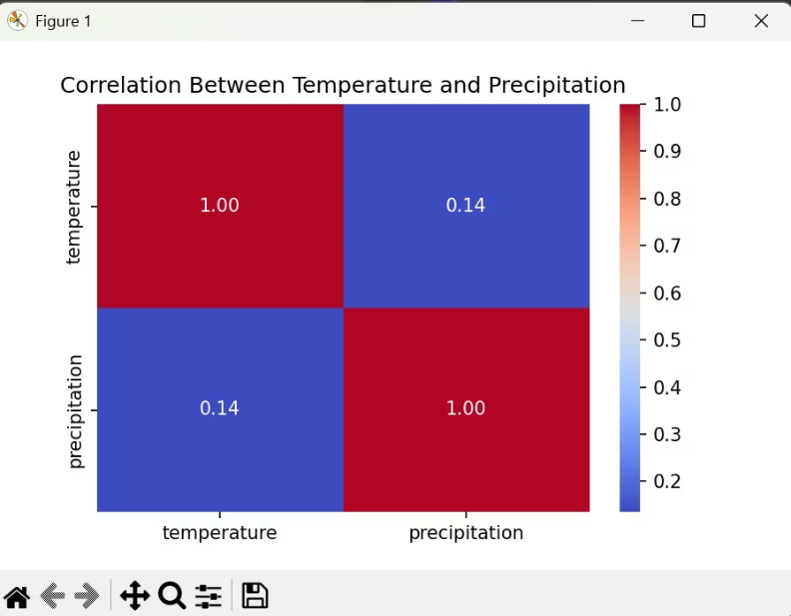
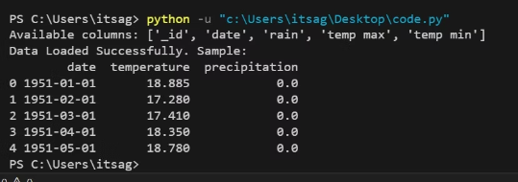
Results:

Slide 11
Conclusion & Future Work
1
Analyzed Weather Data
2
Identified Monthly Trends
We successfully visualized weather patterns over time.
Clear trends were found across different months and years.
3
Correlation Insights
4
Future Steps
Feature relationships were examined for a basic understanding.
In the future, we will add new features such as humidity.

