Slide 1
YATRI AI: Your AI-Powered Traffic & Road Assistant
Revolutionizing traffic information with conversational AI
Predicting congestion using machine learning and real-time data
A smarter way to navigate your city

Slide 2
Title Slide
Title: YATRI AI (Your AI-Powered Traffic & Road Assistant)
Presented by: Amullyajit Nandi
Institution: Institute of Engineering and Management
Branch: CSE (IoT CSBT), 2nd Year

Slide 3
Introduction
YATRI AI is an AI-powered traffic and driving assistant designed to provide a real-time traffic condition, road safety tips, and driving knowledge through voice interaction.
Using machine learning (Random Forest/Decision Tree), speech recognition, and dataset-based analysis, YATRI AI helps users:
✅ Predict traffic conditions based on location & time ✅ Offer safe driving tips and road rule guidance ✅ Provide license assurance knowledge
This project enhances road safety & navigation efficiency, making driving smarter, safer, and more informed.

Slide 4
Problem statement
1. Lack of Accurate Real-Time Traffic Updates
Existing systems rely on GPS-based tracking, which may not always reflect real-time congestion levels.
Solution: AI-powered traffic prediction using machine learning.
2. No Voice-Enabled Traffic Assistance
Users must check apps manually, causing distractions while driving.
Solution: Speech recognition for hands-free traffic updates.
3. Inefficient Route Planning
Current systems do not dynamically adjust routes based on changing traffic conditions.
Solution: AI-powered route optimization (future update).
4. Lack of AI-Based Driver Training & Safety Insights
New drivers lack proper guidance on road rules & accident prevention.
Solution: YATRI AI provides driving tips, road safety rules, and VR-based training (future expansion).

Slide 5
Technologies Used
Programming Language: Python
Speech & Voice Processing
✅ pyttsx3 → Converts text into speech (Text-to-Speech)
✅ speech_recognition → Captures and processes user voice commands
Data Handling & Processing
✅ pandas → Reads and processes traffic data from CSV files
Machine Learning & AI
✅ sklearn.ensemble.RandomForestClassifier → Used for traffic prediction ✅ sklearn.model_selection.train_test_split → Splits dataset into training & testing ✅ sklearn.preprocessing.LabelEncoder → Converts text data (Location, Time) into numerical values
Fuzzy Matching
✅ fuzzywuzzy.process → Finds best-matching locations from user queries
Time & Date Processing
✅ datetime → Extracts and formats the current time for queries

Slide 6
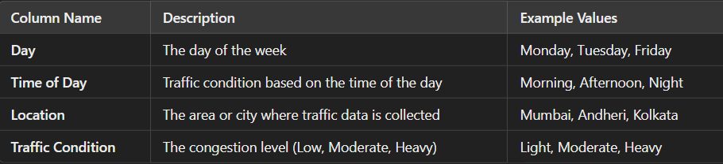
Traffic Dataset Overview The Traffic Dataset used in YATRI AI provides historical and real-time traffic conditions based on location, time of day, and congestion levels.
How It's Used in YATRI AI?
✅ The voice assistant extracts day & time from user input. ✅ It searches the dataset for the corresponding traffic condition. ✅ If found, it returns the predicted traffic status (e.g., "Traffic in Andheri on Monday morning is Heavy"). ✅ If not found, it handles errors and provides alternate responses.
This dataset trains the AI model to predict congestion patterns, helping users plan better travel routes.

Slide 7
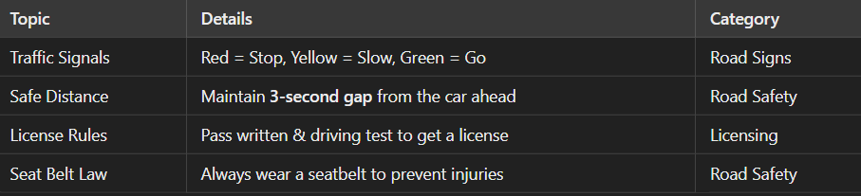
Driving Knowledge Dataset
- Covers Traffic Rules, Road Signs, Safety Tips, License Process
- Example Topics:
- Road Signs and Meanings
- Emergency Handling and Safe Driving Techniques
- License Application Process

Slide 8
AI Functionalities
Speech Recognition & NLP
Converts voice commands into text (Google API, SpeechRecognition).
Identifies traffic-related queries and driving-related questions.
Traffic Prediction (ML Model - Random Forest/Decision Tree)
Uses historical traffic data to predict congestion.
Matches user input with location & time to provide accurate traffic insights.
Conversational AI
Provides human-like responses for a better user experience.
Handles both traffic queries & general driving questions (e.g., “What’s the traffic in Mumbai at 6 PM?”).
Driving Knowledge Assistance
Answers road safety, license rules, and driving best practices.
Uses a structured dataset to educate drivers.
Future Enhancements
IoT Integration for live GPS & sensor-based traffic updates.
Dynamic Route Optimization for real-time navigation.
VR-based Driver Training for AI-powered learning simulations.

Slide 9
Demonstration
Traffic Prediction 🔹 User: "Traffic on Monday morning?" 🔹 AI: "Heavy traffic."
🔹 User: "Friday night?" 🔹 AI: "Light traffic."
Driving Knowledge 🔹 User: "Give me a driving tip." 🔹 AI: "Maintain a 3-second gap from the car ahead."
🔹 User: "Traffic signal rules?" 🔹 AI: "Red = Stop, Yellow = Slow, Green = Go."
General Interaction 🔹 User: "Hello!" → AI: "Hi! How can I help?" 🔹 User: "Goodbye!" → AI: "Drive safely!"

Slide 10
Challenges & Solutions
Challenge 1: Speech Recognition Errors
Problem: Background noise affects voice input accuracy.
Solution: Noise filtering and error handling improve recognition.
Challenge 2: Handling Varied User Queries
Problem: Users phrase questions differently (e.g., "Traffic at 6 PM?" vs. "Is it busy now?").
Solution: Natural Language Processing (NLP) and fuzzy matching for better understanding.
Challenge 3: Limited Real-Time Data
Problem: Dataset-based predictions may not reflect live road conditions.
Solution: Future integration with IoT sensors & live traffic APIs.
Challenge 4: AI Response Accuracy
Problem: AI may not always provide the most relevant answer.
Solution: Machine learning optimization and user feedback mechanism for improvement.

Slide 11
Future Enhancements
1. Real-Time Traffic Integration
Problem: Current system relies on static datasets.
Solution: IoT sensors & GPS data for live traffic updates and congestion alerts.
2. Dynamic Route Optimization
Problem: Users lack alternate routes in case of heavy traffic.
Solution: AI-powered route suggestions based on traffic conditions.
3. Edge AI for Faster Processing
Problem: Cloud-based AI may cause delays.
Solution: Deploy AI on local edge devices for low-latency responses.
4. Virtual Reality (VR) for Driver Training
Problem: New drivers lack hands-on experience in different traffic scenarios.
Solution: VR-based driving simulations to train beginners on:
Traffic rules & road safety
Emergency braking & accident avoidance
Night & bad-weather driving
YATRI AI aims to become a real-time, AI-driven, interactive traffic & driving assistant

Slide 12
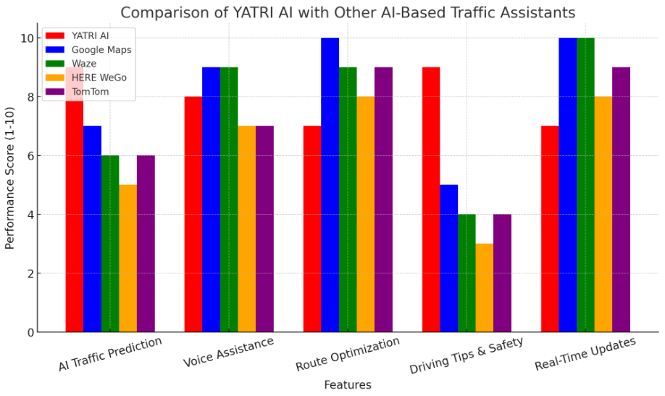
Comparison
Here is the graph comparing YATRI AI with other AI-based traffic assistants based on key features like ai traffic prediction , voice assistance , route optimizer, driving tips and safety , real time updates.

Slide 13
Conclusion
YATRI AI is an AI-powered traffic assistant designed to provide real-time congestion updates, driving knowledge, and voice-based interactions. By using machine learning, speech recognition, and predictive analytics, it enhances road safety and travel efficiency.
Key Benefits:
✅ AI-driven traffic predictions for smarter navigation ✅ Voice-enabled assistant for hands-free interaction ✅ Driving knowledge & safety tips for better road awareness ✅ Future expansion into IoT, real-time data, and VR-based driver training
With continuous AI improvements, YATRI AI is a step toward a safer, smarter, and more connected transportation system.

Slide 14
Research Insights for YATRI AI
AI-Integrated Traffic System (Gebre et al., 2024)
Uses Physics-Informed Neural Networks (PINN) and GPT-4 for accurate traffic estimation.
GPT-4 enhances user interaction, providing real-time traffic assistance.
Federated Learning & Edge AI (Kim et al., 2024)
Edge AI improves real-time traffic updates with faster processing.
Reduces reliance on cloud computing, making AI more efficient.
RouteRover: AI Traffic Prediction (Naveen et al., 2024)
Focuses on traffic congestion prediction & route optimization for Indian cities.
Can help YATRI AI suggest alternate routes in the future.
Explainable AI for Road Safety (Jianu et al., 2024)
Uses AI to predict injury severity in accidents.
Can help YATRI AI provide safety alerts for high-risk areas.

Slide 15
Thank You!

