Slide 1
AirBnB Data Analysis Using Google Cloud Platform
Presented by
Amulya Boyapati

Slide 2
Project Goal
This project would help businesses narrow down their target marketing customer base towards the most likely prospective customers
Also helps the business to understand how various attributes affect the client to accept or reject the Airbnb home.

Slide 3
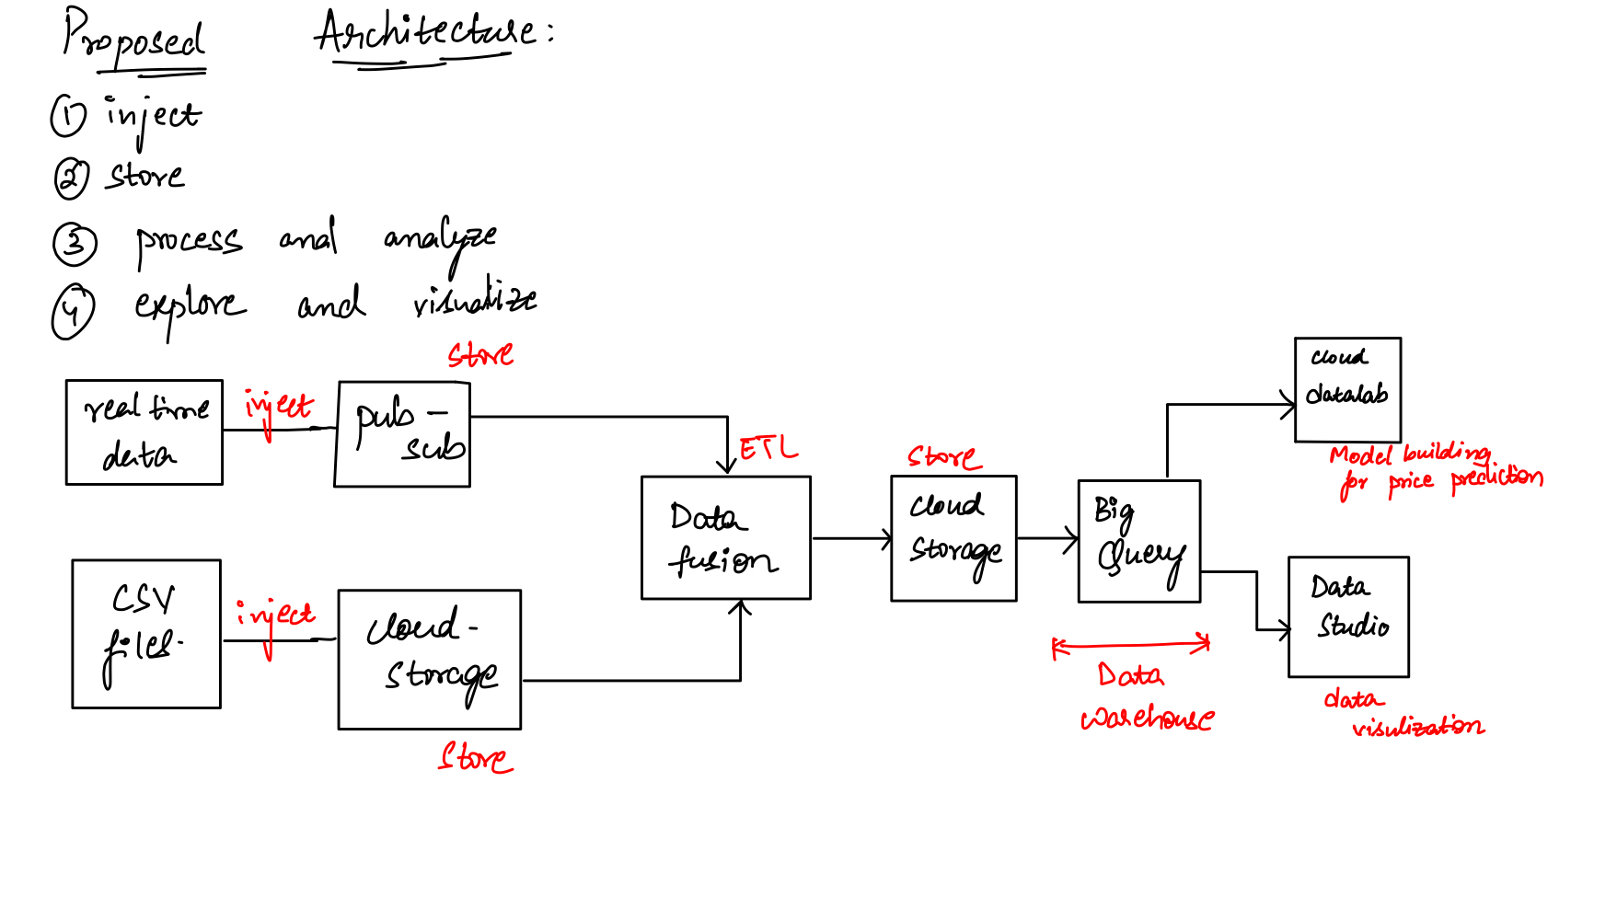
Proposed Architecture

Slide 4
Dataset Description
Downloaded the dataset from http://insideairbnb.com/get-the-data.html
List of CSV’s being used
Calendar.csv
Listings.csv
Reviews.csv

Slide 5
Status of the project
Completed injecting the data and storing it into the cloud storage.
Worked on the cleaning the data on-prem
Identified and built model for predicting the prices
Completed the first two goals of the project (EDA)

Slide 6
Challenges faced
Dropped multiple columns in the given data, but we don't know how dropping those columns will impact the accuracy.
For the ETL process initially, I have built pipelines using Dataflow. Being a beginner, using dataflow threw me lots of errors, which motivated me to use DataFusion for the ETL process.
For building the model to predict the prices on cloud, the use of AutoML caused issues. So initially built on-prem and now use Cloud Datalab in GCP to build the jupyter notebook.

Slide 7
Future Work
ETL using data-fusion
Process and analyze on GCP
Work on Datalab using the on-prem notebook for price prediction

Slide 8

Thank you

