Slide 1
Parking Slot Tracker Smart Parking Management System
Team Members
B. Sai Amulya Goud-217022026193
Lingam Teja Manasvi-217022026216
K. Deekshitha Yadav-210722026205

Slide 2
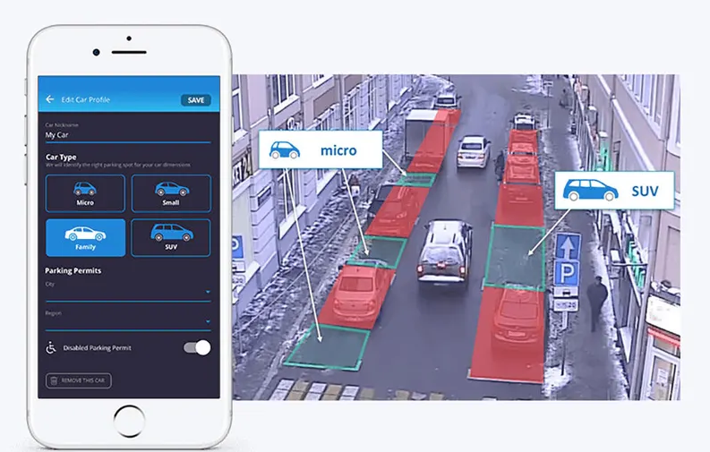
Introduction
Rapid growth of vehicles causes parking congestion
Drivers waste time searching for free parking slots
Traditional parking systems lack real-time updates
Need for a smart automated parking solution

Slide 3
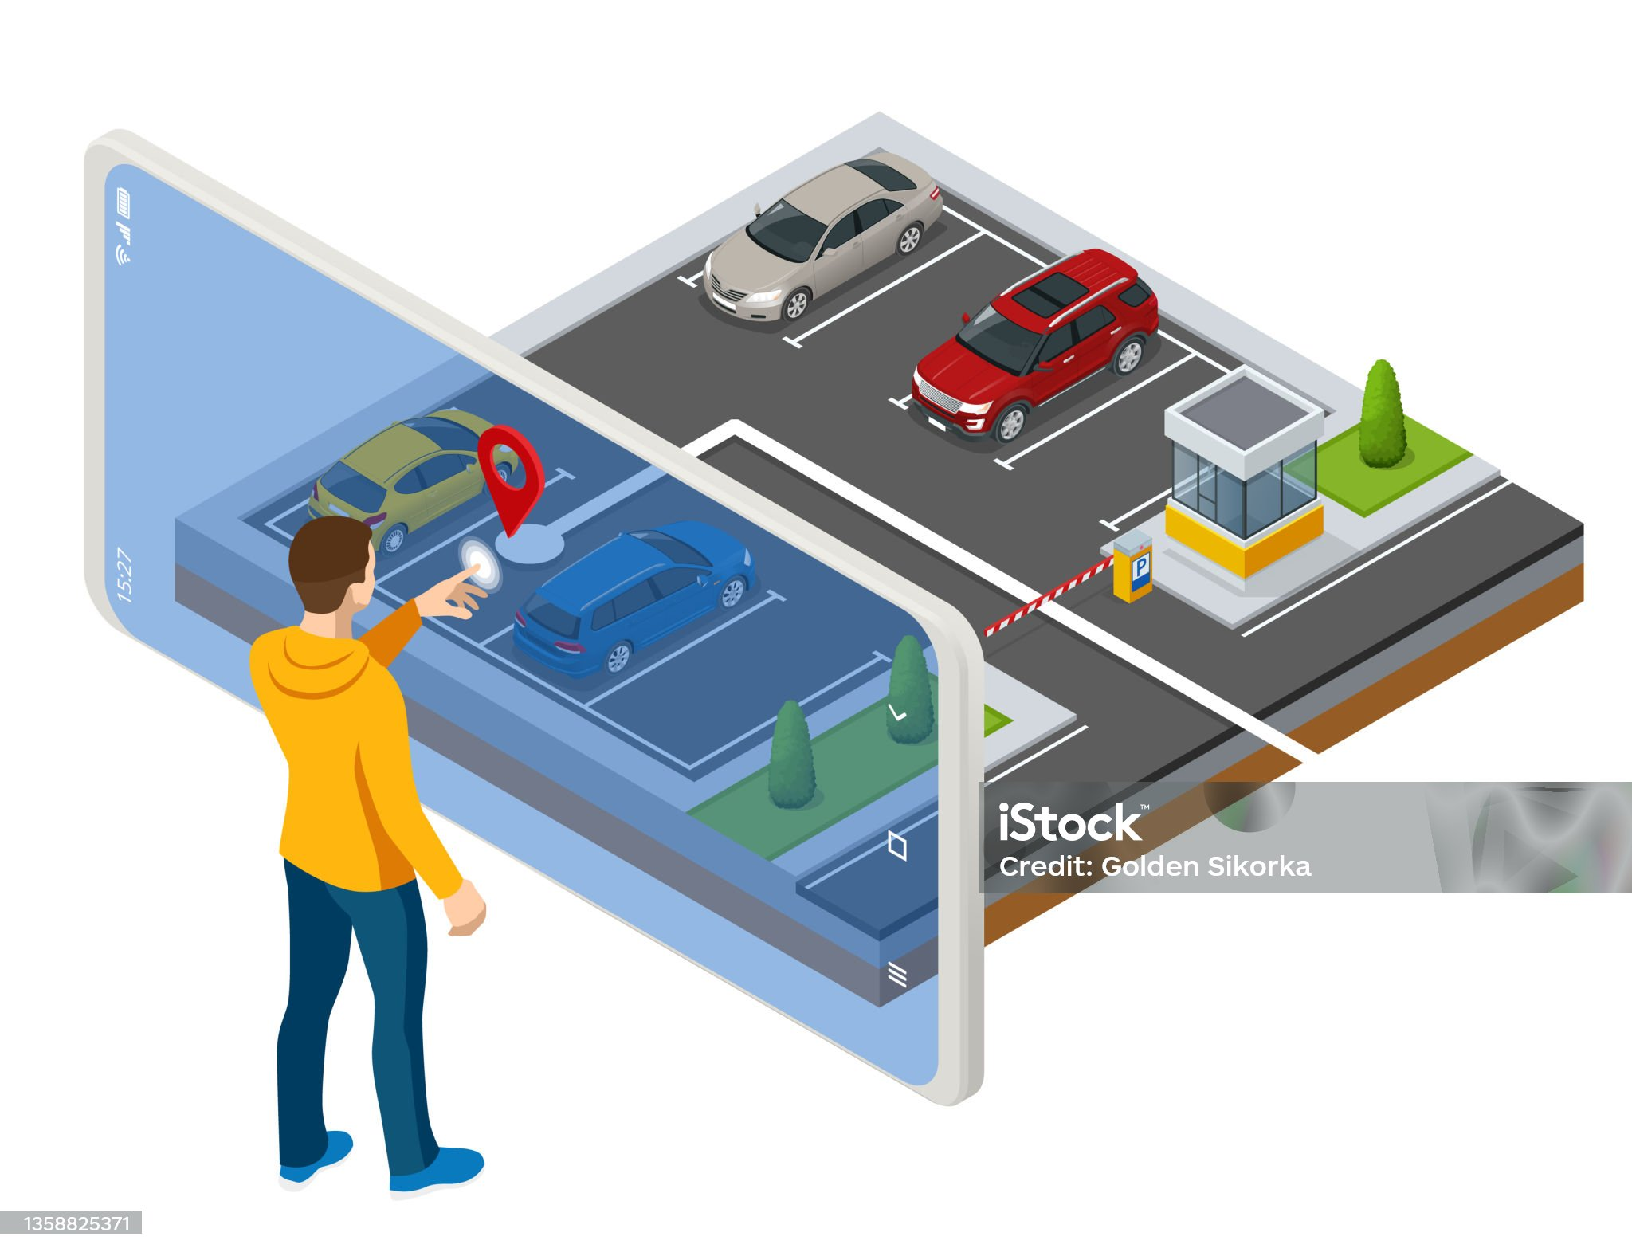
Problem Statement & Need
No real-time visibility of vacant parking slots
Entry/exit based systems are inaccurate
Oversized or poorly parked vehicles cause issues
Existing systems are costly and inefficient

Slide 4
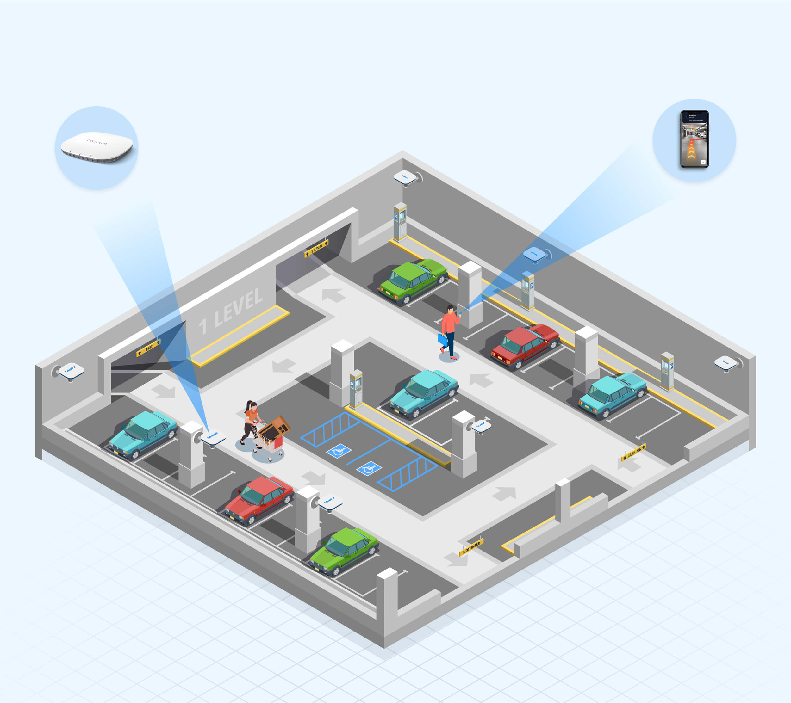
Objectives & Scope
Detect real-time parking slot availability
Reduce parking search time
Improve space utilization
Support small to medium parking areas

Slide 5

System Overview
Sensors: IR / Ultrasonic / Camera
Microcontroller: Arduino / ESP32
Backend server with database
Web or mobile application interface

Slide 6
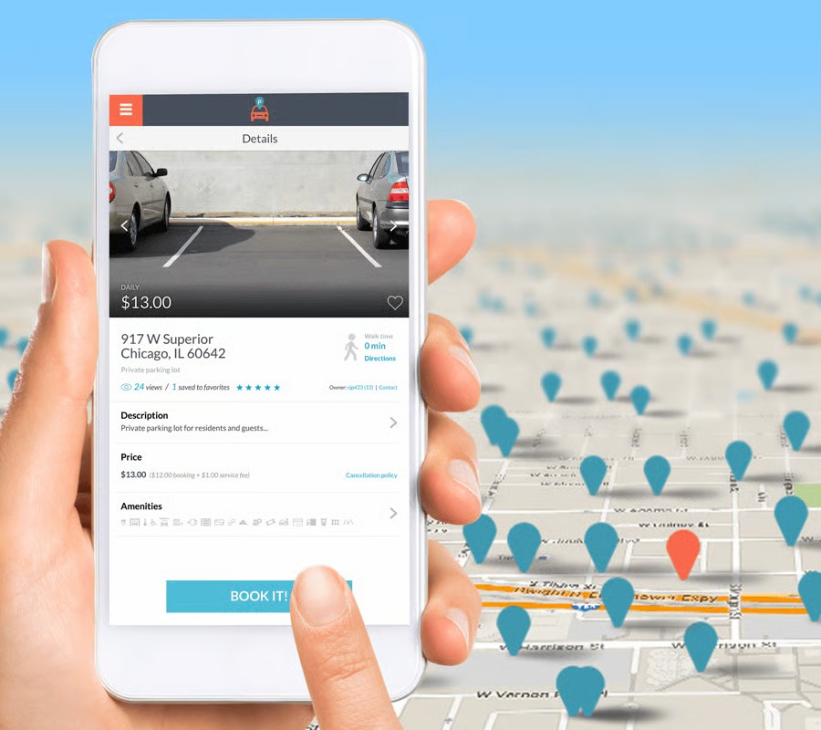
System Features
Real-time slot availability tracking
Color-coded slot status display
Vehicle entry and exit time logging
Admin management and reporting

Slide 7

Feasibility Study
Technically simple and easy to implement
Low-cost hardware components
Minimal human intervention
Scalable and reliable system

Slide 8

Advantages
Saves time and fuel
Reduces traffic congestion
Improves user convenience
Supports smart campus and smart city initiatives

Slide 9
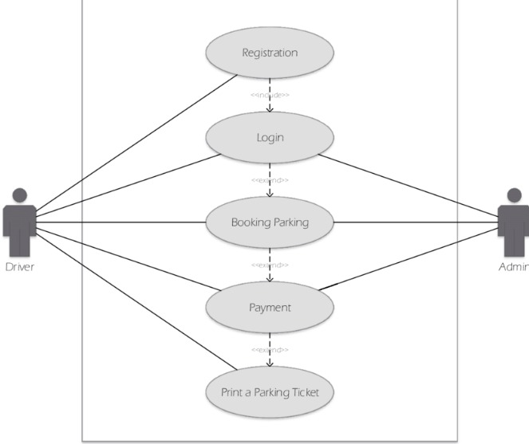
Use Case Diagram

Slide 10
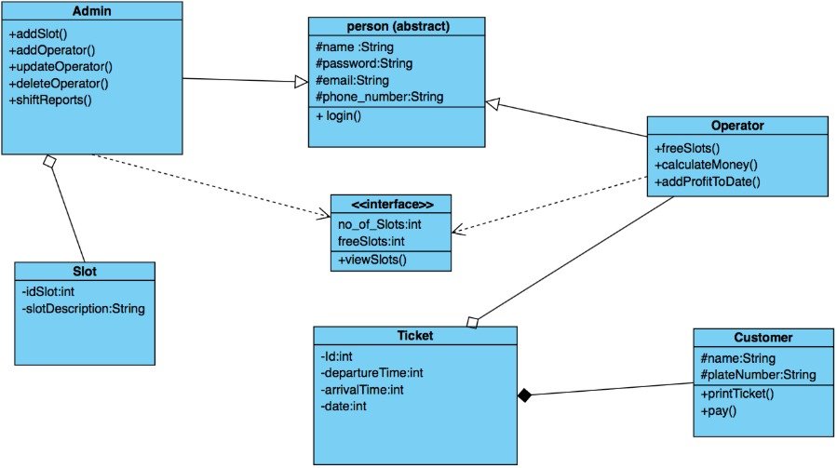
Class diagram

Slide 11
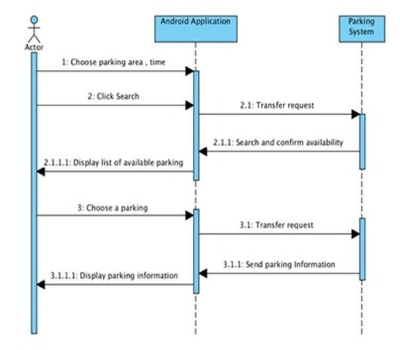
Sequence Diagram

Slide 12
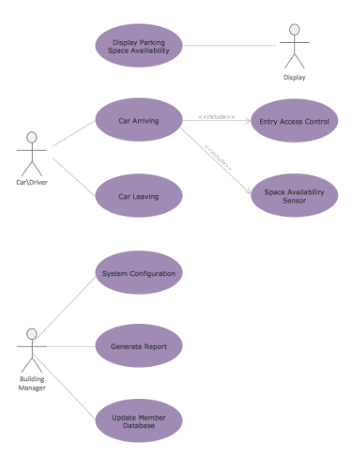
Activity Diagram

Slide 13

Conclusion & Future Scope
Efficient and reliable smart parking solution
Demonstrates IoT and embedded system concepts
Future scope includes mobile apps and automated billing
Can be scaled for commercial parking systems

Slide 14
Thank You

