Slide 1
WEEK - 4 Cyber Security Internship Task
NAME : B SAI AMULYA GOUD
SIN : DG/SEPTEMBER/CYBER/179

Slide 2
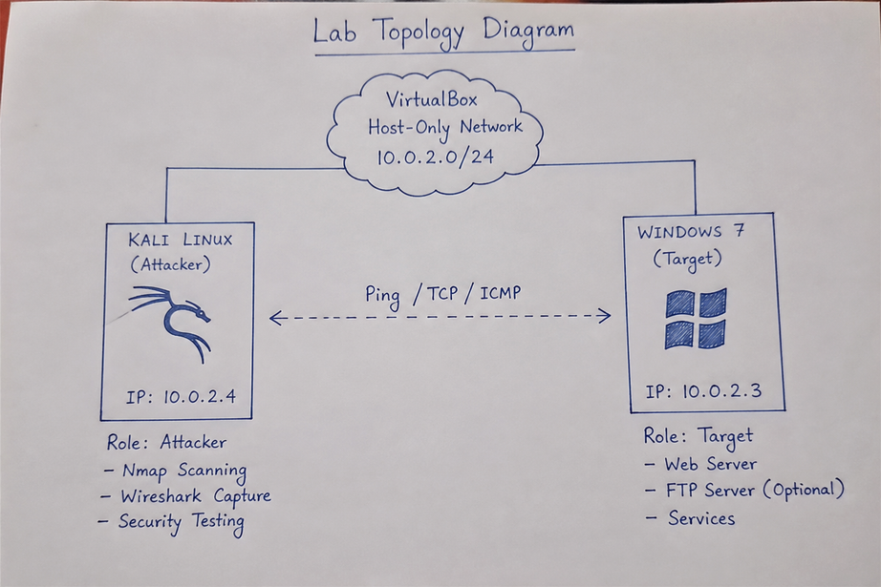
NETWORK SETUP
Objective :
A minimal two-machine virtual network, confirm the machines can talk to each other, and run a first, non-destructive pass of security checks: reachability, service/version scanning, and traffic analysis.
Lab Topology :

Slide 3
Tools Used :
Kali Linux –
Used as the attacker/security testing machine.
Windows 7 –
Used as the target
machine for
hosting services
and
security testing.
VirtualBox –
Used to create and
run the isolated
cybersecurity lab
environment.
Nginx–
Used to host a basic web service on the target machine.
Nmap –
Used for network
scanning,
port discovery,
and
service identification.
Wireshark –
Used to capture and
analyze network
traffic such as HTTP,
DNS, and ICMP.

Slide 4
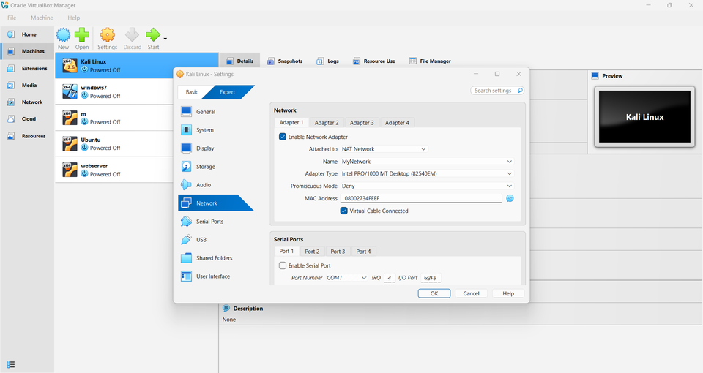
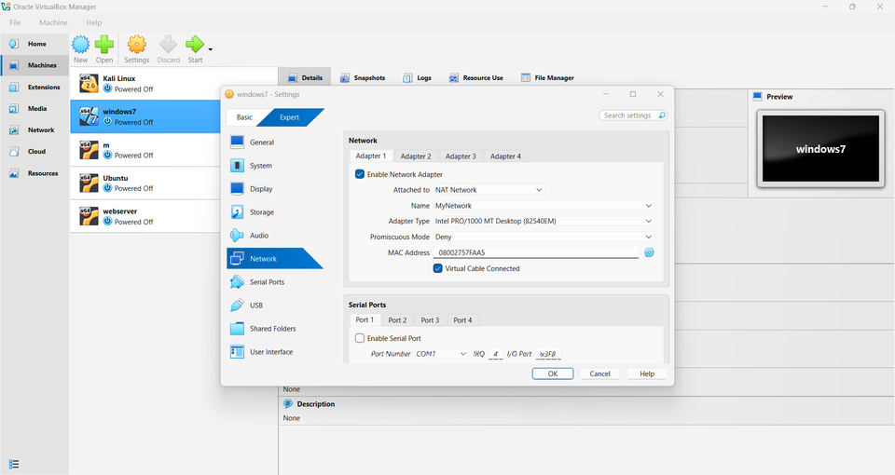
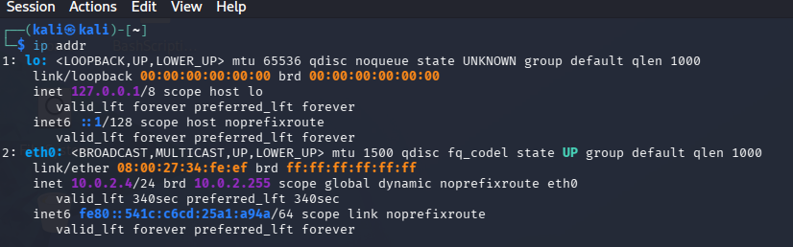
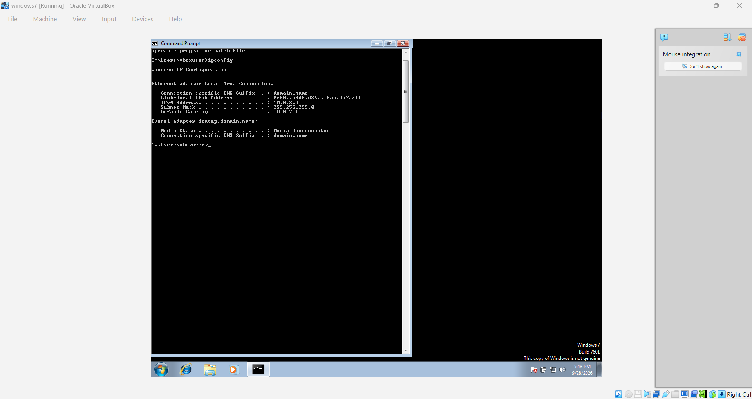
TASK 1 - Setup Basic Network
NETWORK CONNECTION CHECK :
IP ADDRESS :

Slide 5
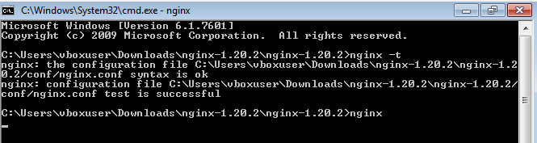
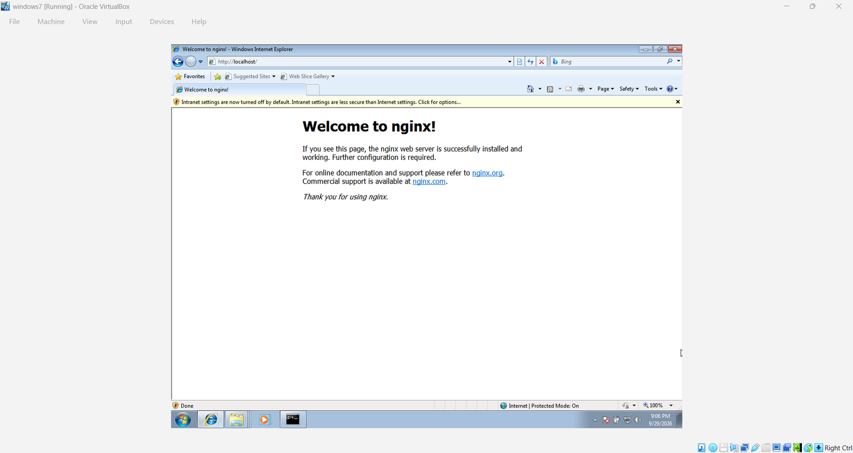
Task 2 - Install & Configure Services
NGNIX -
Used to host a basic web service on the target machine.

Slide 6
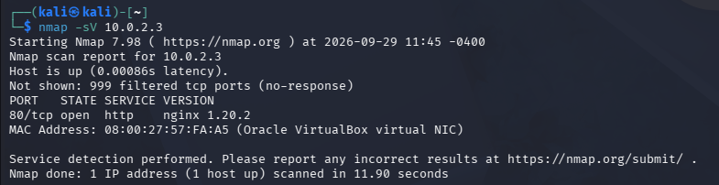
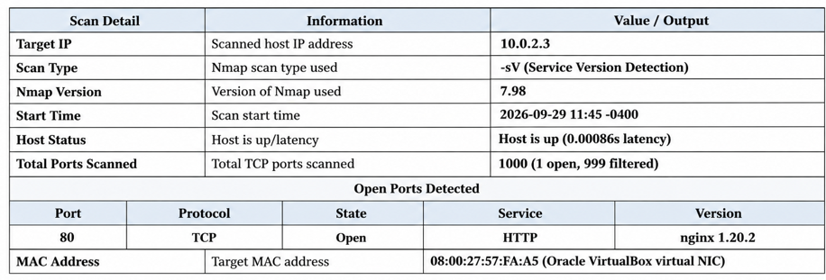
TASK 3 - Network Scanning (Nmap)

Slide 7
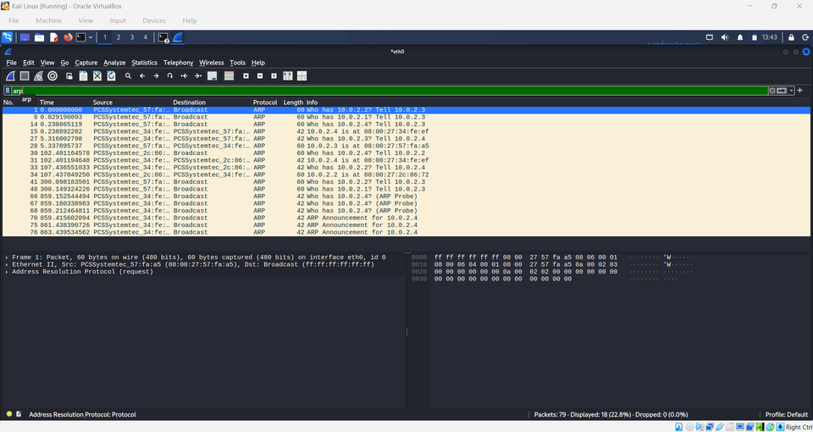
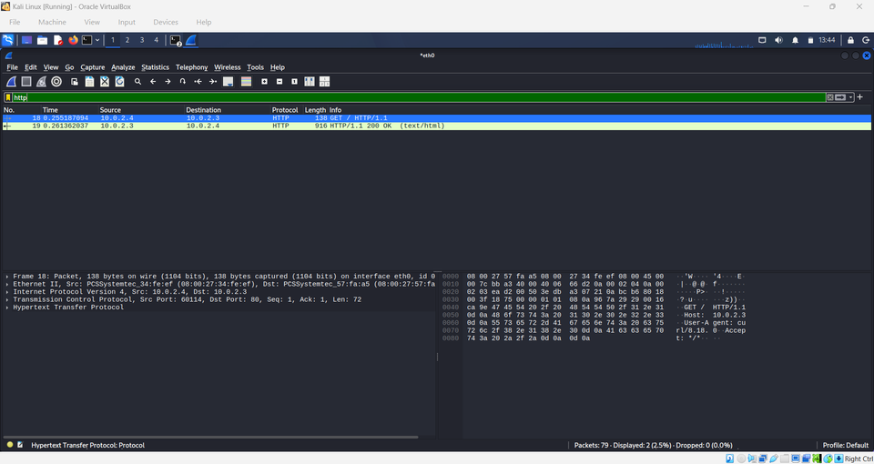
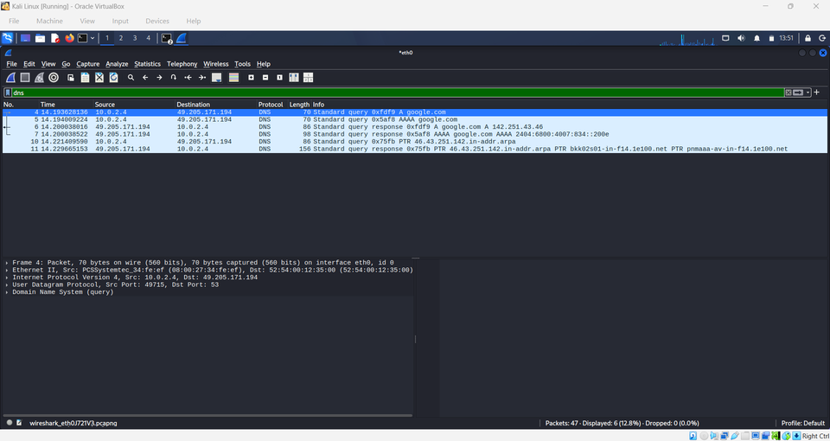
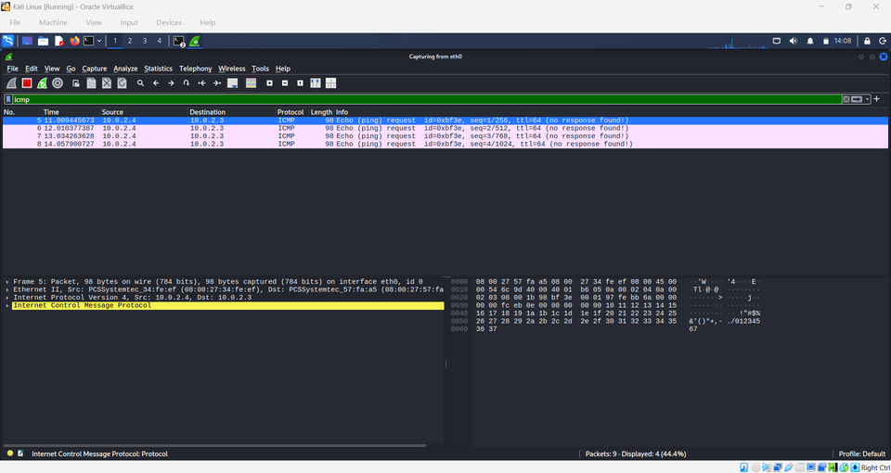
TASK 4 - Traffic Analysis (Wireshark)
ARP :
HTTP :
DNS :
ICMP :

Slide 8
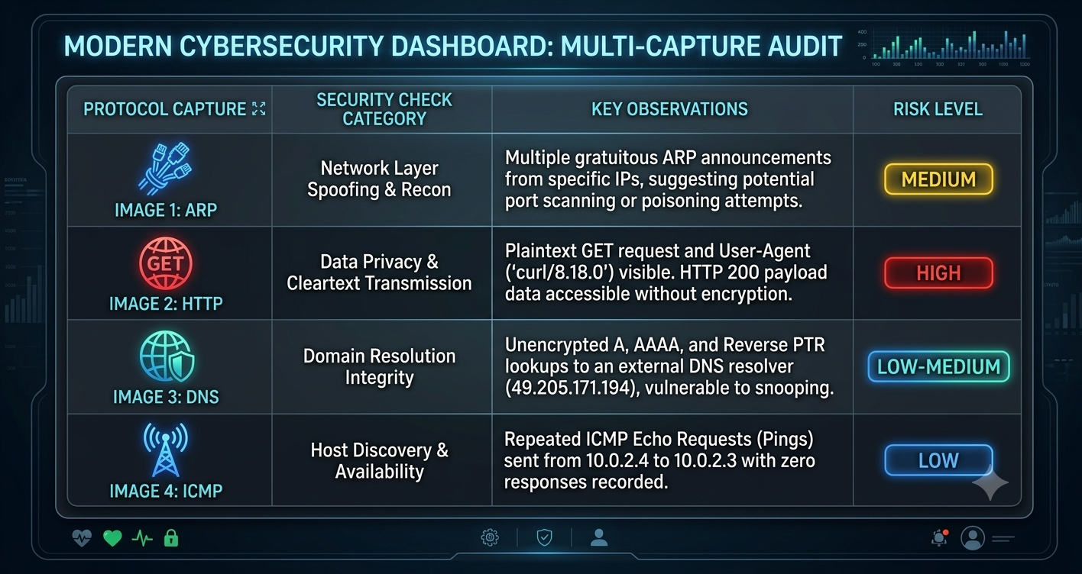

Slide 9
TASK 5 - MINI PROJECT OUTPUT
  I set up a bridged virtual lab network from scratch
  I verified host-to-host reachability with ping and curl
  I found open ports and running services using Nmap
  Read and filtered live traffic in Wireshark
  Recognized everyday risks like cleartext protocols
  I understood why testing must stay inside an authorized lab
  It also reinforced a simple rule for any future testing:
scope everything to a lab that has been explicitly built and
authorized for it.

Slide 10
Thank You

