Slide 1

Kubernetes Failure Prediction using Machine Learning
This project uses machine learning to predict failures in Kubernetes clusters. By analyzing resource usage data, the model can proactively identify potential issues. This allows for timely intervention, preventing downtime and optimizing resource allocation.
By
Ctrl V
Members:AMULYA SHREE M
AKSHAYA ARIGELA
DEEPIKA GL
FROM:
Dayananda Sagar Academy of Technology and Management

Slide 2
Problem Statement & Motivation
Why Failure Prediction Matters
Challenges in Cloud Environments
Predicting Kubernetes failures is crucial for maintaining application uptime.
Unplanned pod crashes
Resource exhaustion
Unplanned pod crashes lead to service disruptions and performance degradation.
Network issues
Service disruptions
AI/ML enables proactive fixes, reducing downtime.

Slide 3
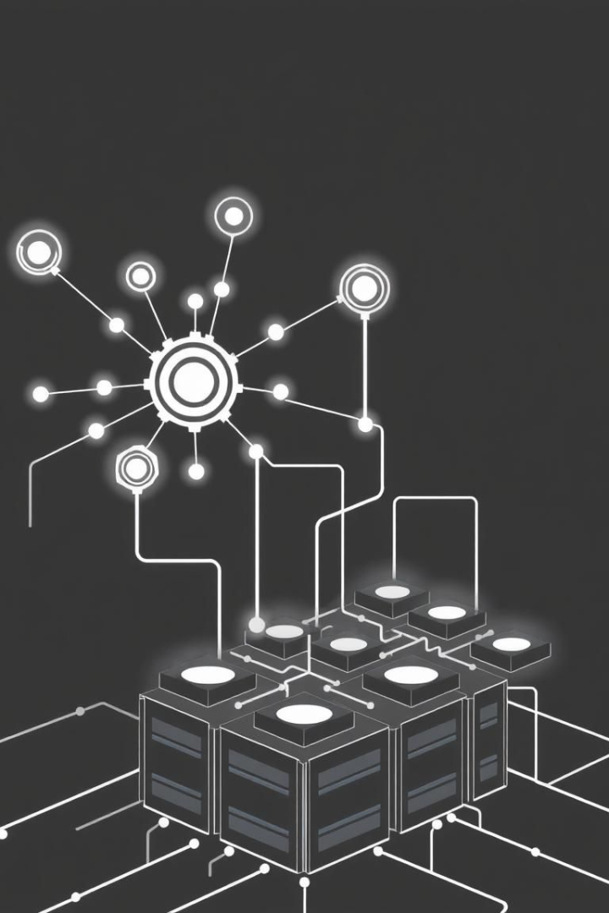



Solution Approach
Input
CPU, Memory, Disk I/O, Network I/O metrics are ingested.
Processing
Isolation Forest detects anomalies.
Output
Model predicts failure likelihood.
FastAPI exposes the ML model via API. This allows integration with existing monitoring systems.

Slide 4

Model & Technology Stack
ML Model
Dataset
Isolation Forest (Anomaly Detection).
Simulated Kubernetes resource usage data.
Languages
Python with ML, API, and Visualization libraries.
Real-time metrics drive anomaly detection in Kubernetes clusters.

Slide 5
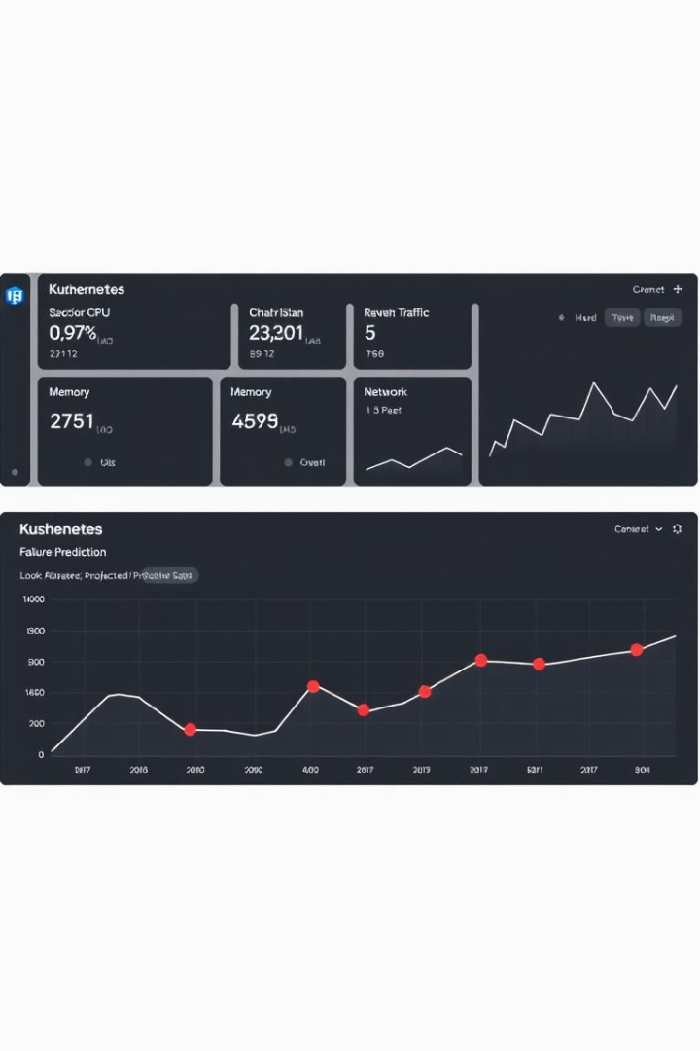
Demo & Results
Metric
Value
Accuracy
94%
Precision
96%
Recall
89%
F1-Score
92%
The API provides failure predictions based on resource usage. The model demonstrates high accuracy in detecting anomalies.

Slide 6
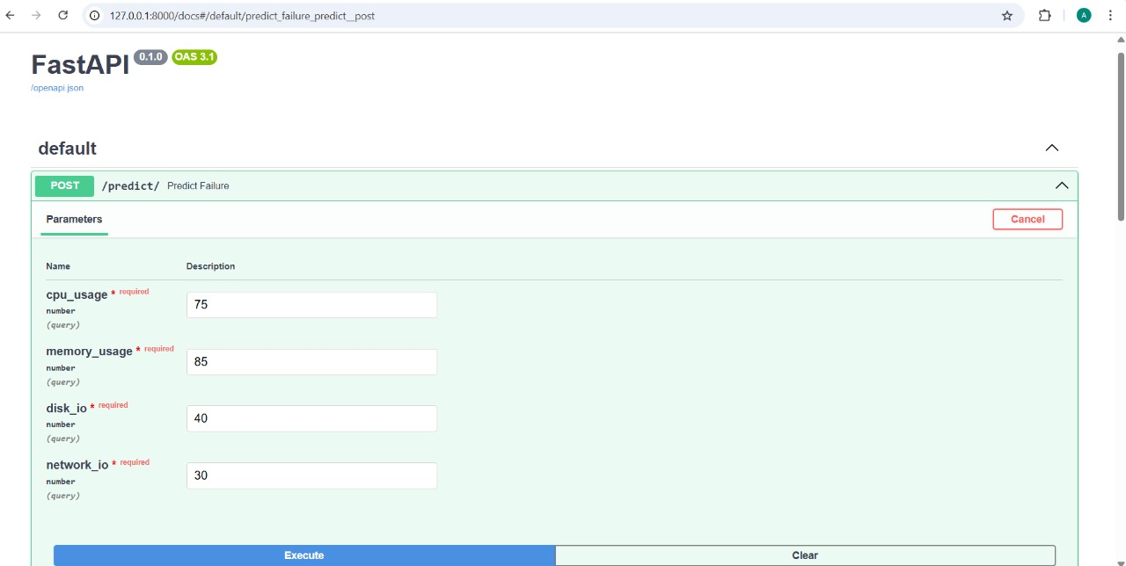
INPUT

Slide 7
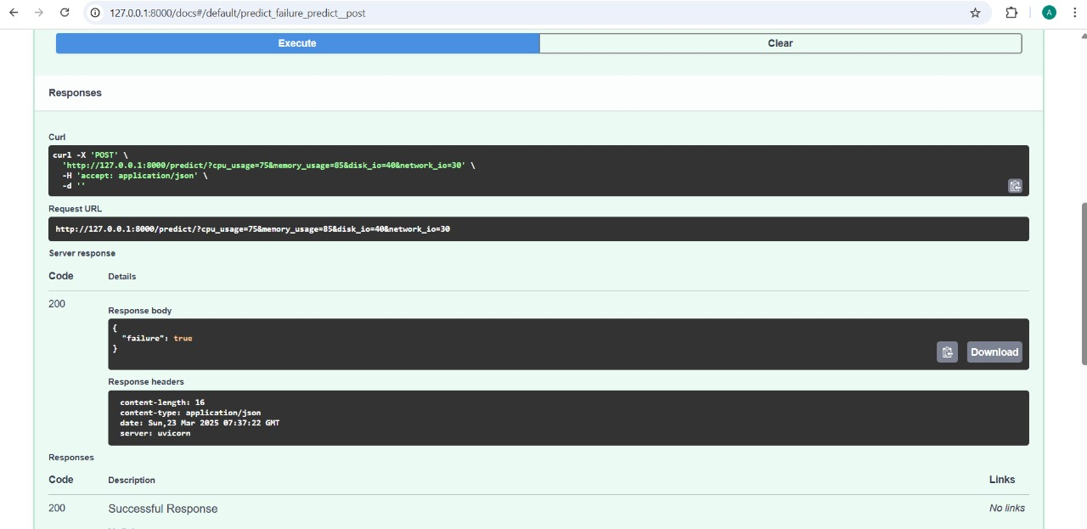
OUTPUT

Slide 8
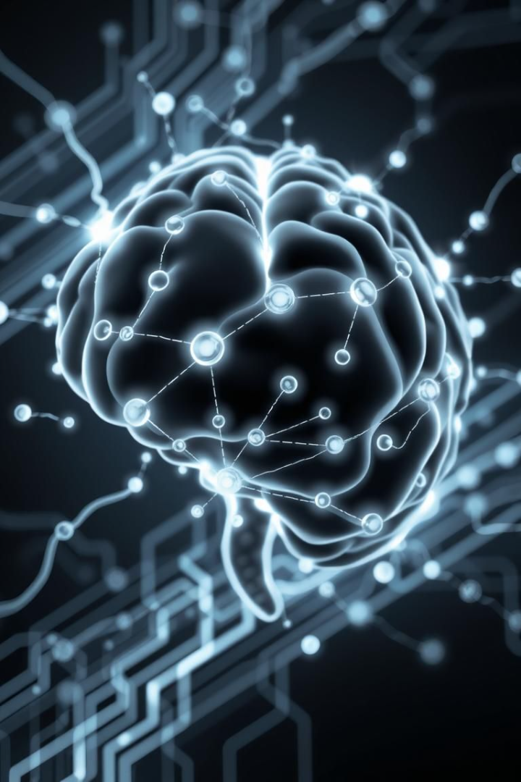



Conclusion & Next Steps
Key Takeaways
Integration
AI prevents failures and optimizes resources.
API integrates with monitoring systems.
Next Steps
Deploy on Kubernetes, use real data, add remediation.

