Slide 1

Team Name : Fab4Coco
Team Leader Name : Dhanushree Soni
Team Size : 4
Problem Statement : Supply Chain Ontology & Governed Conversational Analytics

Slide 2

One Question. One Definition. One Answer.
Different personas. Different wording. The same governed result.
Planning
“What was our on-time delivery performance?”
Procurement
“How reliably did our suppliers deliver?”
Logistics
“What percentage of due lines arrived on time?”
↓
74.26% OTD
Same Gold metric • Same semantic definition • Same filter context

Slide 3
Problem Brief
The problem
The same OTD question produces different answers across teams.
Analyst tickets and custom SQL delay decisions.
Who needs it
Planning, Procurement, Logistics and Finance users.
Data teams that need governed, auditable metrics.
Our solution
One governed ontology and one sanctioned definition per metric.
Natural-language answers with SQL, lineage and definitions.
Canonical supply-chain flow
Supplier → Part → Plant → Order → Shipment → Customer
Supports traceability, impact analysis, quality and action.

Slide 4
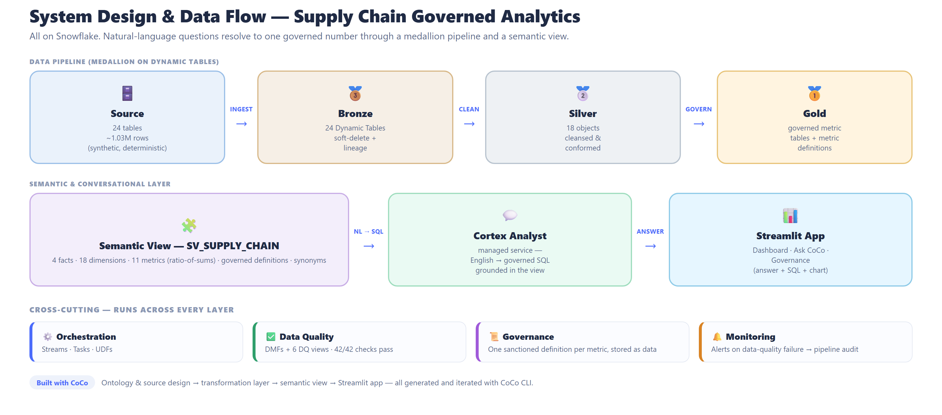
Knowledge Graph • Data Quality / DMFs • Jira MCP Actions

Slide 5
Architecture & CoCo CLI Usage
Governed flow
SOURCE
24 tables
1.03M rows
BRONZE
24 Dynamic
Tables
SILVER
18 conformed
objects
GOLD
Governed
metrics
SEMANTIC
SV_SUPPLY_CHAIN
EXPERIENCE
Streamlit +
Cortex Analyst
→
→
→
→
→
Implemented cross-cutting capabilities
Knowledge Graph
Supplier → Part → Plant → Order → Shipment → Customer
Data Quality
DMFs + governed validation views + freshness checks
Jira MCP
Dry-run alert payloads, deduplication and operational action
Orchestration
Streams + Tasks + UDFs + Dynamic Tables
CoCo CLI was used end to end for discovery, ontology and source design, SQL generation, transformation development, semantic modeling, Streamlit development, knowledge-graph implementation, debugging, testing and validation.

Slide 6
Impact & Results
74.26% governed OTD
One consistent result across Planning, Procurement and Logistics personas.
42 / 42 DQ checks
Checks cover business rules, completeness, uniqueness, referential integrity and freshness.
Self-service analytics
Natural language → governed answer + SQL + chart + definition.
Why it matters
Trusted decisions
Business teams use shared definitions instead of reconciling competing numbers.
Connected impact
Knowledge-graph traversal links an exception to affected entities.
Governed action
Validated alerts flow to Jira MCP with deduplication and safe dry-run.
Scalable foundation: Snowflake-native layers and modular components support extension to live ERP or Marketplace data without redesign.

Slide 7
Three-Minute Demo Story
1. Problem
Different teams produce different answers.
2. Govern
One ontology and one metric definition.
3. Ask
Three personas ask OTD differently.
4. Trace
Knowledge graph shows connected impact.
5. Validate
DMFs and checks confirm trust.
6. Act
Jira MCP proposes a governed action.
One ontology. One definition. One trusted answer. From insight to action.

Slide 8


