Slide 1

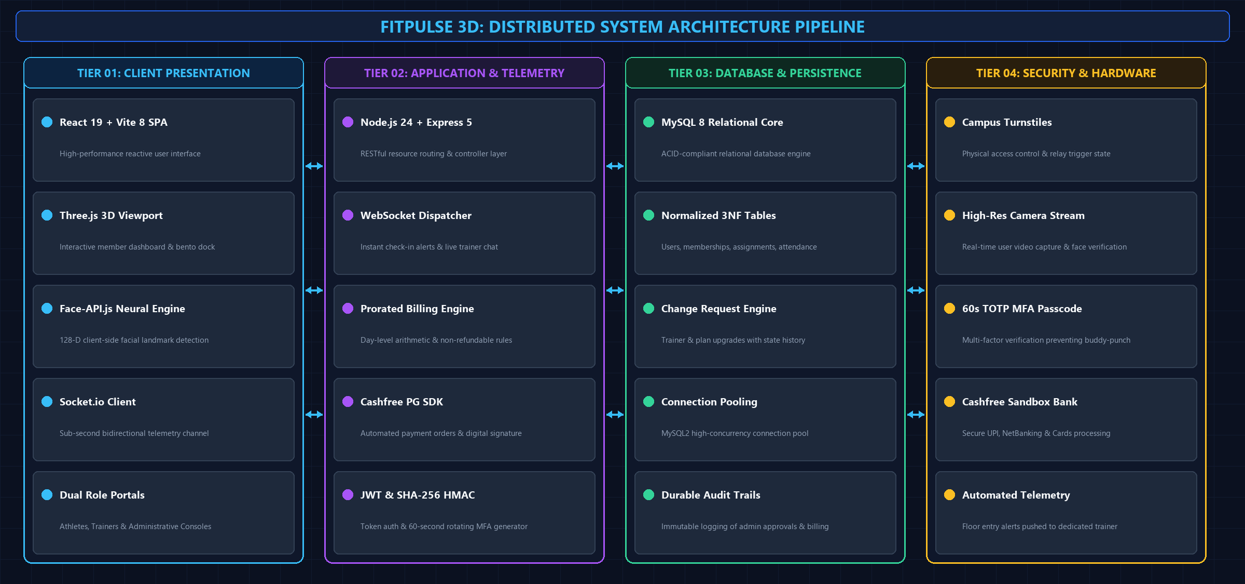
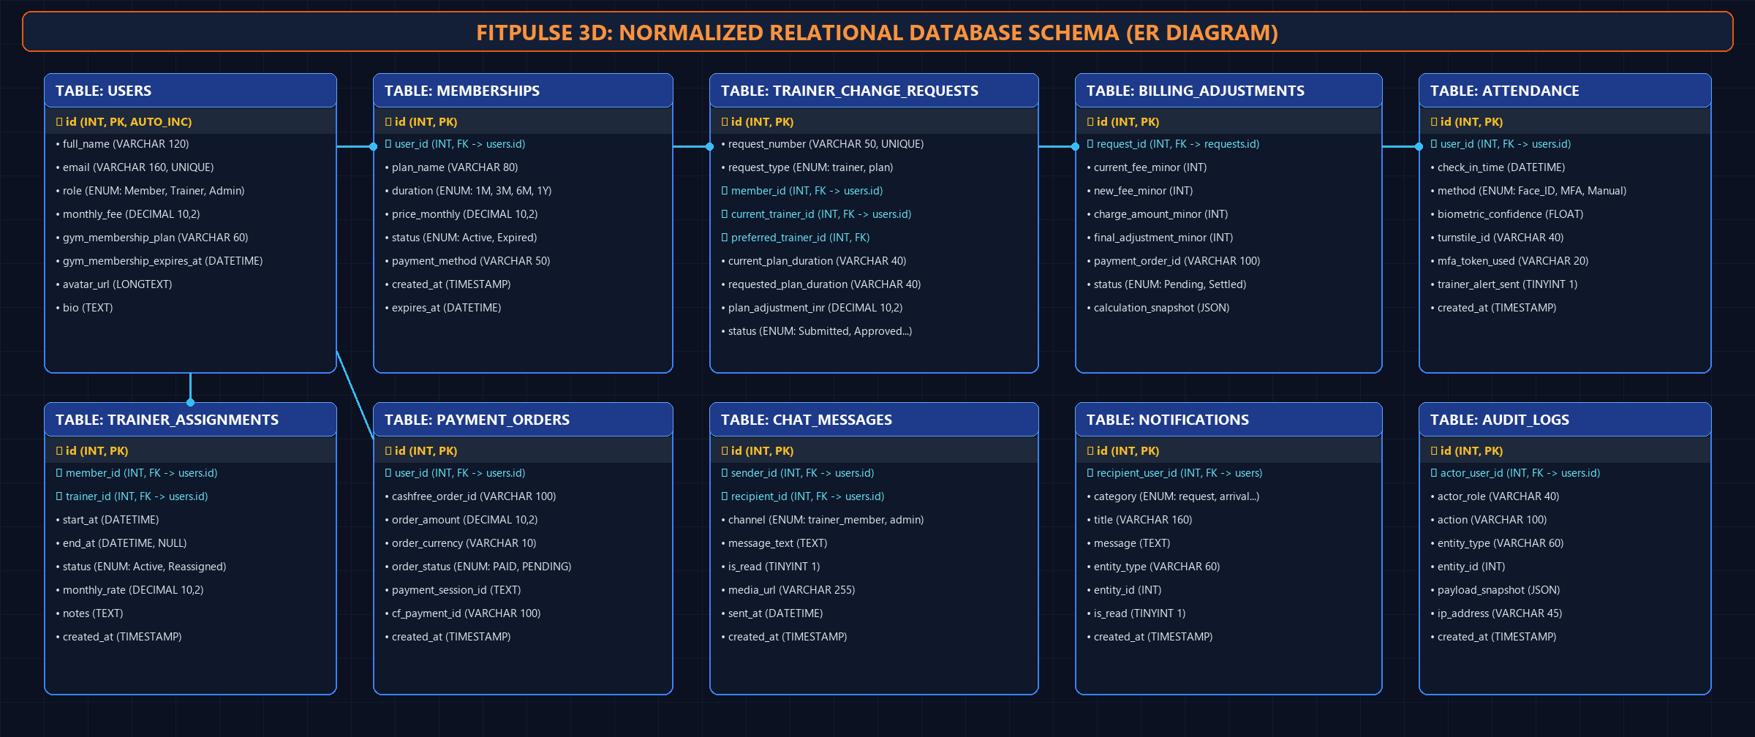
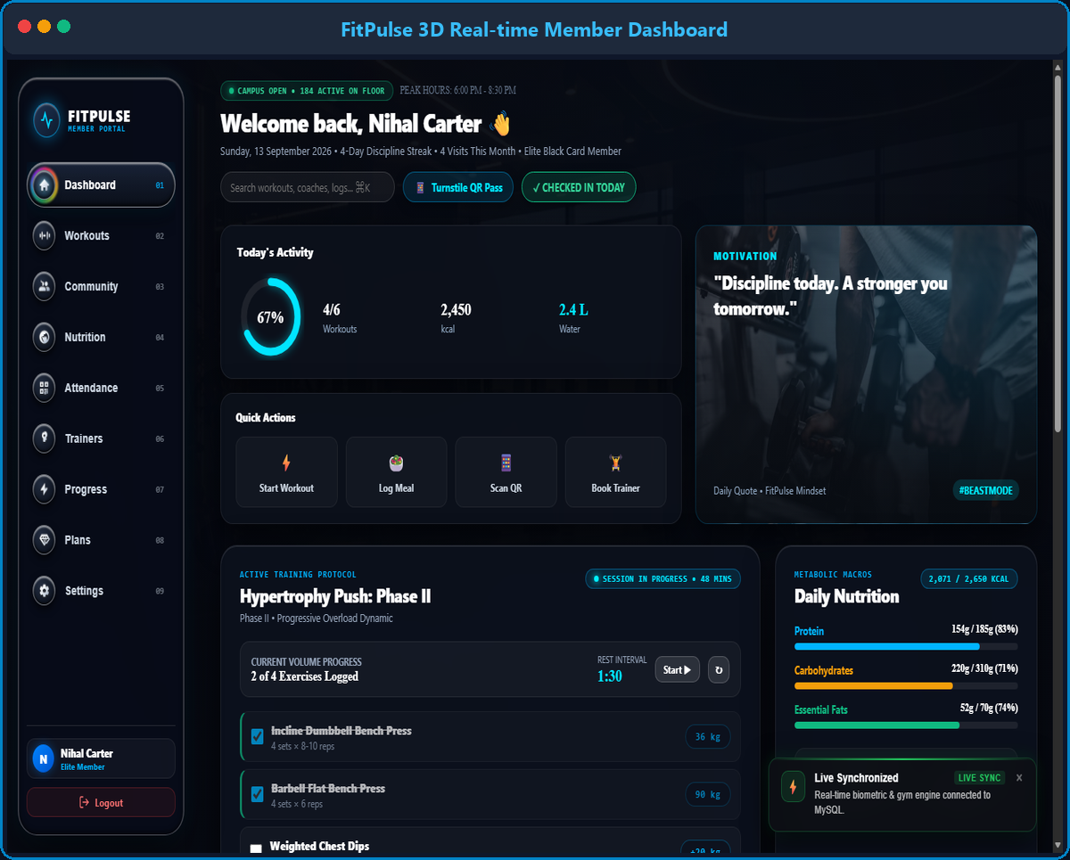


FITPULSE 3D: REAL-TIME GYM MANAGEMENT & BIOMETRIC TELEMETRY SYSTEM
Team ID: PBL-25CS1302E-04 | Section: CSE-S1 | Members: Nihal Metuku (2300030001), K. Shreyas (2300030002), Sai Sathwik (2300030003) | Guide: Dr. Faculty Mentor
Database Systems Engineering & Distributed Backend Development (25CS1302E) | KLH Bachupally Campus, CSE | PBL 2026-27
Abstract
Tools & Technologies
FitPulse is an enterprise-grade fitness ecosystem integrating physical biometric access control with automated financial and coaching governance. Built with React 19, Three.js, Node.js, and MySQL, the platform features 128-D neural facial recognition turnstiles, 60-second rotating TOTP MFA, and real-time WebSocket telemetry for athlete check-in alerts.
Main Outcome: Eliminates buddy-punching, unifies coach-athlete telemetry, and provides automated day-level prorated billing for mid-cycle plan switches with zero-refund policy enforcement.
• Front-End Stack: React 19, Vite 8, Three.js (3D Viewport), CSS Glassmorphic Architecture, Socket.io-Client, Vladmandic Face-API.
• Back-End Services: Node.js 24 (ESM), Express 5, RESTful Endpoints, Cashfree Payment Gateway SDK, Socket.io WebSocket Engine.
• Database Architecture: MySQL 8 Relational Core (Normalized 3NF Schema, Foreign Keys, Indexing, Connection Pool, ACID Transactions).
• Security & Biometrics: 128-D Neural Facial Embeddings, SHA-256 HMAC (60s MFA Engine), bcryptjs password hashing, Git, Postman, VS Code, Sharp.
Problem Statement & Objectives
Problem: Conventional fitness centers rely on shared RFID tags or manual desk registers vulnerable to unauthorized tailgate access, with frequent arithmetic errors in mid-cycle membership tier adjustments and coach allocations.
• Obj 1 (Biometric Access): Implement dual-factor turnstile Face ID (128-D neural embeddings) paired with dynamic 60s rotating TOTP MFA passcodes.
• Obj 2 (Prorated Billing): Build an ACID-compliant billing engine with Cashfree PG integration, unused-credit upgrades, and strict non-refundable downgrade rules.
• Obj 3 (Real-time Telemetry): Establish full-duplex WebSockets for instant check-in notifications to assigned trainers and unified administrative governance.
• Scope: Role-based portals (Member, Coach, Admin), automated Cashfree checkout, workout programmer, nutrition logging, and durable audit logs.
System Architecture
Existing vs Proposed System
Feature | Existing Gym Systems | Proposed System (FitPulse 3D)
Access Control & Attendance | Static RFID / manual logs; prone to buddy punching & loss. | Dual-factor: 128-D Face-API.js + 60s rotating TOTP MFA.
Plan Upgrades | Manual front-desk estimations; frequent arithmetic errors. | Automated day-level proration engine credited via Cashfree PG.
Downgrade Policy | Inconsistent ad-hoc refund credits causing revenue leakage. | Strict No-Refund / Zero-Credit Policy at database layer (₹0.00).
Trainer Telemetry | Siloed logs; coaches unaware when their athletes arrive. | Instant WebSocket alerts pushed to coach upon turnstile entry.
UI & Visualization | Clunky static HTML tables; disjointed user experience. | Interactive 3D Glassmorphism UI (Three.js), Bento HUD.
ER Diagram & Database Design
Feasibility Study
Implementation Screenshots
• Technical Feasibility: High. Built using modern web standards (React 19, Node.js 24, Vite 8, Express 5, MySQL 8). Client-side neural biometric execution eliminates costly dedicated GPU inference servers.
• Economic Feasibility: Extremely cost-effective. Built entirely on open-source frameworks (MySQL, Socket.io, Face-API), utilizing Cashfree Sandbox API and scalable cloud/on-premise deployment.
• Operational Feasibility: Seamless user adoption. Provides self-service profile management for coaches/athletes and 1-click administrative review dossiers with complete audit trail persistence.
• Schedule Feasibility: Delivered on schedule across 14-week phased milestones covering schema design, REST/WebSocket APIs, Cashfree integration, face biometrics, and end-to-end integration testing.
Results & Testing
Conclusion
Fig 1: Member 3D Bento Dashboard
Fig 2: Turnstile Face ID & 60s MFA Scanner
Future Scope
• Functional Verification: 100% test pass rate across authentication, biometric verification, membership transitions, and Cashfree gateway webhooks.
• Performance Benchmarks: Sub-350ms neural facial landmark recognition; sub-20ms MySQL query response time under connection pooling.
• FitPulse successfully modernizes fitness facility management by bridging physical biometric turnstile security with dynamic financial accounting and automated coaching governance.
• Meets all course outcomes for distributed backend development, secure relational schema design, real-time event streaming, and enterprise software engineering.
• AI Form Correction: Real-time camera pose estimation (MediaPipe/MoveNet) for barbell lift mechanics and injury prevention.
• IoT Turnstile Relays: Direct microcontroller interfacing (ESP32 / Raspberry Pi relay gates) for physical turnstile solenoids.
SCAN FOR CODE
References: [1] Elmasri & Navathe, Fundamentals of Database Systems, 7th Ed., Pearson, 2017. [2] Face-API.js & TensorFlow.js: Real-time Facial Landmark Recognition. [3] Cashfree Payments: Payment Gateway Integration Guide, 2024. [4] React & Node.js Distributed Telemetry Docs.

