Slide 1
GYM & FITNESS CLUB
MANAGEMENT SYSTEM
A centralized digital platform for smarter fitness-club management
2520030003-K.Bhavana
2520030032-A.Amulya
2520030124-M.Nihal
Department of Computer Science and Engineering
Gym & Fitness Club Management System • Expo Presentation • 1

Slide 2
01 | Project Overview
What the system brings together
THE IDEA
• Membership management and plan renewal
• QR-based attendance and digital records
• Trainer and class scheduling
• Personalized workout and diet plans
• Online payments using Razorpay
• Fitness progress tracking
• Role-based access for administrators, trainers and members
The Gym & Fitness Club Management System is an integrated platform that brings major fitness-center activities into one place.
Gym & Fitness Club Management System • Expo Presentation • 2

Slide 3
02 | Problem Statement
Why a centralized platform is needed
Fragmented Records
Manual Work
Members, plans, attendance and payments may be maintained separately.
Registers, spreadsheets and paper records increase administrative effort.
Limited Coordination
Progress Tracking
Information sharing between members, trainers and administrators is difficult.
Workout changes and fitness development are harder to monitor consistently.
Gym & Fitness Club Management System • Expo Presentation • 3

Slide 4
03 | Existing vs Proposed
Moving from disconnected processes to one digital platform
EXISTING APPROACH
PROPOSED SYSTEM
• Manual records and spreadsheets
• Separate membership and payment tracking
• Register/basic digital attendance
• Paper or direct trainer communication
• Difficult progress monitoring
• More manual effort and possible data errors
• Centralized member and membership management
• Digital renewals and payment records
• QR-based attendance + Face Recognition
• Trainer, workout and diet management
• Fitness progress tracking
• Common platform for all major gym roles
Gym & Fitness Club Management System • Expo Presentation • 4

Slide 5
04 | Objectives
Core goals of the proposed system
1
Centralize major fitness-club activities in one platform.
2
Simplify membership, renewals, attendance and payment management.
3
Enable trainers to manage personalized workout and diet plans.
4
Allow members to access fitness information and monitor progress.
5
Reduce paperwork, repetitive manual work and data-entry errors.
6
Improve accessibility, coordination and accuracy of gym information.
Gym & Fitness Club Management System • Expo Presentation • 5

Slide 6
05 | Main Modules
Functional areas of the Gym & Fitness Club Management System
ADMIN
MEMBER
TRAINER
Members, trainers, plans, payments and gym operations
Membership, attendance, payments, plans and progress
Members, workout/diet plans and schedules
MEMBERSHIP
ATTENDANCE
PAYMENT
Plans, subscriptions and renewals
QR-based digital attendance + Face Recognition
Online payments and dues using Razorpay
WORKOUT & DIET
SCHEDULE & CLASS
PROGRESS
Personalized fitness and diet plans
Trainer availability and class scheduling
Fitness development and progress records
Gym & Fitness Club Management System • Expo Presentation • 6

Slide 7
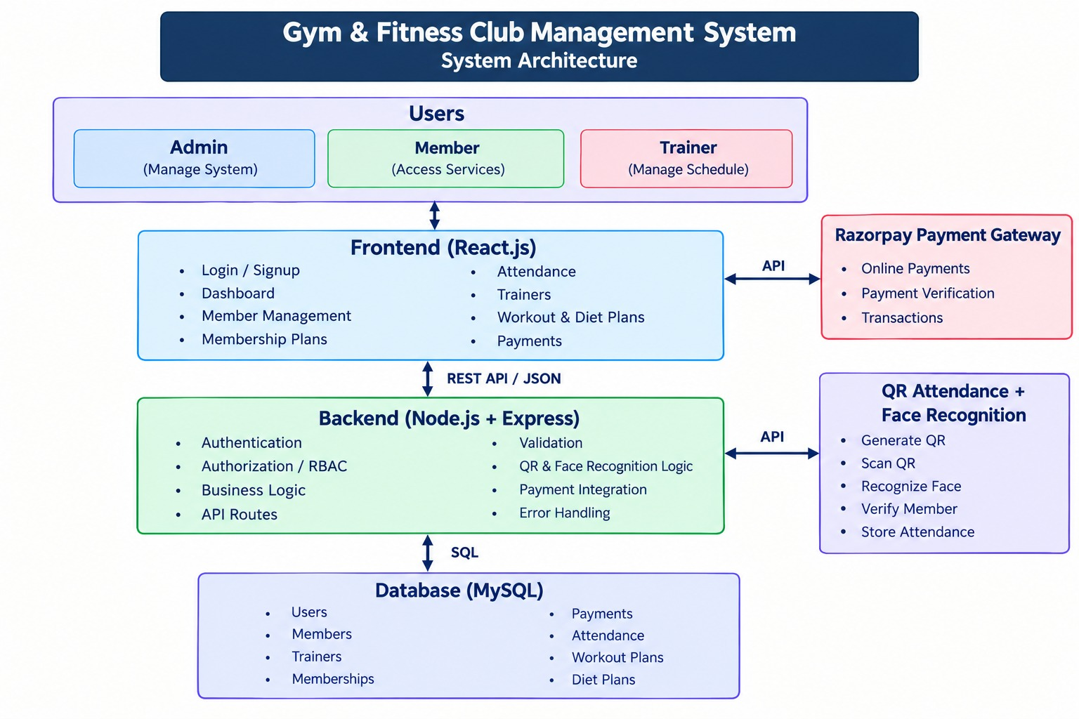
06 | System Architecture
High-level flow of the proposed software system
Gym & Fitness Club Management System • Expo Presentation • 7

Slide 8
07 | Key User Workflows
How the major activities connect
Member Journey
Register / Login → Select Membership → Pay → Mark Attendance → Follow Workout/Diet Plan → Track Progress
Trainer Journey
Login → View Members → Create Workout/Diet Plan → Manage Schedule → Monitor Progress
Admin Journey
Login → Manage Members & Trainers → Manage Plans → Monitor Payments & Attendance → Control Gym Operations
Gym & Fitness Club Management System • Expo Presentation • 8

Slide 9
08 | Technology Stack
Tools and technologies specified for the project
Frontend
Backend
API Framework
React.js
User interface and interactive screens
Node.js
Server-side runtime
Express.js
API and server operations
Database
Payment
Attendance
MySQL
Data storage and management
Razorpay
Online payment integration
QR Code + Face Recognition
Digital attendance verification
Gym & Fitness Club Management System • Expo Presentation • 9

Slide 10
09 | Database Design
Core entities used to organize gym data
Users
Membership Plans
Members
Payments
Trainers
Accounts, contact details and roles
Plan name, duration, price and benefits
Member profile and membership status
Amount, method, transaction and payment status
Trainer profile, specialization and availability
Workout Plans
Attendance
Session Bookings
Progress Records
QR / Face Recognition
Trainer-member fitness plan details
Member attendance, time, method and status
Trainer/member sessions, date, time and location
Fitness measurements and progress notes
Attendance verification scan records
Gym & Fitness Club Management System • Expo Presentation • 10

Slide 11
10 | Highlights
What makes the project useful as a unified fitness platform
One Platform
Digital Attendance
Connects administrators, trainers and members through a common system.
Uses QR-based attendance and Face Recognition for a more convenient process.
Online Payments
Personalized Fitness
Razorpay supports digital membership payment and dues management.
Trainers can manage workout and diet plans for individual members.
Progress Visibility
Reduced Manual Effort
Members can access fitness information and track development over time.
Centralized records reduce paperwork and repeated administrative work.
Gym & Fitness Club Management System • Expo Presentation • 11

Slide 12
11 | CONCLUSION & FUTURE SCOPE
CONCLUSION
FUTURE SCOPE
The proposed system provides a centralized and efficient digital environment for managing memberships, attendance, schedules, workout and diet plans, payments and fitness progress.
It connects administrators, trainers and members while reducing manual work and improving accessibility and coordination.
• Advanced fitness progress analysis
• Enhanced trainer-member communication
• Improved scheduling and notifications
• Additional personalized fitness services
• Broader member engagement features
THANK YOU • QUESTIONS & DEMO
Gym & Fitness Club Management System • Expo Presentation • 12

