Slide 1

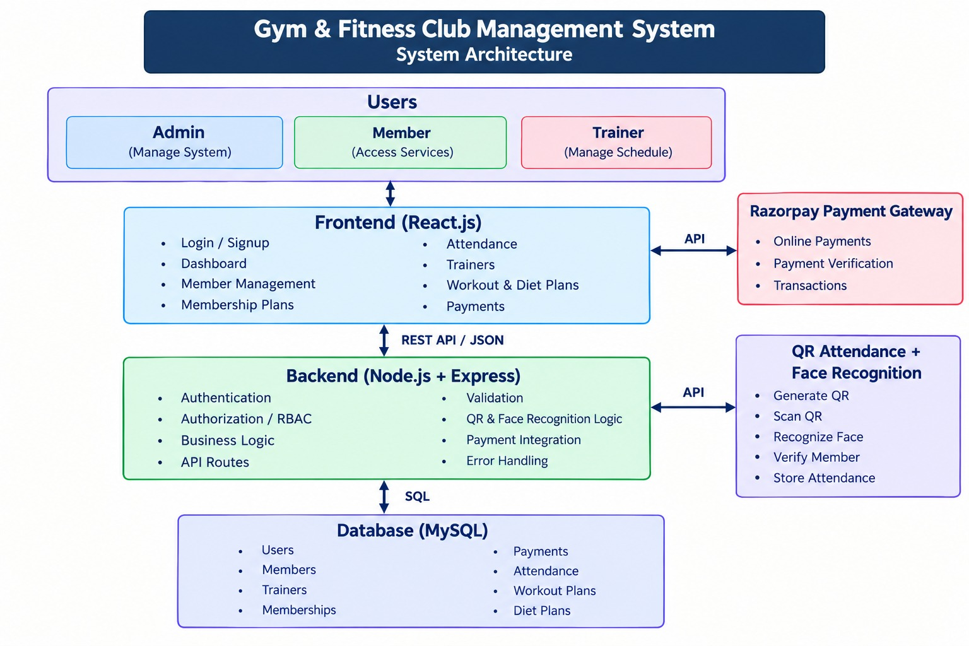
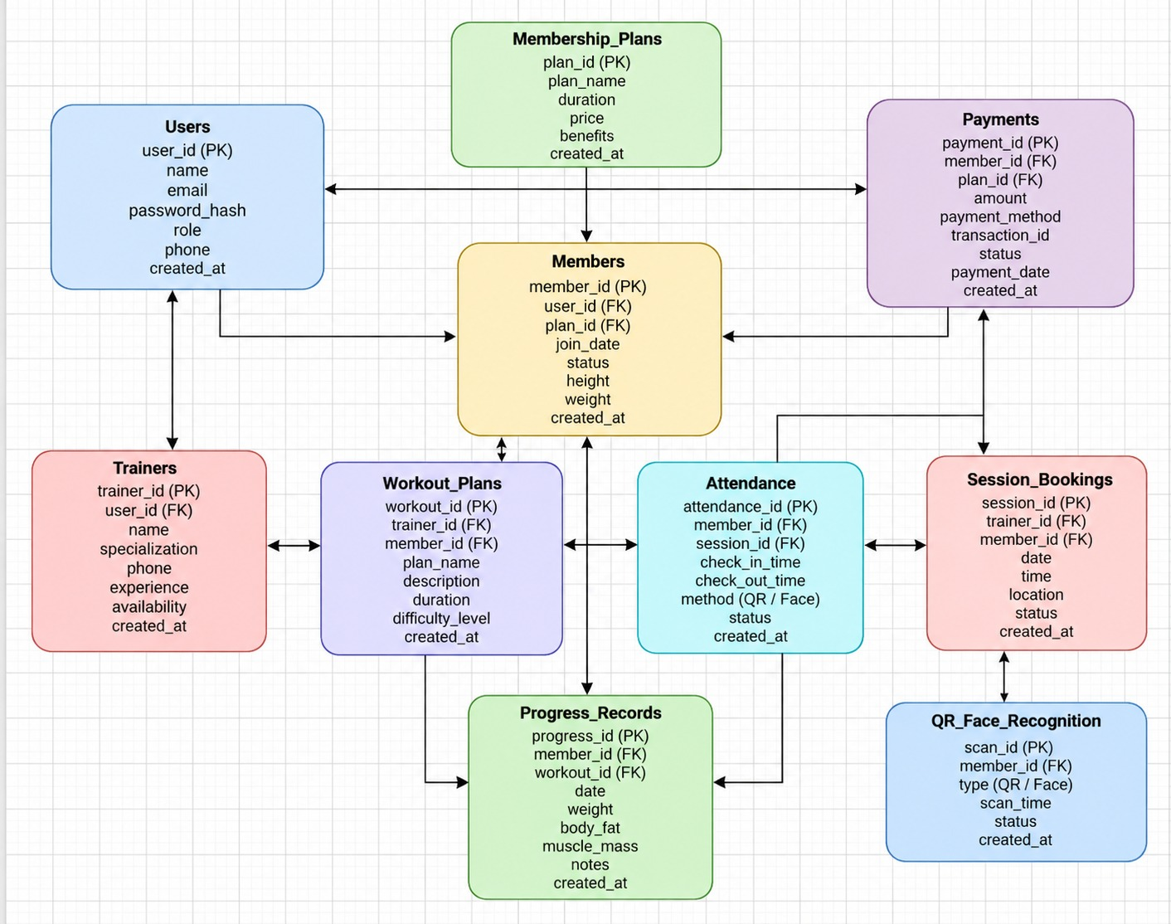
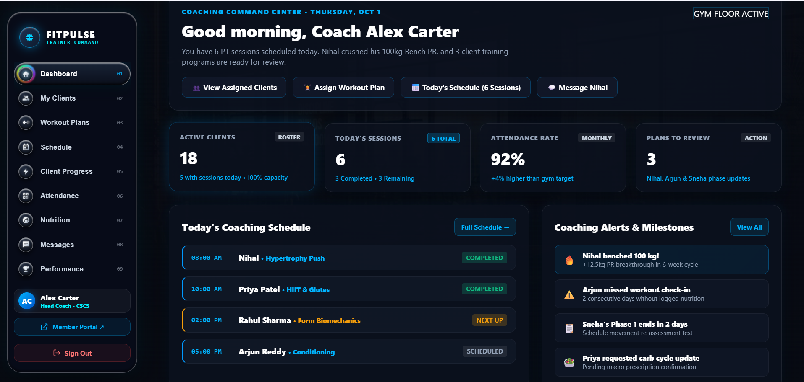
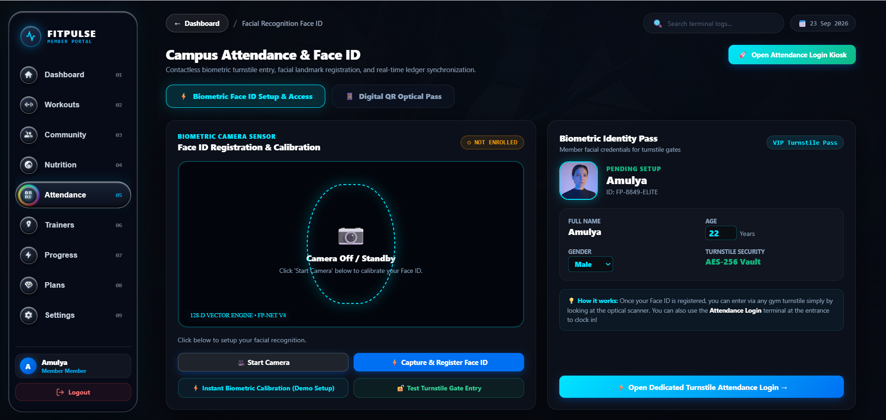

GYM & FITNESS CLUB MANAGEMENT SYSTEM
Team ID: [5] | Section: [S_7] | Members: [K. Bhavana – 2520030003.], [A. Amulya – 2520030032.], [M. Nihal – 2520030124.] | Guide: [Dr. S.Spandana]
Database Systems Engineering and Distributed Backend Development (25CS1302E) | KLH Bachupally Campus, CSE | PBL 2026-27
Abstract
Tools & Technologies
A web-based system for managing gym members, memberships, trainers, payments, and attendance.
Provides separate features for Admin, Member, and Trainer roles. Centralizes gym operations and improves accessibility, tracking, and management.
Front-End: React.js, HTML, CSS, JavaScript
Back-End: Node.js, Express.js, REST APIs
Database: MySQL
Payment: Razorpay
Attendance: QR Code
Development: VS Code, Git/GitHub
Testing: Postman, Browser Developer Tools
Problem Statement & Objectives
Problem: Manual gym management makes it difficult to efficiently handle members, memberships, payments, attendance, and trainer activities.
Objective 1: Provide secure Admin, Member, and Trainer access.
Objective 2: Manage members, trainers, memberships, and workout plans.
Objective 3: Automate payment and attendance management.
Scope: Users: Admin, Member, Trainer Modules: Authentication, Membership, Payments, Attendance, Trainers, Workout & Diet Plans, Admin Management
System Architecture
Existing vs Proposed System
Feature | Existing System | Proposed System
Member Management | Manual Records | Digital management
Attendance | Manual entry | QR-based & Facial recognition
Membership | Paper/manual tracking | Digital membership
Workout plans | Manual communication | Centralized workout & diet plans
Limitation / Gap | Time-consuming & difficult to track | Automated and centralized system
ER Diagram & Database Design
Feasibility Study
Technical: React.js, Node.js, Express.js and MySQL are available and suitable.
Economic: Uses open-source technologies with low implementation cost.
Operational: Simple web interface for Admin, Members and Trainers.
Schedule: Can be developed and tested within the semester timeline.
Implementation Screenshots
[Screenshot 1]
[Screenshot 2]
Results & Testing
Conclusion
Future Scope
Successfully implemented role-based access for Admin, Member and Trainer.
REST APIs connect the React frontend with the Node.js backend. MySQL stores and manages application data.
Developed a centralized web-based Gym & Fitness Club Management System.Simplifies member, membership, trainer, payment and attendance management.
Provides role-based access and digital gym services.
Mobile application for members and trainers.
AI-based personalized workout and diet recommendations.
Advanced fitness progress analytics.
References: [1]React – A JavaScript Library for Building User Interfaces,” Meta, https://react.dev/ [2 ] MySQL Documentation, “MySQL 8.0 Reference Manual,” Oracle, https://dev.mysql.com/doc/ [3] M. Jones, J. Bradley and N. Sakimura, “JSON Web Token (JWT),” RFC 7519, IETF, 2015, https://www.rfc-editor.org/rfc/rfc7519
QR: GitHub

