Slide 1
Customer Churn Prediction Using Elastic Net Regularized Logistic Regression
Section9
2520030003-Kunamaneni Bhavana 2520030189-Alluru Amulya

Slide 2
1. Problem Definition
Customer Churn Prediction
Customer churn occurs when a customer stops using or subscribing to a company's service.
High customer churn can lead to revenue loss and increased customer acquisition costs.
It is difficult for organizations to identify customers who are likely to leave in advance.
Machine learning can analyze historical customer data and identify customers who have a higher probability of churning.
This project develops a Customer Churn Prediction system using Elastic Net Regularized Logistic Regression.
Why is this problem important?
Helps organizations identify high-risk customers.
Supports customer retention strategies.
Reduces potential revenue loss.
Helps businesses understand factors associated with churn.
Enables data-driven decision-making.

Slide 3
Who will use the solution?
Telecommunications companies
Customer relationship management teams
Marketing and sales teams
Business analysts
Customer retention teams
Expected Output
The system will:
Input: Customer information
↓
Machine Learning Model
↓
Output:
Churn Probability
Churn / No Churn prediction
Identification of high-risk customers

Slide 4
2. Dataset Collection
Dataset Information
Dataset Name: IBM Telco Customer Churn Dataset
DatasetFIle F
WA_Fn-UseC_-Telco-Customer-Churn.csv
Dataset Source: IBM sample/customer churn dataset, commonly distributed through Kaggle and other public dataset repositories.
Number of Records: 7,043
Number of Columns: 21
Target Variable: Churn
Target Values:
Yes → Customer churned
No → Customer did not churn

Slide 5
Dataset Features:
Category | Features
Customer Information | customerID, gender, SeniorCitizen, Partner, Dependents
Service Information | PhoneService, MultipleLines, InternetService
Additional Services | OnlineSecurity, OnlineBackup, DeviceProtection, TechSupport
Streaming Services | StreamingTV, StreamingMovies
Contract & Payment | Contract, PaperlessBilling, PaymentMethod
Financial | MonthlyCharges, TotalCharges
Target | Churn
Category | Features
Customer Information | customerID, gender, SeniorCitizen, Partner, Dependents
Service Information | PhoneService, MultipleLines, InternetService
Additional Services | OnlineSecurity, OnlineBackup, DeviceProtection, TechSupport
Streaming Services | StreamingTV, StreamingMovies
Contract & Payment | Contract, PaperlessBilling, PaymentMethod
Financial | MonthlyCharges, TotalCharges
Target | Churn

Slide 6
3. Data Understanding
Basic Dataset Analysis
From the uploaded dataset:
Records: 7,043
Features: 20 input features
Target: 1 (Churn)
Total columns: 21
Duplicate records: 0
Missing values: No direct NaN values detected

Slide 7
Numerical Variables | Categorical Variables
SeniorCitizen tenure MonthlyCharges | gender Partner Dependents PhoneService MultipleLines InternetService OnlineSecurity OnlineBackup DeviceProtection TechSupport StreamingTV StreamingMovies Contract PaperlessBilling PaymentMethod Churn

Slide 8
Statistical Summary
For numerical features, statistical analysis can include:
Mean
Median
Standard deviation
Minimum
Maximum
Quartiles
Important numerical variables:
tenure
Represents the number of months a customer has stayed with the company.
MonthlyCharges
Represents the customer's monthly service charge.
TotalCharges
Represents the total amount charged to the customer.
Purpose: Statistical summary helps understand the range, central tendency, and variation of numerical variables.

Slide 9
Unique Values
Gender
Male
Female
Contract
Month-to-month
One year
Two year
Payment Method
Mailed check
Bank transfer
Credit card
Churn
Yes
No
This helps us understand the categories available in the dataset.

Slide 10
4. Data Preprocessing
1. Remove irrelevant attributes
Remove:
customerID
because it is only a unique customer identifier.
2. Handle missing/blank values
Check for missing and blank values.
For example:
TotalCharges
is initially stored as text and needs conversion to numerical format.
3. Convert numerical variables
Convert:
TotalCharges
from object/string to numeric.

Slide 11
4. Handle categorical variables
Categorical variables cannot be directly given to Logistic Regression.
Therefore, encoding techniques such as One-Hot Encoding are used.
Example:
Contract
Month-to-month
One year
Two year
becomes numerical indicator columns.
5. Scale numerical features
Numerical features such as:
tenure
MonthlyCharges
TotalCharges
are scaled so that variables with different ranges can be handled effectively by the model.

Slide 12
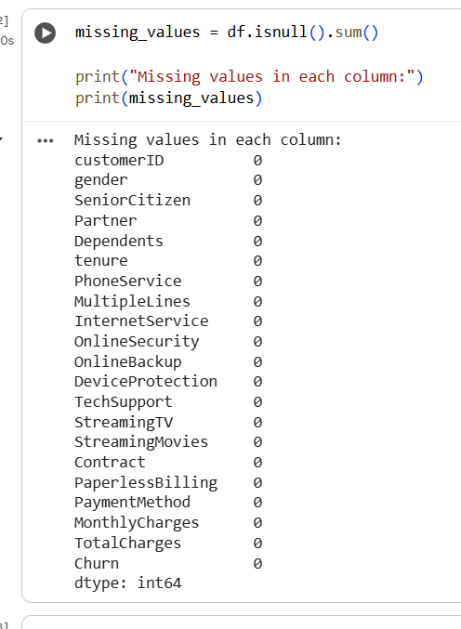
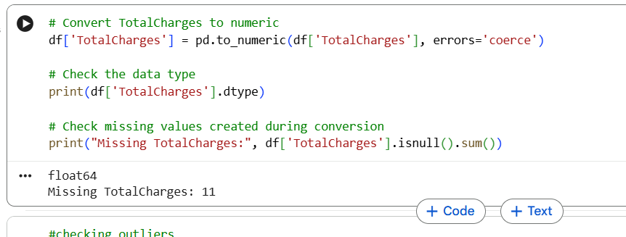

Slide 13
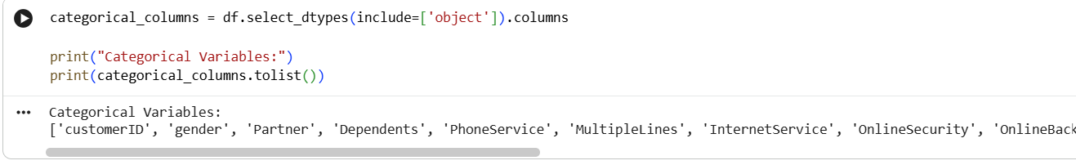
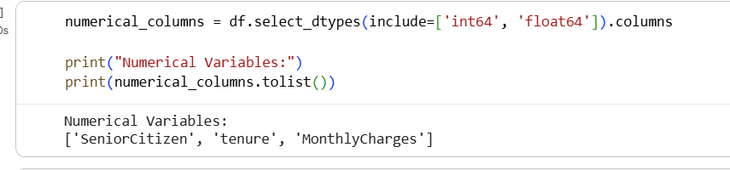

Slide 14
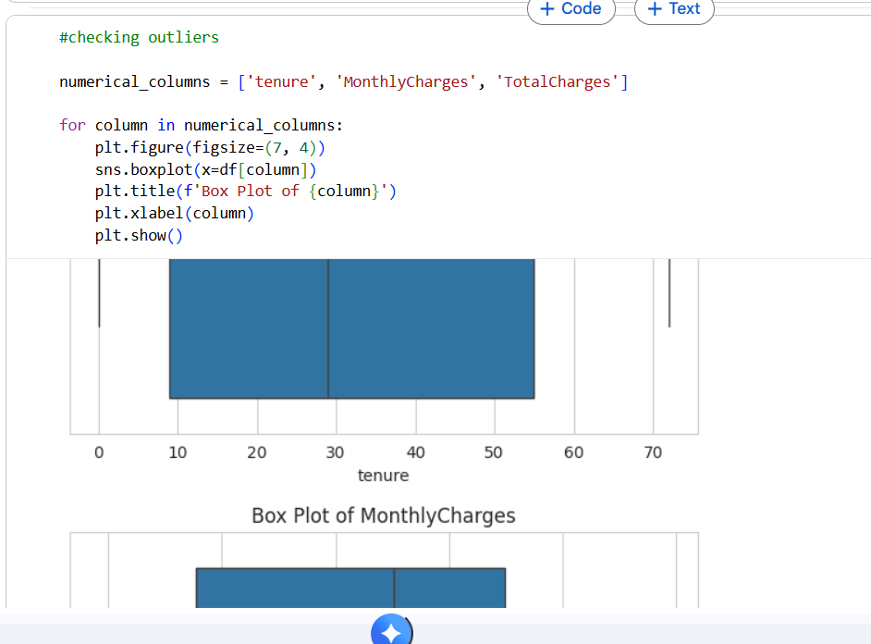
Outlier and Incorrect Data Checking
Outlier Detection
Box plots can be used to identify unusual values in:
tenure , MonthlyCharges , TotalCharges
Incorrect Data
Check for:
Blank values
Invalid numerical values
Unexpected categorical values
Incorrect data types
Final preprocessing flow
Raw Dataset
↓
Remove customerID
↓
Handle blank/missing values
↓
Convert numerical columns
↓
Encode categorical variables
↓
Scale numerical variables
↓
Preprocessed Dataset

Slide 15
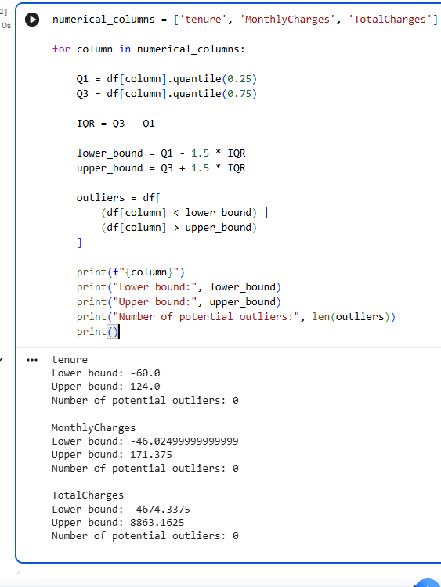
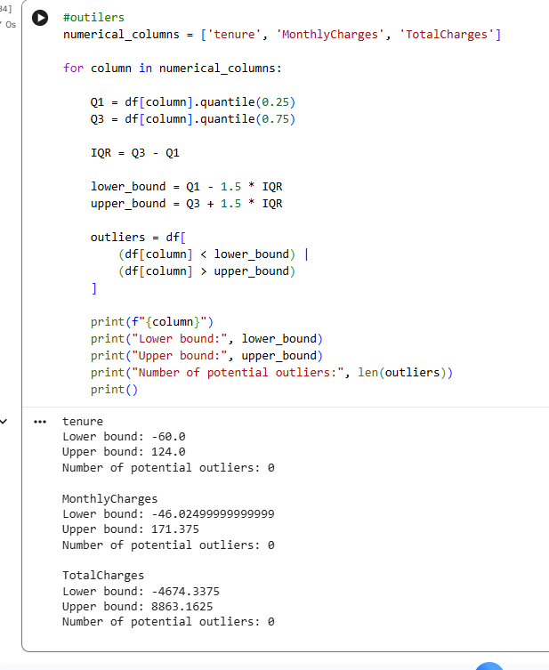

Slide 16
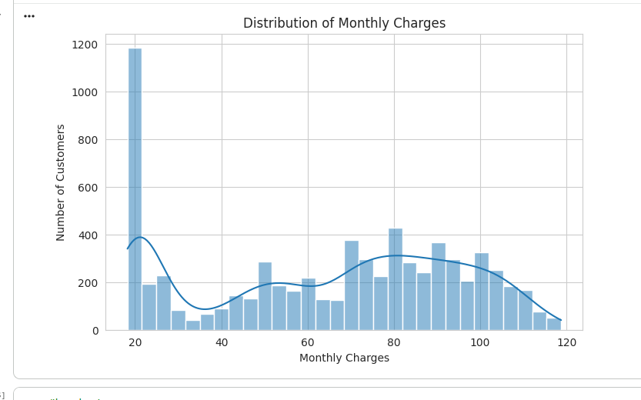
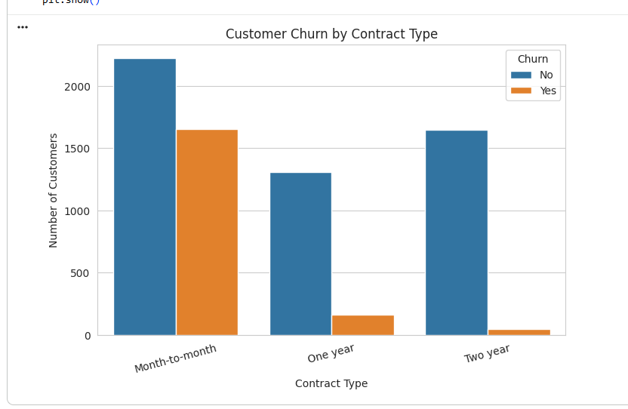
5. Exploratory Data Analysis — EDA
Histogram
Bar chart

Slide 17
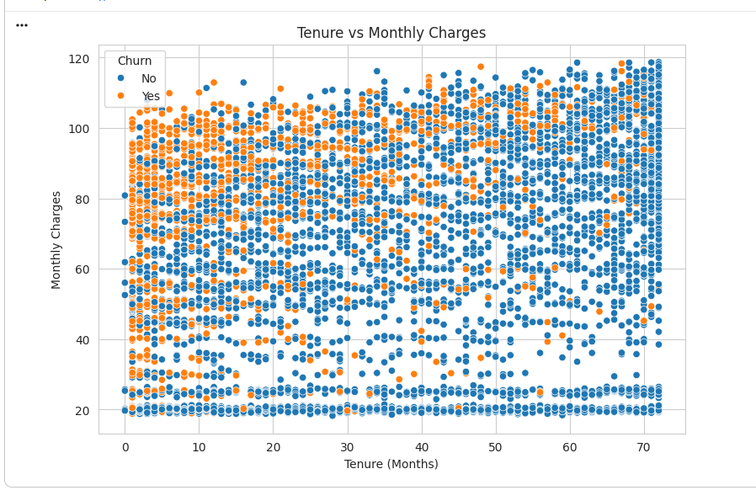
Scatter plot

Slide 18
THANK YOU

