Slide 1
OPERATING SYSTEMS PROJECT
process tree
Process Termination
Message System
PARENT
PID 2450
Detecting and Reporting Child Process Termination
2520030032-A.AMULYA
2520030600-Ch.GAYATRI SRI HARSHITA
2520030275-KUNAL SHAHANE
SEC-7
Faculty : K.HEMA
CHILD
2451
CHILD
2452
exit 0
signal 9
Notes:
Good morning. Our project is the Process Termination Message System. It shows how a parent process uses fork() to create children and then uses waitpid() to find out when and why each child terminated. Introduce team members, then move to the introduction.

Slide 2





02 / INTRODUCTION
Why Termination Info Matters
A parent can create multiple child processes
parent monitors children
PARENT
PID 2450
The parent must know when a child finishes
A child just ending tells the parent nothing useful
Our system reports the termination reason and status
CHILD
2451
CHILD
2452
Demonstrates practical OS process management
exit 0
signal 9
Process Termination Message System
Notes:
A parent can create many children with fork(). It needs to know when each one finishes. A child simply ending gives the parent nothing useful by itself. Our system detects termination and reports the reason and status. This is a practical demonstration of OS process management.

Slide 3
03 / PROBLEM STATEMENT
The Core Problem
“How can a parent process reliably detect the termination of its child process and determine how and why it terminated?”
SYSTEM REQUIREMENTS
01
Detect child termination
02
Identify child using PID
03
Determine termination reason
04
Obtain exit status
05
Detect signal-based termination
06
Prevent zombie processes
Process Termination Message System
Notes:
This is the question our project answers. The parent must reliably detect that a child terminated, identify which child by PID, and understand how and why it ended: normal exit with a status, or a signal. It must also collect the status so no zombie is left behind.

Slide 4




04 / OBJECTIVES
Project Objectives
Create child processes using fork()
Monitor child processes
Detect termination using wait() / waitpid()
Analyze process termination status
Display meaningful termination messages
Demonstrate proper process synchronization
Process Termination Message System
Notes:
Six objectives. We create children with fork(), monitor them, detect termination with wait or waitpid, analyze the status, print a meaningful message, and keep parent and child properly synchronized.

Slide 5

05 / OS CONCEPTS
System Calls & Status Macros
SYSTEM CALLS
STATUS MACROS
fork()
WIFEXITED(status)
Checks normal termination
Creates a child process
WEXITSTATUS(status)
Retrieves exit code
exit()
Terminates a process with an exit status
WIFSIGNALED(status)
Checks signal-based termination
wait() / waitpid()
WTERMSIG(status)
Retrieves terminating signal
Parent waits for and collects child termination status
Zombie prevention: a terminated child stays in the process table until the parent collects its status. waitpid() reaps it, so no zombie remains.
Process Termination Message System
Notes:
Left side: the three system calls. fork creates the child, exit ends a process with a status, wait or waitpid lets the parent collect that status. Right side: four macros that decode the status integer. Bottom: a zombie is a terminated child whose status was never collected; waitpid reaps it.

Slide 6
06 / SYSTEM WORKFLOW
Execution Flow
START
Parent Process
fork()
Child Created
Child Performs Task
Normal
termination?
Status
Received
waitpid()
called
Child Terminates
YES
NO
WIFEXITED
Get exit status
Display message
WIFSIGNALED
Get signal number
Display message
Both paths: waitpid() reaps the child, so no zombie remains.
Parent continues
END
Process Termination Message System
Notes:
Walk the diagram top to bottom. Parent calls fork, a child is created and does its task, then terminates. The parent's waitpid receives the status. If the termination was normal we read the exit status; otherwise we read the signal number. Either way a message is displayed and the parent continues.

Slide 7
07 / IMPLEMENTATION
Key Code
monitor.c
fork() creates the child; waitpid() blocks the parent until that PID terminates and fills status.
1
pid_t pid = fork();
waitpid(pid, &status, 0);
if (WIFEXITED(status)) {
printf("Child exited normally\n");
printf("Exit status: %d\n",
WEXITSTATUS(status));
}
if (WIFSIGNALED(status)) {
printf("Child terminated by signal %d\n",
WTERMSIG(status));
}
WIFEXITED → normal exit; WEXITSTATUS returns the exit code.
2
WIFSIGNALED → killed by a signal; WTERMSIG returns the signal number.
3
Process Termination Message System
Notes:
Left: the core code. fork returns the child's PID to the parent. waitpid blocks until that child terminates and stores the result in status. Right: WIFEXITED then WEXITSTATUS for normal exit; WIFSIGNALED then WTERMSIG for signal termination.

Slide 8
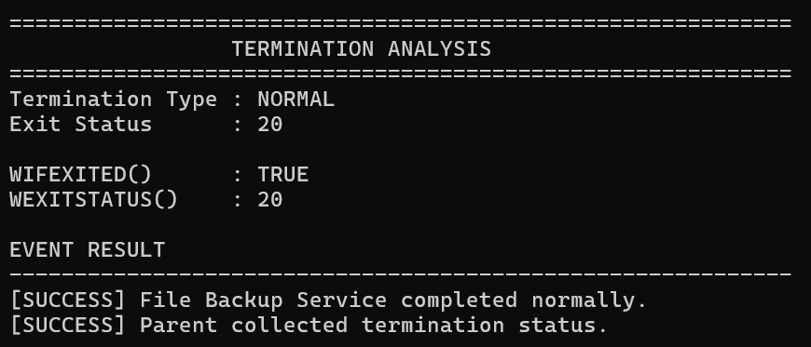
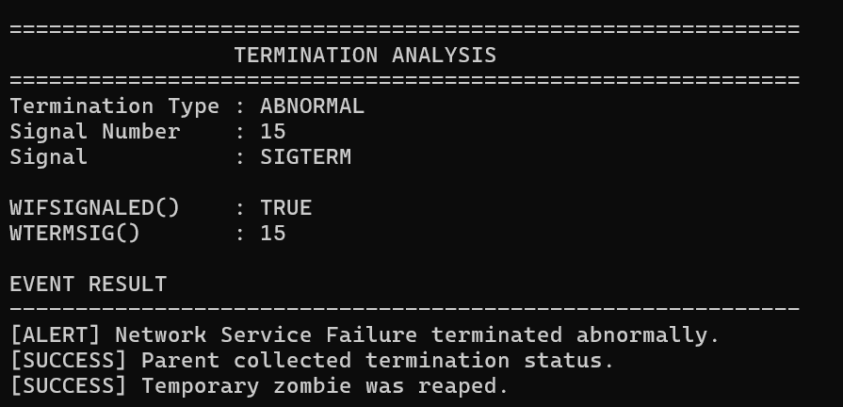
08 / DEMONSTRATION
Sample Output
user@linux: ~
user@linux: ~
$ ./a.out
Parent Process Started
Child Process Created
Child Process PID: 2451
Child: Performing task...
Child: Task completed successfully.
Parent: Child 2451 terminated normally.
Parent: Exit status = 0
$ _
$ ./a.out
Parent Process Started
Child Process Created
Child Process PID: 2452
Child: Performing task...
Parent: Child 2452 terminated by signal 9.
Parent: Termination detected successfully.
$ _
Normal termination → WIFEXITED
Signal termination → WIFSIGNALED
Process Termination Message System
Notes:
Left terminal: the child finishes its task and exits with status 0, so WIFEXITED is true. Right terminal: the child is killed by signal 9, so WIFSIGNALED is true and WTERMSIG returns 9. The same parent code handles both cases.

Slide 9






09 / ADVANTAGES & APPLICATIONS
Why It Matters
ADVANTAGES
APPLICATIONS
Meaningful termination information
Process monitoring
Server applications
Prevents zombie processes
Demonstrates real OS process management
Job scheduling
Background task management
Supports monitoring of child processes
Handles normal and abnormal termination
System administration
Debugging & process supervision
Process Termination Message System
Notes:
Left: what the system gives us, mainly meaningful termination information and zombie prevention for both normal and abnormal termination. Right: places where this pattern is used, such as process monitoring, servers, schedulers, and debugging.

Slide 10
10 / CONCLUSION
Summary
01
Parents need reliable information about child termination
Thank You
02
waitpid() lets the parent collect termination information
03
Status macros distinguish normal and signal-based termination
04
Proper process handling prevents zombie processes
$ exit(0)
05
Demonstrates practical Linux process management and synchronization
Process Termination Message System
Notes:
To summarize: parents need reliable termination information; waitpid collects it; the status macros separate normal from signal termination; collecting status prevents zombies; and the project demonstrates practical Linux process management and synchronization. Thank you, we are happy to take questions.

