Slide 1


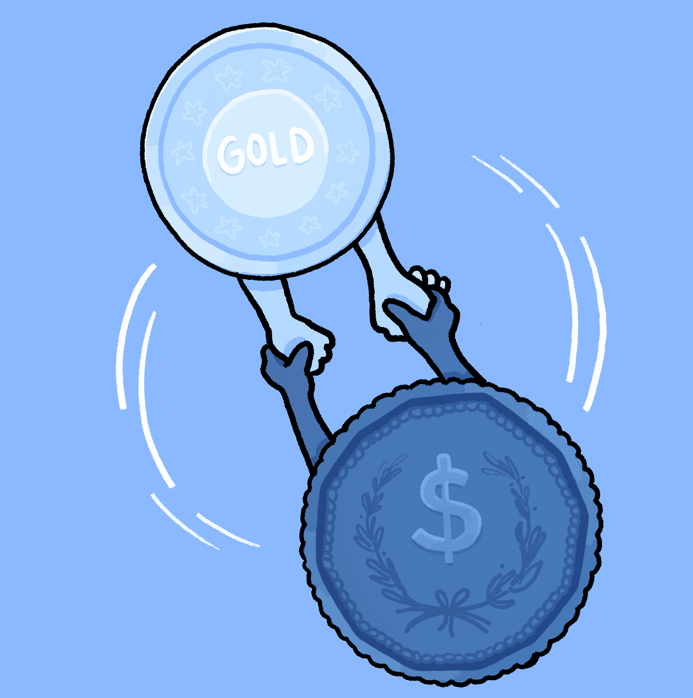

Finance
- Abhishek Reddy Gorla
- Sai Vamshi Challamala
- Sneha Sasanapuri
- Amulya Ambati
- Lakshmi Prasanna Poluru
- Venkata Harshith Nikhil Samudrala

Slide 2
Outline
Domain Applications
Companies leveraging DS
What does a data scientist do in Fin Tech?
Competencies
Broadening Acumen
Notes:
Photo by Sean Pollock on Unsplash

Slide 3



How Data Science Empowered Finance Domain?
01.
02.
03.
04.
Customer Analytics
Fraud Detection
Stocks and Trading
Data handling using Big Data
Notes:
Photo by Sean Pollock on Unsplash

Slide 4

Customer Analytics
What it is?
Identifying & analyzing behavioral patterns and preferences in customers.
How does it work?
Segmentation
Analysis & Modelling
Identifying Reasons
Intervention strategies
Merits
Reduce customer attrition
Enhance loyalty
Improve profitability
Notes:
Photo by Sean Pollock on Unsplash

Slide 5
Behavioral Profile Analysis
Integration of ML Model
Being adaptive to Change
Fraud Detection
(ML based approach to fraud detection)
1
2
3
By integrating ML models, organisation can increase its protection against fraudulent activity
Adaptive analytics is a form of predictive analytics that capture and analyses real time data rather than historical data
Understand preferences & behaviours of customers
“If the money laundering industry were a country, it would have the fourth or fifth largest GDP in the world”
(Quoted in research paper by SAS Institute)
Benefits
Increased Efficiency
Reduced Security Breach
Effortless Scaling
Notes:
Photo by Sean Pollock on Unsplash

Slide 6
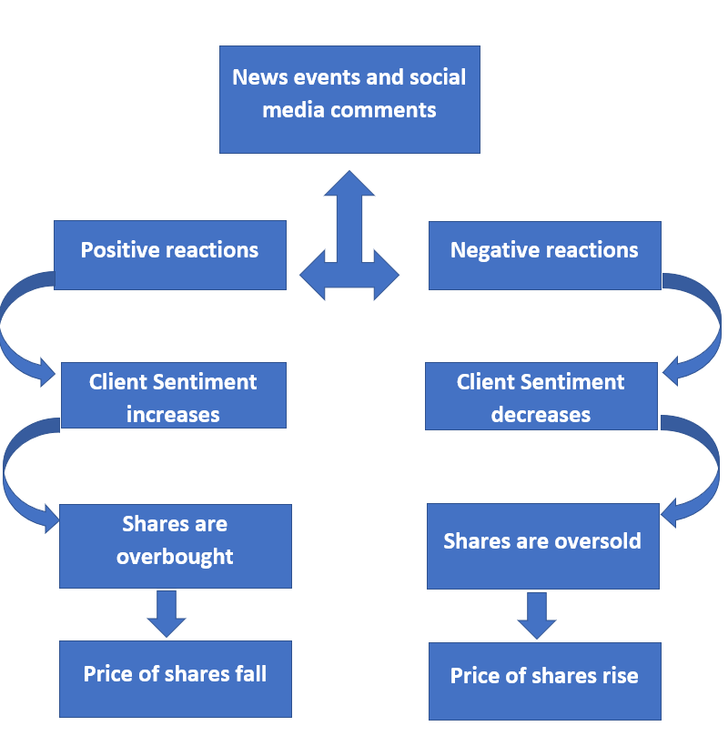
Stocks & Trading
(Stock Market Sentiment Analysis)
How DS serves stocks & trading?
Predictive Analytics
Sentiment Analysis
An avalanche of market data comes out every minute in the form of social media
Analyzing all such data to gauge market & investor sentiment
Market trend analysis
Notes:
Photo by Sean Pollock on Unsplash

Slide 7
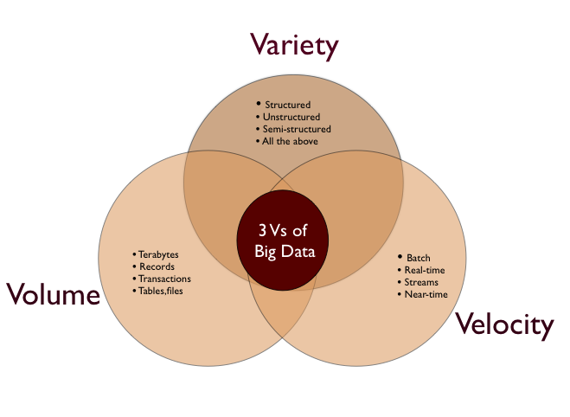
Data handling using Big Data
Big data refers to massive, complex data sets that are rapidly generated and transmitted from a wide variety of sources.
Big Data enables the usage of analytics tools or machine learning modelling discussed in the previous slides and is very important in finance domain because of the vast amount of the data.
Notes:
Photo by Sean Pollock on Unsplash

Slide 8


Case study ICBC
Background
2019 : ICBC acquired 100% of the former Standard Bank
After acquisition, ICBC has become world’s largest bank in terms of assets and market capitalization
Their major tasks include :
Bank stress test report to Federal
Budgets and forecasts
Data in Excel
Difficulty in conducting so many scenarios for exchange rates, inflation rates
Industrial and Commercial Bank of China
Notes:
Photo by Sean Pollock on Unsplash

Slide 9

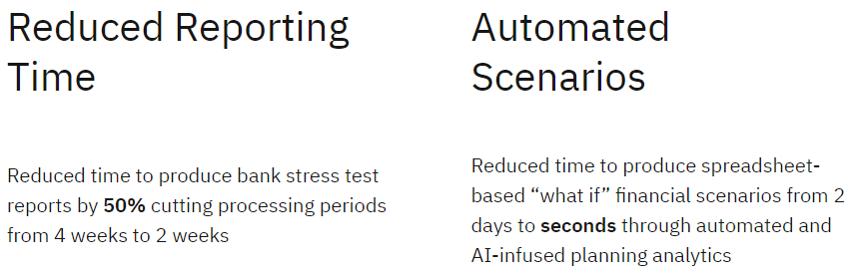
Case study ICBC(cont…)
How ICBC sprint past spreadsheets?
Liaison with IBM Analytics for natural language searching and multi-dimensional expressions based (MDX) queries through AI
*ICBC - Industrial and Commercial Bank of China
Notes:
Photo by Sean Pollock on Unsplash

Slide 10



Other companies
Western Union
Goldman Sachs
Uber
Dynamic pricing
Pricing-specific initiatives to measure customer price sensitivity, predict customer behavior
Credit ratings
Fraud Detection: Transactions, individuals, and organizations are scored for probability of fraud
Unleashed the potential of advanced analytics to gain a competitive edge in a complex and fast-moving market
Notes:
Photo by Sean Pollock on Unsplash

Slide 11
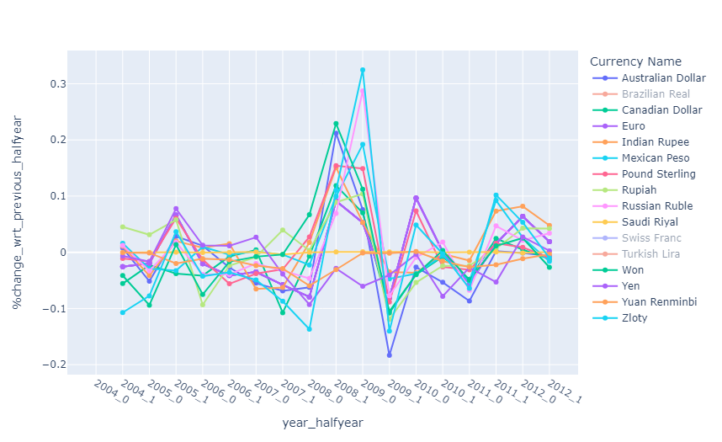
How were Currency exchange rates Impacted?
2008 Global Financial Crisis
With respect to all the currencies, USD has strengthened during 2008 crisis.
Notes:
Photo by Sean Pollock on Unsplash

Slide 12
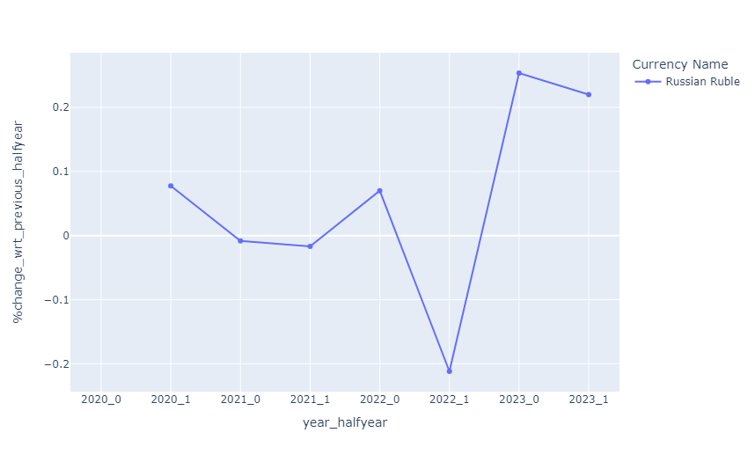
How were Currency exchange rates Impacted?
Crisis between Russia and Ukraine
Russian Ruble highly depreciated in mid to late 2022
Notes:
Photo by Sean Pollock on Unsplash

Slide 13

A day in life of a Financial Data Scientist
Cleaning and preparing data for analysis
Analyzing data for trends and correlations
Analyzing data for trends and correlations
Building predictive models
Building predictive models
Supporting big data projects & developing databases
Supporting big data projects & developing databases
Organizing, interpreting, and visualizing data
Organizing, interpreting & visualizing data
Communicating results to stakeholders

Slide 14
Crucial Competencies
Tech Skills
Domain Expertise
Statistical Modelling
Functional knowledge
Data Analysis
Risk Management
Machine Learning
Communication
BI Tools/Reporting
Research skills
1
Notes:
https://www.pexels.com/photo/person-using-macbook-pro-on-brown-wooden-desk-1061588/

Slide 15

Broadening Acumen
Part of DS Curriculum
CSCI 5502 - Data Mining
STAT 5000, 5001 – Statistical Methods and Applications-1 & 2
Electives
CSCI 5622 – Machine Learning
CSCI 6502 – Big Data Analytics
INFO 5602 – Information Visualisation
EMEA 5023 - Financial Forecasting and Reporting
MSBC 5680 - Optimisation Modelling
MSBX 5310 - Customer Analytics
Notes:
Photo by Sean Pollock on Unsplash

Slide 16
Thank You
"In the world of finance, data is the raw material, and data science is the refinery that transforms it into gold."

