Slide 1
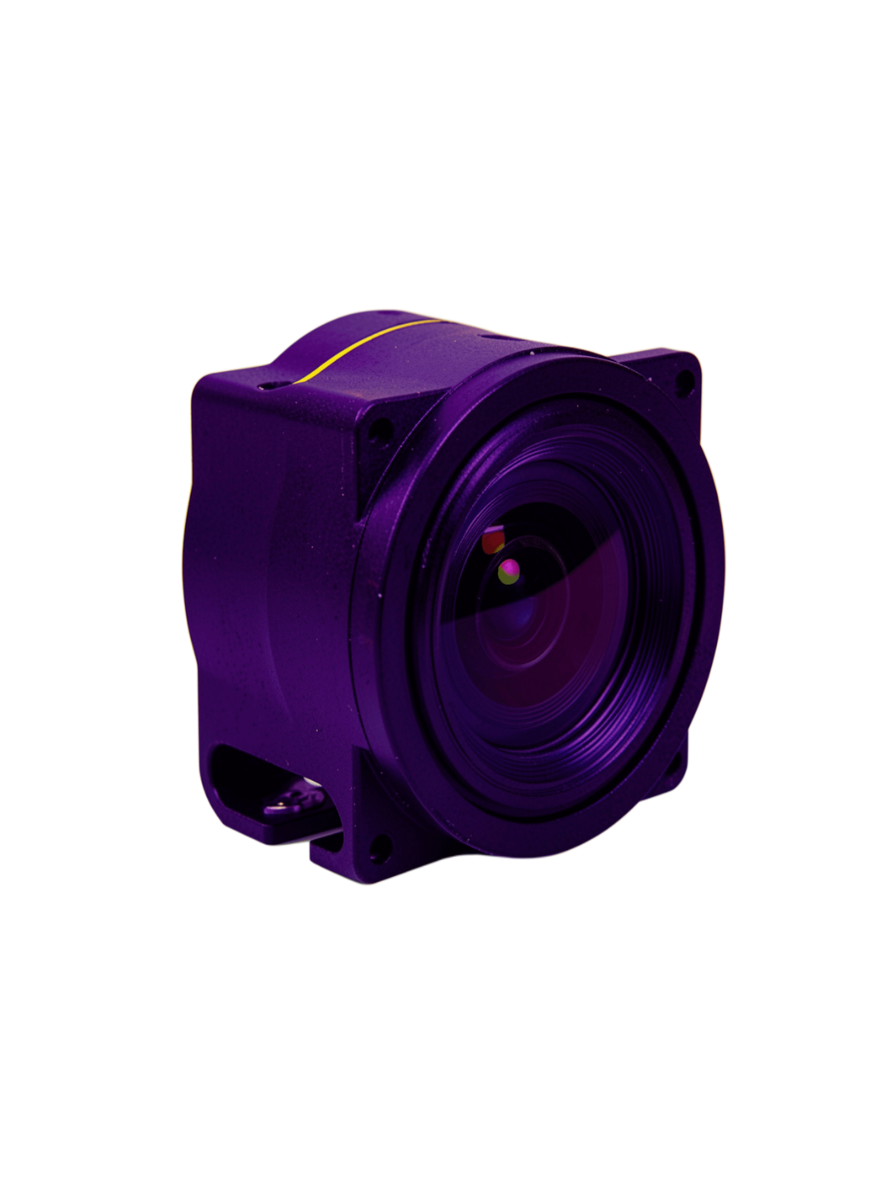

MOODLENS · COMPUTER VISION SYSTEM
MoodLens
Real-Time AI Facial Analysis & Emotion Intelligence
High-performance computer vision for live facial expression analytics, from camera frame to production-ready signal.
FastAPI · OpenCV · DeepFace · TensorFlow · Docker · Vanilla JS
By Amulya Gavankar

Slide 2
CAPABILITY MAP
Three capabilities turn raw video into usable emotion intelligence
Capability | Signal | Deployment value
Real-time precision | Sub-100ms frame evaluation | Immediate feedback
Modular AI engine | ROI localization + deep classification | Backend flexibility
Cloud + edge scale | Docker + throttling + tracking | Concurrent clients
REAL-TIME PRECISION
MODULAR AI ENGINE
CLOUD + EDGE SCALE
Live webcam and video processing with sub-100ms frame evaluation and probability scoring across seven core expressions.
Fast face localization paired with deep neural classification and swappable model backends.
Dockerized services, rate limiting, and frame tracking for concurrent multi-client stability.

Slide 3
SYSTEM ARCHITECTURE
Every frame moves through four decoupled layers
Independent scaling between frontend, gateway, inference, and state layers.
01
02
03
04
Ingest
Control
Infer
Track
Browser or camera stream becomes a frame payload.
FastAPI routing applies token-bucket rate limiting via rate_limit.py.
OpenCV Haar Cascades localize regions of interest; DeepFace analyzes them via engines.py.
tracker.py calculates sequential state and returns real-time JSON metrics.
FRAME PAYLOAD → ROUTED REQUEST → ROI + EMOTION VECTOR → SEQUENTIAL STATE
JSON METRICS
{"emotion":"happy","confidence":0.82}

Slide 4
INFERENCE PIPELINE
Dual-engine inference balances speed with classification depth
STAGE 1 · LOCALIZE
STAGE 2 · CLASSIFY
Fast ROI
Deep signal
OpenCV Haar Cascade detection
DeepFace + TensorFlow
Lightweight detection extracts facial ROIs and calculates dynamic bounding boxes.
Each ROI passes through a deep convolutional network for classification depth.
LOW LATENCY · DYNAMIC BOUNDING BOXES
HAPPY
NEUTRAL
SURPRISE
0.82
0.11
0.04
EMOTION VECTOR · HAPPY · SAD · NEUTRAL · ANGRY · SURPRISE · FEAR · DISGUST · CONFIDENCE SCORING · SMILE DETECTION

Slide 5
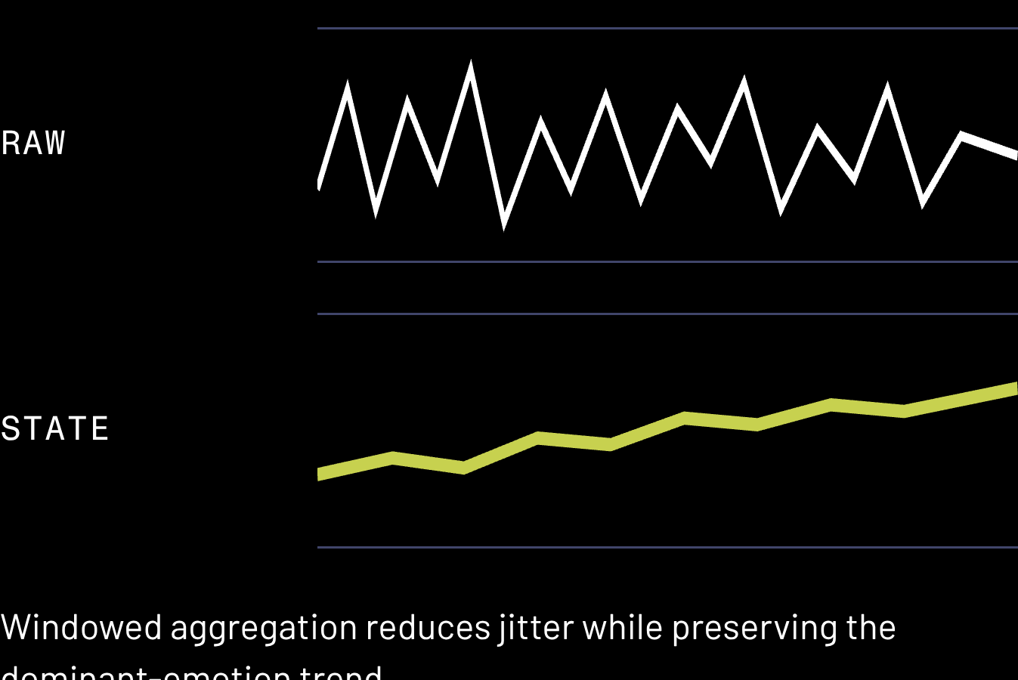
STATE ESTIMATION
Tracking turns noisy frame-by-frame guesses into stable state
1
Persist
SLIDING-WINDOW STABILIZATION
Maintain detection continuity across consecutive frame windows.
2
Aggregate
Calculate sliding-window averages to reduce single-frame jitter.
3
Normalize
Return emotion confidence vectors and face-position coordinates.
4
Protect
Throttle frames so high-FPS streams do not overwhelm the backend.

Slide 6
PRODUCTION BOUNDARY
FastAPI provides the production boundary around the AI core
Layer | File or mechanism | Outcome
Transport | Async REST | High-throughput request handling
Configuration | config.py | Environment-based tuning
Security | CORS middleware | Controlled client access
Validation | Pydantic schemas | Strict frame contracts
ASYNC REST ENDPOINTS
CENTRALIZED CONFIGURATION
CORS + SECURITY
INPUT VALIDATION
Controlled browser integration for web clients.
Pydantic schemas enforce strict frame payload contracts.
High-throughput HTTP surface with low overhead.
Environment-based tuning through config.py.

Slide 7
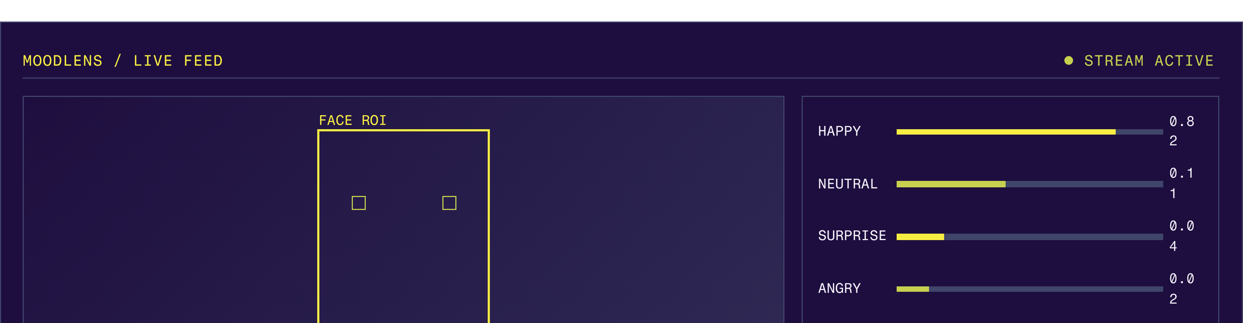
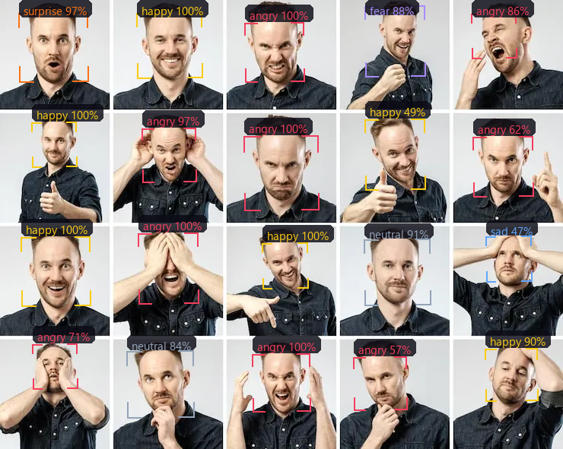
REAL-TIME OBSERVABILITY
The dashboard makes the model legible in real time
VISUAL SYSTEM
LIVE VIDEO CANVAS
PROBABILITY METERS
INTERACTION LAYER
VISUAL SYSTEM
Webcam controls with instant feed toggles.
Dark theme, high-contrast indicator LEDs, and clear state hierarchy.
HTML5 stream with bounding-box overlays from app.js.
Webcam controls with instant feed toggles.
Dark theme, high-contrast indicator LEDs, and clear state hierarchy.
Animated confidence bars for every tracked emotion.

Slide 8
RUNTIME ALIGNMENT
Docker keeps the runtime, AI stack, and developer workflow aligned
CONTAINER TOPOLOGY
DEPENDENCY MATRIX
BASE SERVICE
Requirements file | Contents
requirements.txt | FastAPI, Uvicorn, and OpenCV-headless
requirements-deepface.txt | DeepFace, TensorFlow, and Keras
requirements-dev.txt | Test tooling
Python 3.10 slim container optimized for runtime footprint
ORCHESTRATION
Docker Compose supports multi-container development and production parity
AI DEPENDENCIES
DeepFace, TensorFlow, and Keras

Slide 9
RELIABILITY BOUNDARIES
Reliability is tested at the API, transport, and engine boundaries
Validation area | Tool or fixture | Pass condition
API behavior | PyTest + test_api.py | Expected endpoint response
Async transport | httpx client | Stable concurrent request behavior
Engine fallback | Zero-box fixture | Graceful no-face response
UNIT + INTEGRATION COVERAGE
ASYNC VALIDATION
FALLBACK RESILIENCE
PyTest tests backend endpoints through test_api.py.
httpx simulates realistic asynchronous HTTP behavior.
Tests verify graceful behavior when face detection returns zero bounding boxes.
API CONTRACTS · TRANSPORT BEHAVIOR · ENGINE FALLBACKS

Slide 10
ROADMAP · NEXT SENSING SURFACE
Four expansion moves take MoodLens from single-face inference to ambient intelligence
Stabilize the signal first, then widen the sensing surface.
MULTI-FACE TRACKING
EDGE AI
Map emotion across multiple people in crowded environments.
Optimize for Raspberry Pi 4 and NVIDIA Jetson Nano devices.
1
2
3
4
WEBSOCKETS
ATTENTION ANALYTICS
Add full-duplex streaming for lower-latency frame transport.
Add gaze tracking and head-pose estimation.
DESTINATION
Ambient Intelligence

Slide 11
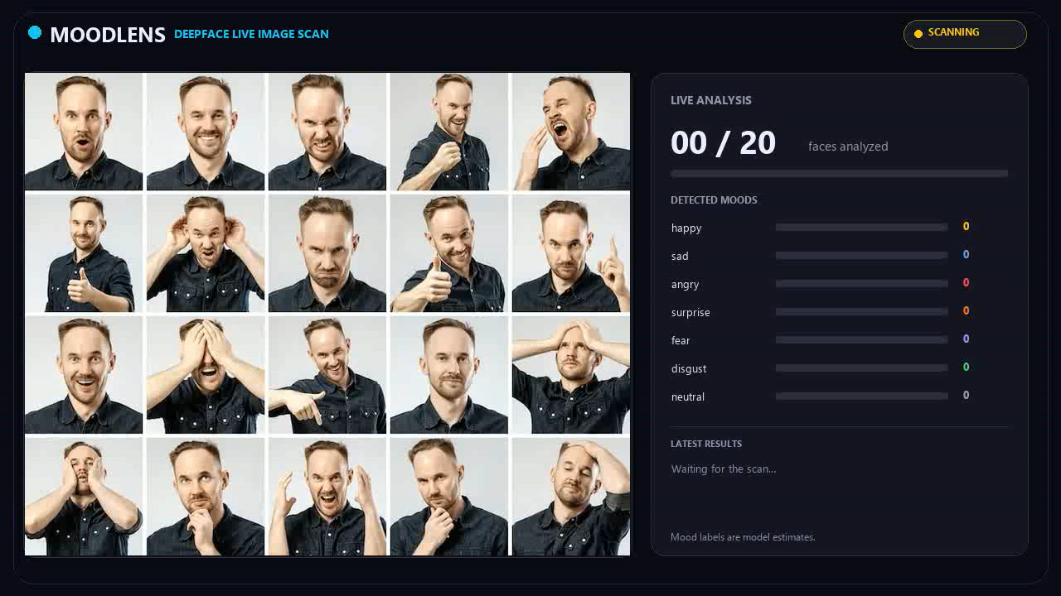
OUTPUT

