Slide 1
Student Attendence Management System
Presented By
P.Amulya

Slide 2
ABSTRACT
The Student Attendance Management System is a software application developed to record, manage, and maintain student attendance efficiently.
The main purpose of this project is to reduce the manual work involved in traditional attendance-taking methods and make attendance management easier and more accurate.
The system helps save time, reduce paperwork, and minimize errors in maintaining attendance records.
It also helps teachers monitor student attendance regularly.
This project provides a simple and effective solution for educational institutions to manage attendance digitally.
In the future, the system can be enhanced with a graphical user interface, automatic attendance percentage calculation, report generation, and a web-based application.

Slide 3
INTRODUCTION
The Student Attendance Management System is a software application designed to record and manage student attendance in an efficient and organized manner.
Attendance is an important part of every educational institution because it helps teachers monitor students' regularity and participation in classes.
In the traditional method, attendance is recorded manually in registers, which requires more time and effort.
Manual record-keeping can also lead to errors, missing records, and difficulties in calculating attendance.
To overcome these problems, the Student Attendance Management System provides a digital solution for maintaining attendance records.
The main goal of this project is to reduce paperwork, save time, improve accuracy, and make attendance management easier for teachers and educational institutions.

Slide 4
OBJECTIVES
To maintain student attendance records digitally instead of using traditional registers.
To store and manage student details in an organized manner.
To reduce the time and effort required to record daily attendance.
To minimize human errors and maintain accurate attendance records.
To retrieve student attendance records quickly whenever required.
To store and manage attendance information using Python and SQL/SQLite.
To help teachers monitor students' attendance regularly.
To reduce the use of paper and make attendance management more efficient.

Slide 5
TECHNOLOGIES
PYTHON – Application logic and user interaction.
SQL – Stores student and attendance data.
Database tables – Student and Attendence.

Slide 6
ADVANTAGES
Reduces the time required to record and manage student attendance.
Replaces traditional attendance registers with digital records.
Minimizes human errors while maintaining attendance records.
Allows users to retrieve student details and attendance records quickly.
Stores student information and attendance details systematically in a database.
Helps teachers monitor students' daily attendance.
Makes it easier to add, view, and update student information.
Reduces the need for paper and physical storage.

Slide 7
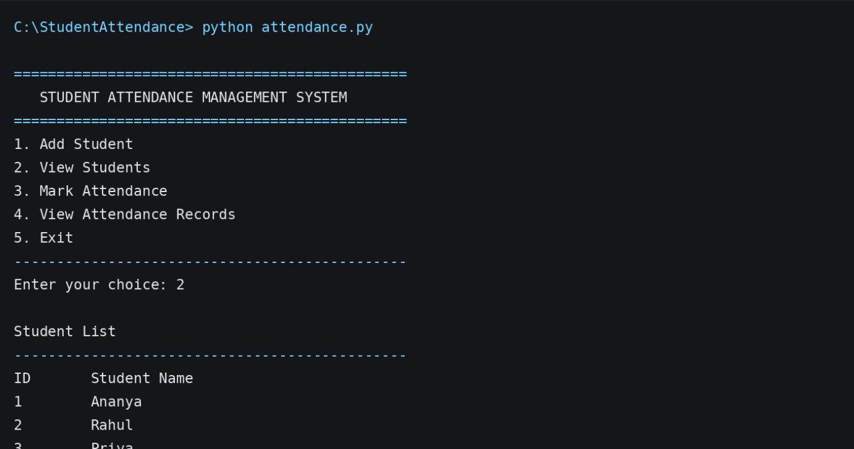
Screenshots

Slide 8
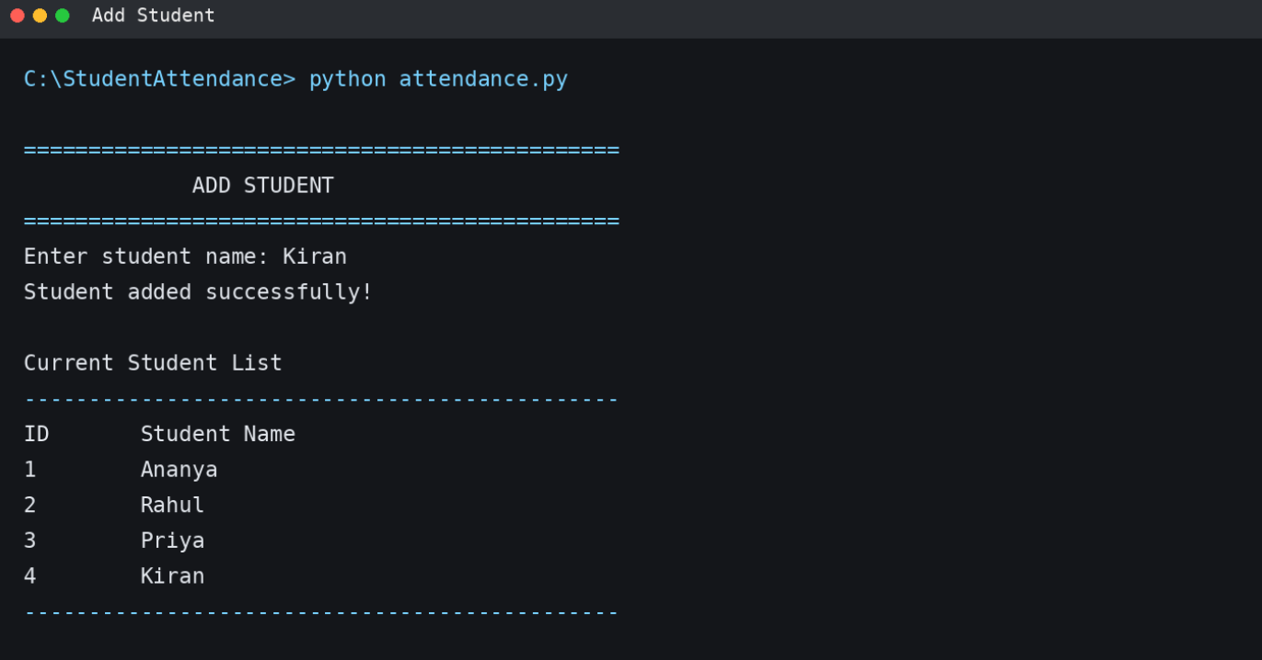

Slide 9
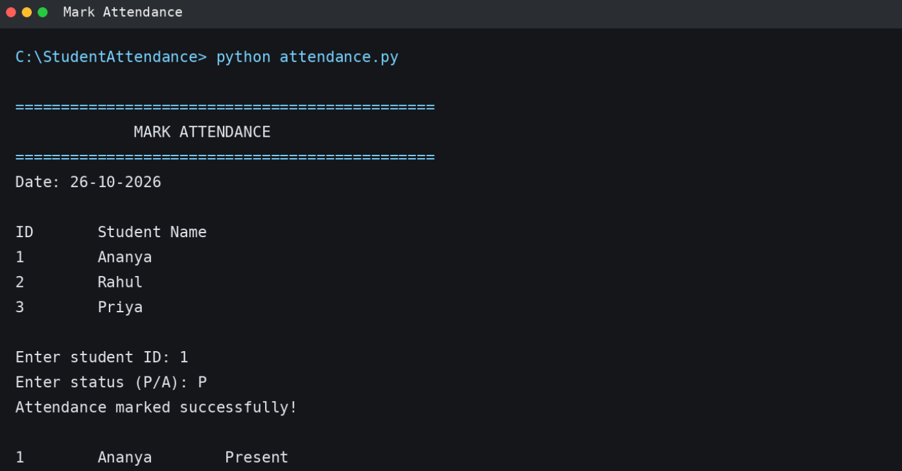

Slide 10
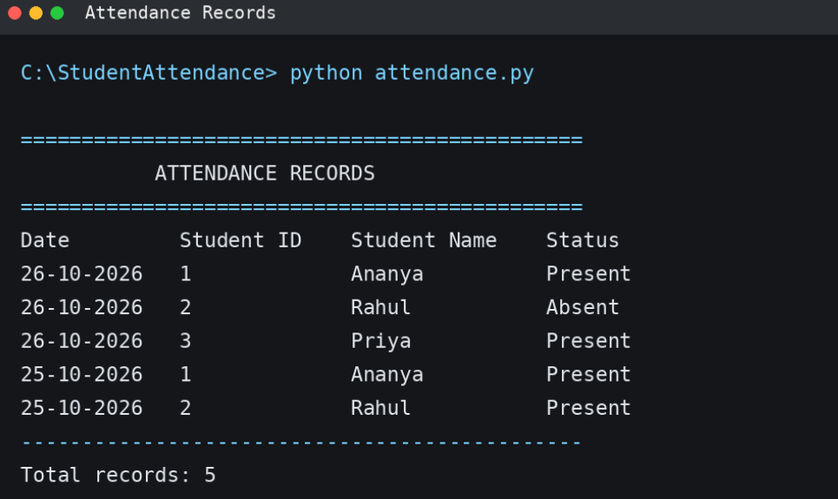

Slide 11
CONCLUSION
The Student Attendance Management System helps to maintain student attendance records easily and accurately. It reduces manual work, saves time, and makes attendance tracking simple. By using Python and SQL, the system stores and manages student details efficiently. In the future, it can be improved by adding features like biometric attendance and automatic notifications.

Slide 12


