Slide 1
Hospital Emergency-Room Triage System
Team No: 24
S. Amulya 2620030210
V. Vaishnavi 2620030208
S. Akshaya 2620030209

Slide 2
Abstract
The Hospital Emergency-Room Triage System is a Java project concept designed to organize patient registration and emergency priority management. It records patient details, classifies urgency according to defined categories, and supports viewing, searching, and managing patient records. The project applies Java foundations, control flow, methods, object-oriented programming, String processing, and data structures. The design aims to make patient information easier to manage and demonstrate how programming concepts can model a real-world hospital workflow.
Note: describe only features present in the final code during demonstration.

Slide 3
Understanding Problem Statement
Problem: During an emergency, staff need a clear way to record incoming patients and identify which cases require attention first.
Project objectives:
• Register patient details such as ID, name, age, and symptoms.
• Assign a triage category using the rules defined in the program.
• View and search patient records.
• Track patient status where supported by the implementation.
• Validate input and handle errors safely.
Expected outcome: a simple Java application that demonstrates organized patient-record and priority management. It is an educational prototype, not a substitute for clinical judgement or approved medical triage protocols.

Slide 4
CO 1 Topics — Java Foundations
Syllabus connection: Module 1 — Computational Thinking & Java Foundations.
• Variables and primitive data types store patient information.
• String values represent names and symptoms; numeric values represent IDs and ages.
• Scanner can collect patient details from console input.
• Operators support comparisons and validation.
• Algorithms and flowcharts describe registration, validation, and triage steps.
Example workflow: read input → validate details → assign a category using project rules → store the record.

Slide 5
CO 2 Topics — Control Flow
Syllabus connection: Module 2 — Selection & Iteration.
• if / else-if statements select a category based on the entered triage level or defined conditions.
• Loops repeatedly display menus and process multiple patient records.
• Conditions check whether a record exists or an input is valid.
• switch can be used for menu choices if present in the code.
These structures control the order of actions and let the program respond differently to different inputs.

Slide 6
CO 3 Topics — Methods, Recursion & Arrays
Syllabus connection: Module 3 — Decomposition with Methods, Recursion & Arrays.
• Separate methods can handle registration, displaying records, searching, and updating status.
• Parameters pass patient IDs or details into methods.
• Return values can report whether a patient was found.
• Arrays can store and traverse records if used in the implementation.
• Counting and searching help summarize or locate patients.
Modular methods make the program easier to read, test, and maintain.

Slide 7
CO 4 — Object-Oriented Design & Exceptions
Syllabus connection: Module 4 — Object-Oriented Modelling, Design & Exception Handling.
• A Patient class models a real-world patient record.
• Objects represent individual patients.
• Fields store patient details; constructors initialize them.
• Encapsulation uses private fields and controlled access methods.
• try-catch can handle invalid input or runtime errors where implemented.
Use inheritance, interfaces, or custom exceptions in the presentation only if they appear in your actual source code.

Slide 8
CO 5 — Strings, Searching & File I/O
Syllabus connection: Module 5 — Strings, Library Algorithms & File I/O.
• String operations process names, symptoms, and priority labels.
• equals / equalsIgnoreCase compare text values.
• Searching locates records by ID or name.
• Sorting can organize records by a chosen field or priority if implemented.
• File I/O can save and reload patient records between runs.
File persistence and sorting are implementation-dependent; if not yet coded, present them as possible extensions.

Slide 9
CO 6 — Collections, Generics & Streams
Syllabus connection: Module 6 — Functional Programming with Collections & Streams.
• ArrayList can hold a changing number of Patient objects.
• HashMap can map patient IDs to records if used.
• Generics provide type-safe collections such as ArrayList<Patient>.
• Comparator can define sorting order.
• Streams and lambdas can filter or count records when implemented.
Explain only the collections and functional APIs actually used in your code; the remaining items are possible enhancements.

Slide 10
Conclusion
The Hospital Emergency-Room Triage System connects Java programming concepts with a practical patient-management scenario. It demonstrates how input handling, conditions, methods, object-oriented modelling, searching, and data structures can support an organized workflow.
Future scope:
• Persistent database or file storage.
• Role-based access for authorized users.
• Patient status history and reporting.
• A graphical user interface and notifications.
• Validation against clinically approved triage protocols.
This project is an academic prototype and does not make real medical decisions.

Slide 11
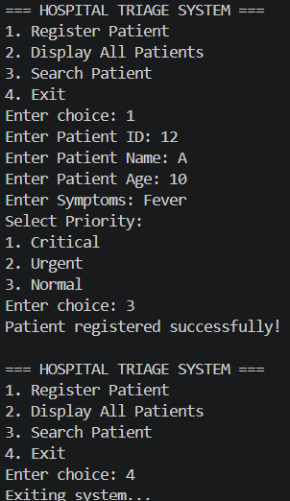
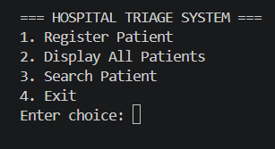
Screen Shots
Program Execution Output

Slide 12
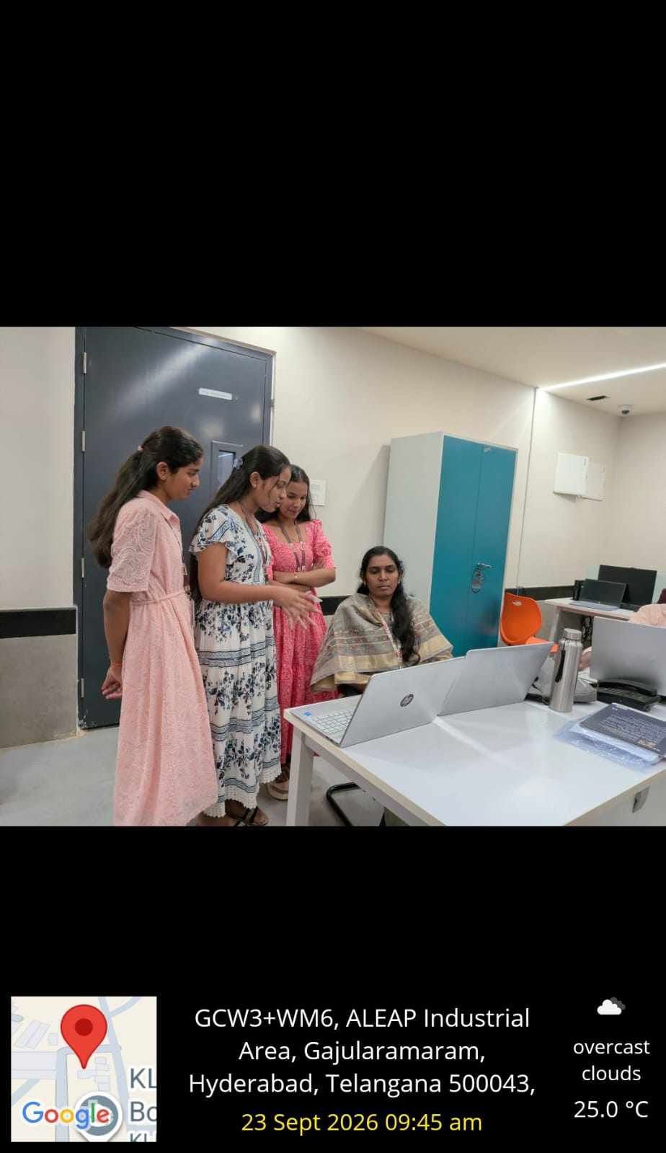
Geo Tag Photo Git Hub Link
https://github.com/amulyareddy967/KLH_2026-27__PSPJ_Hospital-Emergency-Room-Triage-System

Slide 13
THANK YOU

