Slide 1
RecULike : Open Source Academic Recommender System
Liang Xiang
Researcher@Hulu

Slide 2
Main Contents
What is RecULike?
Why build RecULike?
How to build RecULike?
Architecture
Data Importer
Search Engine
Recommender System
Site/API

Slide 3
What is RecULike?
RecULike is a academic recommender system which can:
Recommend research papers to users by analyzing their historical behaviors
Provide related papers of given paper
Connect users and experts

Slide 4

Why build RecULike
We want to write a book
We want to use a real recommender system as our example in the book

Slide 5
How to Build RecULike
Architecture
Data Importer
Search Engine
Recommender System
Site/API

Slide 6
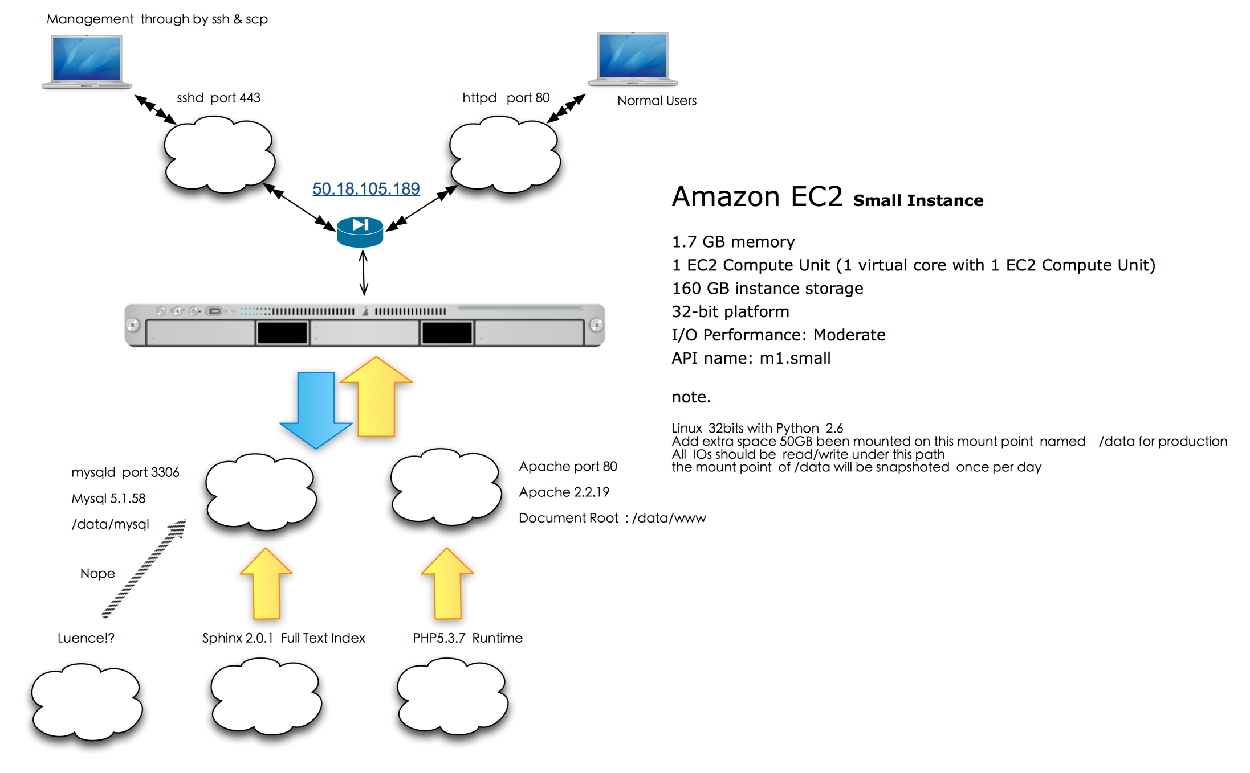
Architecture

Slide 7
Architecture
Metadata Page
DBLP
Meta Data Database
CiteSeer
Importer
Sphinx
Search Page
CiteULike
Cold Start
Recommendation Page
User
Recommender System
User Behavior Database
Log System

Slide 8
Recommender System
Cold-Start
Item-based Method

Slide 9
Item-based Method
vote
User Behavior DB
User Features
search
Offline System
Feature-Item Similarity Table
comment
Log System
Raw Recommendations
Explanation
Site
Ranking & Filtering
Final Recommendations

