Slide 1
Møter
Mandager 14.00 – 17.00.
Mainly evaluating finished tasks and handing out new ones.
Communication outside of group sessions will be handled via Slack.
GitLab. Two branches, master and develop. Merge develop into master once a week at the meeting.

Slide 2
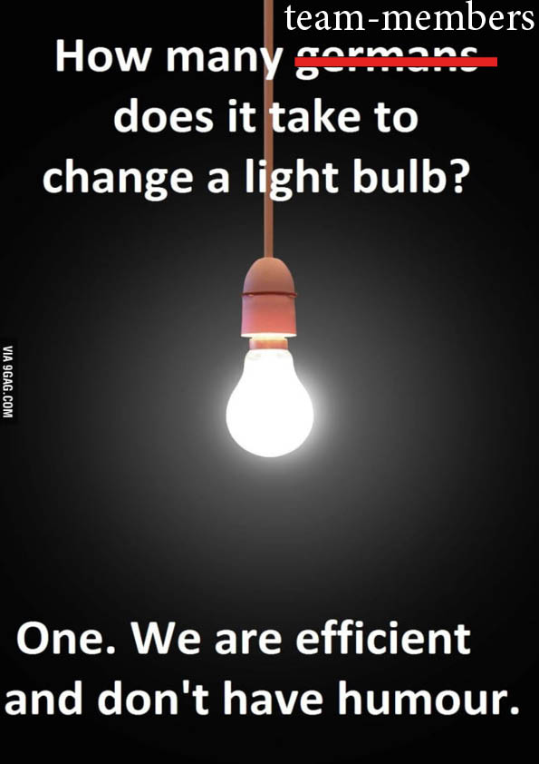
Prosjekt-prosess
Scrum
Backlog
Sprint
Møte
Hvorfor
Tidsberegning
Rettferdig fordeling av oppgaver
Vanskelige/kjipe oppgaver
En person på en oppgave
Modifikasjoner
1 uke sprint
Mandags-møte
Slack

Slide 3
Conflicts avoidance
Share knowledge.
Clearly define responsibilities.
Set and respect deadlines.
Write readable code.
Be open to constructive criticism.
In case of a conflict, first deal with the people involved.

Slide 4
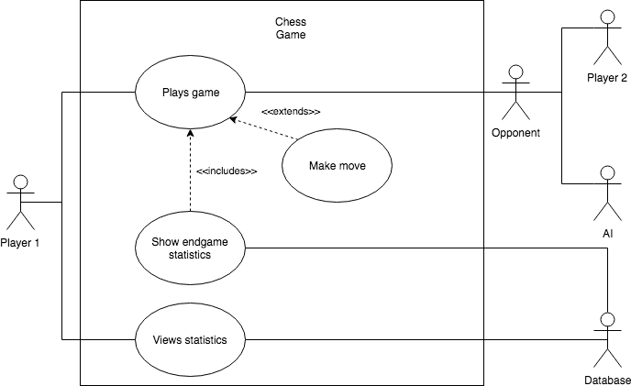
Use Case Diagram

Slide 5
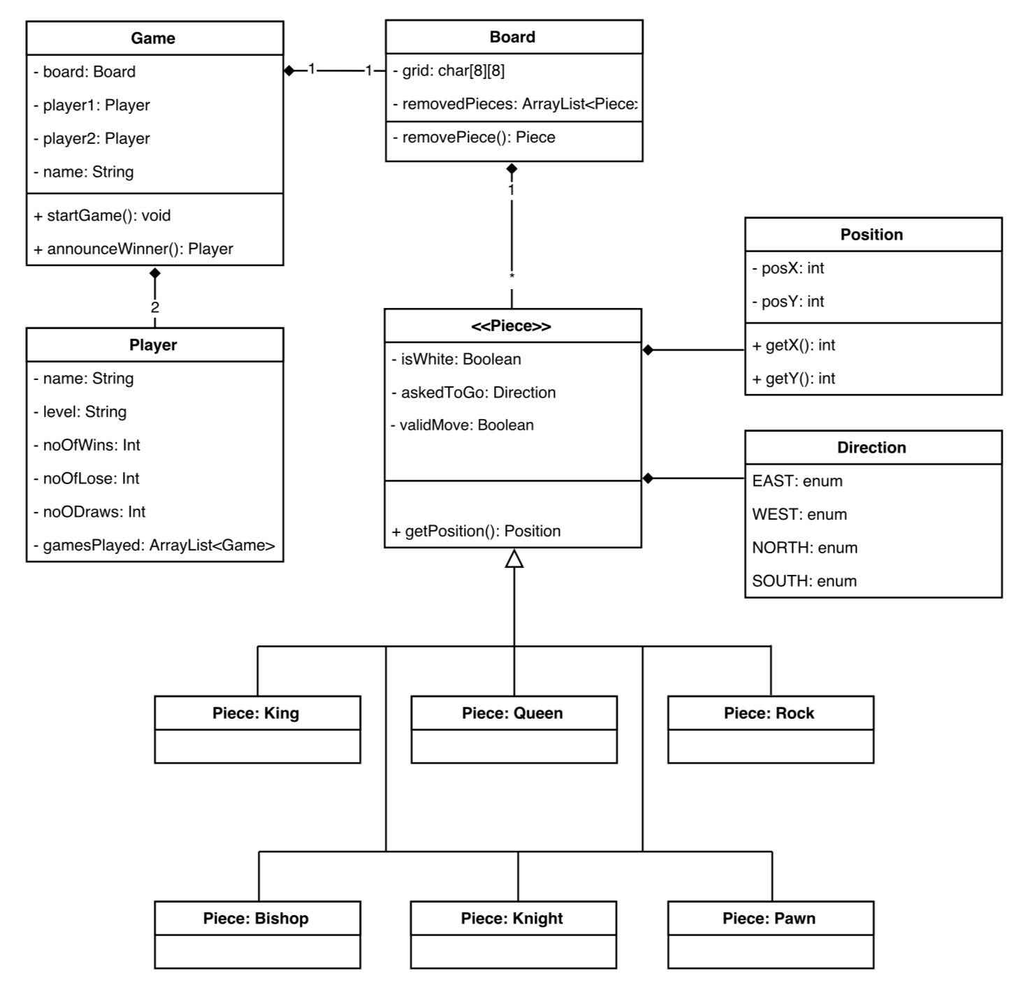
Klassediagram

